Slide 1

“SPEAKER IDENTIFICATION: STATE-OF-THE-ART MODELS & FUTURE OPPORTUNITIES”
Rohan Frederick M23CSA522 Abhishek Sahu M23CSA 504
Chandra Mohan Singh Negi M23CSA512
Rahul Singh M23CSA522

Slide 2
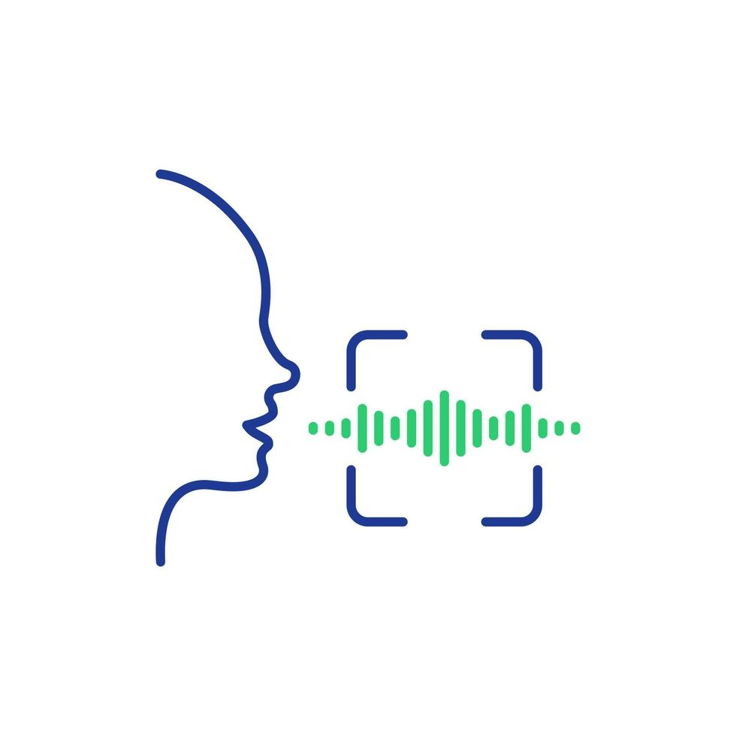
AGENDA
Objective
Application Overview
Understanding The Task And Real World Importance
SOTA
Technology Stack
Comparison

Slide 3
OBJECTIVE
Objective: Analyze & evaluate modern speaker identification models, their strengths, limitations, and future potential.
🛠 Methods & Models:
Deep Learning: ECAPA-TDNN, WavLM, TitaNet (high accuracy, data-hungry).
Classical: GMM, HMM, i-vectors (efficient but less scalable).
📊 Evaluation Metrics:
Accuracy, F1 Score , Re Call , Precision
⚡ Challenges & Future Directions:
Robustness to Noise & Spoofing Attacks 🎭
Low-Resource Language Adaptation 🗣️
Privacy-Preserving Techniques (Federated Learning) 🔒
Generative AI for Speaker Data Augmentation 🤖
Paper Link:- a) https://ieeexplore.ieee.org/document/10335892 - Speaker Identification System Using MFCC ( Implemented )
b) https://arxiv.org/abs/2106.04624 - Speech Brain ( Implemented )
c) https://dl.acm.org/doi/10.1145/3675417.3675542 - Deep Learning Based Speaker Identification System" (June 2024)
d) https://ieeexplore.ieee.org/document/10494311?utm_source=chatgpt.com "A Novel Convolutional Neural Network Model for
Automatic Speaker Recognition" (2024)
e) https://arxiv.org/abs/2407.11510?utm_source=chatgpt.com - "VoxBlink2: A 100K+ Speaker Recognition Corpus and the Open-Set Speaker-Identification
Benchmark" (July 16, 2024):

Slide 4
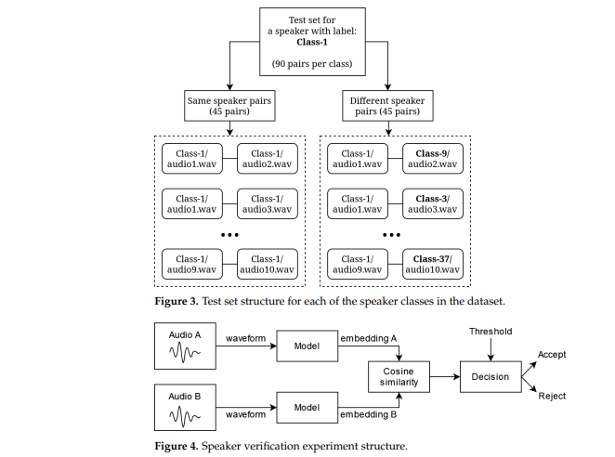
APPLICATION OVERVIEW

Slide 5
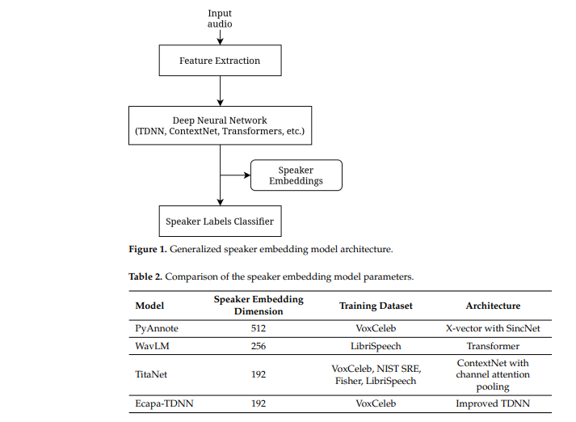
APPLICATION OVERVIEW

Slide 6
UNDERSTANDING THE TASK & REAL-WORLD IMPORTANCE
Task Definition: Speaker Identification involves recognizing the identity of a speaker based on their voice. It is widely used in security, authentication, virtual assistants, call centers, and forensic applications.
Real-World Importance:
Used in biometric authentication (e.g., banking, smart assistants like Alexa).
Helps in forensics for identifying criminals based on voice recordings.
Used in customer service automation for identifying customers.
Crucial for personalized AI interactions in smart homes, healthcare, and IoT

Slide 7
ANALYSIS OF STATE-OF-THE-ART MODELS
Methods/Models Used:
Deep Learning-Based Models: ECAPA-TDNN, WavLM, TitaNet, ResNet-based architectures.
Classical Approaches: Gaussian Mixture Models (GMM), Hidden Markov Models (HMM), and i-vector systems.
Speaker Embeddings: x-vectors and d-vectors with attention mechanisms.
Strengths & Limitations:
Deep learning-based models achieve high accuracy and robustness but require large datasets and high computational power.
Classical models are interpretable and computationally efficient but lack scalability and generalization.
Speaker embeddings improve representation but are sensitive to environmental noise and variability.

Slide 8
EVALUATION METRICS & DISCUSSION
Metrics Used:
Equal Error Rate (EER): Measures the trade-off between false acceptance and false rejection rates.
Detection Cost Function (DCF): Evaluates the performance in security applications.
Top-1 Accuracy / Rank-N Accuracy: Measures how often the correct speaker is ranked in the top predictions.
Signal-to-Noise Ratio (SNR) Performance: Tests robustness in noisy environments.
Strengths & Limitations of Metrics:
EER is widely used but does not always reflect real-world usability.
Accuracy-based metrics can be misleading in imbalanced datasets.
DCF is effective in security applications but requires cost assumptions.

Slide 9
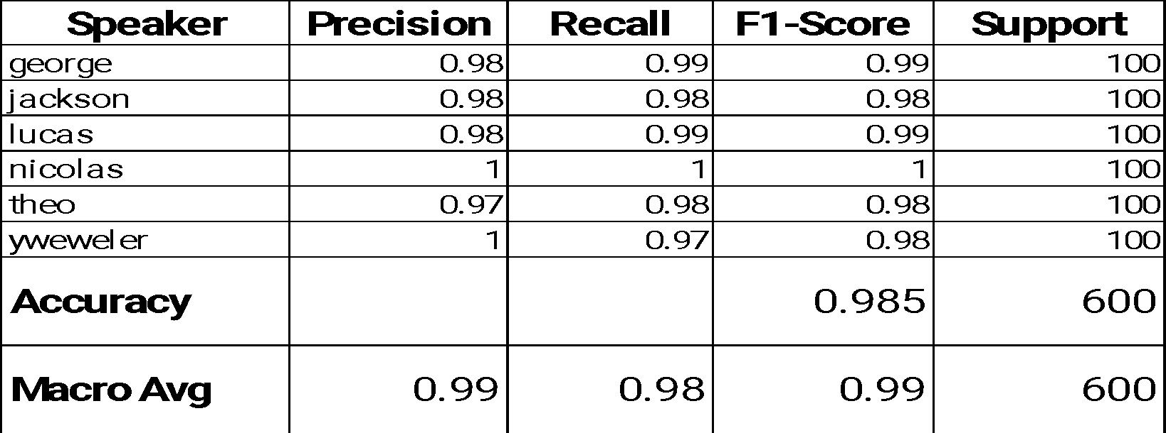
EVALUATION METRICS

Slide 10
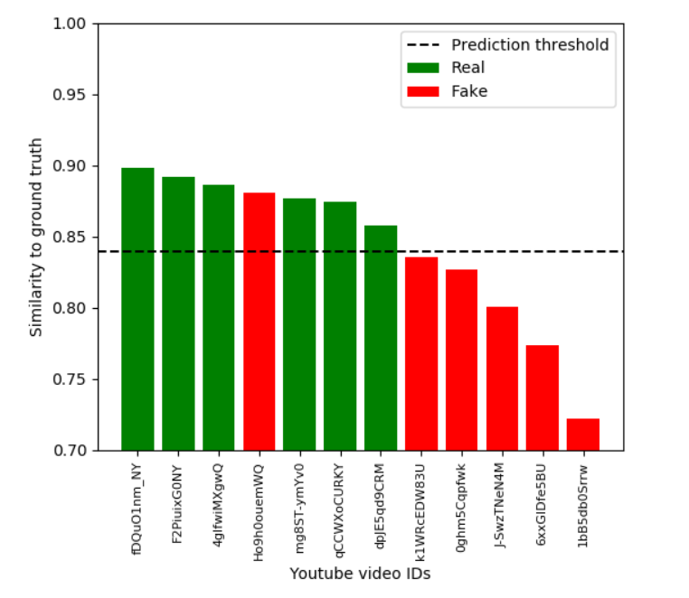

Slide 11
OPEN PROBLEMS & FUTURE OPPORTUNITIES
Open Problems:
Handling low-resource languages and speaker variability.
Improving robustness to environmental noise and spoofing attacks.
Reducing the computational complexity for real-time applications.
Opportunities:
Generative AI for voice synthesis & augmentation to improve model generalization.
Multi-modal learning combining speech with lip movement and facial recognition.
Federated Learning for privacy-preserving speaker identification.
Self-supervised learning for reducing data dependency.

Slide 12
CONCLUSION & NEXT STEPS
Speaker identification is crucial in security, authentication, and smart systems.
SOTA models offer high accuracy but need improvements in robustness and scalability.
Future research should focus on self-supervised learning, multimodal AI, and explainability.
Next Steps: Explore more noise-resistant, efficient, and interpretable models.

Slide 13
THANK YOU
Rohan Frederick
Chandra Mohan Singh Negi
Rahul Singh
Abhishek Singh

