Slide 1
CS 5542 · QUIZ CHALLENGE 2
Controlled Music & Sound
Generation with MusicGen
A study of prompt engineering, control mechanisms, and multi-metric evaluation in text-to-audio foundation models.
Rohan Hashmi · University of Missouri–Kansas City
Spring 2026

Slide 2
01
THE PROBLEM
Why controlled audio generation matters
Game studios and content creators need music and sound that match specific briefs — genre, tempo, mood, instrumentation. Naive prompts to audio foundation models produce unpredictable results. Production systems need consistency, alignment to intent, and measurable quality.
CONTROL
Turn structured scene briefs into reliable audio generations.
EVALUATION
Measure alignment, consistency, diversity, tempo, and variance.
TRADE-OFFS
Quantify what specificity costs in creative range.

Slide 3
02
BACKGROUND
MusicGen in one paragraph
MusicGen is an autoregressive transformer — unlike the diffusion models used for images. It predicts audio tokens sequentially from a text prompt. A T5 encoder turns the text into an embedding, a decoder-only transformer predicts discrete EnCodec audio tokens one step at a time, and EnCodec decodes those tokens into a 32 kHz waveform.
01
02
03
04
T5 Encoder
Transformer
CFG
EnCodec Decode
Text prompt becomes a conditioning embedding.
Predicts discrete audio tokens autoregressively.
Classifier-free guidance steers toward the prompt.
Tokens decoded to a 32 kHz mono waveform.

Slide 4
03
ARCHITECTURE
System pipeline
Structured scene metadata flows through three progressively-constrained prompt strategies, into MusicGen Small, and out to a five-metric evaluation layer.
SceneSpec
metadata
Prompt
template
MusicGen
Small
Generated
audio
Evaluation
layer
scene, genre, BPM,
instruments, mood
naive · structured ·
structured+guidance
T5 + Transformer
+ EnCodec · CFG 3/5
10-sec WAV at 32 kHz
seeded for reproducibility
CLAP · spectral dist ·
tempo accuracy
IMPLEMENTATION
Python · PyTorch · Hugging Face Transformers · LAION-CLAP · librosa · NVIDIA L4 GPU (Colab Pro) · MusicGen Small (300M params)

Slide 5
04
DATA
Structured audio scene specifications
Rather than train a model (MusicGen is already trained), I authored a compact catalog of five diverse audio scenes. Each spec is a dataclass capturing the fields a real content-creator or game-audio platform would receive as a user brief.
CATALOG
SPEC EXAMPLE
00
Workout pop
SceneSpec(
scene_id = "chiptune_platformer",
genre = "8-bit chiptune",
tempo_bpm = 150,
instruments = ["square wave lead",
"triangle wave bass",
"noise channel drums"],
mood = "playful, adventurous,
nostalgic",
key_descriptors = ["NES-style",
"rapid arpeggios"],
)
128 BPM
01
Cinematic suspense
90 BPM
02
Lo-fi study
75 BPM
03
Chiptune platformer
150 BPM
04
Coffee shop folk
95 BPM

Slide 6
05
METHODOLOGY
Three strategies, progressively controlled
NAIVE
"8-bit chiptune"
Baseline
Minimal information — what a casual user would type.
STRUCTURED
"8-bit chiptune, 150 BPM, square wave lead, triangle wave bass, noise channel drums, playful adventurous nostalgic, NES-style, rapid arpeggios, looping chip music, retro videogame, professional studio production, high quality recording"
Intervention
Metadata compiled via template with quality modifiers appended.
STRUCTURED + GUIDANCE
Same as structured, plus quality-floor tokens: "clean mix, no distortion, no vocals, no clipping" — and CFG raised from 3.0 to 5.0.
Control stack
MusicGen has no negative-prompt mechanism, so the closest analog is higher classifier-free guidance + quality tokens.

Slide 7
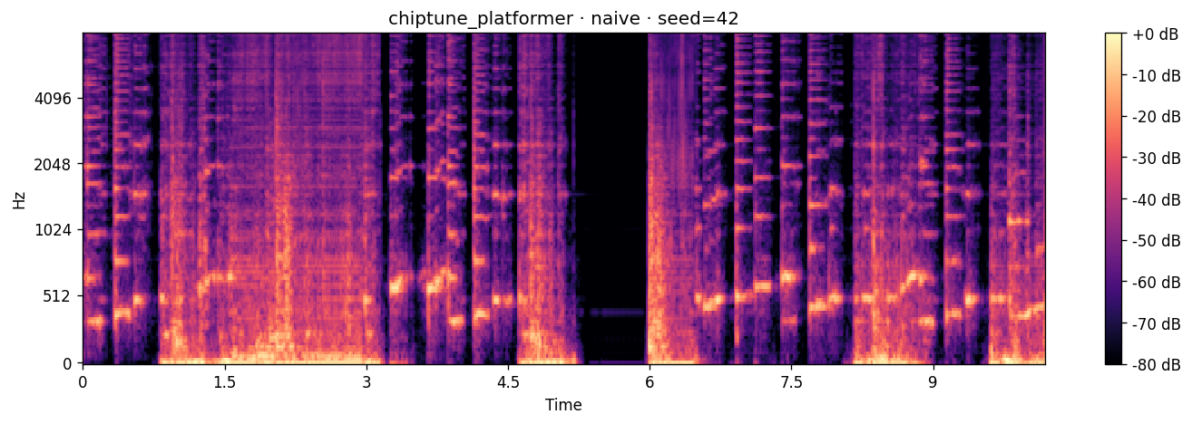
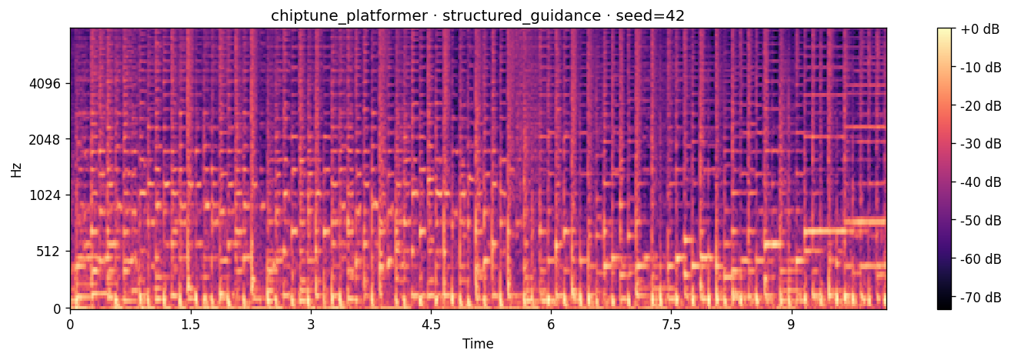
06
RESULTS
The dramatic case: “8-bit chiptune”
NAIVE PROMPT
STRUCTURED + GUIDANCE
"8-bit chiptune"
Full metadata + quality floor + CFG 5.0
Raw CLAP: 6.68 · Detected tempo: 101 BPM (target 150)
Raw CLAP: 48.87 · Detected tempo: 150 BPM (exact)

Slide 8
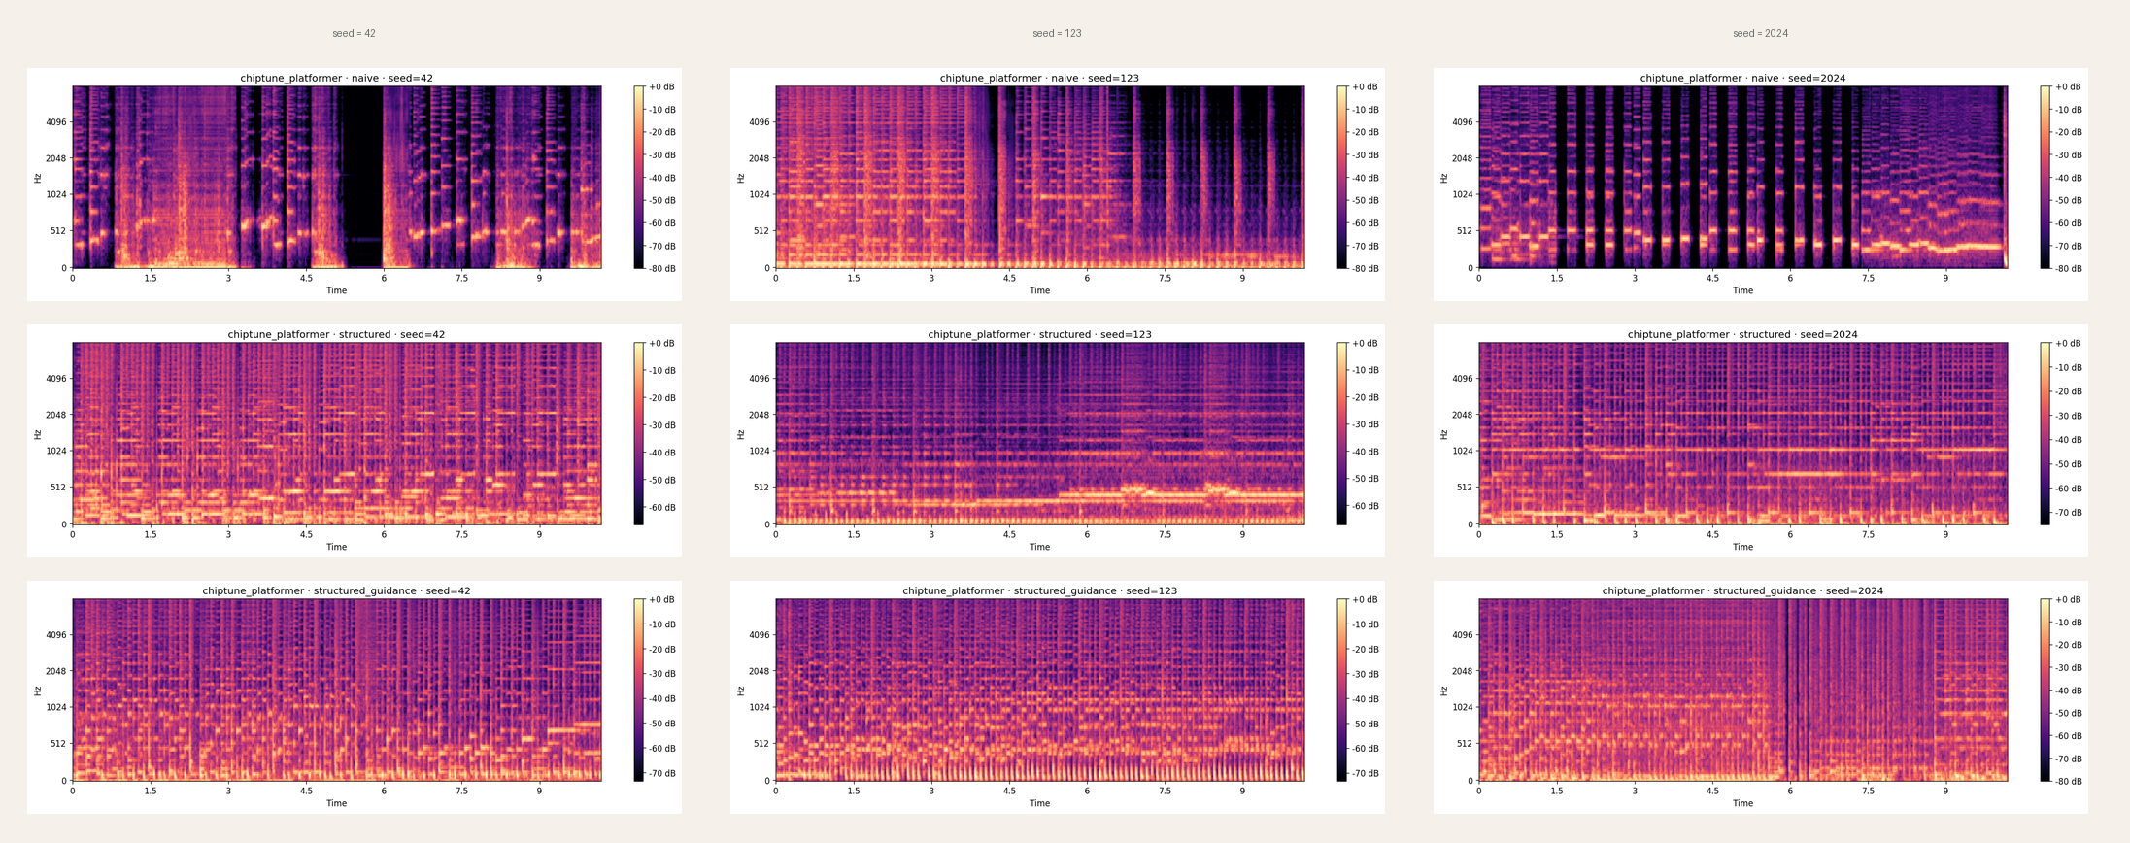
07
RESULTS
Full strategy × seed matrix
Same scene, different prompts (rows) and different random seeds (columns). Reading down shows what each strategy produces. Reading across shows how much each strategy changes between runs.
NAIVE
STRUCTURED
STRUCTURED + GUIDENCE

Slide 9
08
EVALUATION
Five metrics, one coherent story
Raw CLAP
Does the audio match the prompt you gave it? Scores each clip against its exact prompt. The industry-standard alignment check. Short prompts usually win here — but that's a bias, not a signal.
Semantic CLAP
Does the audio match the concept — regardless of how you asked? Scores each clip against the same canonical description of its scene, so all three strategies get a fair comparison. Controls for prompt-length effects.
Consistency
Does the same prompt produce similar audio across seeds? Measures how much same-scene clips drift when only the random seed changes. Lower = the prompt is doing its job. Uses mel-spectrogram distance.
Diversity
Does the system produce varied output for different scenes? Measures how much different-scene clips differ from each other. Higher = genuine range, not collapse to a single "sound". Also mel-spectrogram distance.
Tempo Accuracy
Is the beat actually at the BPM you asked for? The only objective, physics-based check in the set. Reported as median (robust) and mean (inflated by beat-tracker failures on sparse music).

Slide 10
09
EVALUATION
Evaluation results across 45 generations
STRATEGY
RAW CLAP ↑
SEMANTIC CLAP ↑
CONSIST. ↓
DIVERSITY ↑
TEMPO MAE (MED) ↓
Naive
19.78
31.65
0.0485
0.0557
25.0
Structured
41.65
45.25
0.0305
0.0404
20.3
Structured + Guidance
48.12
49.45
0.0306
0.0379
1.2
naive-winning metric (diversity only)
structured-winning metric
HEADLINE
Structured + Guidance wins alignment and tempo accuracy; consistency is essentially tied with Structured. Naive wins only diversity. Same control vs. diversity trade-off as Challenge 1 — reproduced in audio

Slide 11
10
ANALYSIS
Metrics carry their training bias with them
FINDING
CHALLENGE 1 · IMAGES
CHALLENGE 2 · AUDIO
Naive 30.80 > Structured 28.08
Structured 41.65 > Naive 19.78
CLIP was trained on short web captions. Long prompts have more ways to fail. Had to introduce semantic CLIP to see the real ranking.
CLAP was trained on detailed music captions with instruments and BPM. Long prompts look more correct, not less. No bias fix needed for the ranking.
TAKEAWAY
Same lesson as Challenge 1: one alignment metric is never enough. But the trap is different — what biased CLIP in Challenge 1 isn't what biases CLAP here. You can't just copy the fix; you must re-diagnose.

Slide 12
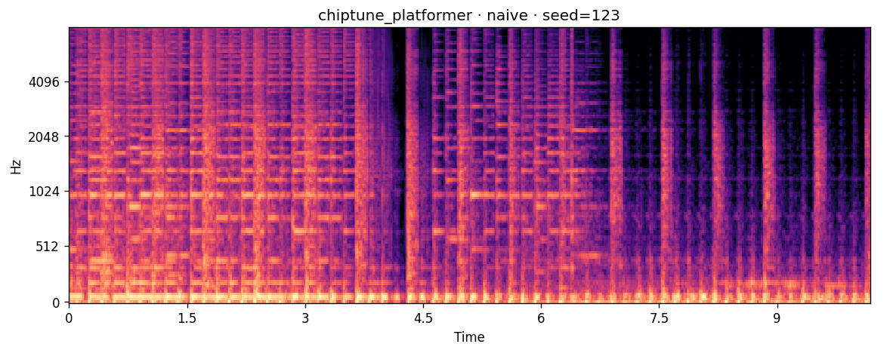
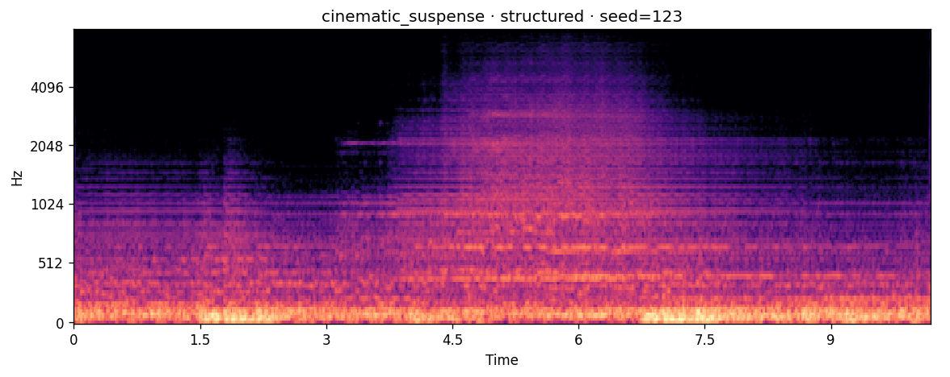
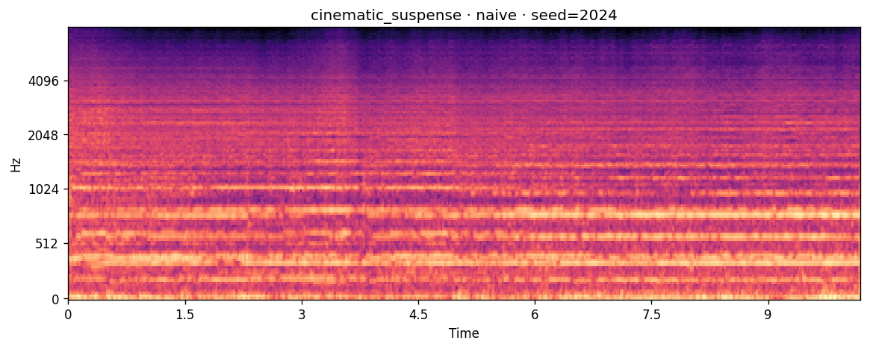
11
FAILURE ANALYSIS
Where the system breaks
Naive prompts fail on niche genres
The beat tracker misreads sparse audio
MusicGen doesn't support negative prompts
"8-bit chiptune" produced generic electronic noise across all three seeds — CLAP score 6.86, close to zero. Chiptune is rare in MusicGen's training data, so the model has nothing to fall back on without anchor words like "square wave" or "NES-style".
For cinematic suspense at seed 123, librosa reported 250 BPM when the target was 90. There's no clear drum pulse in orchestral music, so the tracker latched onto the wrong subdivision. The audio is fine — the measurement isn't.
The "negative prompt" approach from Challenge 1 doesn't exist here. I had to rebuild the control stack using higher guidance (CFG 5.0) and quality-floor words in the positive prompt ("clean mix, no distortion"). Same goal, different mechanism.

Slide 13
12
REFLECTION
Limitations, caveats, next steps
LIMITATIONS
NEXT STEPS
CLAP scores shift slightly between runs I ran the full pipeline twice. Scores moved by less than 1 point (under 2%). The rankings stayed the same, but a single run isn't enough to be sure.
Average multiple runs Run the evaluation 3–5 times, report confidence intervals instead of single numbers.
Only 45 total clips 5 scenes × 3 strategies × 3 seeds. Enough to see clear trends, not enough to prove them statistically.
Scale up to 100+ clips per scene More samples would tighten the numbers and let me run proper significance tests.
Beat tracker fails on sparse music Librosa couldn't find a stable beat in the cinematic suspense clips and guessed wildly (250 BPM detected for a 90 BPM target). This is a measurement bug, not a generation bug.
Use neural beat trackers instead Models like beat-this or TCN-based trackers handle quiet, rhythm-less music better than librosa's onset detector.

Slide 14
13
DISCLOSURE
Tools, technologies, and AI assistance
STACK
AI ASSISTANCE DISCLOSURE
Model
MusicGen Small (facebook/musicgen-small)
Claude (Anthropic) — used as a pair-programming assistant for: debugging numpy/librosa dependency conflicts, structuring the evaluation pipeline, diagnosing the CLAP detail-bias finding, designing the “structured + guidance” strategy as the MusicGen analog of Challenge 1’s negative-prompt approach, and shaping the slide structure.
All code was reviewed. All audio was generated by Colab notebook. All metric values were computed from first-principles Python; none were estimated. Verified across two independent runs.
Framework
Hugging Face Transformers
Audio eval
LAION-CLAP, librosa, scipy
Reference SR
32 kHz mono
Compute
NVIDIA L4 GPU (Colab Pro)
Language
Python 3.12, PyTorch 2.x
REPO
github.com/rohanhashmi2/cs5542-quiz-challenge-2
DEMO VIDEO
Screen Recording 2026-04-23 at 2.57.53 PM.mov

Slide 15
CS 5542 · QUIZ CHALLENGE 2
“Control costs diversity. Alignment costs specificity. The engineering is choosing the right trade.”
— The same thesis, reproduced across modalities.
Thank you.

