Slide 1
CS 542 – Computer Network 1 Project Simulator of Link State Routing - Algorithm
Name: Rohan Suresh Jain
Seat Number: 39
CWID: A20378201

Slide 2
Link State Routing Algorithm
All link-state routing protocols apply Dijkstra's algorithm to calculate the best path route.
It is used in packet switching for network communication.
This algorithm uses accumulated costs along each path, from source to destination, to determine the total cost of a route.
Examples includes OSPF and IS-IS.

Slide 3
Dijkstra’s Algorithm
It is used to find the shortest path between the routers in the network.
It is also called as single source shortest path problem.
Link State routing algorithm applied Dijkstra’s alogorithm to find the best path route.

Slide 4
Dijkstra’s Algorithm Pseudo Code
dist[s] ←0 (distance to source vertex is zero) for all v ∈ V–{s}
do dist[v] ←∞ (set all other distances to infinity)
S←∅ (S, the set of visited vertices is initially empty)
Q←V (Q, the queue initially contains all vertices)
while Q ≠∅ (while the queue is not empty)
do u ← mindistance(Q,dist) (select the element of Q with the min. distance)
S←S∪{u} (add u to list of visited vertices)
for all v ∈ neighbors[u] do if dist[v] > dist[u] + w(u, v) (if new shortest path found)
then d[v] ←d[u] + w(u, v) (set new value of shortest path)
(if desired, add traceback code)
return dist

Slide 5
The following code is executed using the example given below.
v
3
w
5
2
u
z
2
3
1
1
x
1
y
2

Slide 6
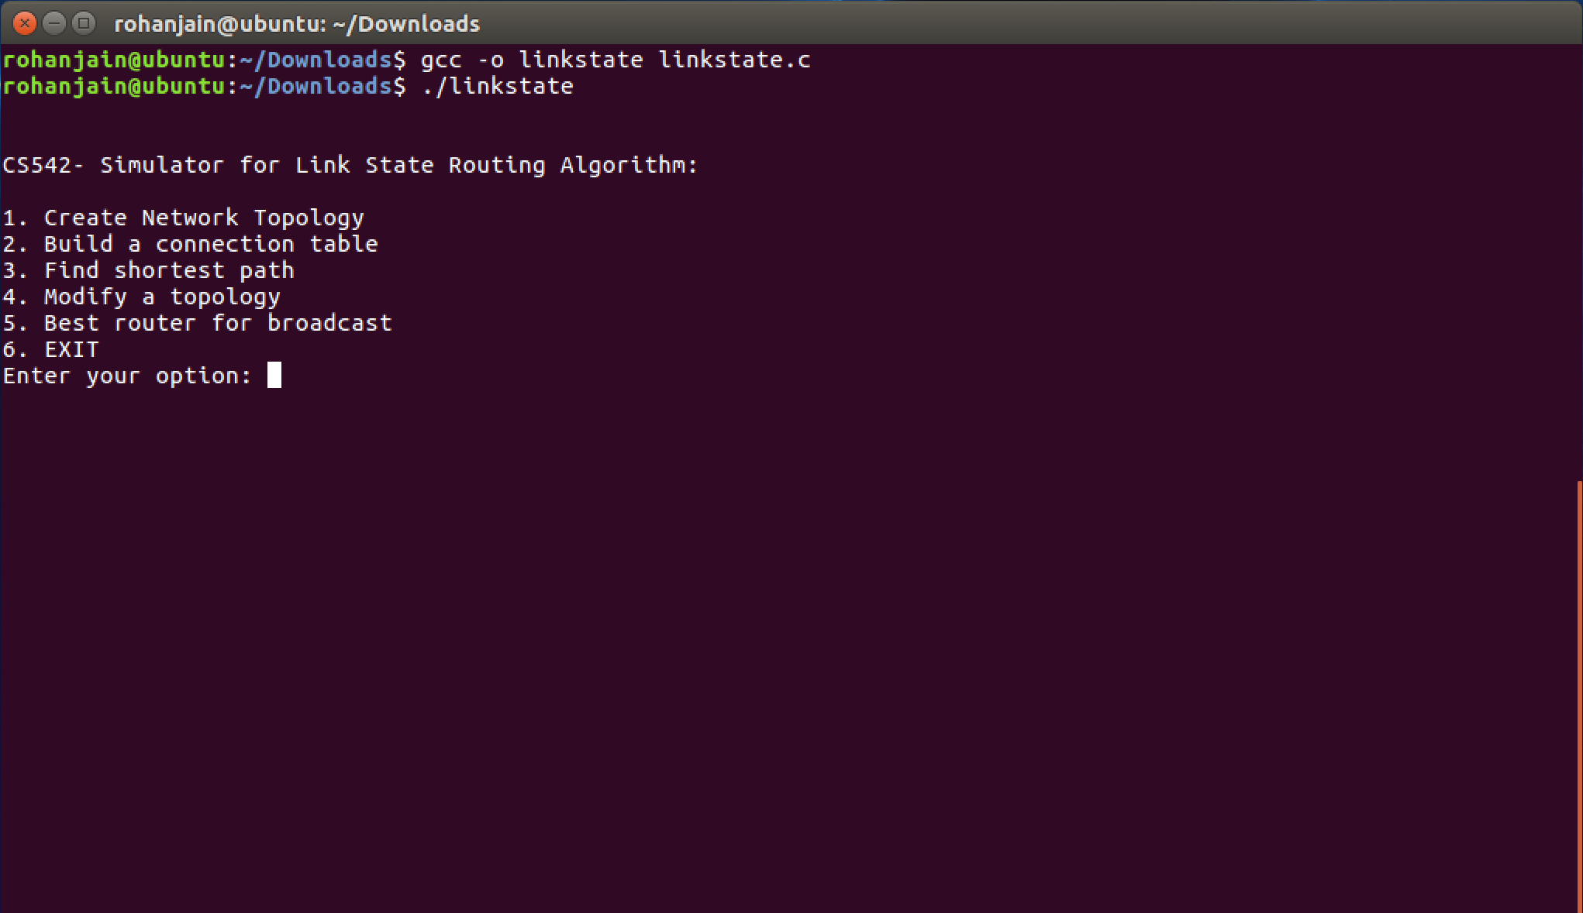
Compiling and running of the code(‘linkstate.c’) using ‘gcc’

Slide 7
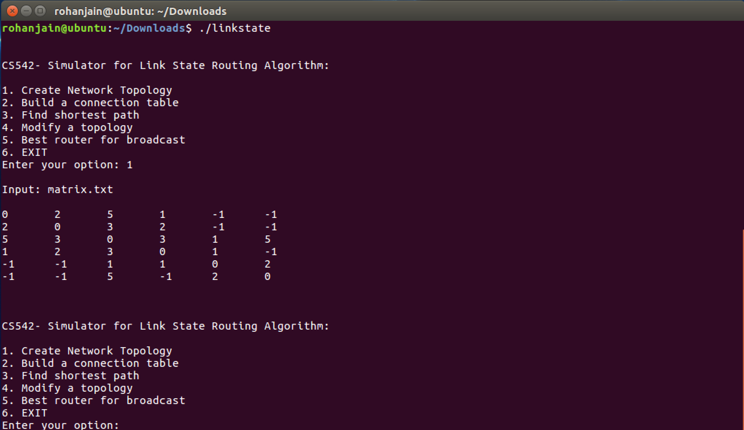
Selection of 1st option for inputting user’s matrix(matrix.txt) and printing matrix

Slide 8
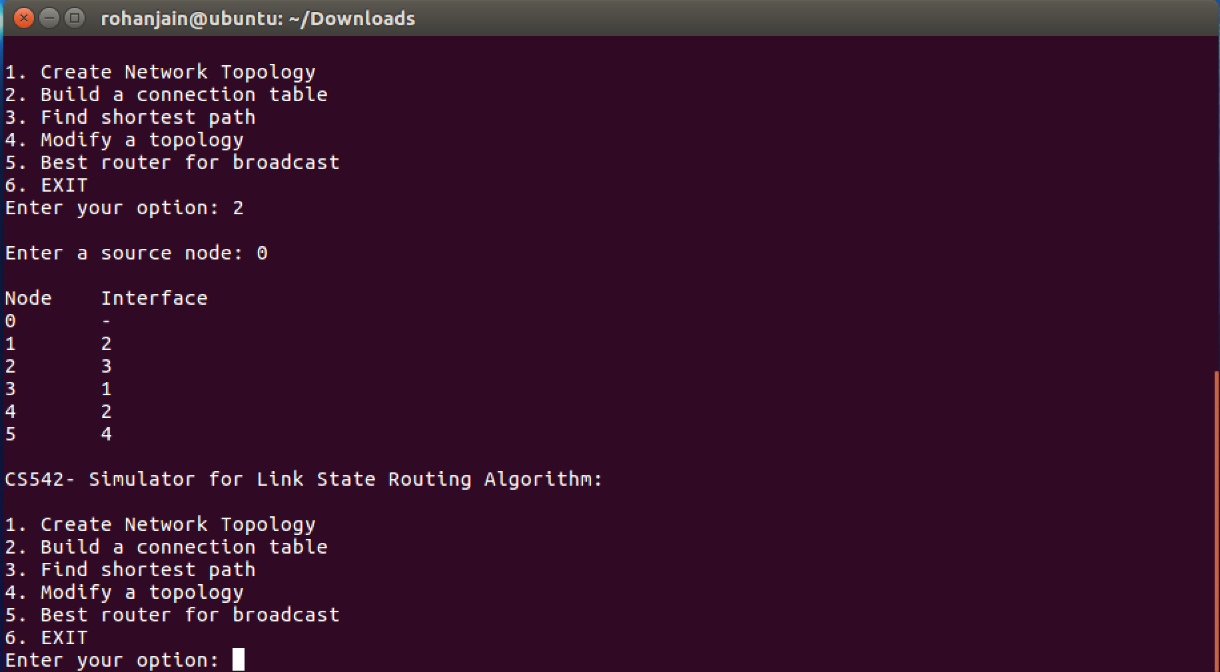
Selection of 2nd option for inputting source router(router ‘0’) and printing its connection table.

Slide 9
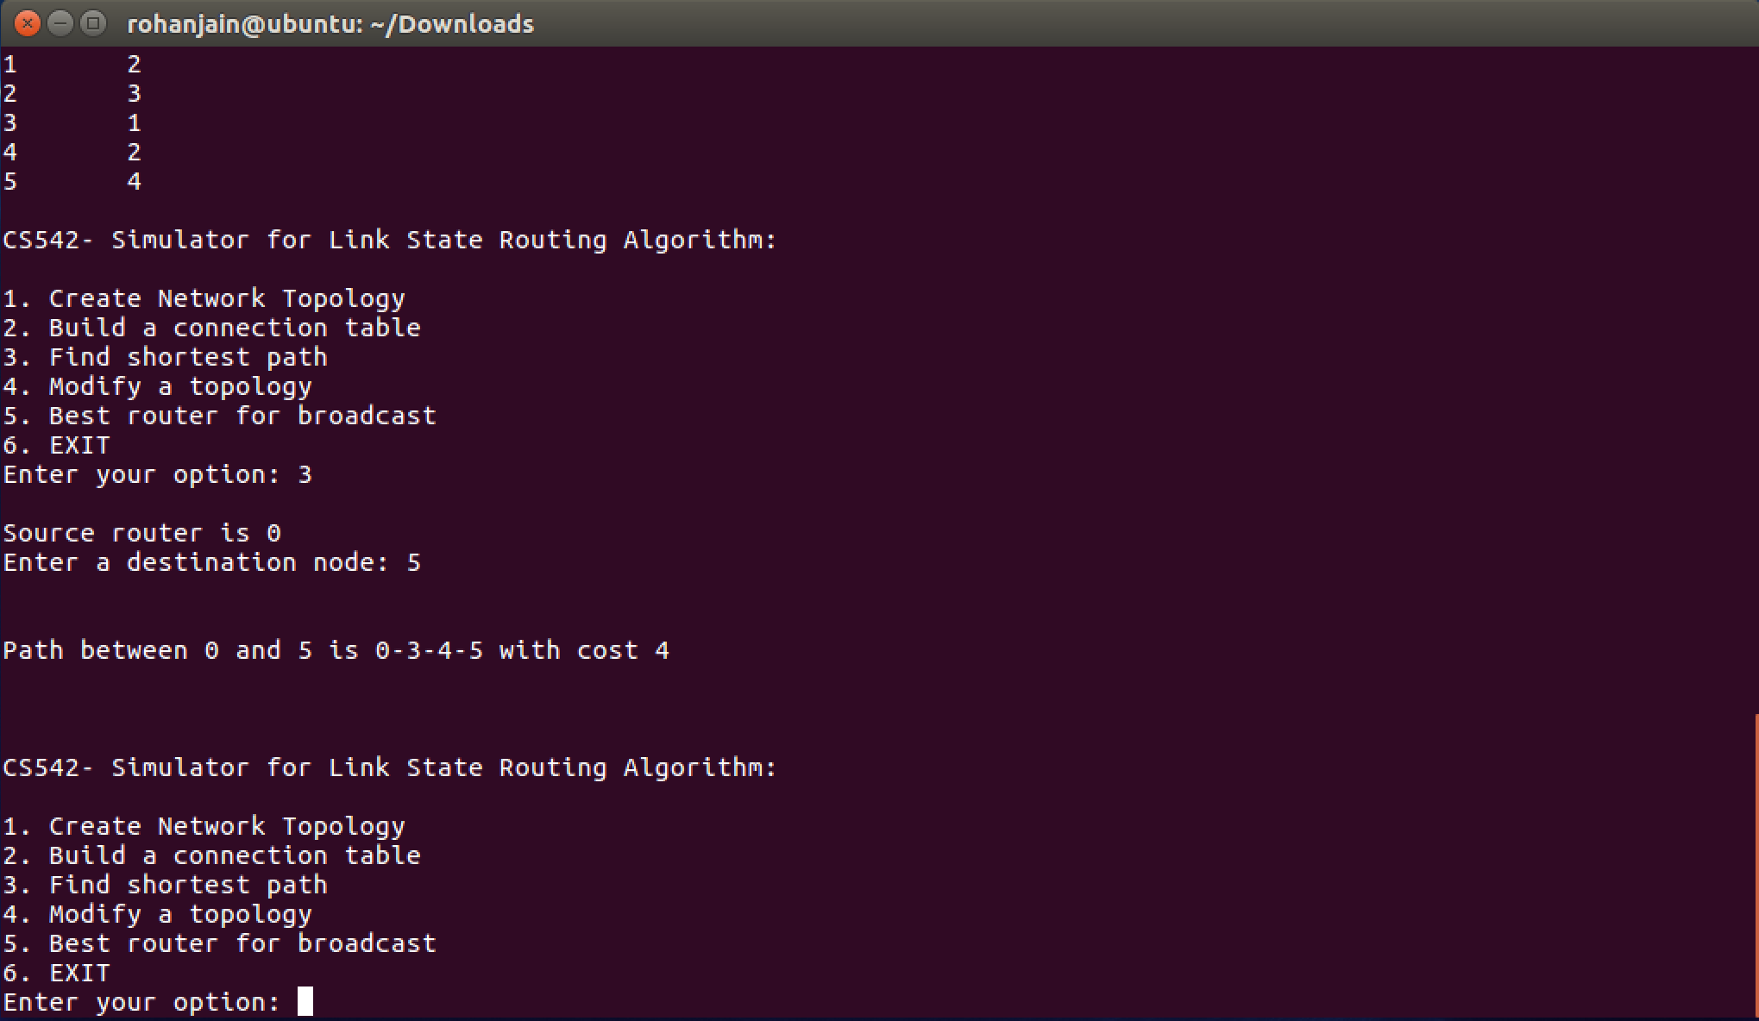
Selection of 3rd option for inputting destination router (router ’5’) and printing shortest path between source(router ‘0’) and dest(router ‘5’) with cost(‘4).

Slide 10
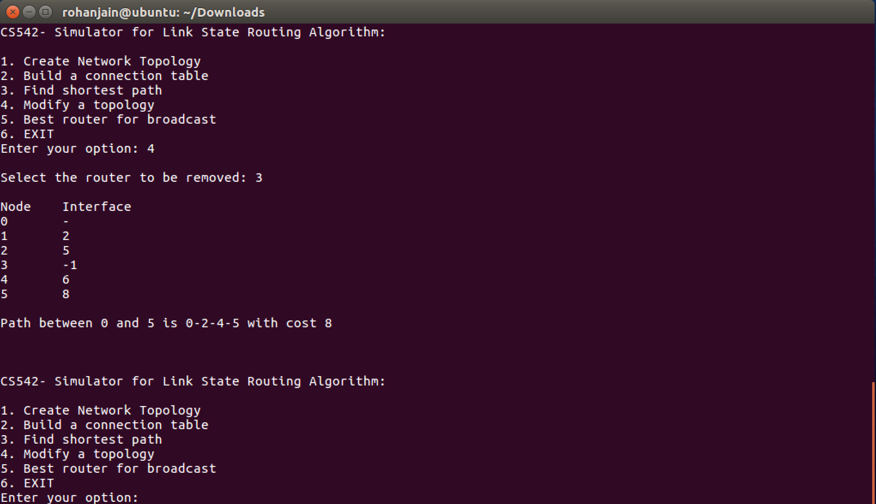
Selection of 4th option for router(router ‘3’) to be removed and printing new shortest path from source(router ‘0’) to dest(router ‘5’) along with cost.

Slide 11
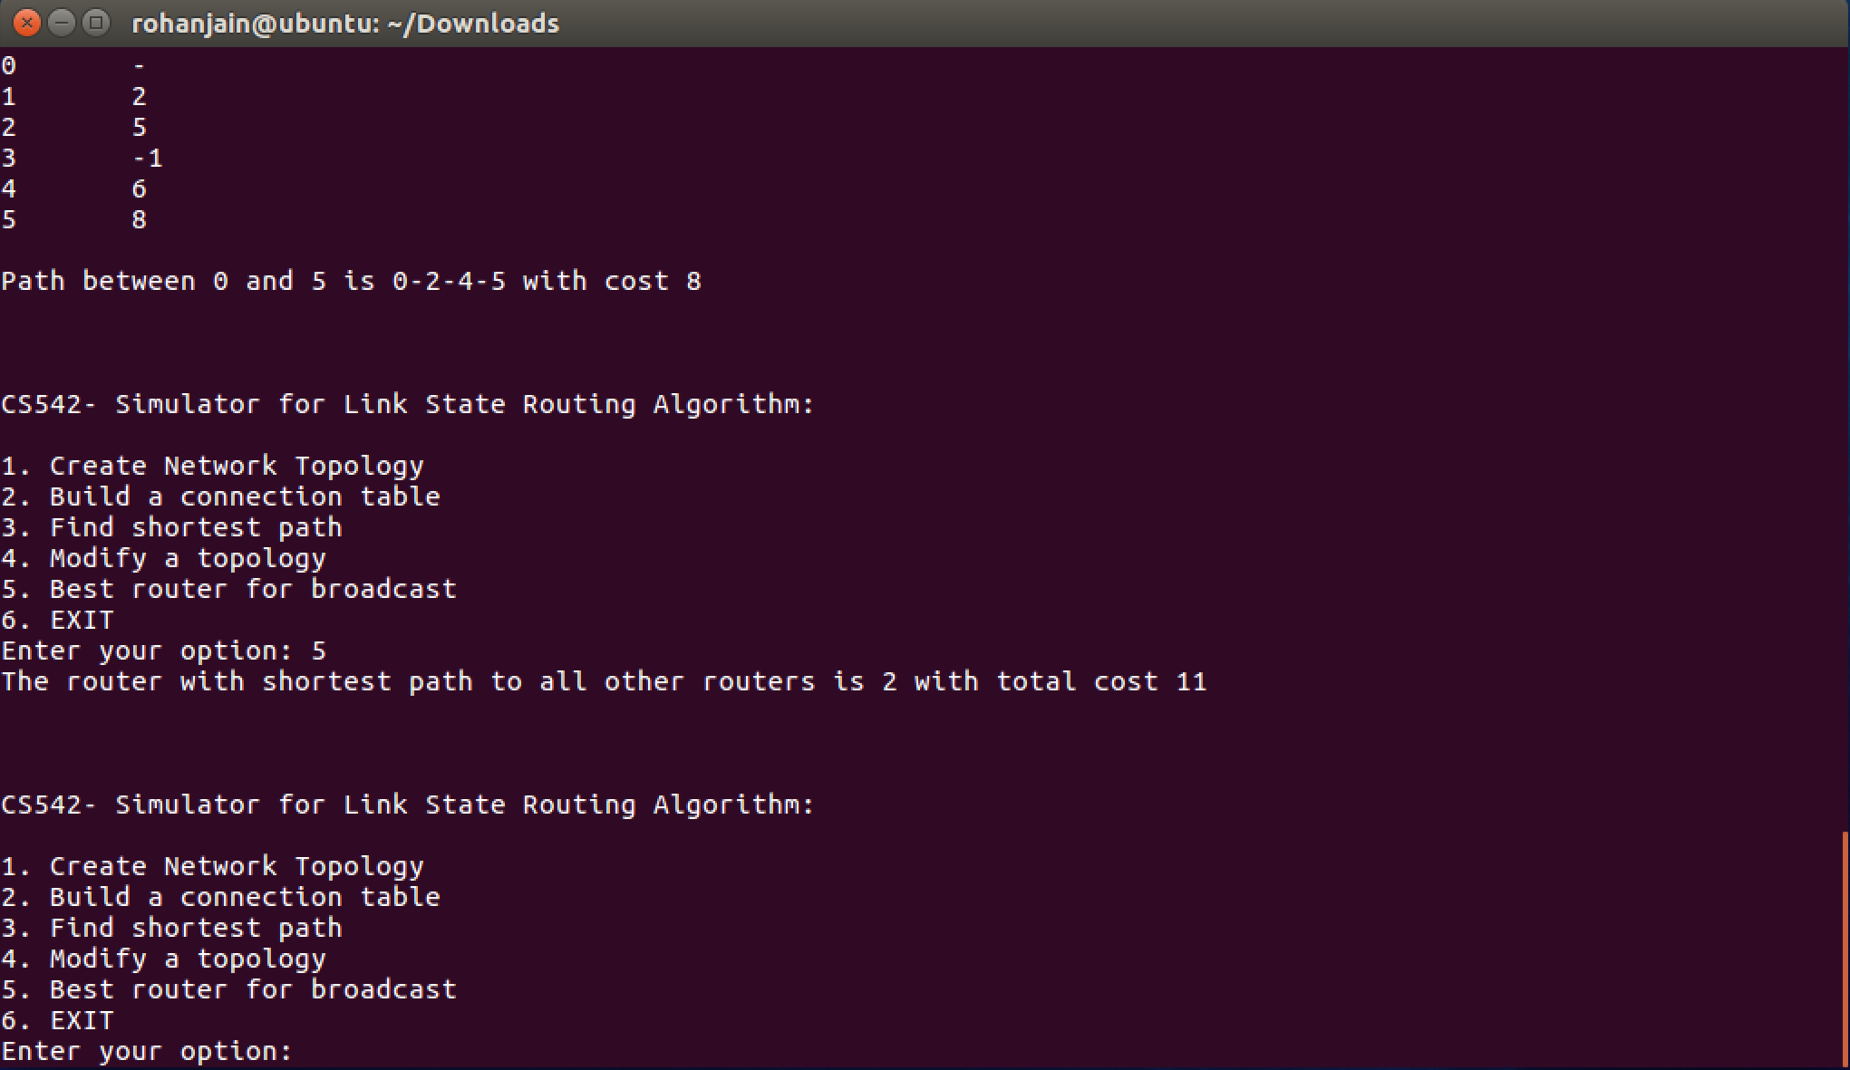
Selection of 5th option which display best router(router’2’) which has shortest path to all other routers.

Slide 12
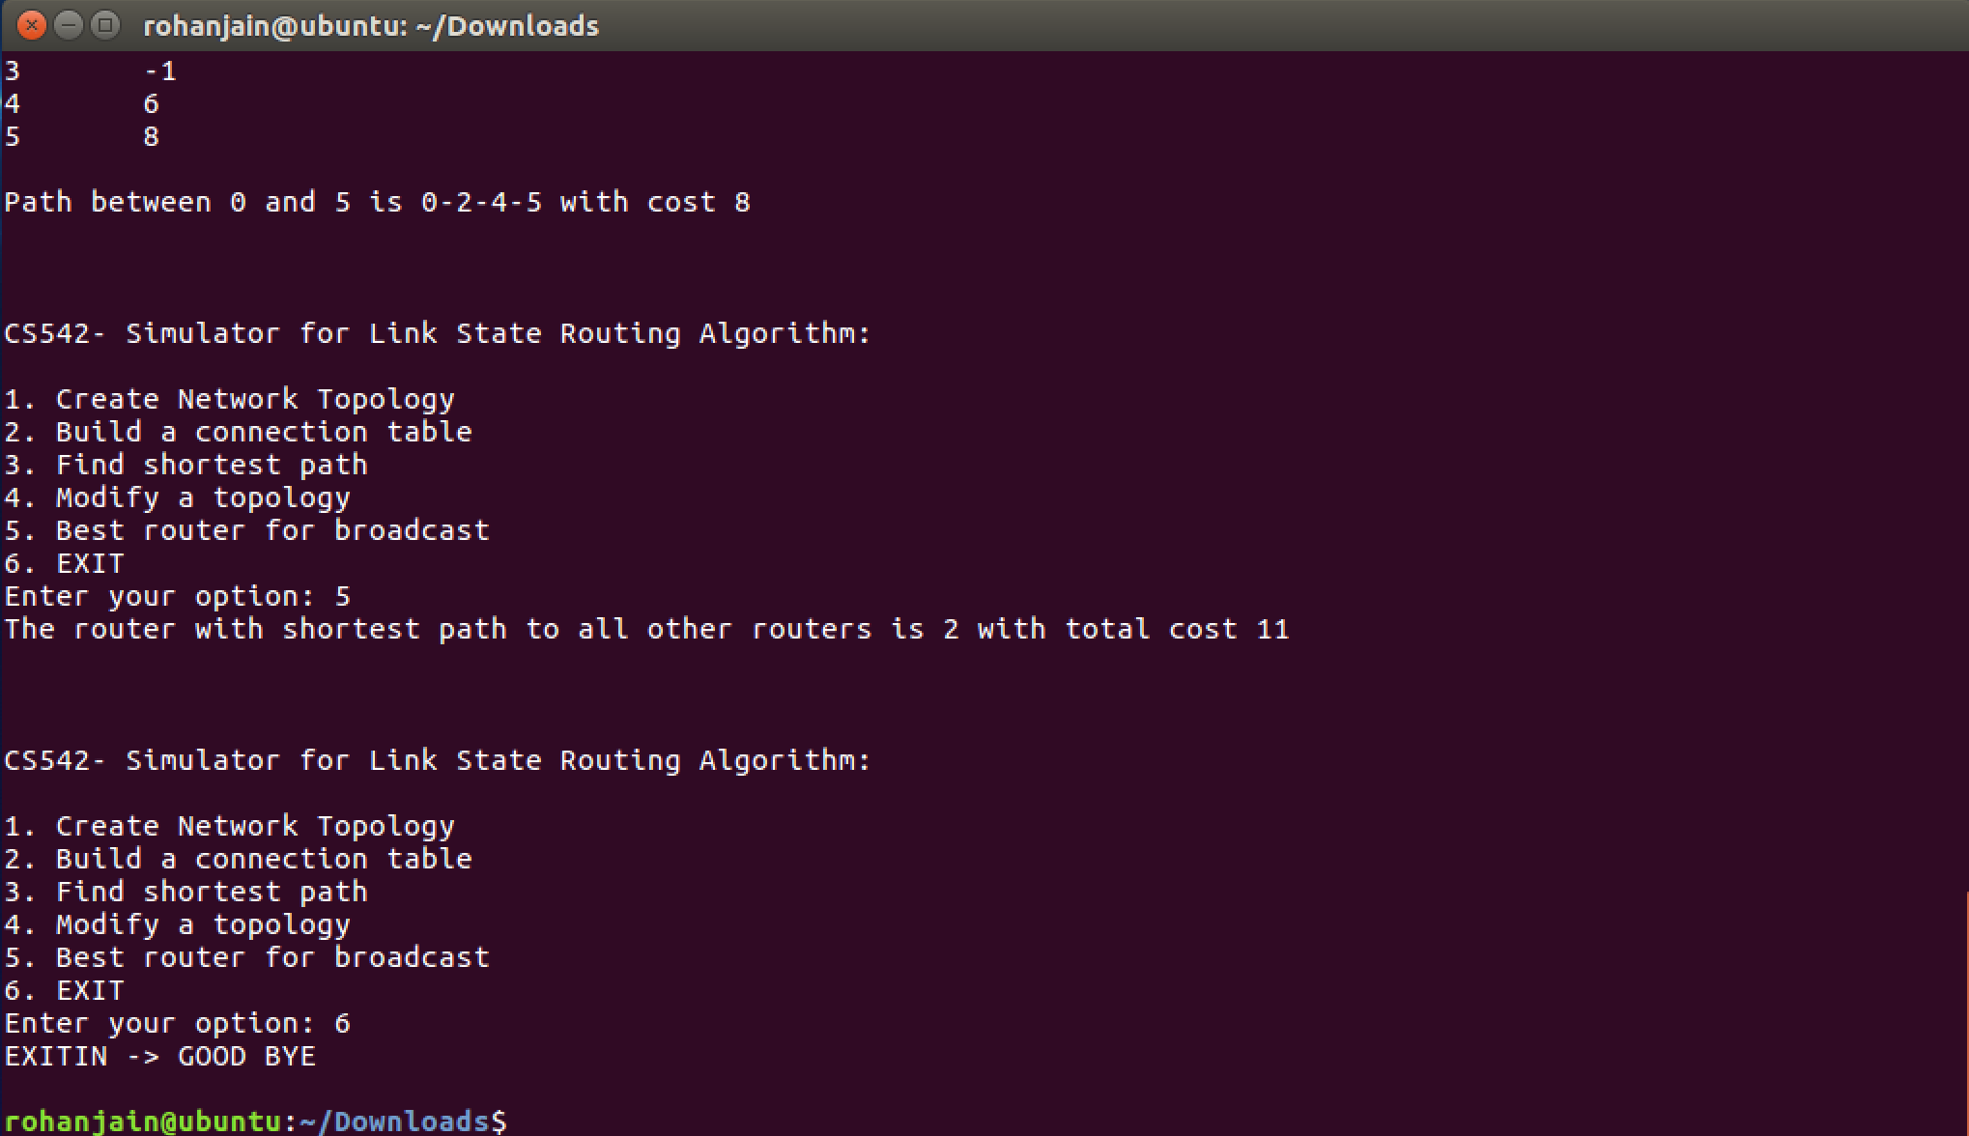
Selection of 6th option to exit the program.

Slide 13
Conclusion
Implemented code for Link State Routing Algorithm works for any size of network(matrix).
Given a valid input, it will find shortest path from source to destination.
Additional functionalities of code includes finding the shortest path from source to destination after router is removed and finding the best router for broadcast.

