Slide 1
Sales_insight
File created on: 02-02-2023 12:55:27

Slide 2
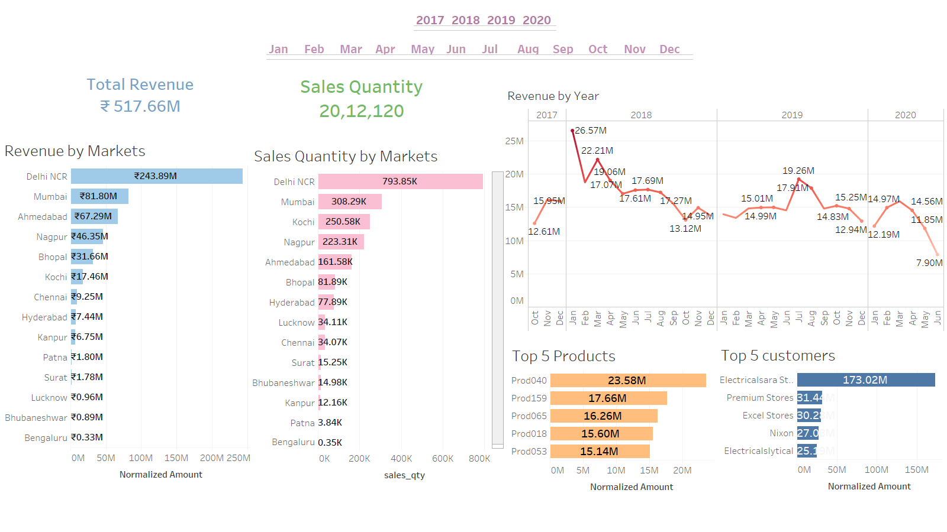

Slide 3
