Slide 2
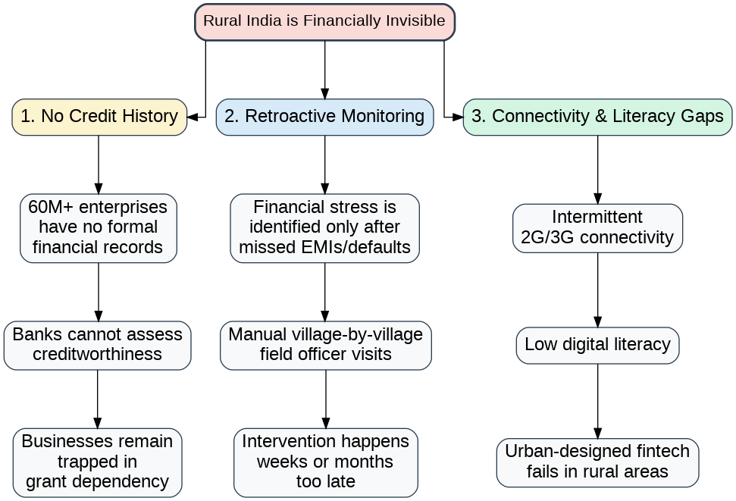
The current system is hindsight-driven. By the time a problem is spotted, it's already a default, a liquidity crunch, or a collapsed livelihood.
The core tension is simple: millions of productive enterprises generate real cash flow, but nobody can see it. Banks rely on formal records that don't exist. Monitoring is manual. And even if a digital tool existed, it would need to survive offline village environments. This gap costs banks millions in NPAs and keeps rural entrepreneurs locked out of formal credit.

Slide 3
We turn simple ledger entries into a credit-bureau substitute — giving rural enterprises financial foresight and giving institutions early-warning radar

