Slide 1
CMPE 274 – Business Intelligence Technologies Movie Recommendation System
Amit Bharadia
Arihant Sai Paruchuru
Nitish Joshi
Rohan Kamat

Slide 2
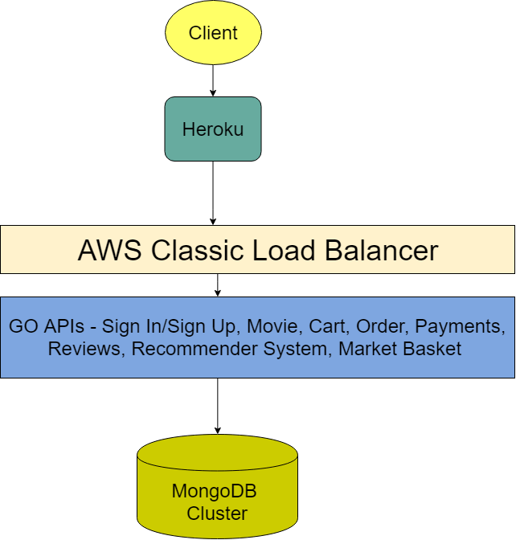
Architecture

Slide 3
Technology Stack - Front End & Languages Used
NodeJS
HTML5
JavaScript
EJS Package
Golang
Python

Slide 4
Technology Stack - Data & ML API’s
Dataset: MovieLens
100,000 ratings
1700 movie records.
1000 users.
Image scraping from IMDB website.
Recommender System
Market-basket Analysis API (Apriori)

Slide 5
Technology Stack - Cloud & Backend
AWS EC2 instances
MongoDB
Docker
Heroku
VPC Peering Connection
Portainer

Slide 6
Demonstration!

Slide 7
Thank you!

