Slide 1
INTERNSHIP PROJECT
Text-to-Speech
Conversion
Web Application
A focused web application that turns written text into spoken audio.
Rohan Sharma · B.Tech – Artificial Intelligence · ABESIT Ghaziabad

Slide 2
PROJECT PREMISE
A simple web app that turns written text into speech
A short path from typed text to playable audio.
01
02
03
Web-based Text-to-Speech application
English and Hindi
Focused internship project
Choose the language and voice.
React + Vite frontend with a Node.js/Express backend.
Converts written text into spoken audio.
Uses the ElevenLabs Text-to-Speech API.
02

Slide 3
USER JOURNEY
The user journey is short, but complete
01
02
03
Input
Measure
Choose
Enter or paste text.
See character and word counts.
Select language and voice.
04
05
06
Generate
Listen
Reset
Send a validated request for speech.
Play the generated audio or download it.
Clear the form and start again.
Guardrails: input validation and API rate limiting.
03

Slide 4
The stack separates the interface from the speech engine
Each layer has a focused role, from the React interface to the ElevenLabs API.
LAYER | TECHNOLOGY
Frontend | React + Vite
Styling | Bootstrap + CSS
Backend | Node.js + Express
TTS | ElevenLabs API
Deployment | Vercel + Render
API testing | Postman
Version control | Git + GitHub
04

Slide 5
ARCHITECTURE
Text moves through five clear system stages
React frontend
Express backend
ElevenLabs TTS API
Generated MP3
React player
01
02
03
04
05
User enters text and chooses language and voice.
React sends the request to the backend.
The API returns generated MP3 audio.
The frontend loads the audio into a React player.
Express validates the request and calls the external speech engine.
05

Slide 6
BACKEND SURFACE
Three endpoints keep the backend focused
1
2
3
GET /api/health
POST /api/tts
GET /api/voices
Service health check.
Validate text and request speech generation.
Retrieve available voice options.
The backend validates the request, communicates with ElevenLabs, receives the generated audio, and returns it to the frontend.
06

Slide 7
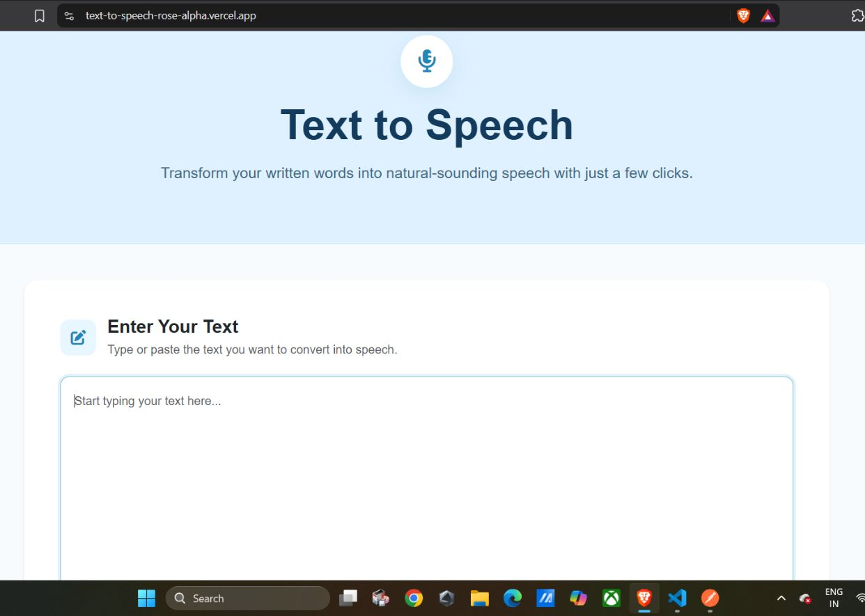
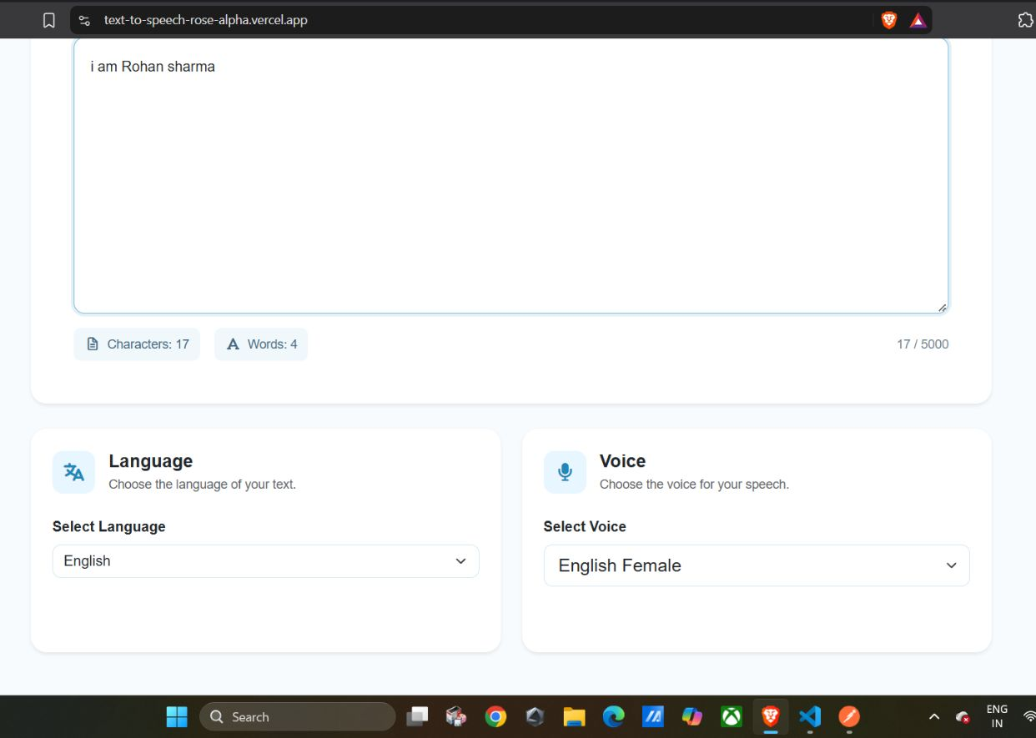
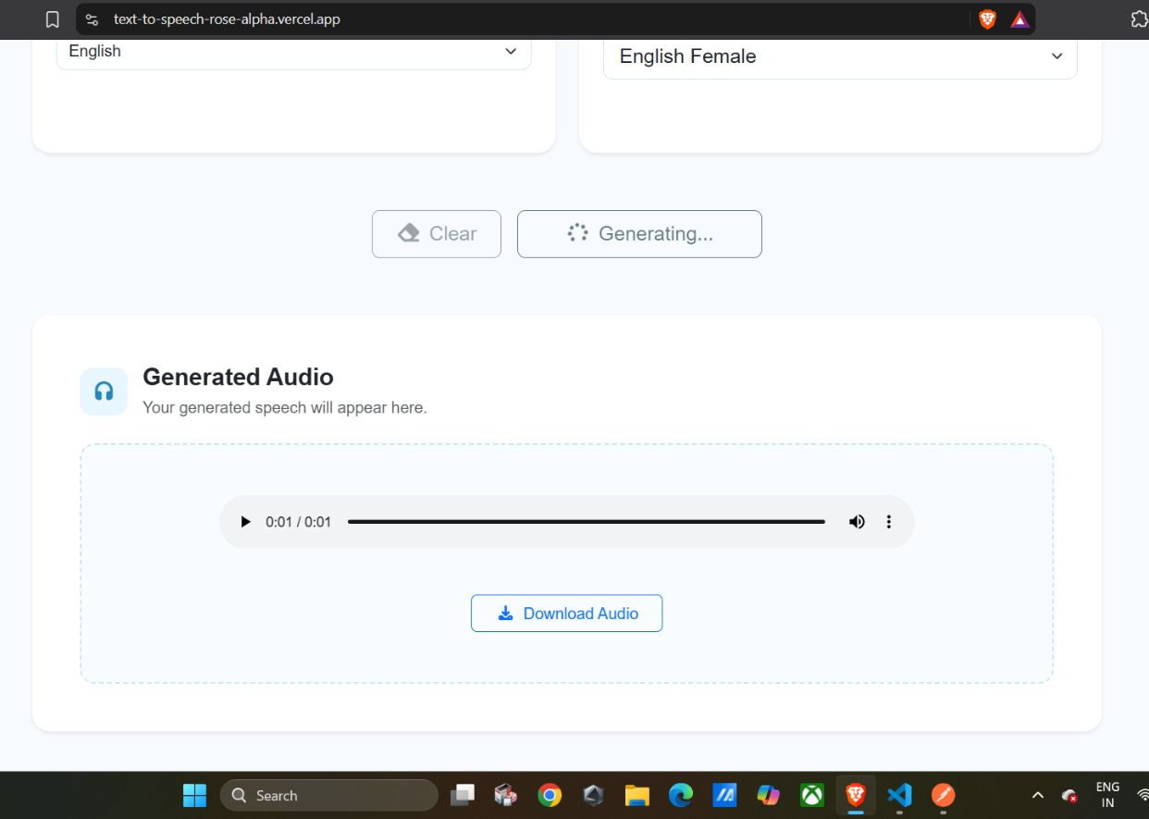
INTERFACE EVIDENCE
The interface is built around one visible outcome: playable audio
Home
Text input
FLOW SUMMARY
Application flow
Text input → Language & voice → Generate → Audio player
Generated audio
07

Slide 8
DELIVERY
Deployed as a complete,
usable project
Deployment
Conclusion
Frontend: Vercel
Backend: Render
Source code: GitHub
API collection: Postman
The project successfully provides a functional web-based Text-to-Speech system with a React frontend, Express backend, and ElevenLabs API integration.

