Slide 1
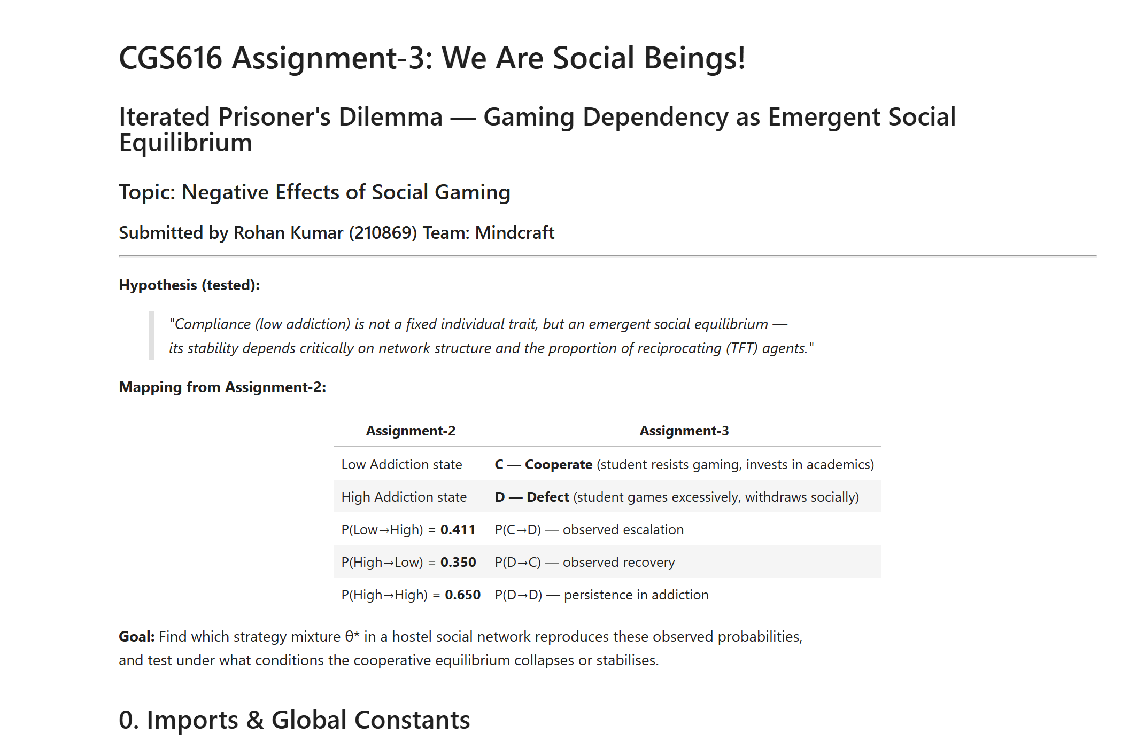

Slide 2
Hypothesis
Given topic — gaming dependency spreading among IIT Kanpur students in hostels the most natural and defensible hypothesis is:
"Gaming addiction spreads not through individual weakness, but through social contagion — specifically, when a small number of highly-connected students (hub nodes) adopt Always Defect behaviour, cooperation collapses across the network."
This maps perfectly to our data because:
Our social loneliness and social pressure antecedents already capture peer influence
Hostel shared rooms = higher connectivity = more contagion
The "Hub Effect in Networks" experiment is listed explicitly in the assignment Modified hypothesis: Excessive gaming is not a fixed individual trait but an emergent social equilibrium — the transition probabilities P(C→D) = 0.411 and P(D→C) = 0.350 reflect a population-level balance between peer-driven escalation and reciprocity-based recovery, whose stability is critically sensitive to network structure and the proportion of Tit-for-Tat agents in the hostel social network.

Slide 3
The Full Conceptual Chain
Here is how every piece connects:
Step 1 — From Assignment 2, extract your transition matrix You already computed P(Low→High) and P(High→Low) for all 50 students. Average them. These are your P(C→D) and P(D→C) — your observed data.
Step 2 — Define your IPD payoff matrix Map it to gaming context:
R (mutual cooperation) = both students study/socialize → moderate wellbeing for both
T (temptation) = you game while your friend studies → you get max entertainment, they feel social pressure
S (sucker) = you study while your friend games → you feel left out, FOMO
P (mutual defection) = both game excessively → both suffer academically
Use R=3, T=5, P=1, S=0 as given.
Step 3 — Choose strategies that make psychological sense

Slide 4
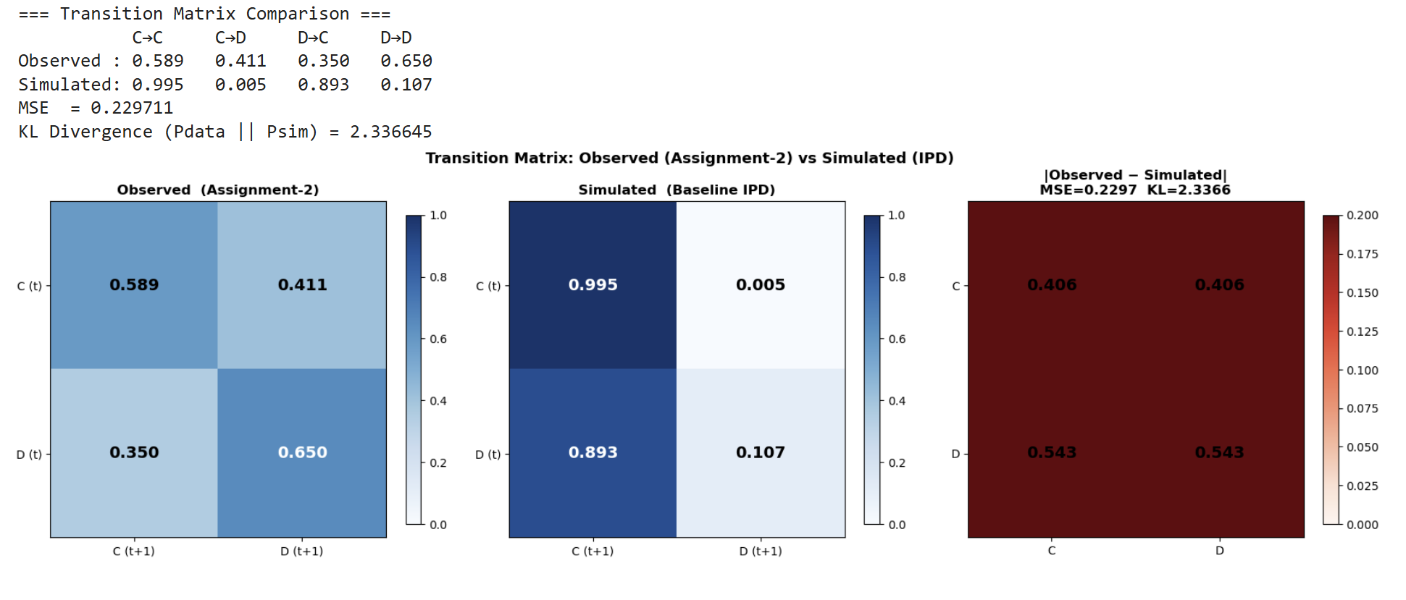

Slide 5
Payoff matrix:
C vs C → (R,R) = (3,3) C vs D → (S,T) = (0,5)
D vs C → (T,S) = (5,0) D vs D → (P,P) = (1,1)
Condition T>R>P>S: 5>3>1>0 ✓
Observed (Assignment-2): P(C→D)=0.411 P(D→C)=0.35
Strategy │ Psychological profile in gaming context
──────────┼──────────────────────────────────────────────────────────────
AC │ Highly disciplined — always resists gaming, ignores peer pressure
AD │ Habitual heavy gamer — always pulls peers toward gaming
TFT │ Mirror student — copies roommate; reciprocates both cooperation and gaming
TF2T │ Tolerant student — needs 2 consecutive bad days before switching to gaming
GTFT │ Forgiving student — occasionally resets gaming habit, promotes recovery
GT │ Once-burned student — games forever after one academic setback
STFT │ Suspicious student — starts gaming, then mirrors; never fully trusts
RAND │ Unpredictable — noisy, stress-driven, inconsistent behaviour
PAVLOV │ Habit reinforcer — repeats whatever gave satisfaction last time

Slide 6
Step 3 — Choose strategies that make psychological sense
TFT = a student who mirrors their roommate's behavior (most realistic for hostel life)
AD = a student with high prior gaming history who always pulls others in
AC = a highly disciplined student who always cooperates regardless
GTFT = a student who occasionally forgives a friend's gaming phase
Grim Trigger = a student who, once academically damaged, permanently disengages socially
Step 4 — Build the network Use a small-world network (Watts-Strogatz) — this is the most realistic for a hostel. Students have strong local clusters (floor/wing friends) with a few long-range connections (clubs, classrooms). Scale-free also works if you want to test the hub hypothesis.
Step 5 — Run the simulation and match Run IPD across generations. Track what fraction of the population is in C vs D each generation. Find the strategy mixture θ = (θ_TFT, θ_AD, θ_AC, ...) that minimizes the error between your simulated P(C→D) and your observed one from Assignment 2.
Step 6 — Run the experiments
Insert one AD agent in a TFT population — does gaming spread?
Put the AD agent at a hub node vs a leaf node — does position matter?
Compare TFT vs GTFT — does forgiveness help students recover?

Slide 7
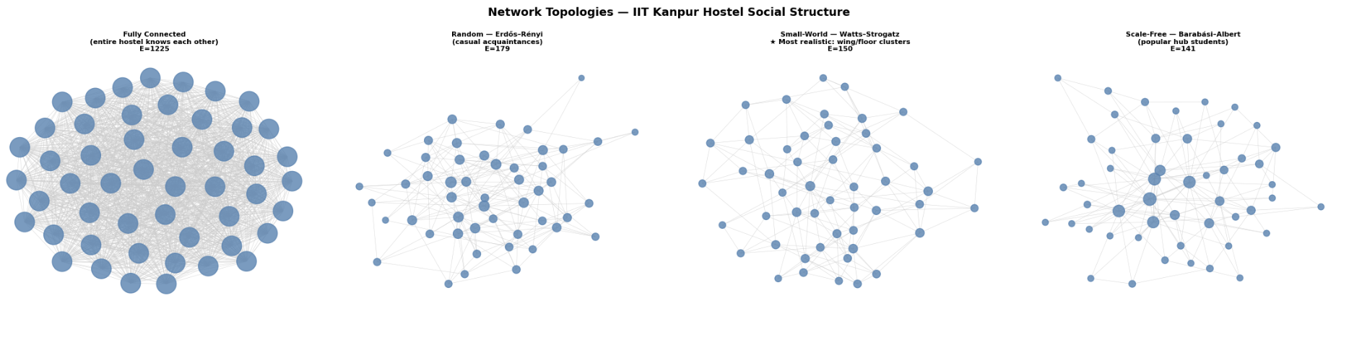

Slide 8
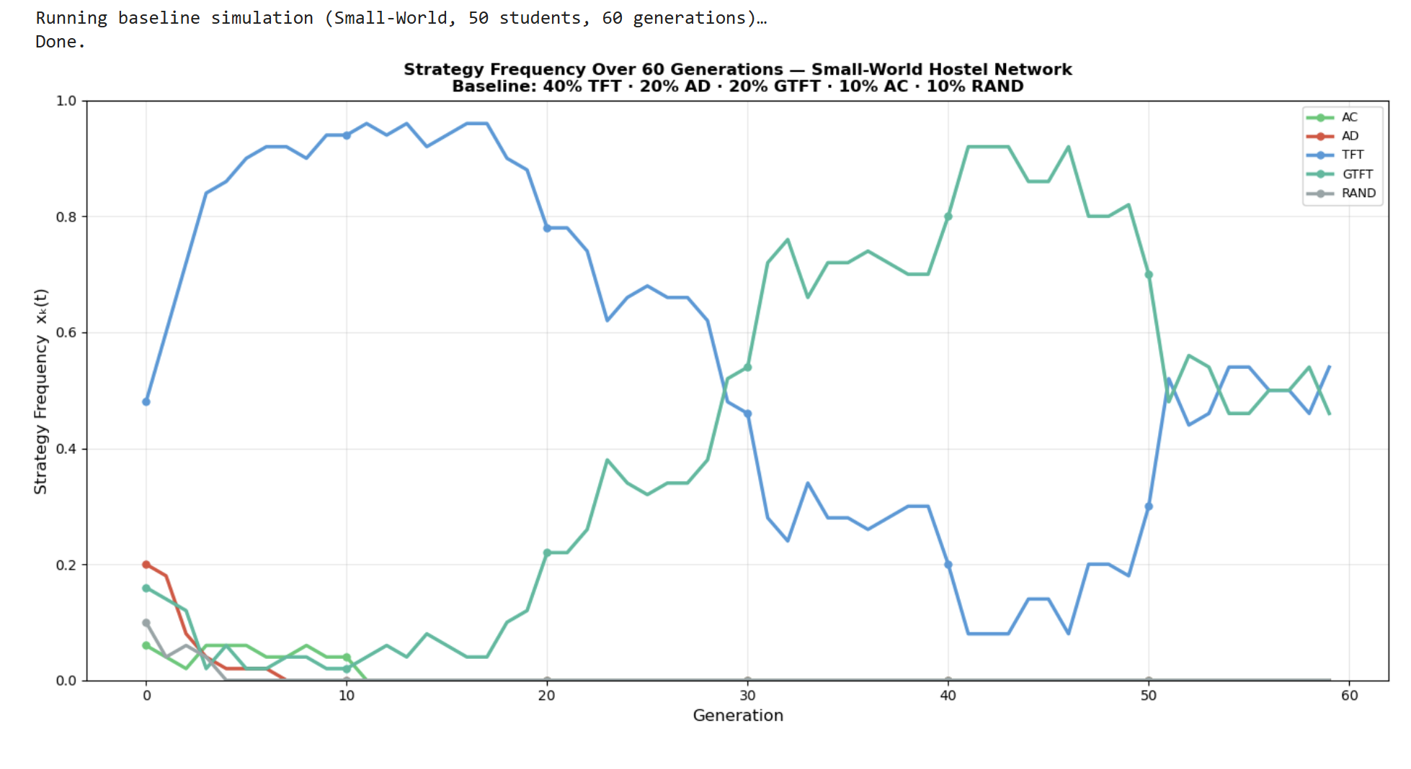

Slide 9
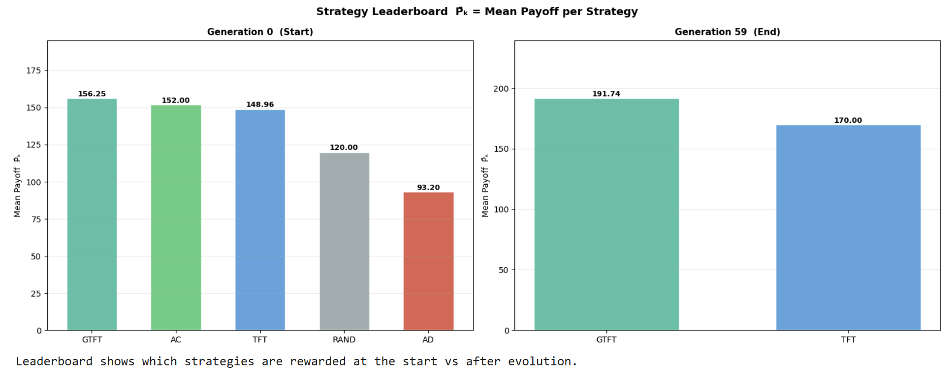

Slide 10
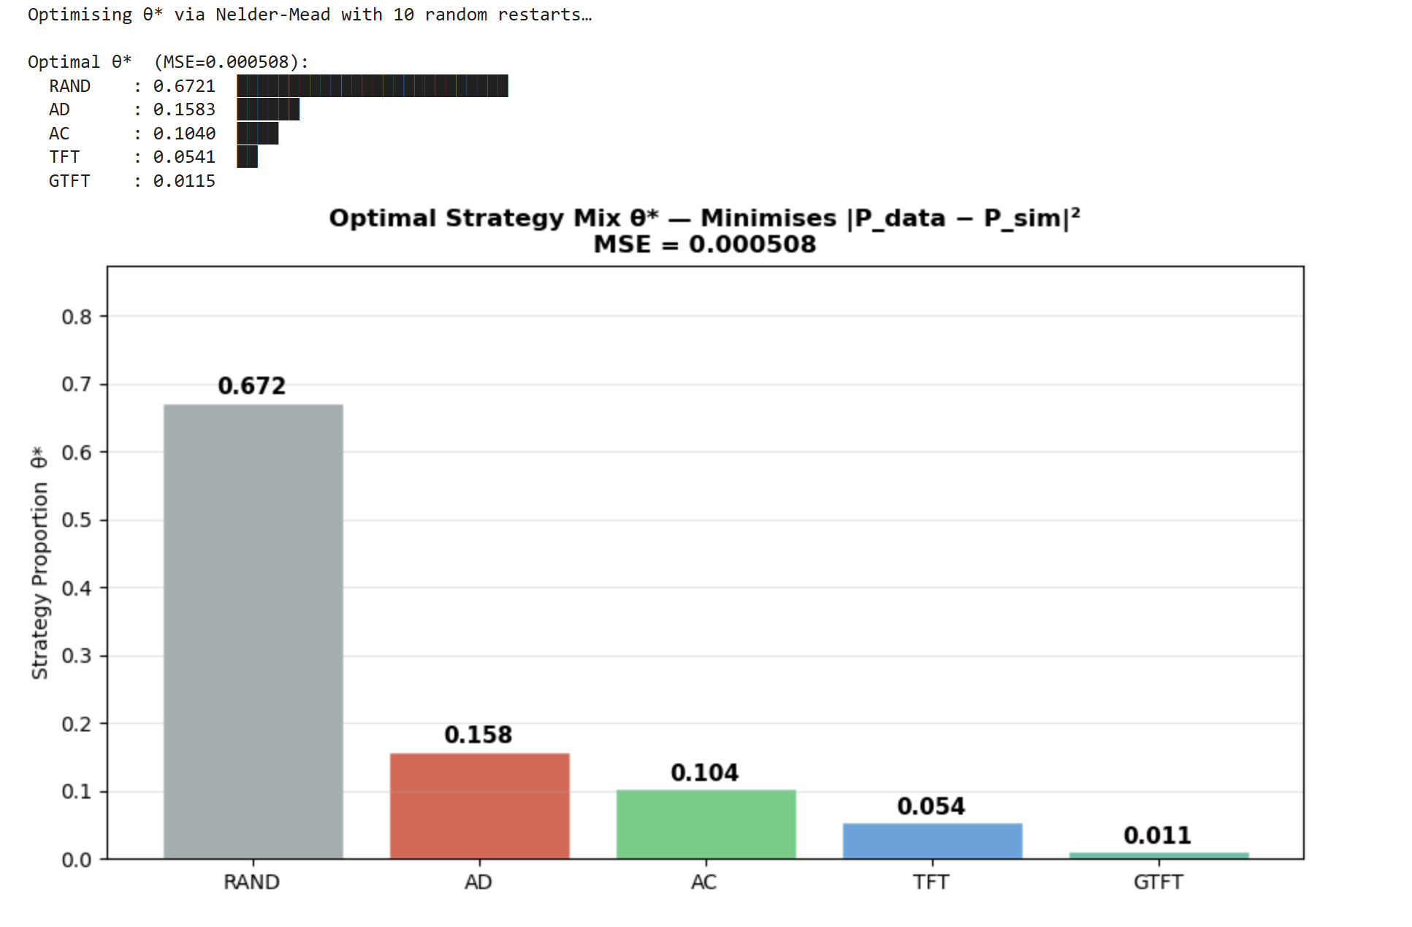

Slide 11
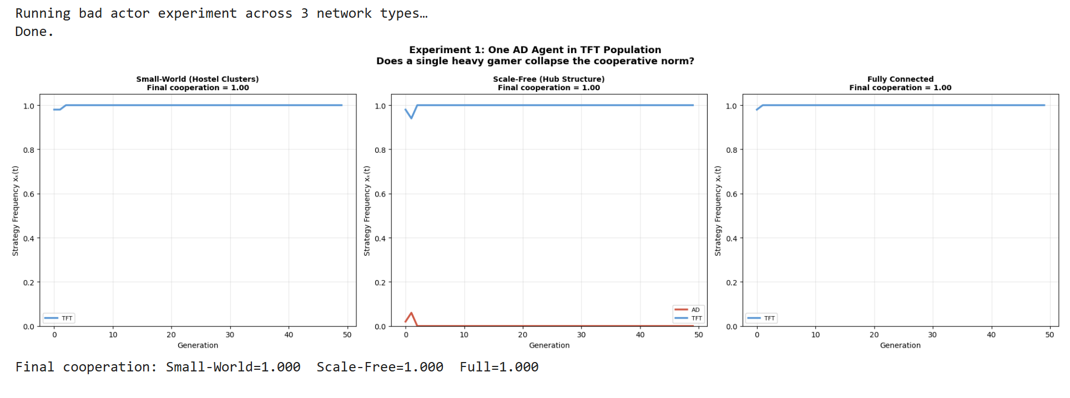

Slide 12
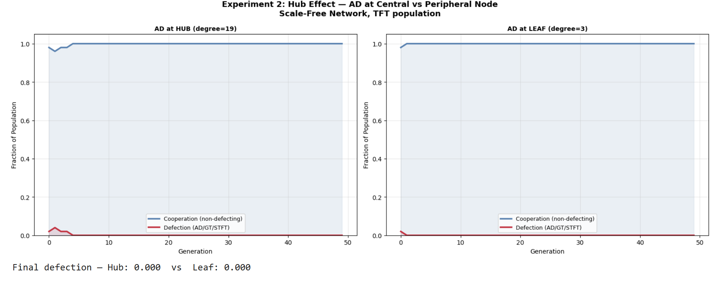

Slide 13
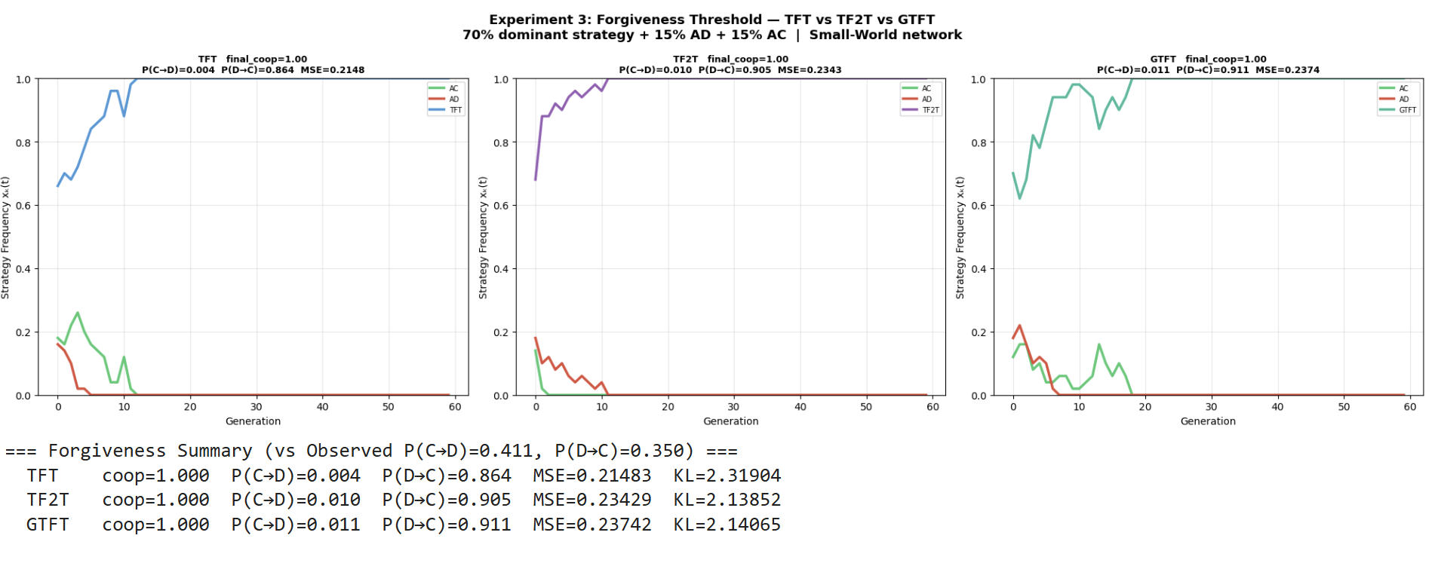

Slide 14
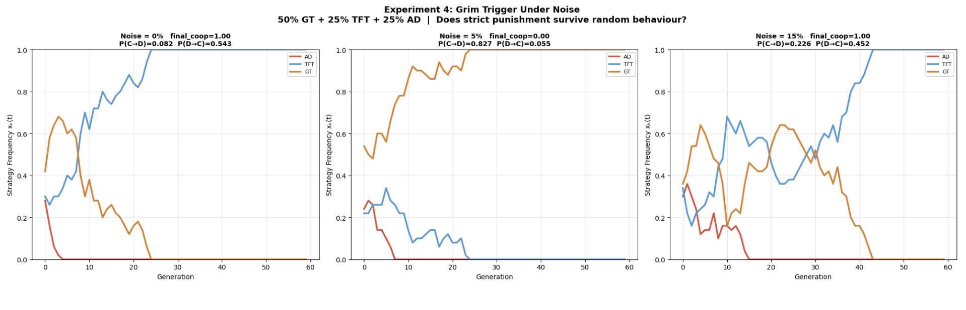

Slide 15
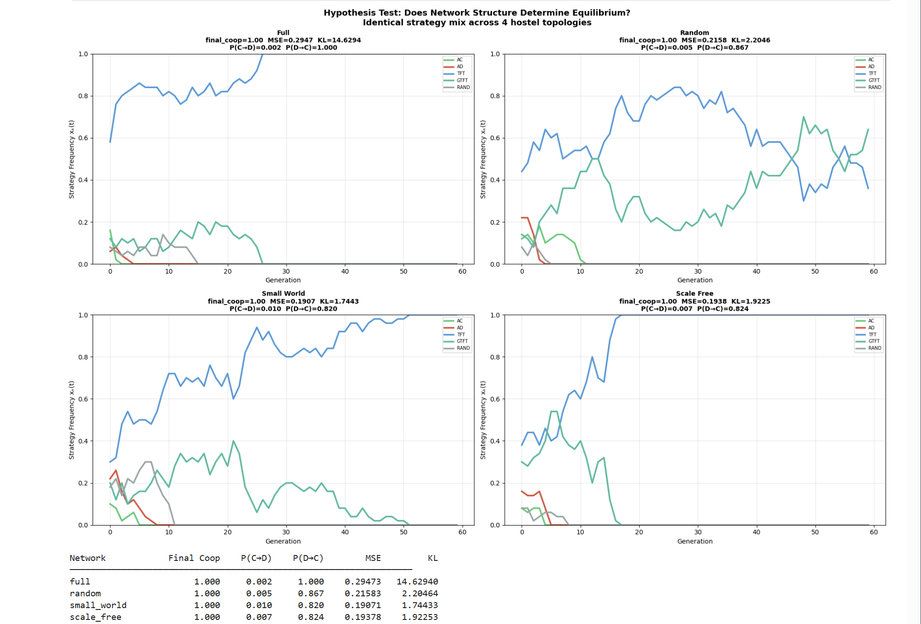

Slide 16
