Slide 1

SE101.3

Slide 2
Lecture 07
Multithreading

Slide 3
Multitasking and Multithreading
Multitasking:
refers to a computer's ability to perform multiple jobs concurrently
more than one program are running concurrently, e.g., UNIX
Multithreading:
A thread is a single sequence of execution within a program
refers to multiple threads of control within a single program
each program can run multiple threads of control within it, e.g., Web Browser

Slide 4
Concurrency vs. Parallelism
CPU
CPU1
CPU2

Slide 5
Threads and Processes
CPU
Process 1
Process 2
Process 3
Process 4
main
run
GC

Slide 6
What are Threads Good For?
To maintain responsiveness of an application during a long running task
To enable cancellation of separable tasks
Some problems are intrinsically parallel
To monitor status of some resource
Some APIs and systems demand it

Slide 7
Application Thread
When we execute an application:
The JVM creates a Thread object whose task is defined by the main() method
The JVM starts the thread
The thread executes the statements of the program one by one
After executing all the statements, the method returns and the thread dies

Slide 8
Multiple Threads in an Application
Each thread has its private run-time stack
If two threads execute the same method, each will have its own copy of the local variables the methods uses
Two different threads can act on the same object and same static fields concurrently

Slide 9
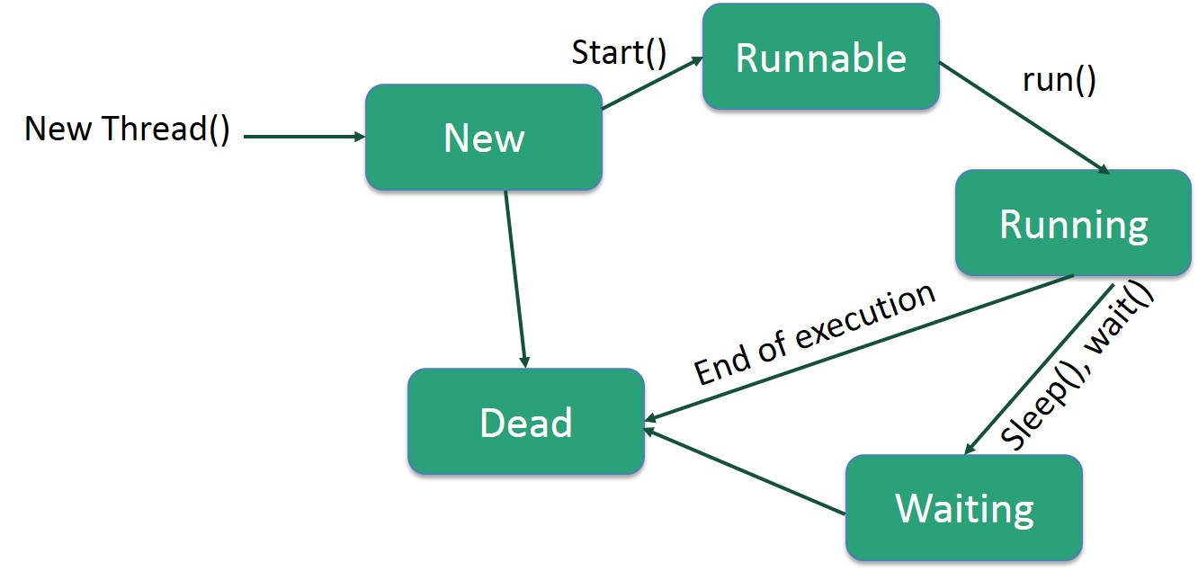
Life Cycle of a Thread

Slide 10
Creating Threads
There are two ways to create our own Thread object
Subclassing the Thread class and instantiating a new object of that class
Implementing the Runnable interface
In both cases the run() method should be implemented

Slide 11
Extending Thread
public class ThreadExample extends Thread {
public void run () {
for (int i = 1; i <= 100; i++) {
System.out.println(“---”);
}
}
}

Slide 12
Thread Methods
void start()
Creates a new thread and makes it runnable
This method can be called only once
void run()
The new thread begins its life inside this method
void stop() (deprecated)
The thread is being terminated

Slide 13
Thread Methods
void yield()
Causes the currently executing thread object to temporarily pause and allow other threads to execute
Allow only threads of the same priority to run
void sleep(int m) or sleep(int m, int n)
The thread sleeps for m milliseconds, plus n nanoseconds

Slide 14
Implementing Runnable
public class RunnableExample implements Runnable {
public void run () {
for (int i = 1; i <= 100; i++) {
System.out.println (“***”);
}
}
}

Slide 15
A Runnable Object
When running the Runnable object, a Thread object is created from the Runnable object
The Thread object’s run() method calls the Runnable object’s run() method
Allows threads to run inside any object, regardless of inheritance

Slide 16
Starting the Threads
public class ThreadsStartExample {
public static void main (String argv[]) {
new ThreadExample ().start ();
new Thread(new RunnableExample ()).start ();
}
}
What will we see when running
ThreadsStartExample?

Slide 17
Scheduling Threads
start()
Ready queue
Newly created
threads
Currently executed
thread
I/O operation completes
Waiting for I/O operation to be completed
Waiting to be notified
Sleeping
Waiting to enter a synchronized section

Slide 18
Thread State Diagram
isAlive()
Running
new ThreadExample();
while (…) { … }
New Thread
Runnable
Dead Thread
thread.start();
run() method returns
Blocked
Object.wait()
Thread.sleep()
blocking IO call
waiting on a monitor

Slide 19
Example
public class PrintThread1 extends Thread {
String name;
public PrintThread1(String name) {
this.name = name;
}
public void run() {
for (int i=1; i<100 ; i++) {
try {
sleep((long)(Math.random() * 100));
} catch (InterruptedException ie) { }
System.out.print(name);
}
}

Slide 20
Example (cont)
public static void main(String args[]) {
PrintThread1 a = new PrintThread1(“Th1");
PrintThread1 b = new PrintThread1(“Th2");
a.start();
b.start();
}
}

Slide 21
Th2
Th2
Th1
Th2
Th1
Th2
Th1
Th2
Th2
Th1
Th2
Th1
Th2
Th1
Th2
Th2
Th1
Th1
Th2
Th1
Th1
Th2
Th1
Th2

Slide 22
Thread Priority
Every thread has a priority
When a thread is created, it inherits the priority of the thread that created it
The priority values range from 1 to 10, in increasing priority

Slide 23
Thread Priority (cont.)
The priority can be adjusted subsequently using the setPriority() method
The priority of a thread may be obtained using getPriority()
Priority constants are defined:
MIN_PRIORITY=1
MAX_PRIORITY=10
NORM_PRIORITY=5

Slide 24
Daemon Threads
Daemon threads are “background” threads, that provide services to other threads,
e.g., the garbage collection thread
Daemon threads die when the Java VM exits
Thread priority is low

Slide 25
class WorkerThread extends Thread {
public WorkerThread() {
setDaemon(false) ;
}
public void run() {
int count=0 ;
while (true) {
System.out.println("Hello from Worker "+count++) ;
try {
sleep(5000);
} catch (InterruptedException e) {}
}
}
}

Slide 26
public class DaemonTest {
public static void main(String[] args) {
new WorkerThread().start();
try {
Thread.sleep(7500);
} catch (InterruptedException e) {}
System.out.println("Main Thread ending") ;
}
}

Slide 27
Thank You

