Slide 1

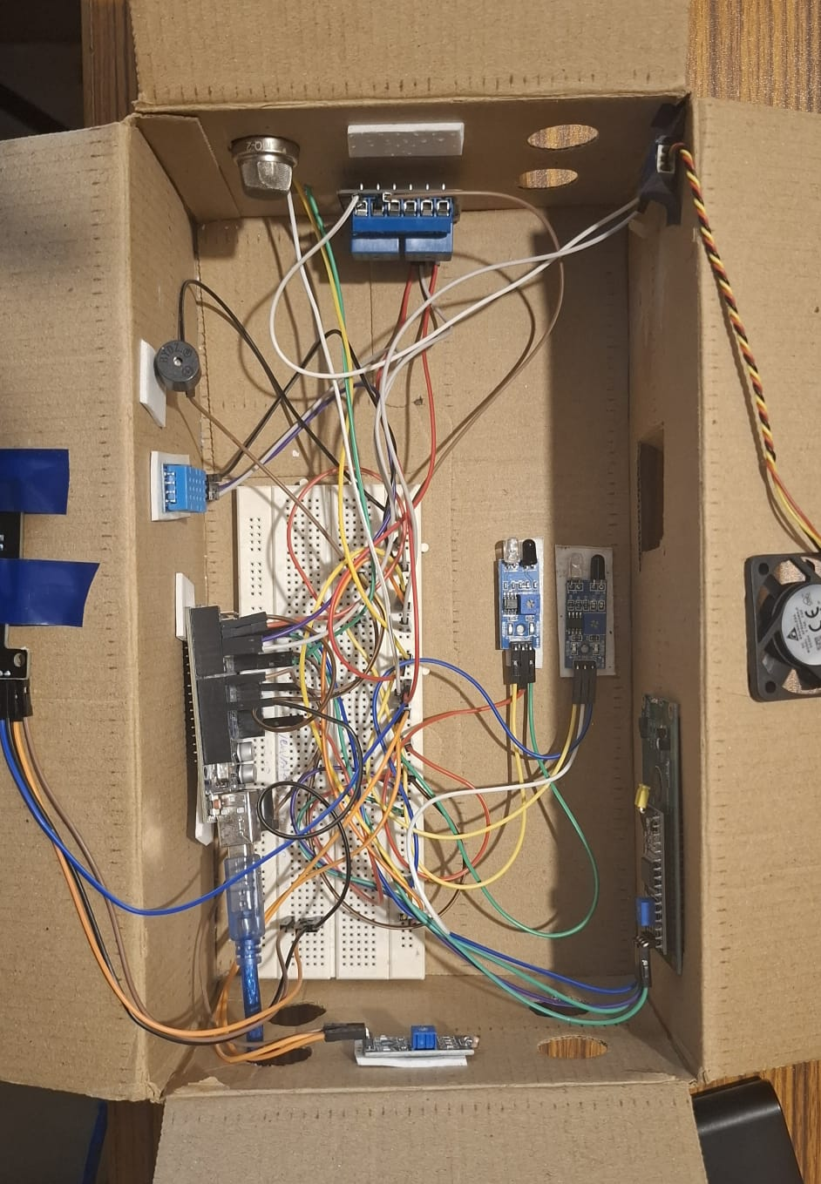

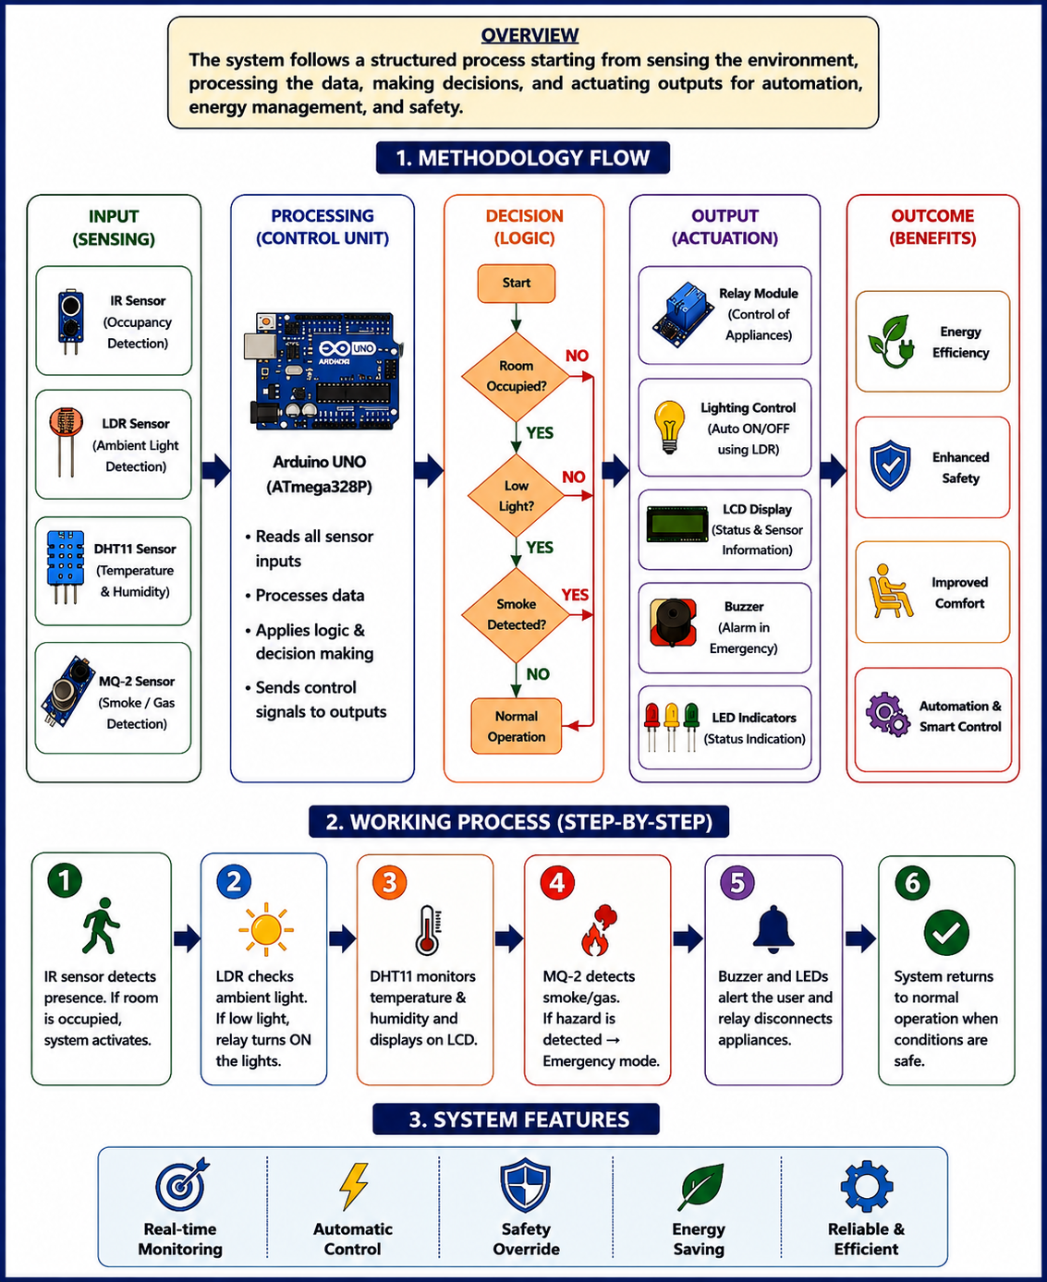

RV College of Engineering, Bengaluru – 560059.
Go, change the world
Smart Energy Management and Room Automation System
Branch: CS
Section: D
^{V}
IDEA LAB SEE Project - II SEM
Rohan G | Rohan kumar P | Prem chandra sagar V | R syed mohammed mahir
1RZ25CS139| 1RZ25CS140 | 1RV25CS134 | 1RV25CS139 Mentor Name Dr Gangadhar Angadi
Introduction
Results & Discussions
The Smart Energy Management and Room Automation System is an Arduino-based solution developed to improve energy efficiency, comfort, and safety in indoor environments. It uses an IR sensor for occupancy detection, an LDR sensor for automatic lighting control, a DHT11 sensor for temperature monitoring, and an MQ-2 sensor for smoke detection. The system automatically controls appliances, displays real-time information, and provides emergency alerts when hazardous conditions are detected.
Objectives
• To detect room occupancy automatically using an IR sensor.
• To implement smart lighting control using an LDR sensor for energy conservation.
• To monitor room temperature in real time using a DHT11 sensor.
• To detect smoke and provide immediate safety alerts using an MQ-2 smoke sensor and buzzer.
• To automate appliance control through a relay module based on sensor inputs.
• To enhance energy efficiency, user comfort, and safety through intelligent room automation.
Methodology
Successfully demonstrated real-time automation by integrating occupancy detection, smart lighting, temperature monitoring, and smoke detection into a single system
The prototype responded accurately and reliably to changing environmental conditions, ensuring efficient energy management and enhanced user safety.
Experimental evaluation confirmed the system as a cost-effective, scalable, and practical solution for smart home and office automation.
Occupancy detection was tested using the IR sensor and accurately identified room entry and exit events.
• The LDR sensor successfully controlled lighting based on ambient light conditions, turning lights ON in dark environments and OFF in bright conditions.
• Temperature readings obtained from the DHT11 sensor were displayed correctly on the LCD and remained consistent during testing.
• Smoke detection tests using the MQ-2 sensor successfully triggered the buzzer, red LED alert, and relay shutdown when the threshold value was exceeded.
• The integrated system operated reliably under different test scenarios, effectively improving energy efficiency, user comfort, and safety through intelligent automation.
Testing/Validation & Feedback
Measurable Outcomes
• Successfully detected room occupancy using an IR sensor with automatic system activation.
• Achieved automatic lighting control based on ambient light intensity using an LDR sensor.
• Monitored and displayed real-time room temperature using a DHT11 sensor.
• Detected smoke levels above the predefined threshold and triggered emergency alerts.
• Automatically disconnected electrical loads during hazardous conditions using a relay module.
Empirical, Calculations, Tools & Techniques
References
Tools Used
• Arduino Uno Microcontroller
• Arduino IDE
• DHT11 Temperature Sensor
• IR Sensor
• LDR Sensor
• MQ-2 Smoke Sensor
• LCD 16×2 I2C Display
• Buzzer and LEDs
Techniques Used
• Occupancy-Based Automation
• Sensor Data Acquisition and Processing
• Threshold-Based Decision Making
• Automatic Lighting Control
• Real-Time Environmental Monitoring
• Smoke Detection and Emergency Alert Mechanism
• Embedded System Programming using Arduino C++
[1] Arduino Uno Datasheet, Arduino Documentation, Arduino.cc.
[2] DHT11 Temperature and Humidity Sensor Datasheet, Aosong Electronics.
[3] MQ-2 Smoke Sensor Datasheet, Winsen Electronics.
[4] Arduino IDE Documentation, Arduino Software Platform.
[5] LiquidCrystal_I2C Library Documentation, Arduino Libraries
QR codes
2024-2025

