Slide 1


Team Edafos
Soil Health
Priyanka swami
Deepak Pandey
Pradeep Ram
S S Yaswanth Tippireddy
Rohankant C Tatelu

Slide 2
Context-Soil testing
Current Scenario
Solution
?
Slow collection of soil samples
Sharing results
Understanding and implementing the results
Mobility to laboratories
High testing cost
Continuing the practice in long term

Slide 3
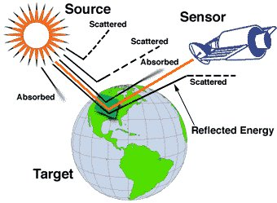
Remote sensing
Cost effective
Easy to access
Quick and easy to Scale

Slide 4
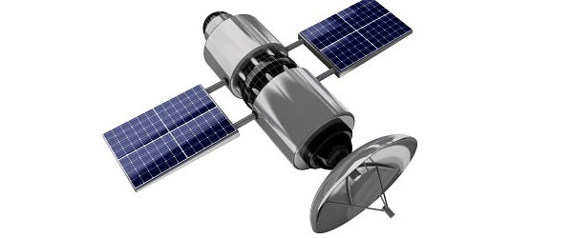
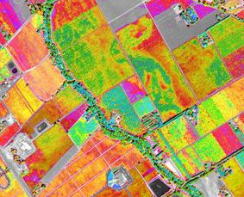
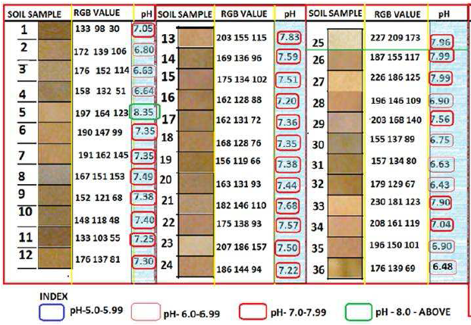
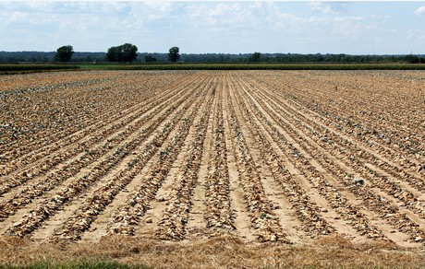
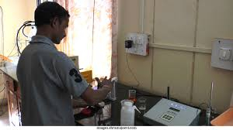
Working model

Slide 5
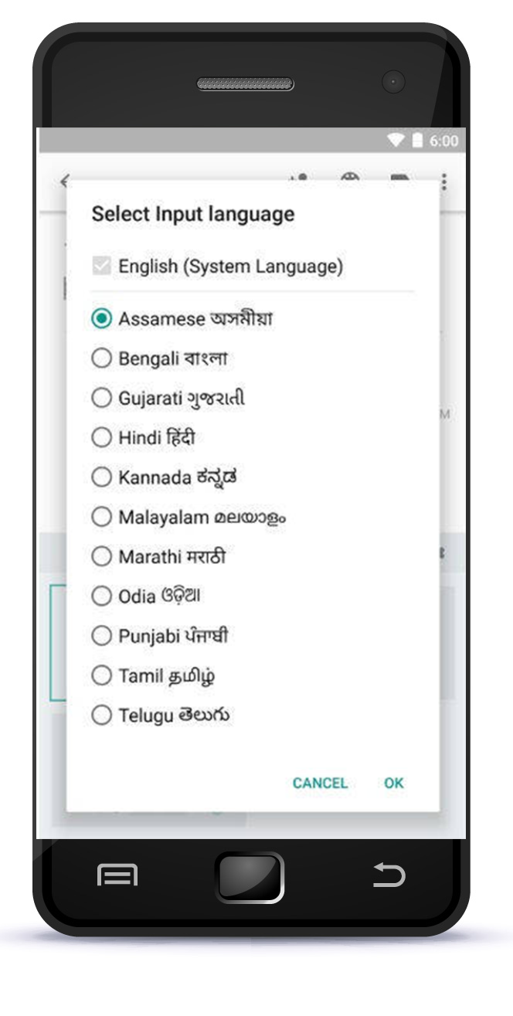

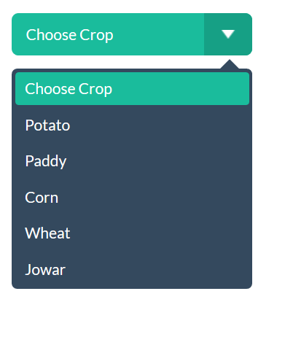
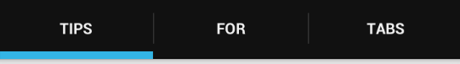
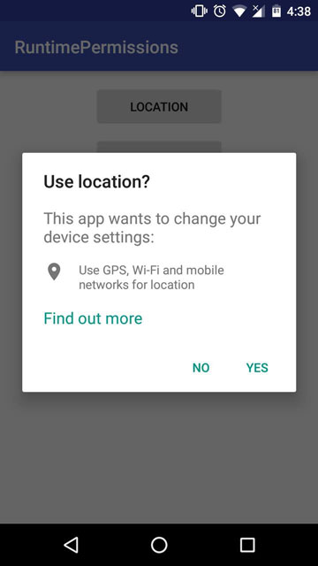
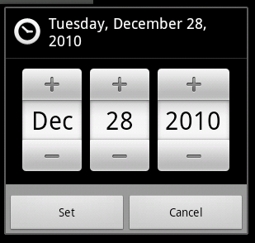
The App
Parameter
Organic manure | 5 ton/ha
Lime | -
Gypsum | -
N | 35 kg/ha
P₂O₅ | 50 Kg/ha
K₂O | 35 Kg/ha
Ca | -
Mg | -
S | -
Zn | 20 Kg/ha
B | -
Fe | -
At Sowing
After 15 Days
After 30 Days
Select Sowing Date

Slide 6
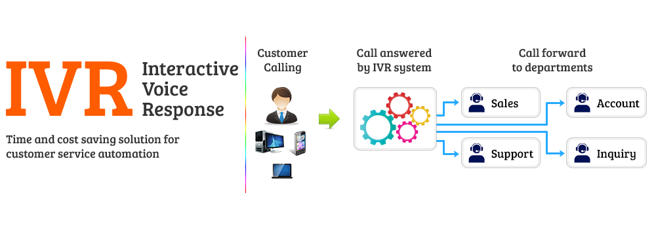
The Feature phone farmers
One time registration and farm plot mapping using smartphone
Reminders in local languages
IVR Systems for communications
Customer support helpline

Slide 7
Revenue streams
Product portfolio
Target consumer
Value proposition
Soil testing and Advisory services
Farmers
Cost cutting and increased productivity through holistic soil management advisory
Field staff training programmes
Agri companies with crop development programs
Comprehensive training programs to increase the field staff’s expertise in soil health management
Data selling
Agri companies with own supply chains for procurement
Increased traceability and better compliance with safety standards
Advertising crop inputs on the App
Farmers and Suppliers
Better prices for farmers and targeted reach for suppliers

Slide 8
18000 farmers in first year
5.5 lakh farmers in five years
Starting with pulse and oil seed growing areas having low productivity
Free trial for one crop cycle
INR 100 for subsequent cycles

