Slide 1
IOT Weather Station Architecture
LAB 1 DEV302x Microsoft Professional Capstone
Rohan Menon 7181D4C0

Slide 2
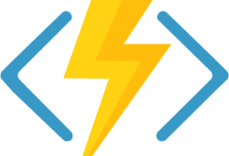


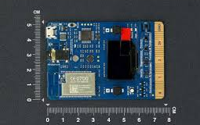

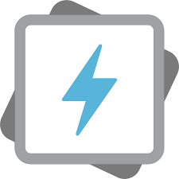
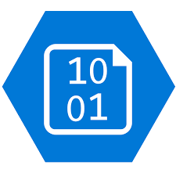
Weather Station Architecture for POV
Update MX Chip Device Twin Desired State in IOT hub based on WindSpeed Telemetry received from MX Chip
Azure Function
Stream processing and
rules evaluations of data
IOT Hub
Stream Analytics
Securely provision and send data from Device to Cloud and Cloud to Device
Output pre selected telemetry data from MX Chip to Azure functions to trigger action on IOT hub
Cold Path data store
Azure Data Lake Storage Gen 1
Data Lake Analytics
Telemetry/Device Properties Update
MX Chip
Run query on historical data
Things
Insights
Actions

Slide 3
Reasons for choosing the sub systems
Weather Station - MX Chip – can simulate the sensor data required from Wind turbine and also change device properties remotely through C2D communication
IOT hub offers – secure device to cloud communication, device management, capturing telemetry data and cloud to device communication
Stream Analytics – helps to transfer data from IOT hub to required desired Azure services for further processing. Stream Analytics can also do basic transformation of the transferred data.
Azure Functions – serverless and cost effective app service to trigger a task, in this case updating the device twin of the MX Chip device in IOT hub based on analysing windspeed telemetry coming from Stream Analytics
Data Lake Storage - Azure Data Lake can store nearly unlimited amounts of data cost effectively and features that make it ideal for data analytics. Supports JSON format
Data Lake Analytics – helps to run queries on the Data Lake Storage using U-SQL queries and download the analysis to csv files

