Slide 1
IOT Architecture
LAB 1 DEV302x Microsoft Professional Capstone
Rohan Menon 7181D4C0

Slide 2
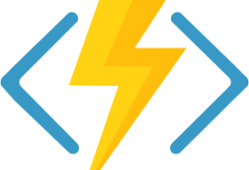

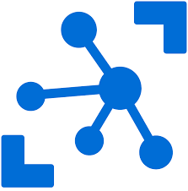
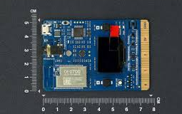

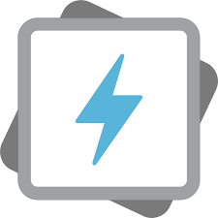
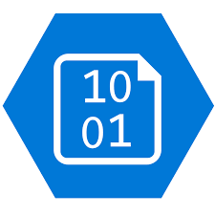
Weather Station Architecture for POV
Update Device Twin Desired State based on
Azure Function
IOT Hub
Stream Analytics
Stream processing and
rules evaluations over data
Provision and send data from devices to Cloud
Cold Path Store data
Azure Data Lake Storage Gen 1
Data Lake Analytics
Telemetry/Direct Methods/Device management
MX Chip
Things
Insights
Actions

Slide 3
Reasons for choosing the sub systems
MX Chip – can simulate the sensor data required from Wind farm
IOT hub offers – secure device to cloud communication, device management, capturing telemetry data and cloud to device communication
Stream Analytics – helps to transfer data from IOThub to required desired Azure services for further processing. Stream Analytics can also do basic transformation of the transferred data.
Azure Functions – help to trigger a task, in this case updating the device twin of the MX Chip device based on analysing the data coming from Stream Analytics for a specific condition
Data Lake Storage - Azure Data Lake can store nearly unlimited amounts of data (like Blob Storage), but it has other features that make it ideal for data analytics.
Data Lake Analytics – helps to run queries on the Data Lake Storage using U-SQL queries and download the analysis to csv files

