Slide 1
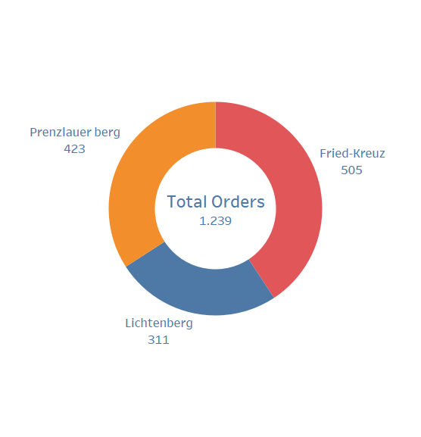
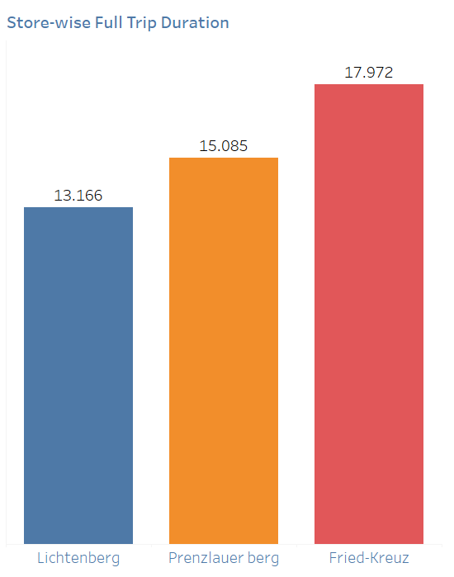
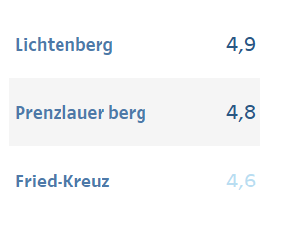
Getir Stores Dashboard
Orders
Ratings
Lichtenburg Store received 4.9/5 ratings in last three days, best among the three stores.
Fried-Kreuz Store received maximum orders in last three days
In the previous three days, Lichtenburg Store has the best average full trip duration of 13.166 minutes out of the three stores.

Slide 2
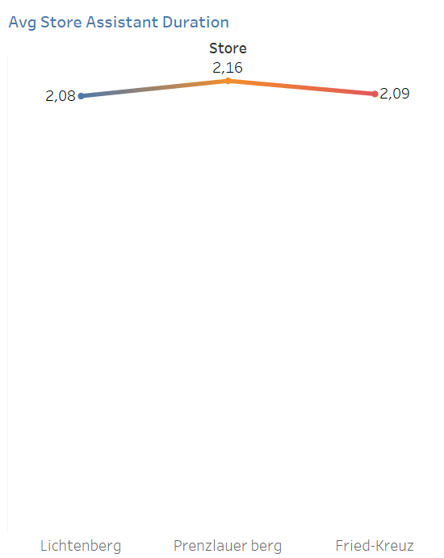
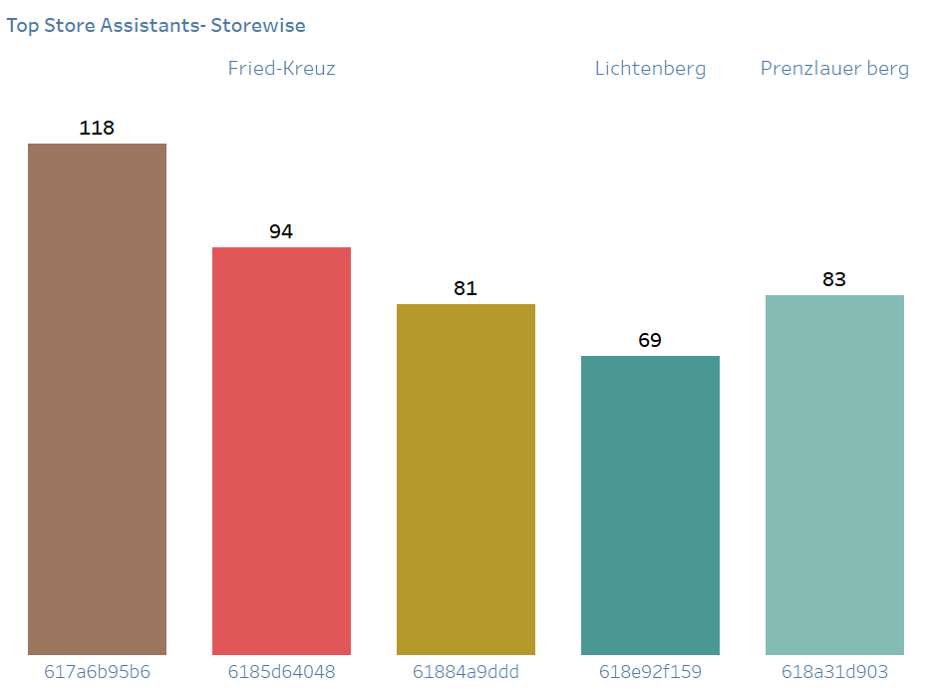
Getir Stores Dashboard
Findings:
In the previous three days, All the three Stores has the best average full trip duration more than 10 minutes which is more than the company’s minimum order delivery criteria of 10 minutes.
Recommendation:
All the three stores must improve the KPI of delivery of orders within 10 minutes.
Findings:
In the previous three days, All the three Stores has the best average store assistant duration more than 2 minutes.
Recommendation:
The Store assistant duration should be minimum so that the overall delivery time can be improved.
Lichtenburg and Fried-Kreuz Store has the best average assistant duration in last three days
Store Assistant 617a6b95b6 form Fried-Kreuz store packed most number of orders in the last three days followed by 6185d64048 with 94 orders at the same store.

Slide 3
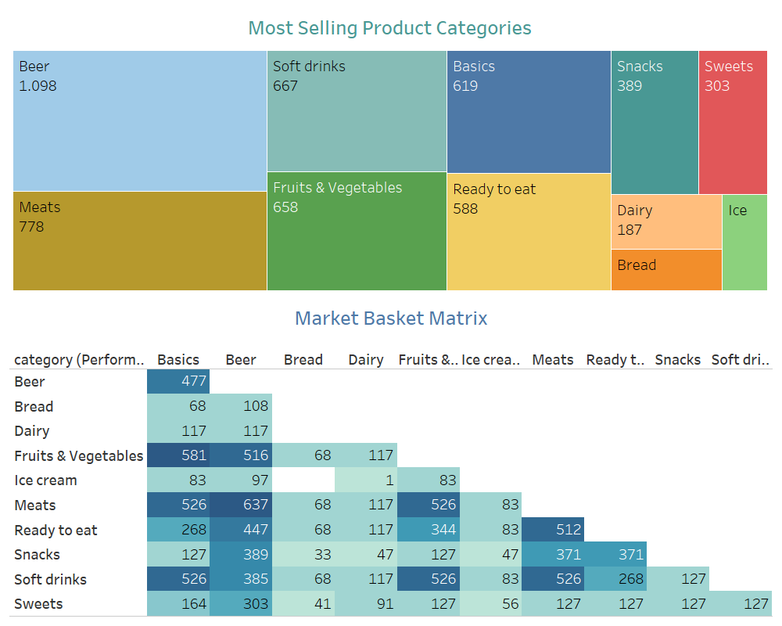
Getir Orders Dashboard
Findings:
Beer is the most sold product category followed by Meats and Soft drinks in the last three days
Recommendations:
At the store, all these categories products should be kept in the vicinity of each other to have order preparation time minimum.
Also, the company can promote these categories products for more sales through discounts, offers etc.
Findings:
The categories [Beer, Meats] are the most purchase together by customers followed by [basics, fruits & Vegetables] category in the last three days

