Slide 1
Proximity Sensing Cap for the Visually Impaired

Slide 2
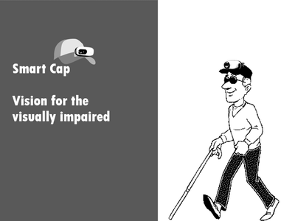
About
Good Vision is a precious gift, but unfortunately loss of vision is becoming common these days. Our prototype, Proximity Sensing Cap is built for the aid of visually impaired individuals for navigation and obstacle/surrounding detection.

Slide 3


Components
The components used for this project are :
Development Board Arduino Uno.
Sensors Ultrasonic Sensors - “HC-SR04” x 3
Others 1. LRA Vibrators x 2
2. Buzzer x 1
3. 9V Battery

Slide 4
Code
#define trigPin1 2
#define echoPin1 3
#define trigPin2 4
#define echoPin2 5
#define trigPin3 6
#define echoPin3 7
#define vibrator1 9
#define vibrator2 11
#define buzzer 13
void setup(){
pinMode(trigPin1, OUTPUT);
pinMode(echoPin1, INPUT);
pinMode(trigPin2, OUTPUT);
pinMode(echoPin2, INPUT);
pinMode(trigPin3, OUTPUT);
pinMode(echoPin3, INPUT);
pinMode(vibrator1, OUTPUT);
pinMode(vibrator2, OUTPUT);
pinMode(buzzer, OUTPUT);
Serial.begin(9600);}

Slide 5
void loop(){
long duration, distance;
digitalWrite(trigPin1, LOW);
delayMicroseconds(2);
digitalWrite(trigPin1, HIGH);
delayMicroseconds(1);
digitalWrite(trigPin1, LOW);
duration = pulseIn(echoPin1, HIGH);
distance = (duration/2) / 29.1;
if(distance>=10 && distance < 100){
digitalWrite(buzzer,HIGH);
Serial.println(distance);}
else if(distance >=100 && distance <150){
digitalWrite(buzzer,HIGH);
delay(100);
Serial.println(distance);
digitalWrite(buzzer,LOW);}
else if (distance>=160){
digitalWrite(buzzer,LOW);
Serial.println(distance);}
delay(200);
digitalWrite(trigPin2, LOW);
delayMicroseconds(2);

Slide 6
digitalWrite(trigPin2, HIGH);
delayMicroseconds(1);
digitalWrite(trigPin2, LOW);
duration = pulseIn(echoPin2, HIGH);
distance = (duration/2) / 29.1;
if (distance < 70){
digitalWrite(vibrator1,HIGH);}
else{
digitalWrite(vibrator1,LOW);
} delay(200);
digitalWrite(trigPin3, LOW);
delayMicroseconds(2);
digitalWrite(trigPin3, HIGH);
delayMicroseconds(2);
digitalWrite(trigPin3, LOW);
duration = pulseIn(echoPin3, HIGH);
distance = (duration/2) / 29.1;
if (distance < 70){
digitalWrite(vibrator2,HIGH);}
else{
digitalWrite(vibrator2,LOW);
} delay(200);}

Slide 7
Project By :
SALONI GOVIL
01FB16ECS333
ROHAN MOHAPATRA
01FB16ECS307
SAKSHAM GOYAL
01FB16ECS332
SAILESH GADDALAY
01FB16ECS331

