Slide 1

Problem Statement and Team Details
Problem Statement: AI-Powered EdTech Platform With interactive 3D AI professor.
Team Name: Code Core
Team Leader Name: Deepak Singh Jeena
Institute Name: Indraprastha Engineering College Ghaziabad
Team Leader Email ID: jeenad36@gmail.com

Slide 2
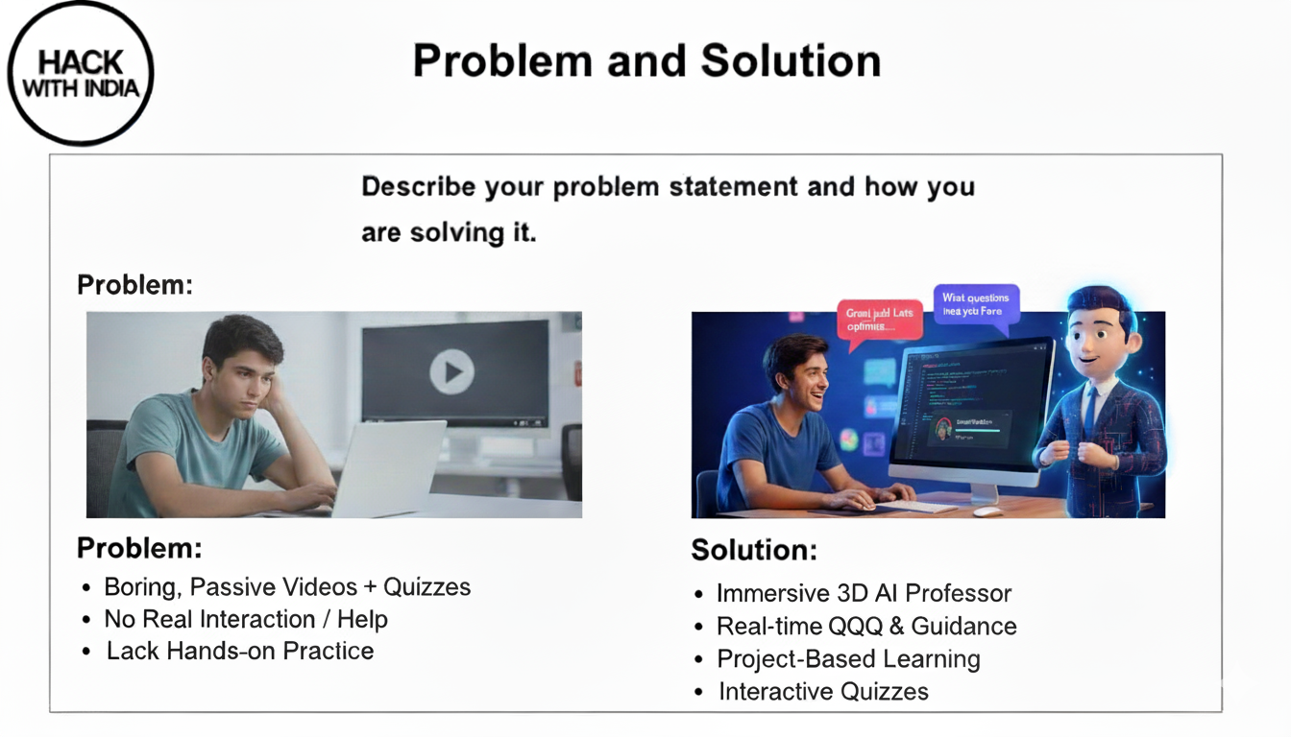

Slide 3
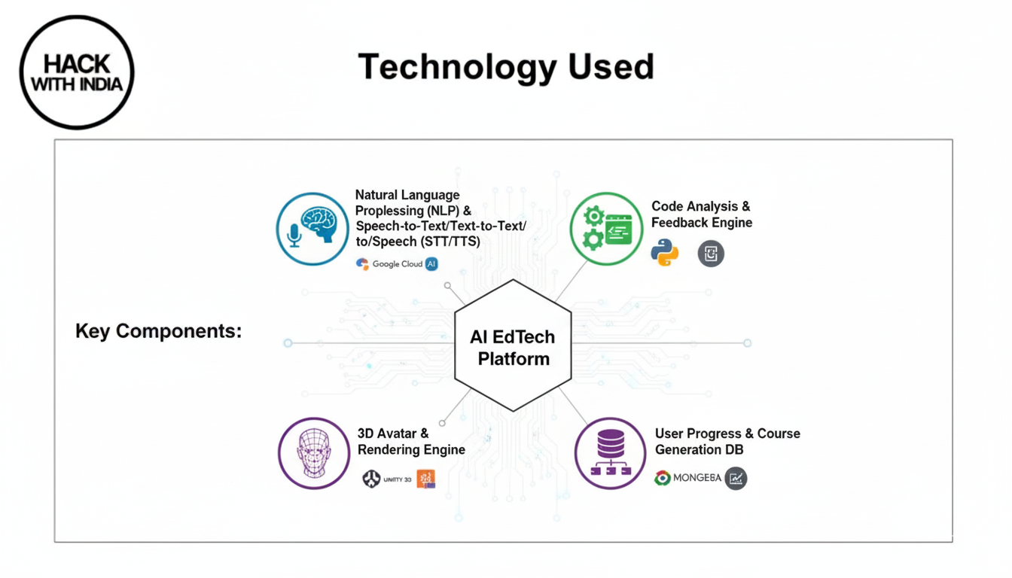

Slide 4
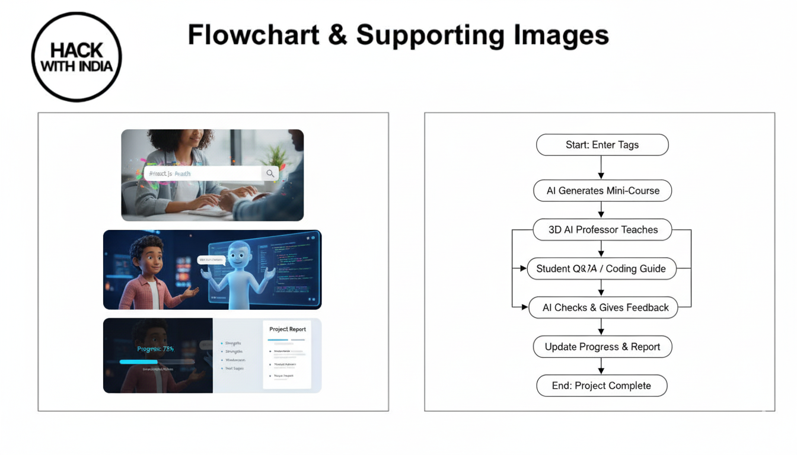

Slide 5
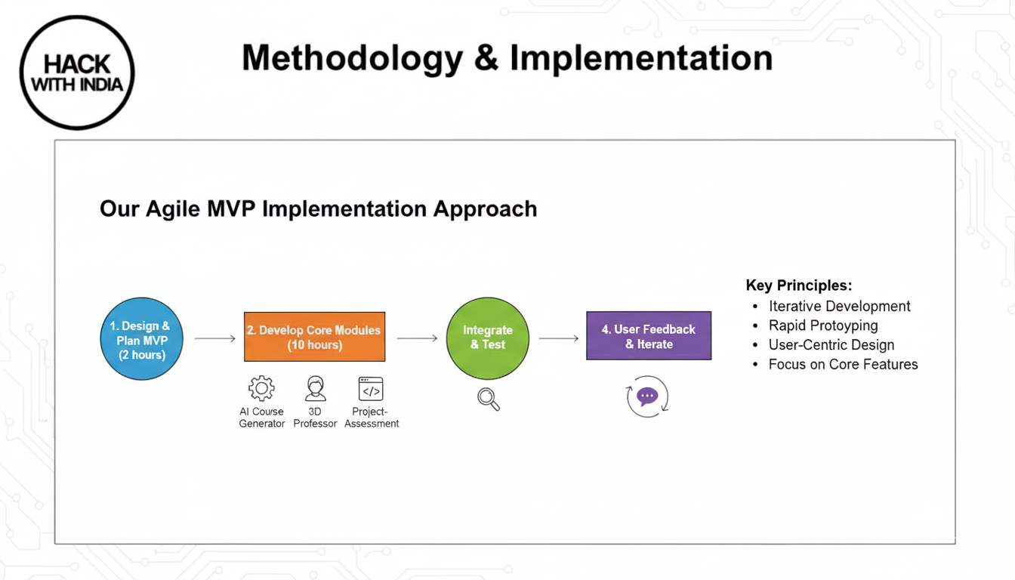

Slide 6
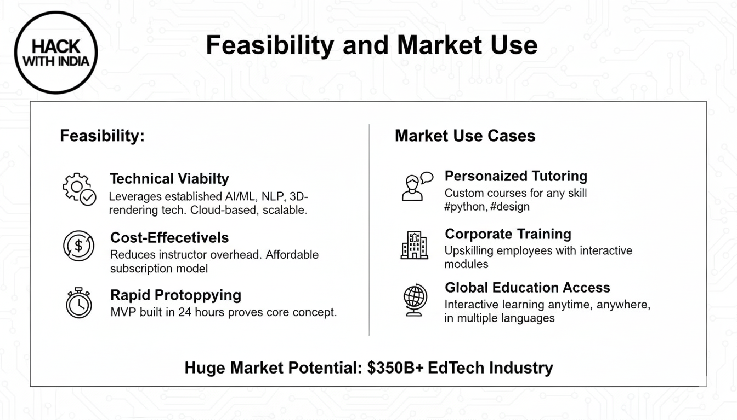

Slide 7
