Slide 1
Serverless

Slide 2
What is Serverless
Compute Engine
No Server to provision or manage
Auto Scale with usage
Availability and fault tolerance is built-in
Pay for use
FaaS (Function as a service)

Slide 3
Types
AWS Lambda
GCP Cloud Function
Hauwie FunctionGraph

Slide 4
AWS Lambda
One of the AWS Compute Service
Automated Version of EC2
Background tasks
Need aws IAM role to execute lambda functions.
Entry point of the lambda function is defined under handler of the format: script_name.function_name

Slide 5
Creation
Using Inline Editor
Upload zip
Upload via s3: applicable when zip size is above 50 MB. Bucket should be in same region of lambda.

Slide 6
Anatomy of Lambda Function
Handler Function: Entry point to lambda function
Event Object : Pass data to lambda function.
Context Object: Provides runtime information.
https://docs.aws.amazon.com/lambda/latest/dg/python-context-object.html
Can return value depending on invocation type.

Slide 7
Layers
Packages that can be shared across lambda functions.
Not applicable if zip file is used.
The combined size of packages(zip) and lambda layers shouldn’t exceed 250MB.
Packages are zipped structure as follow:
/python/lib/python3.6/site-packages/..
Install python packages in the above dir structure zip and upload as layers
Note
C packages such as numpy, pandas need to be compiled in amazon ec2 linux instances.
Python packages can be compiled in any system with runtime same as one provided in console.

Slide 8
Invocation
Lambda function can be invoked in the following two ways:
Synchronous:
Using aws cli:
aws lambda invoke –function-name <..> —invocation-type RequestResponse --payload ‘{“key”:”value”}’
Output is written to response.json
Using boto3 client:
CLIENT.invoke(
FunctionName='rndRegionGoogleSerp',
InvocationType='RequestResponse',
LogType='Tail',
Payload=json.dumps(payload)
)
Using AWS API gateway

Slide 9
Invocation (contd.)
Asynchronous:
Using aws cli:
aws lambda invoke –function-name <..> --invocation-type Event --payload ‘{“key”:”value”}’
response.json is created but doesn’t contain anything.
Using boto3 client:
CLIENT.invoke(
FunctionName='rndRegionGoogleSerp',
InvocationType='Event',
LogType='Tail',
Payload=json.dumps(payload)
)
Triggers such as Cloudwatch events, s3 file change, etc

Slide 10
Some Helpful aws cli commands
aws lambda list-functions
aws lambda get-function –function-name <..>
Aws lambda delete-function –function-name <..>
aws lambda invoke –function-name <..> —invocation-type RequestResponse/Event --payload ‘{“key”:”value”}’

Slide 11
Reading and Writing df to s3
Reading:
Using S3 key url :
df = pd.read_csv(‘https://bucket.s3.amazonaws.com/prefix/filekey.tsv’, sep=’\t’)
Using boto3 client :
s3_client = boto3.client(‘s3’)
response = s3_client.get_object(BucketName, key)
df = pd.read_csv(response[‘Body’], sep=’\t’)
Writing:
Using Buffer
from io import StringIO
csv_buffer = StringIO()
df.to_csv(csv_buffer, index=False, sep=’\t’)
s3_res = boto3.resource(‘s3’)
s3_res.Object(BucketName, key).put(Body=csv_buffer.getValue())

Slide 12
Reading and Writing df to s3 (contd)
Writing:
Using temp folders:
In Lambda, we only have write permission on temp folder (/tmp)
Write file to temp folder using python file object
Copy file to s3
s3_resource = boto3.resource("s3")
s3_resource.Object(bucket_name, key).upload_file(Filename=local_lambda_tmp_file)

Slide 13
Scrapping using AWS Lambda
The lambda handler along with any supporting scripts should be under src folder.
Installation Steps:
Firslty, we need to create a project zip since lambda only allows upload upto 50MB for raw file.
make build-lambda-package
cleans project and download the necessary chrome binary and its headless sibling.
Finally create a zip file that needs to be uploaded to s3 to be used by aws lambda
upload the zip to s3 bucket
In aws lambda:
in the Code entry type > select s3 upload and provide the object url of the s3 object uploaded.
we also need to set two environment variables as mentioned:
PYTHONPATH = /var/task/src:/var/task/lib
PATH = /var/task/bin
Write output to s3.

Slide 14
AWS lambda Limitations
The combined size of lambda package and layers cannot exceed 250MB.
Max concurrency of 1000
Max timeout of 15 minutes
Max Ram size of 3GB

Slide 15
GCP Cloud Function
GCP alternate to aws lambda
Entry point is main.py
Unlike in aws lambda, requirements.txt is entered in the console itself for inline editing and is kept in the same folder level as main.py when uploading via zip.
No concept of layers

Slide 16
Creation
Using Inline Editor
Zip upload to Cloud Function
Zip upload to Cloud Storage

Slide 17
Anatomy of cloud Function
The handler function is given in console during creation of cloud function which should be present in main.py
Only request object is input parameters to the entry point function. This object is analogous to flask request object. All inputs to the cloud function is given via this request object.

Slide 18
Invocation
Synchronous
GCP_ENDPOINT = 'https://us-east1-gbd-research.cloudfunctions.net/rnd_amazon_serp_result_query'
HEADERS = {'content-type': 'application/json'}
resp = requests.post(GCP_ENDPOINT, json = query, headers=HEADERS)
Asynchronous
GCP_ENDPOINT = 'https://us-east1-gbd-research.cloudfunctions.net/rnd_amazon_serp_result_query'
HEADERS = {'content-type': 'application/json'}
resp = requests.post(GCP_ENDPOINT, json = query, headers=HEADERS, timeout=REQUEST_TIMEOUT)

Slide 19
Writing to Cloud Storage
Writing:
Using temp folders:
In cloud fucntion, we only have write permission on temp folder (/tmp)
Write file to temp folder using python file object
Copy file to cloud storage
from gcloud import storage
client = storage.Client()
bucket = client.get_bucket(BUCKET_NAME)
blob = bucket.blob(output_file_path) # remote file path
blob.upload_from_filename(filename=local_tmp_file_path)

Slide 20
Scrapping using Cloud Function
Installation Steps:
Firstly, we need to create a project zip. The code doesn’t need to be under src folder.
Run make fetch-dependencies which will download the required chrome binary and its headless sibling under bin folder.
Here the requirements.txt is file itself and we do not need to install the packages ourselves like in lambda
Create a zip file that needs to be uploaded
In cloud function:
we also need to set one environment variable as mentioned:
PYTHONPATH = /user_code:/user_code/lib
Unlike in aws lambda, we cannot override env variable PATH which is why the required file paths is present in the script main.py itself.
Write output to cloud storage.

Slide 21
GCP Cloud Function Limitations
Only python runtime available is 3.7.
No concept of layers.
Max timeout of 9 minutes.
Max Ram size of 2GB.

Slide 22
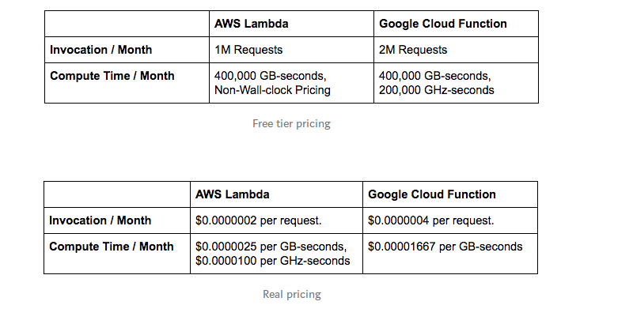
Pricing

