Slide 1
Grantha
An unsupervised grouping study of heritage documents by topic
SIH26096 · Hierarchical and density clustering, PCA visualisation
Rajith Sundar · Etikala Sai Pranav · Vemuri Rohan
Notes:
Introduce the team and the problem in one line: old scanned Indian books have no subject labels; we group them by topic without labels and let anyone place a new page among the groups.

Slide 2
Old scans have no subject labels
Indian digital archives hold hundreds of thousands of scanned books with a title, a language tag and the scanning centre, but no subject.
A reader holding one scan cannot find the books it belongs with.
Input: a page image, a PDF or pasted text, in 8 languages.
Output: its topic group from two methods, other groups it is close to, the 5 closest archive books (often in other languages), and its place on the PCA map.
It abstains when the OCR is too weak to judge.
2,578
printed books grouped, in 8 languages
0
labels used to form the groups
58.7%
subject right on unseen test books (simple guess 48.0%)
Grantha · SIH26096
Notes:
Rohan. The user is an archivist or researcher holding an unindexed scan. Show the input and output, and stress that nothing is retrained when a page is checked.

Slide 3
Data: a stratified sample of 3,000 real books
Digital Library of India scans on the Internet Archive: ~434,000 eligible books in our 8 languages.
375 books per language, seeded draw across 5 era bands (to 1960, plus undated).
Text: the archive's whole-book OCR for 2,971 books; 5 pages per book re-read with Tesseract for quality and upload tests.
Split 60 / 20 / 20 into train, validation, test before any result; every fit on train only.
Rights: only OCR text, catalogue fields and links are kept. No scans are redistributed.
Language | Readable | Median OCR conf.
Bengali | 359 of 375 | 73
English | 370 of 375 | 92
Gujarati | 352 of 375 | 72
Hindi | 333 of 375 | 76
Kannada | 326 of 375 | 75
Sanskrit | 281 of 375 | 61
Tamil | 296 of 375 | 63
Telugu | 261 of 375 | 55
Grantha · SIH26096
Notes:
Rajith. Source, sample design, splits. About 434,000 eligible books in the 8 languages; equal shares per language so English (58% of the pool) does not dominate.

Slide 4
OCR and preprocessing
3 → 43
23 → 73
2,578
Gujarati pilot books read with the Gujarati model, out of 50, after the confidence check
OCR confidence on a Tamil upload the script detector had called Latin
of 3,000 books readable (confidence ≥ 50, ≥ 100 clean words)
Tokens: [\p{L}\p{M}]+ keeps Indic vowel signs inside words; stopwords learned per language (a term in > 30% of that language's books).
Relevance: the archive's subject field is the scanning centre, so it was dropped as leakage. Missing years: median plus a flag. Scaling: standardise.
Metadata added to the text swamps it (91% of books in one group at weight 1), so the study clusters text alone.
Grantha · SIH26096
Notes:
Rajith. Tesseract's script detector misroutes Gujarati and once called a Tamil scan Latin; both fixes choose the model by OCR confidence. Tokeniser keeps vowel signs; stopwords learned per language; subject field = scanning centre, dropped.

Slide 5
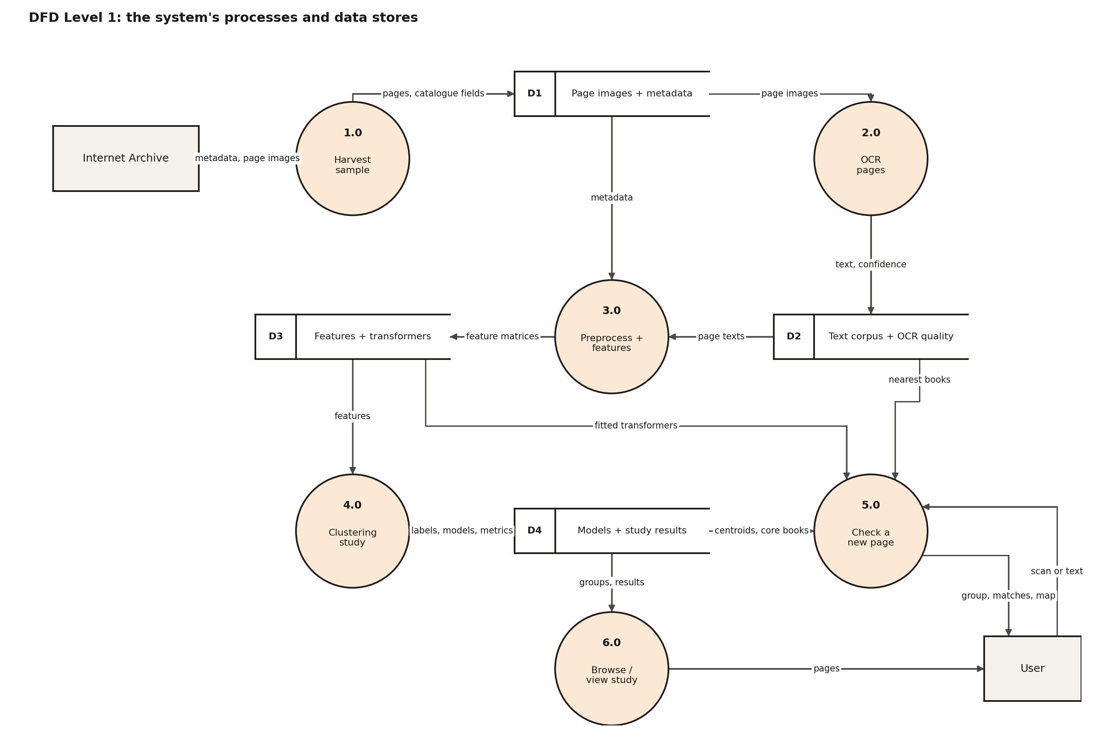
System design
Python 3.12, Tesseract 5, scikit-learn, SciPy.
Gemini Embedding 001 through Google's API; local encoders compared on a GPU.
FastAPI serves the API and a static website.
Docker: app image (1.1 GB) and a pipeline image that reruns the study.
40 pytest tests; 66 app checks.
Grantha · SIH26096
Notes:
Rohan. Walk the Level 1 DFD: harvest, OCR, preprocess and features, clustering study, check a new page, browse. Level 0 and Level 2 diagrams are in the report.

Slide 6
First result: groups followed language, not topic
1.00
+3 pts
0.14
TF-IDF groups vs script (NMI): every group is one script
v1 subject accuracy over guessing from the script
silhouette of the language-like groups: higher, for the wrong reason
Multilingual encoders place each language in its own region; the biggest distances are language distances.
Fix 1: subtract each language's average position (train books only). A new page is centred by its OCR language.
Fix 2: choose the encoder by how much topic it carries, measured before clustering.
The clustering methods and the silhouette-based choice stay exactly as the brief asks.
Grantha · SIH26096
Notes:
Pranav. The brief asks for grouping by TOPIC. Version 1 grouped by language. TF-IDF groups were exactly the scripts; LaBSE groups beat a 'subject from script' guess by only 3 points. Silhouette made it worse: language groups are far apart, so they score higher.

Slide 7
Choosing the encoder
Encoder | As is | Language removed
gemini-embedding-001 | 63.9% | 75.0%
BAAI/bge-m3 | 60.7% | 68.2%
sentence-transformers/LaBSE | 60.9% | 64.9%
l3cube-pune/indic-sentence-similarity-sbert | 55.8% | 64.5%
multilingual-e5-large (325 books) | 57.2% | 65.8%
Removing the language adds 4 to 11 points to every encoder.
Gemini Embedding 001 (Google, online) leads by ~7 points over the best open model.
Labels only measure; they never form or choose the groups.
Grantha · SIH26096
Notes:
Pranav. Score: how often a book's subject matches its 7 nearest neighbours, on labelled train and validation books only. It is the ceiling for any grouping. Removing the language helps every model; Gemini carries the most topic. Trade-off: it is closed and online.

Slide 8
Two feature sets, two methods, rules fixed in advance
 | A: TF-IDF + LSA | G: Gemini, language removed
Built from | word 1–2-grams + character 3–5-grams | 10 passages per book, averaged, language mean removed
Reduced to | 100 dims (SVD, 47% of variance) | 100 dims (PCA, 77% of variance)
Hierarchical | Ward, average, complete; k = 2–15 | Ward, average, complete; k = 2–15
DBSCAN | 24 eps × MinPts from k-distance curves | 24 eps × MinPts from k-distance curves
Metric: Euclidean vs Manhattan on 4 pre-set criteria (Euclidean wins 3 of 4 on both).
Final choice: highest silhouette among settings with script NMI ≤ 0.5 and bootstrap ARI ≥ 0.5. TF-IDF (silhouette 0.228) fails: its groups are scripts.
Chosen on train books, then refitted on all books without re-choosing.
Grantha · SIH26096
Notes:
Pranav. Every choice (metric, setting, final feature set) is made by a rule written before the run. Silhouette picks, under two limits: groups must not just follow script, and must survive resampling.

Slide 9
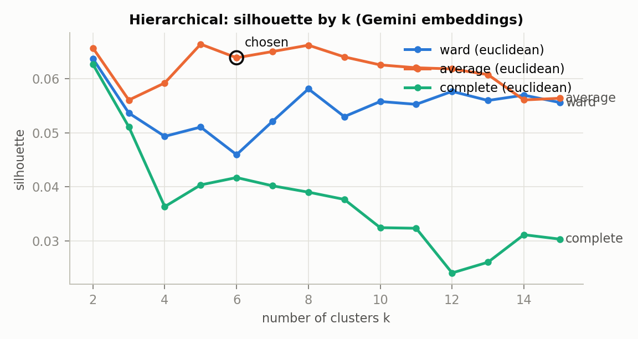
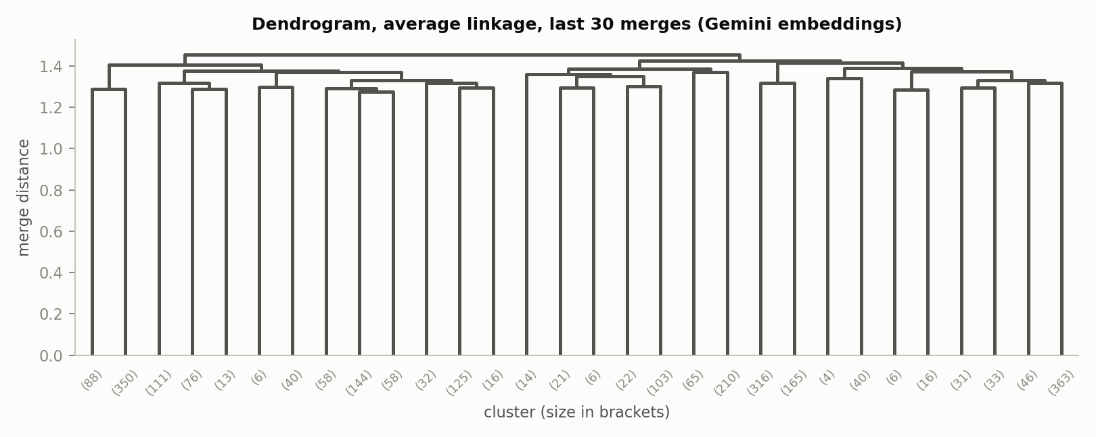
Hierarchical clustering
Gemini: average linkage, k = 6, silhouette 0.072 on train, 0.064 refitted on all books.
Groups barely follow script (NMI 0.05) and follow the catalogue subject more than any other grouping (0.19).
Valid setting: k ≥ 3 and every group at least 1% of the books.
Grantha · SIH26096
Notes:
Pranav. Silhouette picked average linkage with 6 groups on the train books, with no floor on k. Silhouettes are low because topics overlap; the old 0.14 came from language separation.

Slide 10
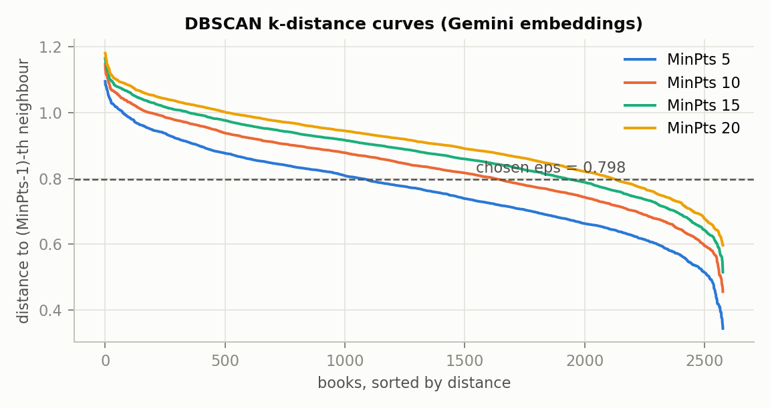
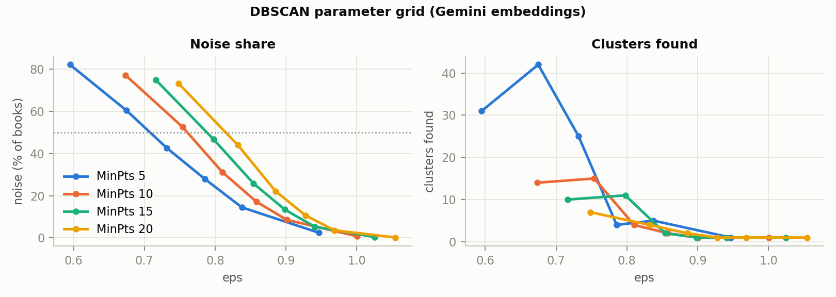
DBSCAN: narrower dense topics
MinPts 15, eps 0.798: 11 dense groups, 47% noise (version 1: 2 groups).
Groups include medicine, Buddhist scriptures, the national movement (Gandhi, Nehru, Tilak), regional dynastic history, English fiction.
HDBSCAN check: 4 groups that agree with the hierarchical ones (ARI 0.84).
Grantha · SIH26096
Notes:
Pranav. eps values come from the k-distance curves. 9 of 24 settings are valid. DBSCAN keeps the dense cores of topics and leaves the overlapping middle as noise.

Slide 11
6 topic groups, each across several languages
Group | Books | Scripts | Median year
Modern fiction and stories | 438 | Bengali 25%, Kannada 23%, Latin 21%, Gujarati 12% | 1933
Politics, society and public life | 679 | Latin 26%, Devanagari 21%, Gujarati 14%, Bengali 12% | 1927
Science, medicine and technical works | 441 | Latin 34%, Devanagari 18%, Tamil 15%, Telugu 10% | 1922
Poetry, epics and classical literature | 481 | Telugu 19%, Tamil 18%, Devanagari 18%, Gujarati 18% | 1916
Christian scriptures and hymns | 44 | Kannada 32%, Latin 27%, Gujarati 18%, Tamil 7% | 1908
Religion and philosophy | 495 | Devanagari 30%, Latin 15%, Tamil 14%, Bengali 14% | 1919
Cross-language neighbours: a Hindi passage on fevers finds Tamil fever-treatment books.
Caution: poetry and religion are older and less legible than fiction and public life.
Grantha · SIH26096
Notes:
Pranav. Names come from reading each group's distinctive words and typical books. Every group spans several scripts. A Hindi passage on fevers finds Tamil medical books; a devotional poem finds Krishna works in Hindi, Bengali and Gujarati.

Slide 12
Accuracy on unseen books
Target (test books, measured once) | Result | Aim | Met
T1: one page lands with its own book's group | 72.5% (with tags 82.5%) | 80% | no
T2: subject from the group vs best simple guess | 58.7% vs 48.0% | +10 pts | yes
T3: stability (bootstrap ARI) | 0.58 | 0.60 | no
Version 1 beat the script guess by 3 points; version 2 by 10.7 (p 0.0005).
With tags, a book's subject is among its tags 72.0% of the time, but only 49% of tags are right: a hint, not a second answer.
Validation agrees with test within ~2 points. Test rests on 75 labelled books (±6 points).
Grantha · SIH26096
Notes:
Pranav. Targets fixed before any result. Two validation rounds (language removal + encoder; then tags). Test books measured once; validation and test agree, so no overfitting. T2 met; T1 and T3 missed, reported as misses.

Slide 13
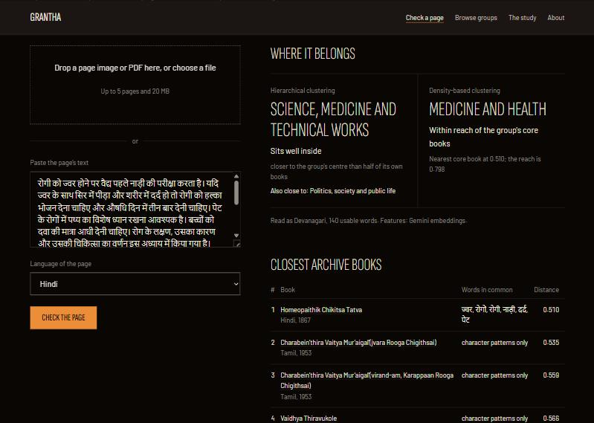
The app: check a page
Nearest group centre, judged against the group's own books, plus 'also close to'.
DBSCAN: joins a group only within eps of a core book.
5 nearest books, shared words, archive links.
Abstains under 20 words; cautions on weak OCR.
No retraining, nothing stored.
Grantha · SIH26096
Notes:
Rohan. Live demo if possible: paste or upload a page. The screenshot: a Hindi passage on fevers lands in science and medicine; its nearest books include Tamil medical works.

Slide 14
Delivered
1 command
65/66
1.1 GB
docker compose up: the site and API on port 8000
app checks passed on the container, all 8 languages
app image (was 6.1 GB)
Tesseract with 8 languages, fitted model, results, website; no scans. Needs internet for Gemini.
Pipeline service reruns every step; README lists them.
Pages: landing, check, browse, study (every result, plain summary first), about.
Report, this deck, viva notes and a short-paper draft.
Grantha · SIH26096
Notes:
Rohan. Show docker compose up. The key lives in a git-ignored .env and enters only at run time. The one failed check: a Sanskrit page read with the Hindi model (same script), same group either way.

Slide 15
Limits and next steps
Printed books only, not handwritten manuscripts.
The encoder is closed and online: text goes to Google; the best open model is ~7 points lower.
T1 (72.5% vs 80%) and T3 (0.58 vs 0.60) missed; silhouettes are low because topics overlap.
Subject labels made by the assistant, to be spot-checked by the team.
Next: more books per language, an open encoder fine-tuned on the archive's own text, expert-checked labels, handwriting recognition.
Grantha · SIH26096
Notes:
Everyone. State the limits plainly; they are also on the Study page.

Slide 16
Team
 | Rajith Sundar | Etikala Sai Pranav | Vemuri Rohan
Area | Data and OCR | Clustering study | App and delivery
Built | Harvest, whole-book text, OCR and routing, pilot, cleaning, missing values, encoding, scaling, splits | Features, language removal, encoder choice, distance study, hierarchical and DBSCAN grids, stability, evaluation, tags | API, new-page checker, web pages, Docker, plan and documents
Grantha · SIH26096
Notes:
Each person answers questions on their own area.

