Slide 1
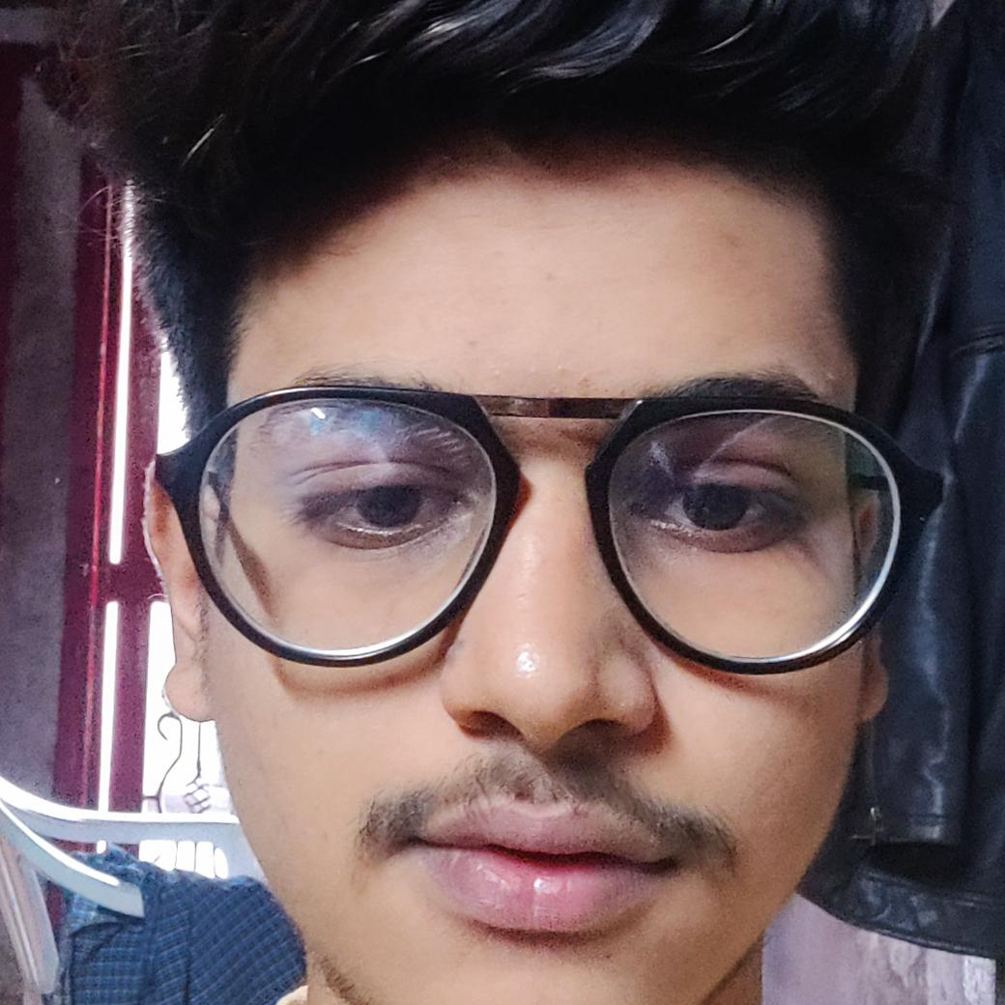



Rohan Neve
Analyst/Software Engineer
Bachelor of Technology
Computer Science : 2016 - 2020
Skills Java 11
Spring Boot, MVC
Spring Security
MERN Stack
NodeJS
MongoDB
Database
SQL database – Oracle, MySQL
No SQL database – MongoDB
Web Technologies
HTML5
CSS3
Javascript
AddOns
Github
Maven
Postman
Additional Details
Leadership
Quick Learner
Team management
Mumbai-Airoli
Rohan-jayvant.neve@capgemini.com
+91 9623231646
A4
Software Engineer who is Strong in design and integration with intuitive problem-solving skills. Passionate about implementing and launching new projects.
Ready to learn new technologies and implement them to further improve my knowledge.
Eager to work in a team of dedicated people and serve a key role in the enhancement and development of the project.
Hands on experience in creating microservices with Spring boot, Spring Security, Spring Cloud API Gateway, Eureka server..
Flight Booking System
Completed end to end case study of Flight Booking System along with JWT authentication, Swagger and payment testing using Braintree in MERN Stack. Material-UI and Angular Bootstrap used for user interface.

