Slide 1
Chapter 8: Memory Management

Slide 2
Chapter 8: Memory Management
Background
Swapping
Contiguous Allocation
Paging
Segmentation
Segmentation with Paging

Slide 3
Background
Program must be brought into memory and placed within a process for it to be run
Input queue – collection of processes on the disk that are waiting to be brought into memory to run the program
User programs go through several steps before being run

Slide 4
Binding of Instructions and Data to Memory
Address binding of instructions and data to memory addresses can
happen at three different stages
Compile time: If memory location known a priori, absolute code can be generated; must recompile code if starting location changes
Load time: Must generate relocatable code if memory location is not known at compile time
Execution time: Binding delayed until run time if the process can be moved during its execution from one memory segment to another. Need hardware support for address maps (e.g., base and limit registers).

Slide 5

Multistep Processing of a User Program

Slide 6
Logical vs. Physical Address Space
The concept of a logical address space that is bound to a separate physical address space is central to proper memory management
  Logical address – generated by the CPU; also referred to as virtual address
  Physical address – address seen by the memory unit
Logical and physical addresses are the same in compile-time and load-time address-binding schemes; logical (virtual) and physical addresses differ in execution-time address-binding scheme

Slide 7
Memory-Management Unit (MMU)
Hardware device that maps virtual (logical) to physical address
In MMU scheme, the value in the relocation register is added to every address generated by a user process at the time it is sent to memory
The user program deals with logical addresses; it never sees the real physical addresses

Slide 8

Dynamic relocation using a relocation register

Slide 9
Dynamic Loading
Routine is not loaded until it is called
Better memory-space utilization; unused routine is never loaded
Useful when large amounts of code are needed to handle infrequently occurring cases
No special support from the operating system is required implemented through program design

Slide 10
Swapping
A process can be swapped temporarily out of memory to a backing store, and then brought back into memory for continued execution
Backing store – fast disk large enough to accommodate copies of all memory images for all users; must provide direct access to these memory images
Roll out, roll in – swapping variant used for priority-based scheduling algorithms; lower-priority process is swapped out so higher-priority process can be loaded and executed
Major part of swap time is transfer time; total transfer time is directly proportional to the amount of memory swapped
Modified versions of swapping are found on many systems (i.e., UNIX, Linux, and Windows)

Slide 11

Schematic View of Swapping

Slide 12
Contiguous Allocation
Main memory usually into two partitions:
  Resident operating system, usually held in low memory with interrupt vector
  User processes then held in high memory
Single-partition allocation
  Relocation-register scheme used to protect user processes from each other, and from changing operating-system code and data
  Relocation register contains value of smallest physical address; limit register contains range of logical addresses – each logical address must be less than the limit register

Slide 13
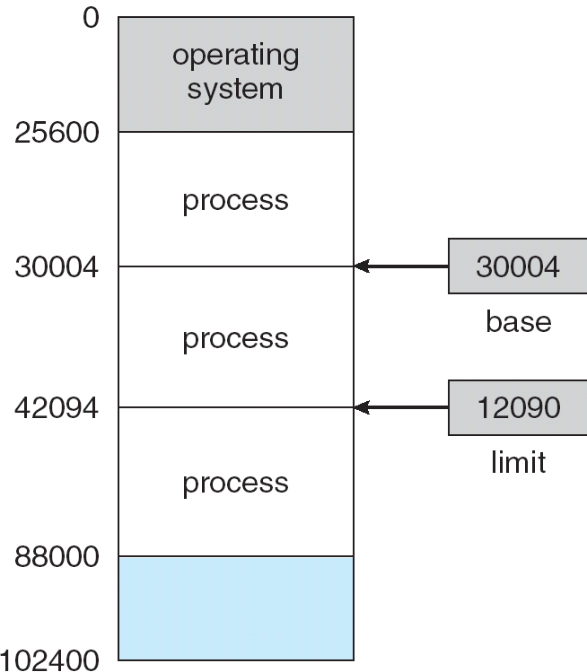
A base and a limit register define a logical address space

Slide 14

HW address protection with base and limit registers

Slide 15
Contiguous Allocation (Cont.)
Multiple-partition allocation
  Hole – block of available memory; holes of various size are scattered throughout memory
  When a process arrives, it is allocated memory from a hole large enough to accommodate it
  Operating system maintains information about:
  a) allocated partitions b) free partitions (hole)
OS
OS
OS
OS
process 5
process 5
process 5
process 5
process 9
process 9
process 8
process 10
process 2
process 2
process 2
process 2

Slide 16
Dynamic Storage-Allocation Problem
How to satisfy a request of size n from a list of free holes
First-fit: Allocate the first hole that is big enough
Best-fit: Allocate the smallest hole that is big enough; must search entire list, unless ordered by size. Produces the smallest leftover hole.
Worst-fit: Allocate the largest hole; must also search entire list. Produces the largest leftover hole.
First-fit and best-fit better than worst-fit in terms of speed and storage utilization

Slide 17
Fragmentation
External Fragmentation – total memory space exists to satisfy a request, but it is not contiguous
Internal Fragmentation – allocated memory may be slightly larger than requested memory; this size difference is memory internal to a partition, but not being used
Reduce external fragmentation by compaction
  Shuffle memory contents to place all free memory together in one large block
  Compaction is possible only if relocation is dynamic, and is done at execution time
  I/O problem
    Do I/O only into OS buffers

Slide 18
Paging
Logical address space of a process can be noncontiguous; process is allocated physical memory whenever the latter is available
Divide physical memory into fixed-sized blocks called frames (size is power of 2, between 512 bytes and 8192 bytes)
Divide logical memory into blocks of same size called pages.
Keep track of all free frames
To run a program of size n pages, need to find n free frames and load program
Set up a page table to translate logical to physical addresses
Internal fragmentation

Slide 19
Address Translation Scheme
Address generated by CPU is divided into:
  Page number (p) – used as an index into a page table which contains base address of each page in physical memory
  Page offset (d) – combined with base address to define the physical memory address that is sent to the memory unit

Slide 20
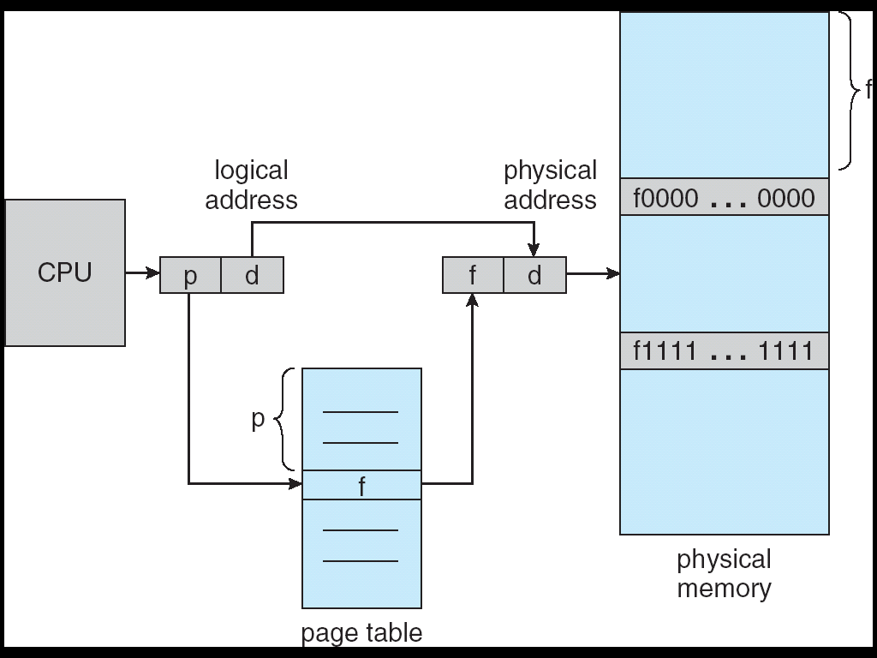
Address Translation Architecture

Slide 21

Paging Example

Slide 22

Paging Example

Slide 23

Free Frames
Before allocation
After allocation

Slide 24
Implementation of Page Table
Page table is kept in main memory
Page-table base register (PTBR) points to the page table
Page-table length register (PRLR) indicates size of the page table
In this scheme every data/instruction access requires two memory accesses. One for the page table and one for the data/instruction.
The two memory access problem can be solved by the use of a special fast-lookup hardware cache called associative memory or translation look-aside buffers (TLBs)

Slide 25
Associative Memory
Associative memory – parallel search
Address translation (A´, A´´)
  If A´ is in associative register, get frame # out
  Otherwise get frame # from page table in memory
Page #
Frame #

Slide 26

Paging Hardware With TLB

Slide 27
Effective Access Time
Associative Lookup = ε time unit
Assume memory cycle time is 1 microsecond
Hit ratio – percentage of times that a page number is found in the associative registers; ratio related to number of associative registers
Hit ratio = α
Effective Access Time (EAT)
EAT = (1 + ε) α + (2 + ε)(1 – α)
= 2 + ε – α

Slide 28
Memory Protection
Memory protection implemented by associating protection bit with each frame
Valid-invalid bit attached to each entry in the page table:
  “valid” indicates that the associated page is in the process’ logical address space, and is thus a legal page
  “invalid” indicates that the page is not in the process’ logical address space

Slide 29

Valid (v) or Invalid (i) Bit In A Page Table

Slide 30
Page Table Structure
Hierarchical Paging
Hashed Page Tables
Inverted Page Tables

Slide 31
Segmentation
Memory-management scheme that supports user view of memory
A program is a collection of segments. A segment is a logical unit such as:
main program,
procedure,
function,
method,
object,
local variables, global variables,
common block,
stack,
symbol table, arrays

Slide 32

User’s View of a Program

Slide 33
Logical View of Segmentation
1
1
4
2
3
4
2
3
user space
physical memory space

Slide 34
Segmentation Architecture
Logical address consists of a two tuple:
<segment-number, offset>,
Segment table – maps two-dimensional physical addresses; each table entry has:
  base – contains the starting physical address where the segments reside in memory
  limit – specifies the length of the segment
Segment-table base register (STBR) points to the segment table’s location in memory
Segment-table length register (STLR) indicates number of segments used by a program;
segment number s is legal if s < STLR

Slide 35
Segmentation Architecture (Cont.)
Relocation.
  dynamic
  by segment table
Sharing.
  shared segments
  same segment number
Allocation.
  first fit/best fit
  external fragmentation

Slide 36
Segmentation Architecture (Cont.)
Protection. With each entry in segment table associate:
  validation bit = 0 ⇒ illegal segment
  read/write/execute privileges
Protection bits associated with segments; code sharing occurs at segment level
Since segments vary in length, memory allocation is a dynamic storage-allocation problem
A segmentation example is shown in the following diagram

Slide 37

Address Translation Architecture

Slide 38

Example of Segmentation

Slide 39
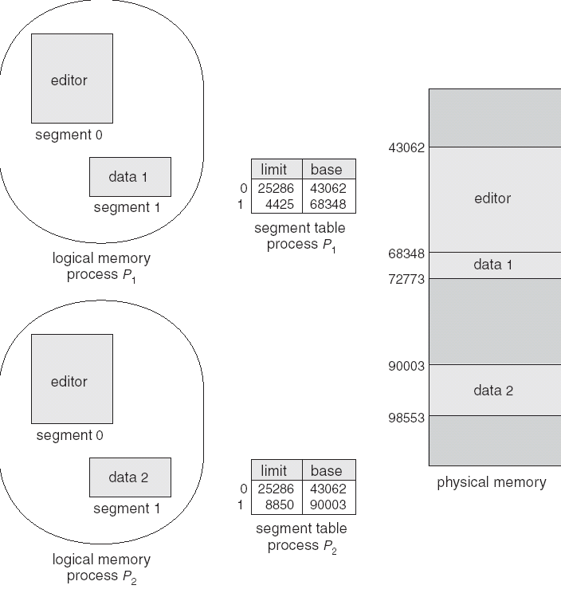
Sharing of Segments

Slide 40
Segmentation with Paging – MULTICS
The MULTICS system solved problems of external fragmentation and lengthy search times by paging the segments
Solution differs from pure segmentation in that the segment-table entry contains not the base address of the segment, but rather the base address of a page table for this segment

Slide 41

MULTICS Address Translation Scheme

Slide 42
Segmentation with Paging – Intel 386
As shown in the following diagram, the Intel 386 uses segmentation with paging for memory management with a two-level paging scheme

Slide 43

Intel 30386 Address Translation

Slide 44
Linux on Intel 80x86
Uses minimal segmentation to keep memory management implementation more portable
Uses 6 segments:
  Kernel code
  Kernel data
  User code (shared by all user processes, using logical addresses)
  User data (likewise shared)
  Task-state (per-process hardware context)
  LDT
Uses 2 protection levels:
  Kernel mode
  User mode

Slide 45
End of Chapter 8

