Slide 1
Chapter 9: Virtual Memory

Slide 2
Chapter 9: Virtual Memory
Background
Demand Paging
Process Creation
Page Replacement
Allocation of Frames
Thrashing
Demand Segmentation
Operating System Examples

Slide 3
Background
Virtual memory – separation of user logical memory from physical memory.
  Only part of the program needs to be in memory for execution.
  Logical address space can therefore be much larger than physical address space.
  Allows address spaces to be shared by several processes.
  Allows for more efficient process creation.
Virtual memory can be implemented via:
  Demand paging
  Demand segmentation

Slide 4
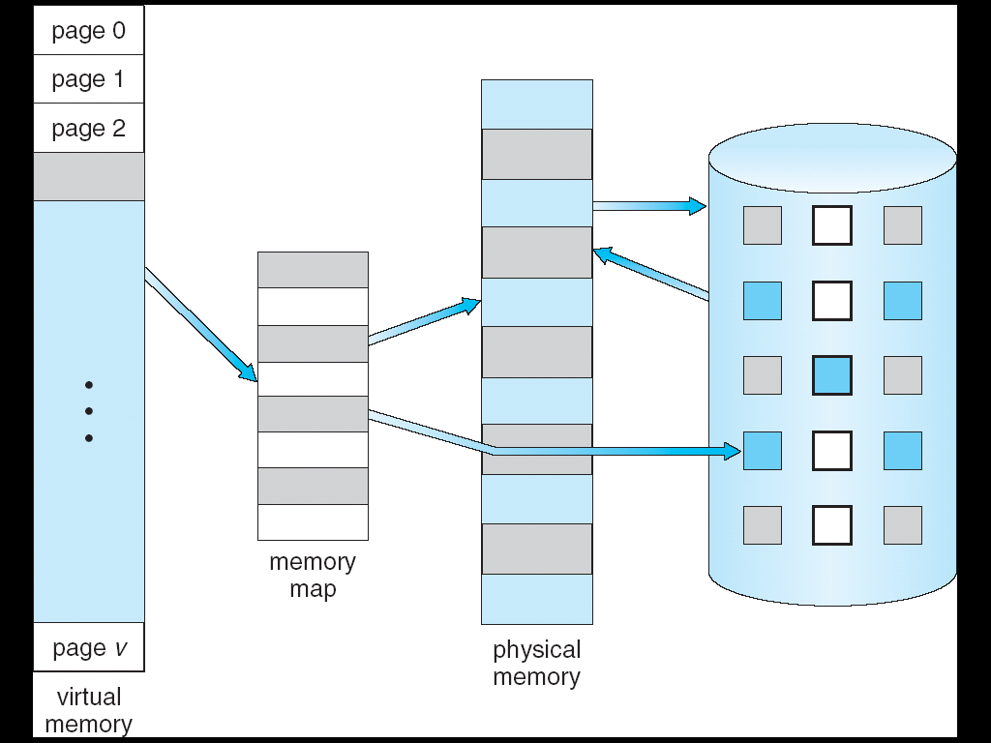
Virtual Memory That is Larger Than Physical Memory
⇒

Slide 5

Virtual-address Space

Slide 6

Shared Library Using Virtual Memory

Slide 7
Demand Paging
Bring a page into memory only when it is needed
  Less I/O needed
  Less memory needed
  Faster response
  More users
Page is needed ⇒ reference to it
  invalid reference ⇒ abort
  not-in-memory ⇒ bring to memory

Slide 8
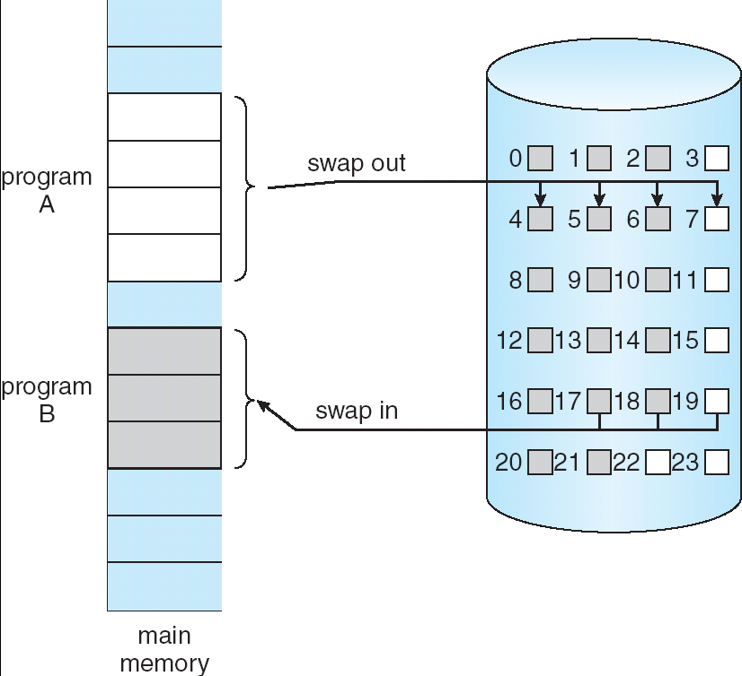
Transfer of a Paged Memory to Contiguous Disk Space

Slide 9
Valid-Invalid Bit
With each page table entry a valid–invalid bit is associated
(1 ⇒ in-memory, 0 ⇒ not-in-memory)
Initially valid–invalid but is set to 0 on all entries
Example of a page table snapshot:
During address translation, if valid–invalid bit in page table entry is 0 ⇒ page fault
Frame #
valid-invalid bit
1
1
1
1
0

0
0
page table

Slide 10

Page Table When Some Pages Are Not in Main Memory

Slide 11
Page Fault
If there is ever a reference to a page, first reference will trap to
OS ⇒ page fault
OS looks at another table to decide:
  Invalid reference ⇒ abort.
  Just not in memory.
Get empty frame.
Swap page into frame.
Reset tables, validation bit = 1.
Restart instruction: Least Recently Used
  block move
  auto increment/decrement location

Slide 12

Steps in Handling a Page Fault

Slide 13
What happens if there is no free frame?
Page replacement – find some page in memory, but not really in use, swap it out
  algorithm
  performance – want an algorithm which will result in minimum number of page faults
Same page may be brought into memory several times

Slide 14
Performance of Demand Paging
Page Fault Rate 0 ≤ p ≤ 1.0
  if p = 0 no page faults
  if p = 1, every reference is a fault
Effective Access Time (EAT)
EAT = (1 – p) x memory access
+ p (page fault overhead
+ [swap page out ]
+ swap page in
+ restart overhead)

Slide 15
Demand Paging Example
Memory access time = 1 microsecond
50% of the time the page that is being replaced has been modified and therefore needs to be swapped out
Swap Page Time = 10 msec = 10,000 msec
EAT = (1 – p) x 1 + p (15000)
1 + 15000P (in msec)

Slide 16
Basic Page Replacement
Find the location of the desired page on disk
Find a free frame:
- If there is a free frame, use it
- If there is no free frame, use a page replacement algorithm to select a victim frame
Read the desired page into the (newly) free frame. Update the page and frame tables.
Restart the process

Slide 17

Page Replacement

Slide 18
Page Replacement Algorithms
Want lowest page-fault rate
Evaluate algorithm by running it on a particular string of memory references (reference string) and computing the number of page faults on that string
In all our examples, the reference string is
1, 2, 3, 4, 1, 2, 5, 1, 2, 3, 4, 5

Slide 19

Graph of Page Faults Versus The Number of Frames

Slide 20
First-In-First-Out (FIFO) Algorithm
Reference string: 1, 2, 3, 4, 1, 2, 5, 1, 2, 3, 4, 5
3 frames (3 pages can be in memory at a time per process)
4 frames
FIFO Replacement – Belady’s Anomaly
  more frames ⇒ more page faults
1
1
4
5
2
2
1
3
9 page faults
3
3
2
4
1
1
5
4
2
2
1
5
10 page faults
3
3
2
4
4
3

Slide 21

FIFO Page Replacement

Slide 22

FIFO Illustrating Belady’s Anomaly

Slide 23
Optimal Algorithm
Replace page that will not be used for longest period of time
4 frames example
1, 2, 3, 4, 1, 2, 5, 1, 2, 3, 4, 5
How do you know this?
Used for measuring how well your algorithm performs
1
4
2
6 page faults
3
4
5

Slide 24

Optimal Page Replacement

Slide 25
Least Recently Used (LRU) Algorithm
Reference string: 1, 2, 3, 4, 1, 2, 5, 1, 2, 3, 4, 5
Counter implementation
  Every page entry has a counter; every time page is referenced through this entry, copy the clock into the counter
  When a page needs to be changed, look at the counters to determine which are to change
1
5
2
3
5
4
4
3

Slide 26

LRU Page Replacement

Slide 27
LRU Algorithm (Cont.)
Stack implementation – keep a stack of page numbers in a double link form:
  Page referenced:
    move it to the top
    requires 6 pointers to be changed
  No search for replacement

Slide 28

Use Of A Stack to Record The Most Recent Page References

Slide 29
LRU Approximation Algorithms
Reference bit
  With each page associate a bit, initially = 0
  When page is referenced bit set to 1
  Replace the one which is 0 (if one exists). We do not know the order, however.
Second chance
  Need reference bit
  Clock replacement
  If page to be replaced (in clock order) has reference bit = 1 then:
    set reference bit 0
    leave page in memory
    replace next page (in clock order), subject to same rules

Slide 30
Counting Algorithms
Keep a counter of the number of references that have been made to each page
LFU Algorithm: replaces page with smallest count
MFU Algorithm: based on the argument that the page with the smallest count was probably just brought in and has yet to be used

Slide 31
Thrashing
If a process does not have “enough” pages, the page-fault rate is very high. This leads to:
  low CPU utilization
  operating system thinks that it needs to increase the degree of multiprogramming
  another process added to the system
Thrashing ≡ a process is busy swapping pages in and out

Slide 32

Thrashing (Cont.)

Slide 33
Demand Paging and Thrashing
Why does demand paging work?
Locality model
  Process migrates from one locality to another
  Localities may overlap
Why does thrashing occur?
Σ size of locality > total memory size

Slide 34
End of Chapter 9

