Slide 2
MINOR-1
Student Segmentation using
K-Means Clustering Algorithm
MEMBER’S NAME | ROLL NUMBER | SAP ID | BRANCH
Rohan Nyati | R177219148 | 500075940 | BTech CSE -AIML
Rajneesh | R177219143 | 500076347 | BTech CSE -AIML
Shantanu Jaswal | R177219170 | 500075224 | BTech CSE -AIML
Under the guidance of
Dr.Sujoy Chatterjee

Slide 3
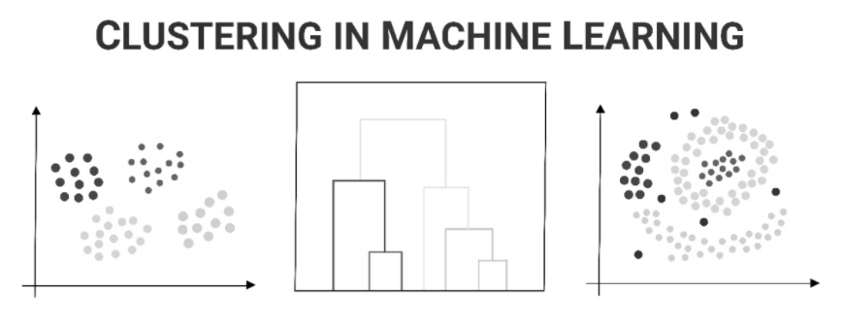
Abstract
The goal of this project is to create clusters of students on the basis of their current academic standings.
So the motivation here is to access the college in analyzing such students and assisting them in their coming semesters.
As a ML enthusiast, we wanted to explore the core of K Means clustering algorithms using a programming approach to gain the pure insights and working of this algorithm.

Slide 4
Introduction
Achieving Student Segmentation using K-Means clustering algorithm
K-means clustering algorithm computes the centroids and iterates until it finds optimal centroid. It assumes that the number of clusters are already known. It is also called flat clustering algorithm. The number of clusters identified from data by the algorithm is represented by ‘K’ in K-means.

Slide 5
Literature Review
The K-Means algorithm based on dividing [1] is a kind of cluster algorithm, and it is proposed by J.B.MacQueen. This algorithm which is unsupervised is usually used in data mining and pattern recognition. Aiming at minimizing cluster performance index, square-error and error criterion are foundations of this algorithm. The K-Means algorithm based on dividing is a kind of cluster algorithm, and has advantages of briefness, efficiency and certainty.
D = ||X-Z|| = [i=1n(x_{i}-z_{i})²]0.5
D is the distance of X and Z in n-dimensional space, where X and Z are two samples.

Slide 6
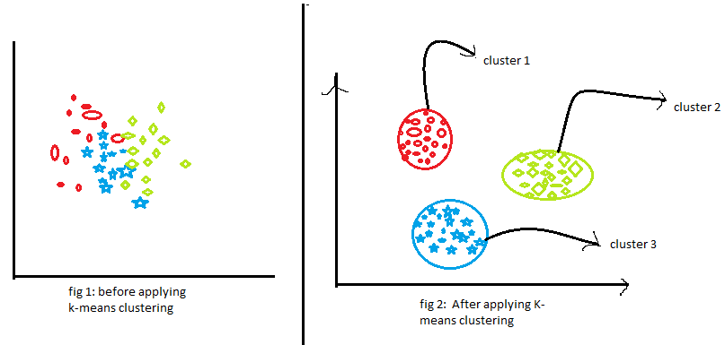
Literature Review
The incremental K-means algorithm[2] presented in this paper is similar to the block sequential algorithm with the exception that each block is accessed only one time. Each block is going through a set of l epochs of K-means where the final centers of block ݅i are used as the initial centers for block i+1.
SRC:https://editor.analyticsvidhya.com/uploads/56854k%20means%20clustering.png

Slide 7
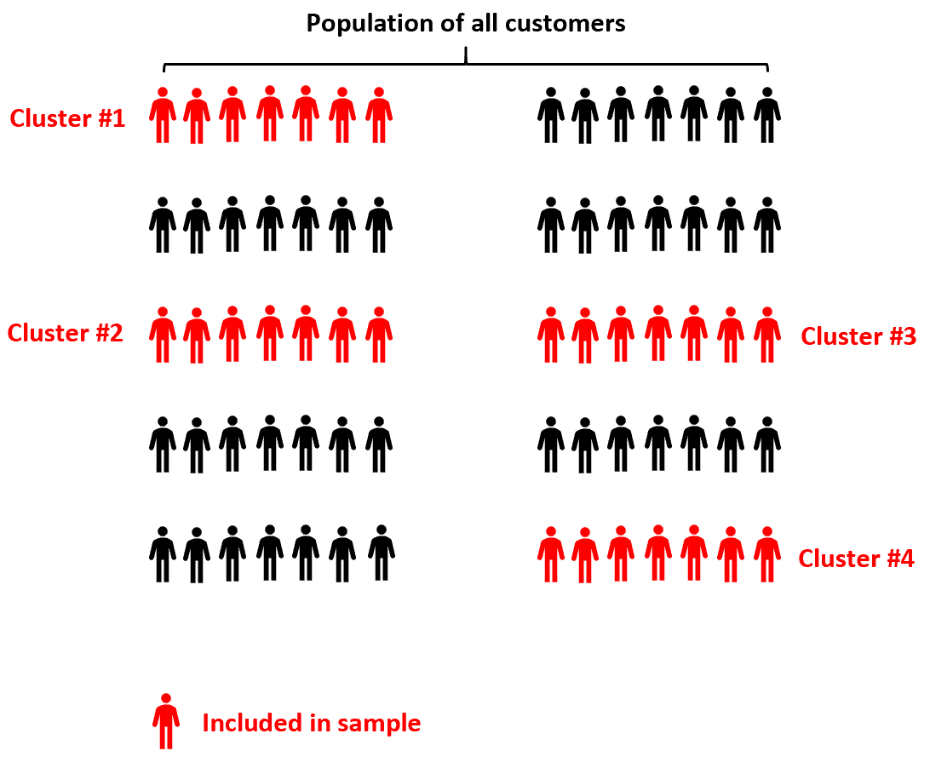
Problem Statement
If there are 1,2,3, ..., n number of students :
How to segment those students into different clusters (C₁,C₂,C₃…C_{k})
To find the number of student being fully vaccinated and will they be joining campus or not .
src:https://www.statology.org/wp-content/uploads/2021/02/twostage_cluster1.png

Slide 8
Objective
To obtain Cluster of students using K-Means Clustering algorithms .
To find how many number of students belong to which cluster .
To find total number of students being fully vaccinated and joining the campus .

Slide 9
Methodology
1. Problem understanding and definition
2. Dataset creation
3. Data File Handling
4. Working on Students Sgpa
5. Using clustering algorithm to obtain cluster of students
6. Differentiating students being vaccinated or not
7. Results

Slide 10
Characteristic of Data
S.No | Columns | Total Entries | Data types
0 | Sno | 1499 | Int64
1 | Name | 1499 | Object
2 | Vaccinated | 1499 | Int64
3 | Joining Campus | 1499 | Int64
4 | SEM3 | 1499 | Float64
5 | SEM4 | 1499 | Float64
Total 6 columns including 3 integer entries , 2 float entry and 1 object entry.
The dataset contains 1499 values , including sno, name , vaccination information, joining campus preference,semester (3,4) sgpa of students.
The dataset is in txt file format.

Slide 11
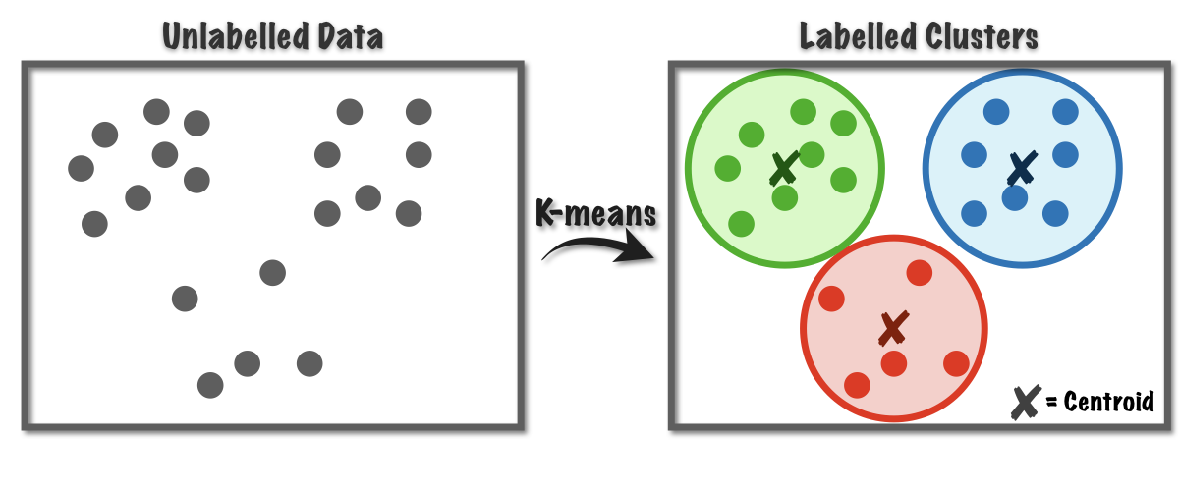
K-Means Algorithm
Input: k: the number of clusters, D: a data set containing n objects.
Output: A set of k clusters.
Method:
(1) arbitrarily choose k objects from D as the initial cluster centers;
(2) repeat
(3) (re)assign each object to the cluster to which the object is the most similar, based on mean value of the objects in the cluster;
(4) update the cluster means, that is, calculate the mean value of the objects for each cluster;
(5)until no change
SRC:https://miro.medium.com/max/1400/1*rw8IUza1dbffBhiA4i0GNQ.png

Slide 12
WorkFlow Diagram
Generate random centroids
START
calculate updated centroids
Calculate Euclidean distance
Load dataset
Generate output text file
Store distance in variable arr
Classification on further features
Print dataset
Find which row belongs to which cluster
RESULT

Slide 13
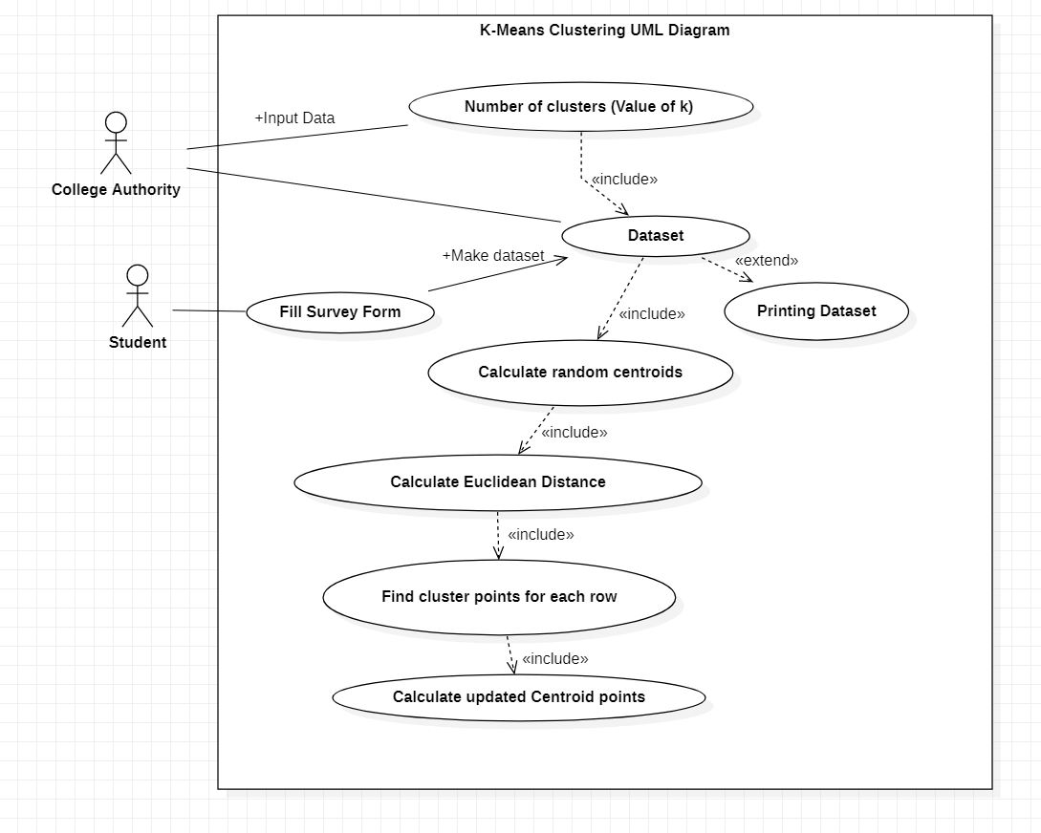

Slide 14
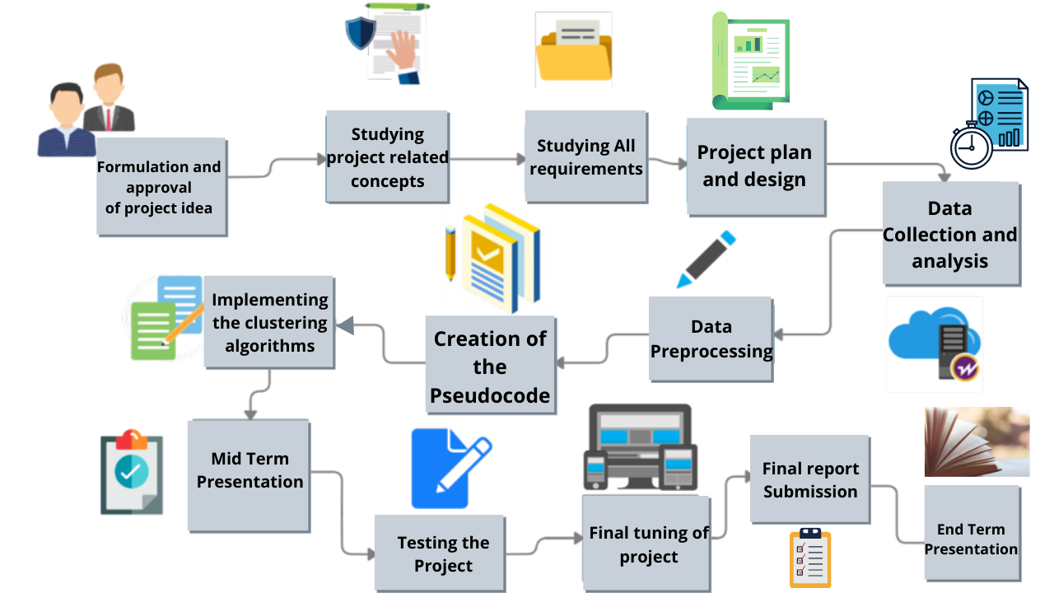
Flow of work

Slide 15
Gantt Chart
6 Sept 21 | 20 Sept 21 | 1 Nov 21 | 20 Nov 21 | 10 Dec 21 | 30 Dec 21
Timeline
Synopsis and Mentor approval
Data creation and 50% code completion
Mid Term presentation
Working on remaining features
End term presentation

Slide 16
Mid Term Changes
We were told to change our project title name and work only on K-Means
All the changes have been made and project title changed from “Student Segmentation using Clustering Algorithm” To “Student Segmentation using K-means clustering algorithm”.
We were asked how we are going show that our final coordinates our actually final updated coordinates?
For that we have made our entire K-Means code recursive to calculate the number of Iterations and have attached the “Error Graph” to show how the value of updated coordinates change over a period of time and gets fixed after a certain amount of time.

Slide 17
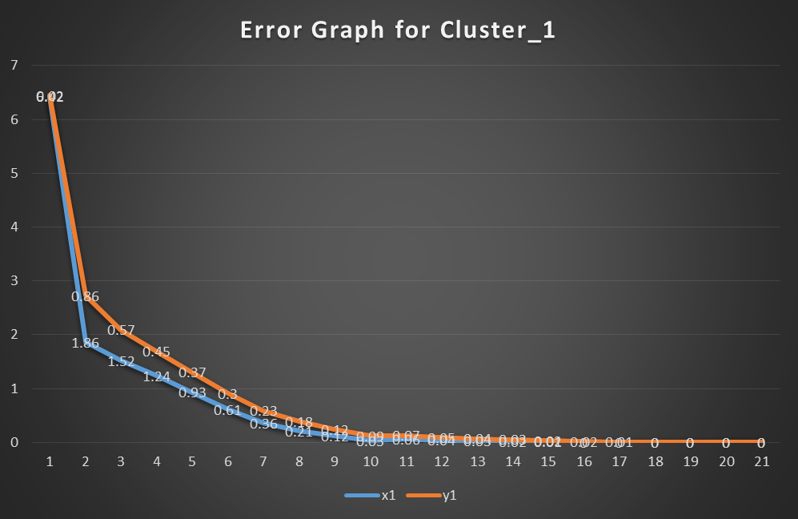
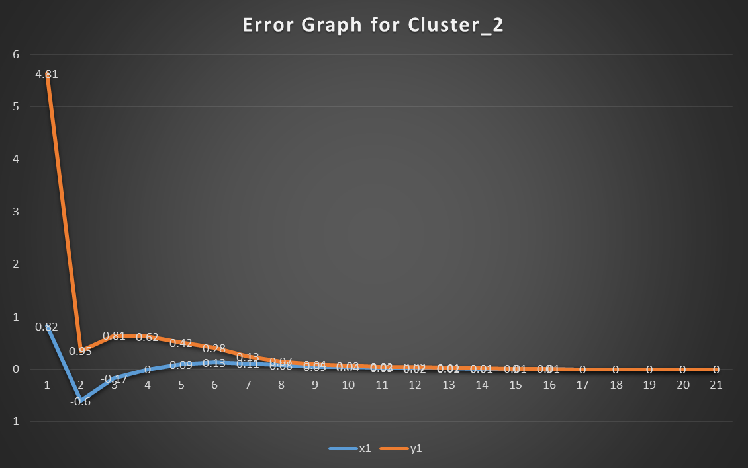
Error Graph
Figure 1
Figure 2

Slide 18
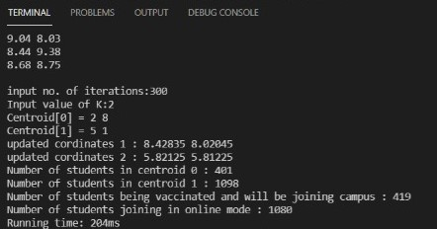
Final Code Snippet
Figure 3

Slide 19
Outcome of Project
From this we concluded that since lockdown most number of students SGPA’s have ranged in the category of second cluster having cluster centres as (5.81 , 5.81).
Out of total 1500 students, 419 students have been fully vaccinated and will be joining campus as soon as asked.
From this we inferred that colleges should provide extra classes and workshops to the students to increase their Industrial and Academic Knowledge .

Slide 20
Future Work to be done
1 . We can try to implement Silhouette Method to find the optimal value of k i.e number of cluster.

Slide 21
SOFTWARE REQUIREMENTS
Name of Component |  | Specification
Operating System |  | Windows 10, Macintosh
Front end |  | C , C++ Programming Language
IDE Required |  | Visual Studio Code/XCode
HARDWARE REQUIREMENTS
Name of Component |  | Specification
Processor |  | Intel(R) Core(TM)i5-3210M CPY @ 2.50GHz 2.50
RAM |  | 4GB
Hard Disk |  | 500GB HDD or 250GB SSD
Mouse |  | 2 or 3 Button mouse
Keyboard |  | 101 Key Keyboard

Slide 22
References
[1]A Clustering Method Based on K-Means Algorithm Youguo Li, Haiyan Wu Department of Computer Science Xinyang Agriculture College Xinyang, Henan 464000,China December 2012
https://www.researchgate.net/publication/271616608_A_Clustering_Method_Based_on_K-Means_Algorithm/link/57da70fc08aeea1959316130/downloa
[2]Dynamic Incremental K-means Clustering Bryant Aaron, Dan E. Tamir Department of Computer Science, Texas State University, San Marcos, Texas, USA, Naphtali D. Rishe, and Abraham Kandel School of Computing and Information Sciences Florida International University Miami,Florida,USA 2014 International Conference
http://cake.fiu.edu/Publications/Aaron+al-14-DK.Dynamic_Incremental_K-means_Clustering_IEEE-downloaded.pdf
Github- https://github.com/Rajkuhar/minor

