Slide 2
MINOR-1
Student Segmentation using
Clustering Algorithm
MEMBER’S NAME | ROLL NUMBER | SAP ID | BRANCH
Rohan Nyati | R177219148 | 500075940 | BTech CSE -AIML
Rajneesh | R177219143 | 500076347 | BTech CSE -AIML
Shantanu Jaswal | R177219170 | 500075224 | BTech CSE -AIML
Under the guidance of
Dr.Sujoy Chatterjee

Slide 3
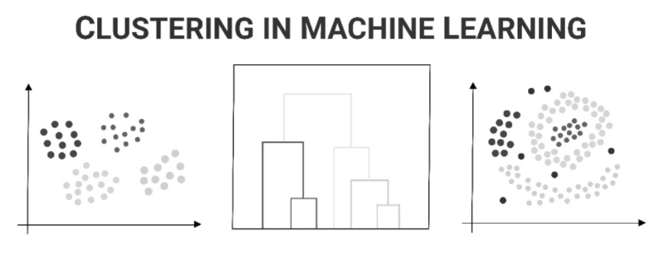
Abstract
The goal of this project is to create clusters of students on the basis of their current academic standings.
So the motivation here is to access the college in analyzing such students and assisting them in their coming semesters.
As a ML enthusiast, we wanted to explore the core of clustering algorithms using a programming approach to gain the pure insights and working of these algorithms.

Slide 4
Introduction
Achieving Student Segmentation using clustering algorithm
In our project we have implemented one of these given clustering algorithms :
- K-means clustering algorithm computes the centroids and iterates until we it finds optimal centroid. It assumes that the number of clusters are already known. It is also called flat clustering algorithm. The number of clusters identified from data by the algorithm is represented by ‘K’ in K-means.
- Density-Based Spatial Clustering of Applications with Noise (DBSCAN) is a base algorithm for density-based clustering. It can discover clusters of different shapes and sizes from a large amount of data, which is containing noise and outliers.

Slide 5
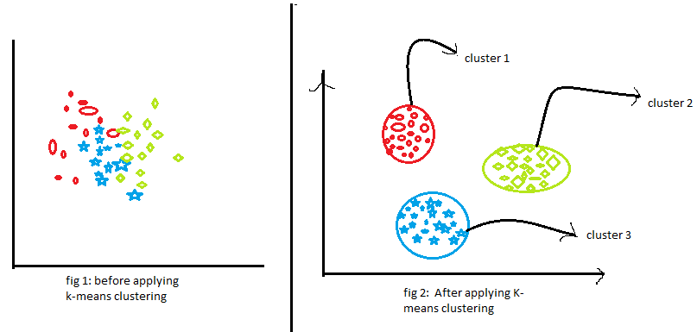
Literature Review
The K-Means algorithm based on dividing [1] is a kind of cluster algorithm, and it is proposed by J.B.MacQueen. This algorithm which is unsupervised is usually used in data mining and pattern recognition. Aiming at minimizing cluster performance index, square-error and error criterion are foundations of this algorithm. The K-Means algorithm based on dividing is a kind of cluster algorithm, and has advantages of briefness, efficiency and certainty.
D = ||X-Z|| = [i=1n(x_{i}-z_{i})²]0.5
D is the distance of X and Z in n-dimensional space, where X and Z are two samples.
The incremental K-means algorithm[2] presented in this paper is similar to the block sequential algorithm with the exception that each block is accessed only one time. Each block is going through a set of l epochs of K-means where the final centers of block ݅i are used as the initial centers for block i+1.
SRC:https://editor.analyticsvidhya.com/uploads/56854k%20means%20clustering.png

Slide 6
Literature Review
DBSCAN is a density based algorithm [3] used for clustering that requires only one input parameter and supports the user in determining an appropriate value for it. It discovers clusters of arbitrary shape. Finally, DBSCAN is efficient even for large spatial databases.
The Eps-neighborhood of a point p,
denoted by:-
N_{Eps}(P), is defined N_{Eps}(P) = {q D | dist(p,q) _< Eps}.
A naive approach could require for each point in a cluster that there are at least a minimum number (MinPts) of points in an Eps-neighborhood of that point.
We require that for every point p in a cluster C there is a point q in C so that p is inside of the Eps-neighborhood of q and NEps(q) contains at least MinPts points.
A point p is directly density-reachable from a point q wrt. Eps, MinPts if:-
1) p NEps(P) and
2)| NEps(P) | > MinPts (core point condition)
INCREMENTAL DBSCAN CLUSTERING [4] insertion of some new data items into the already existing clusters .The new data which are not inserted into any clusters, they are treated as noise or outliers. Sometimes outliers which fulfil the Minpts & eps criteria , combinly can form clusters using DBSCAN.
% Change in database = (( new data - old data) X 100) / (old data)

Slide 7
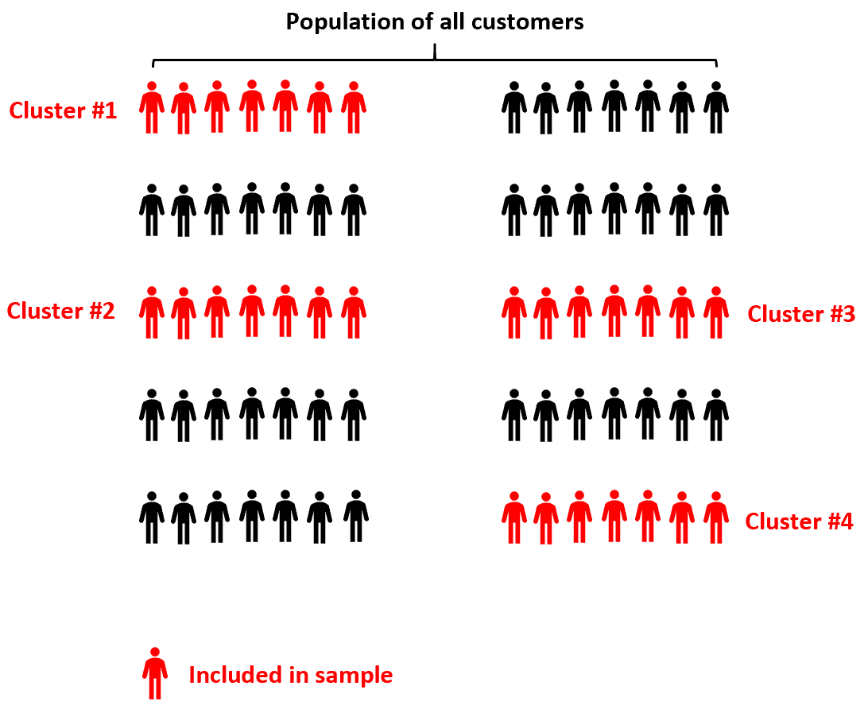
Problem Statement
If there are 1,2,3, ..., n number of students :
How to segment those students into different clusters (C₁,C₂,C₃…C_{k})
How to map a new student into particular cluster (C₁,C₂...C_{k})
To find the number of student being fully vaccinated and will they be joining campus or not .
src:https://www.statology.org/wp-content/uploads/2021/02/twostage_cluster1.png

Slide 8
Objective
To obtain clear understanding of Clustering algorithms
To create clusters of students on the basis of their current academic standings.

Slide 9
Methodology
1. Problem understanding and definition
2. Dataset creation
3. Data File Handling
4. Working on Students Sgpa
5. Using clustering algorithm to obtain cluster of students
6. Differentiating students being vaccinated or not
7. Results

Slide 10
Characteristic of Data
S.No | Columns | Total Entries | Data types
0 | Sno | 1499 | Int64
1 | Name | 1499 | Object
2 | Vaccinated | 1499 | Int64
3 | Joining Campus | 1499 | Int64
4 | SEM3 | 1499 | Float64
5 | SEM4 | 1499 | Float64
Total 6 columns including 3 integer entries , 2 float entry and 1 object entry.
The dataset contains 1499 values , including sno, name , vaccination information, joining campus preference,semester (3,4) sgpa of students.
The dataset is in CSV(comma separated values) format.

Slide 11
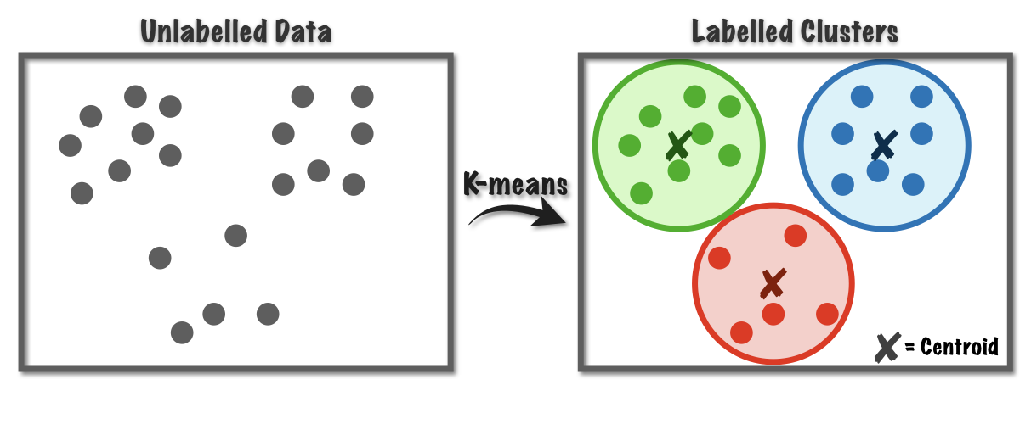
K-Means Algorithm
Input: k: the number of clusters, D: a data set containing n objects.
Output: A set of k clusters.
Method:
(1) arbitrarily choose k objects from D as the initial cluster centers;
(2) repeat
(3) (re)assign each object to the cluster to which the object is the most similar, based on mean value of the objects in the cluster;
(4) update the cluster means, that is, calculate the mean value of the objects for each cluster;
(5)until no change
SRC:https://miro.medium.com/max/1400/1*rw8IUza1dbffBhiA4i0GNQ.png

Slide 12
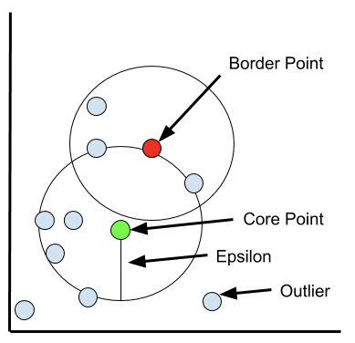
DBSCAN Algorithm
Input :
D: a data set containing n objects,
r: the radius parameter, and
MinPts: the 𝝐-neighborhood density threshold.
Output : A set of density-based clusters.
Method:
(1) mark all objects as unvisited;
(2) do
(3) randomly select an unvisited object p;
(4) mark p as visited;
(5) if the 𝝐-neighborhood of p has at least MinPts objects
(6) create a new cluster C, and add p to C;
(7) let N be the set of objects in the 𝝐-neighborhood of p;
(8) for each point p’ in N
(9) if p’ is unvisited
(10) mark p’ as visited;
(11) if the 𝝐-neighborhood of p’ has at least MinPts points, add those points to N;
(12) if p’ is not yet a member of any cluster, add p’ to C;
(13) end for
(14) output C;
(15) else mark p as noise;
(16) until no object is unvisited
SRC:https://miro.medium.com/max/778/1*NSTKALeiFbGg4J0UQSI0tg.png

Slide 13
WorkFlow Diagram
START
Generate random centroids
calculate updated centroids
Calculate Euclidean distance
Load dataset
Generate output text file
Store distance in variable arr
Differentiate on further features
Print dataset
Find which row belongs to which cluster
END

Slide 14
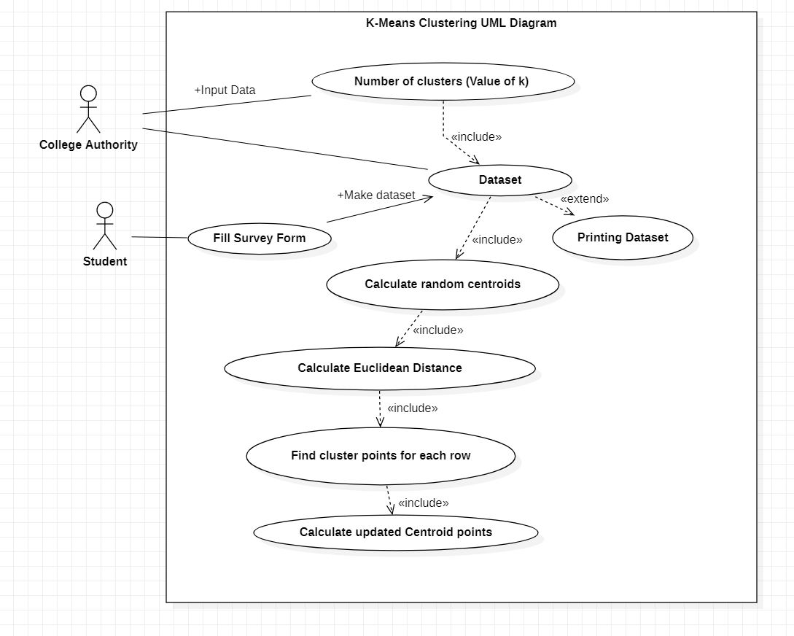

Slide 15
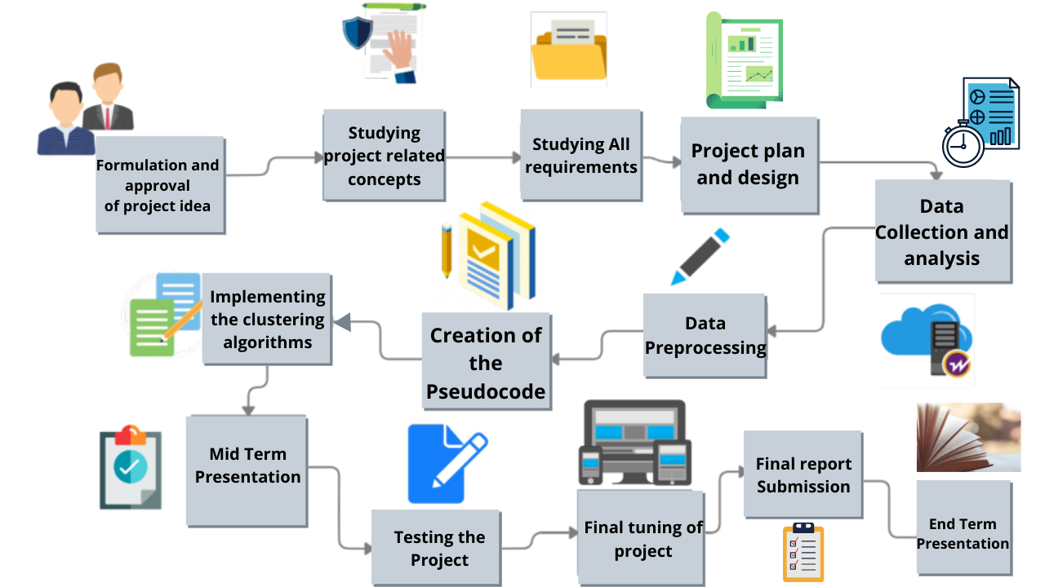
Flow of work

Slide 16
Gantt Chart
6 Sept 21 | 20 Sept 21 | 1 Nov 21 | 20 Nov 21 | 10 Dec 21 | 30 Dec 21
Timeline
Synopsis and Mentor approval
Data creation and 50% code completion
Mid Term presentation
Working on remaining features
End term presentation

Slide 17
Future Work to be done
1 . Completing the File Handling and Input.txt file extraction part and connecting it with the rest of the code .
2 . Working on the remaining features .

Slide 18
SOFTWARE REQUIREMENTS
Name of Component |  | Specification
Operating System |  | Windows 10, Macintosh
Front end |  | C , C++ Programming Language
IDE Required |  | Visual Studio Code/XCode
HARDWARE REQUIREMENTS
Name of Component |  | Specification
Processor |  | Intel(R) Core(TM)i5-3210M CPY @ 2.50GHz 2.50
RAM |  | 4GB
Hard Disk |  | 500GB HDD or 250GB SSD
Mouse |  | 2 or 3 Button mouse
Keyboard |  | 101 Key Keyboard

Slide 19
References
[1]A Clustering Method Based on K-Means Algorithm Youguo Li, Haiyan Wu Department of Computer Science Xinyang Agriculture College Xinyang, Henan 464000,China December 2012
https://www.researchgate.net/publication/271616608_A_Clustering_Method_Based_on_K-Means_Algorithm/link/57da70fc08aeea1959316130/downloa
[2]Dynamic Incremental K-means Clustering Bryant Aaron, Dan E. Tamir Department of Computer Science, Texas State University, San Marcos, Texas, USA, Naphtali D. Rishe, and Abraham Kandel School of Computing and Information Sciences Florida International University Miami,Florida,USA 2014 International Conference
http://cake.fiu.edu/Publications/Aaron+al-14-DK.Dynamic_Incremental_K-means_Clustering_IEEE-downloaded.pdf
[3] A Density-Based Algorithm for Discovering Clusters in Large Spatial Databases with Noise Martin Ester, Hans-Peter Kriegel, Jiirg Sander, Xiaowei Xu Institute for Computer Science, University of Munich Oettingenstr. 67, D-80538 Miinchen, German© 1996
https://www.aaai.org/Papers/KDD/1996/KDD96-037.pdf
[4] International Journal of Enterprise Computing and Business Systems Analysis and Study of Incremental DBSCAN Clustering Algorithm SANJAY CHAKRABORTY Prof. N.K.NAGWANI National Institute of Technology National Institute of Technology (NIT) Raipur, CG, India.Vol. 1 Issue 2 July 2011
https://arxiv.org/ftp/arxiv/papers/1406/1406.4754.pdf

