Slide 1
Interaction Model

Slide 2
Interaction Model
The class model describes the objects in a system and their relationships
The state model describes the life cycles of the objects
The interaction model describes how the objects interact
Both state model and interaction model are needed to describe behavior fully. They view behavior from different perspective

Slide 3
Interaction Model
Can be modelled at different level of abstraction
At high level, Use cases describes how a system interacts with outside actors
Sequence diagrams provide more detail and show the messages exchanged among a set of objects over time
Activity diagrams provide details and show the flow of control among the steps of a computation (data flow and control flow)

Slide 4
Sequence models
Two kinds of sequence models
Scenarios
Sequence Diagram

Slide 5
Scenario
A sequence of events that occurs during one particular execution of a system
Scope of scenario can vary
May include all events in the system
May include only those events generated by certain objects

Slide 6
Example: Scenario for a session with an online stock broker
John Doe logs in
System establishes secure communication
System displays portfolio information
John Doe enters a buy order for 100 shares of GE at the market price
System verifies sufficient funds for purchase
System displays confirmation screen with estimated cost
John Doe confirms purchase
System place order on securities exchanged
System displays transaction tracking number
John Doe logs out
System establishes insecure communication
System displays good bye screen
Securities exchange reports results of trade
Expresses interaction at high level
A scenario contains messages between objects as well as activities performed by objects
Each message transmits information from one object to another.

Slide 7
Sequence Diagram
Scenario is convenient for writing but does not clearly show the sender and the receiver of each messages
Sequence diagram
Shows the participants in an interaction and the sequence of messages among them
Shows the interaction of a system with its actors to perform all or part of a use case

Slide 8
Key parts of a Sequence Diagram
participant: an object or entity that acts in the sequence diagram
message: communication between participant objects
The axes in a sequence diagram:
horizontal: which object/participant is acting
vertical: lifeline ( time – top -> bottom ) (spacing is irrelevant)

Slide 9
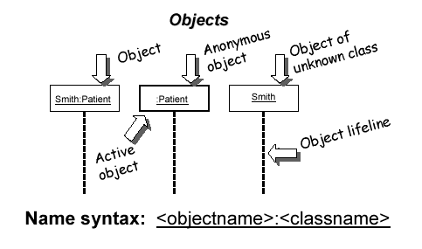
Representing objects
Squares with object type, optionally preceded by object name and colon
write object's name if it clarifies the diagram
object's "life line" represented by dashed vert. line

Slide 10
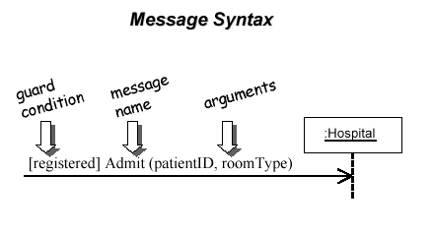
Messages between objects
message (method call) indicated by horizontal arrow to other object
write message name and arguments above arrow

Slide 11
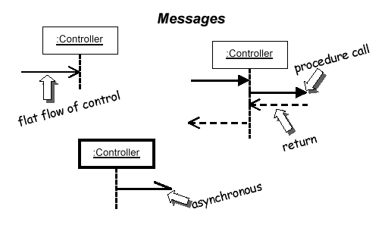
Messages, continued
message (method call) indicated by horizontal arrow to other object
dashed arrow back indicates return
different arrowheads for normal / concurrent (asynchronous) methods

Slide 12
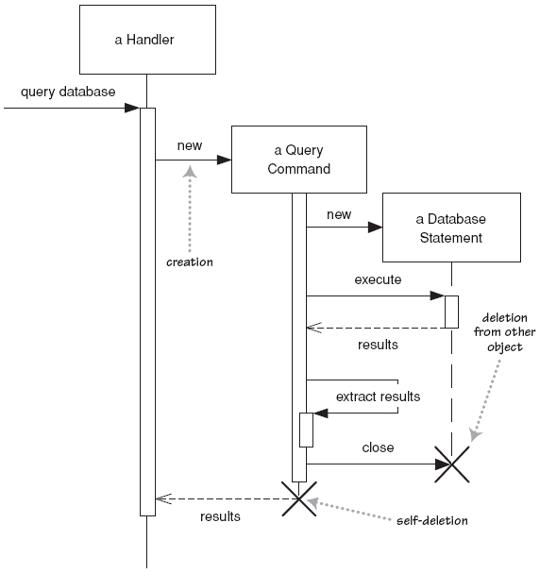
Lifetime of objects
creation: arrow with 'new' written above it
notice that an object created after the start of the scenario appears lower than the others
deletion: an X at bottom of object's lifeline

Slide 13
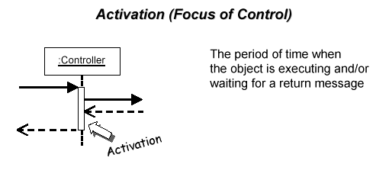
Indicating method calls
activation: thick box over object's life line; drawn when object's method is on the stack
either that object is running its code, or it is on the stack waiting for another object's method to finish
nest to indicate recursion
Activation
Nesting

Slide 14
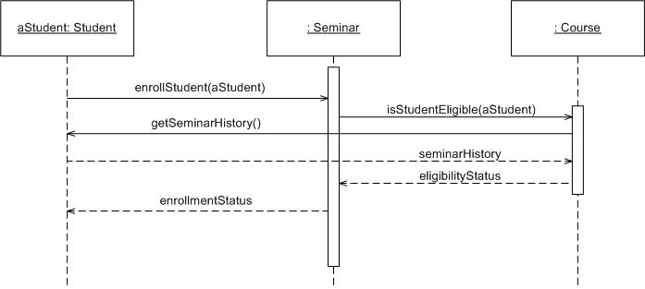
Example

Slide 15
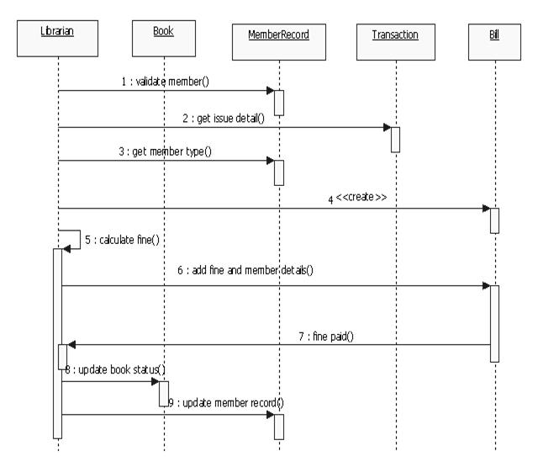

Slide 16
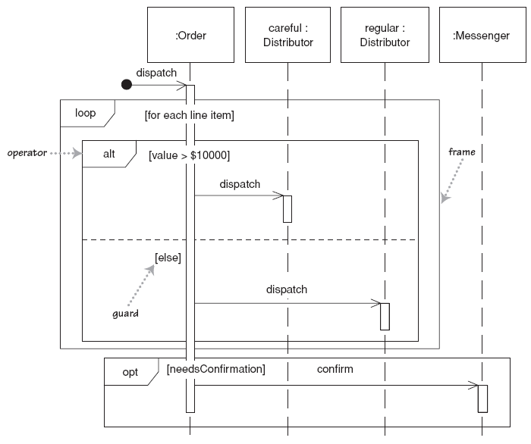
Indicating selection and loops
frame: box around part of a sequence diagram to indicate selection or loop
if -> (opt) [condition]
if/else -> (alt) [condition], separated by horizontal dashed line
loop -> (loop) [condition or items to loop over]

Slide 17
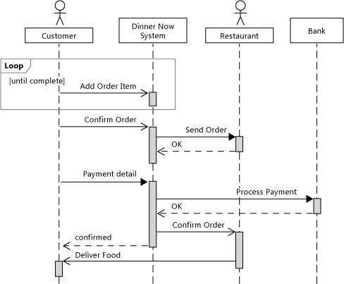
Example

