Slide 1
Component & Deployment Diagram

Slide 2
Physical views
a system model is intended to show the logical and design aspects of the system independent of its final packaging in an implementation medium
The implementation aspects are also important for both reusability and performance purposes
UML includes two kinds of views for representing implementation units
the implementation view
the deployment view.

Slide 3
Implementation View
shows the physical packaging of the reusable pieces of the system into substitutable units, called components
A component is a physical unit of implementation with well-defined interfaces that is intended to be used as a replaceable part of a system
Each component embodies the implementation of certain classes from the system design
a component in a system can be replaced by another component that supports the proper interfaces
The component view shows the network of dependencies among components

Slide 4

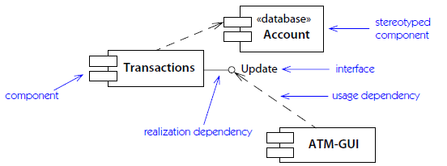
Fig: Component with interfaces
Fig: Component diagram

Slide 5
Deployment view
shows the physical arrangement of run-time computational resources, such as computers and their interconnections called nodes
A node is a run-time physical object that represents a computational resource, generally having at least a memory and often processing capability

Slide 6
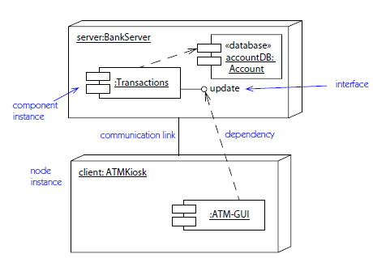

Slide 7
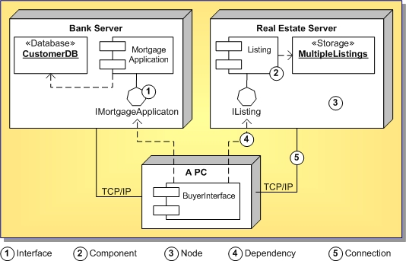

Slide 8
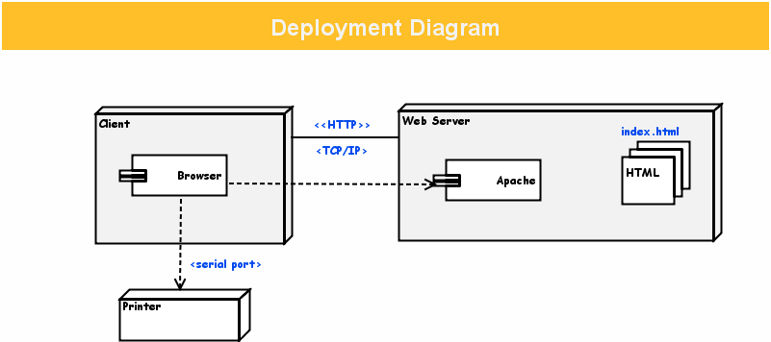

Slide 9
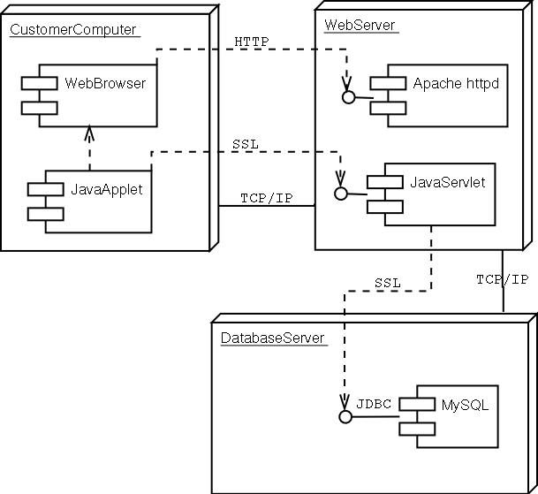

Slide 10
