Slide 1
8051 Programming

Slide 2
Programming Language
High Level Programming – Application Oriented such as C, C++, C#, Java etc
Low Level programming: Assembly Programming
In the early days of the computer, programmers coded in machine language, consisting of 0s and 1s
Tedious, slow and prone to error
Assembly languages, which provided mnemonics for the machine code instructions, plus other features, were developed
An Assembly language program consist of a series of lines of Assembly language instructions
Assembly language is referred to as a low level language
It deals directly with the internal structure of the CPU

Slide 3
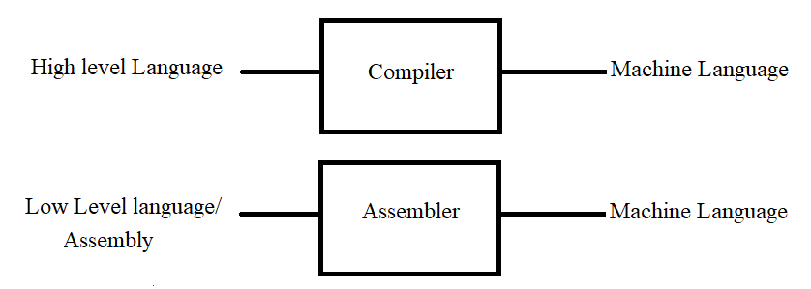
Compiler and Assembler
Compiler: Converts High level language program into machine level programming
Assembler: Converts low level language program into machine level programming

Slide 4
ASSEMBLER DIRECTIVES
The assembling directives give the directions to the CPU. The 8051 microcontroller consists of various kinds of assembly directives to give the direction to the control unit. The most useful directives are 8051 programming, such as:
ORG
DB
EQU
END

Slide 5
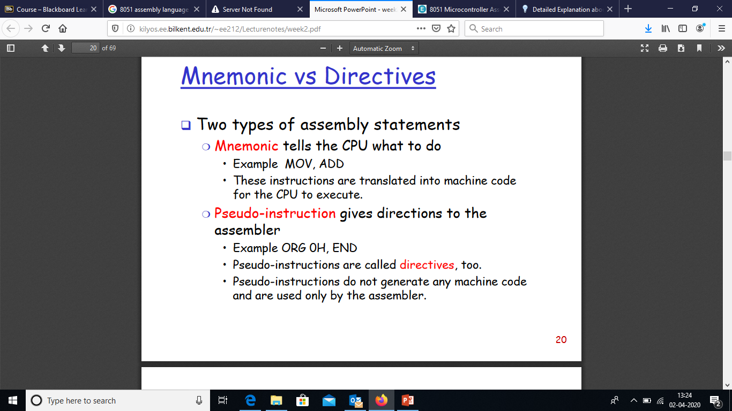

Slide 6
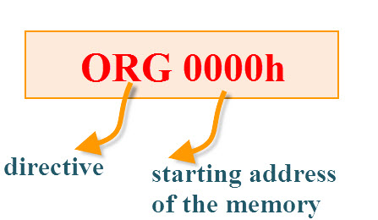
ORG(origin): This directive indicates the start of the program.
This is used to set the register address during assembly.
For example; ORG 0000h tells the compiler all subsequent code starting at address 0000h

Slide 7
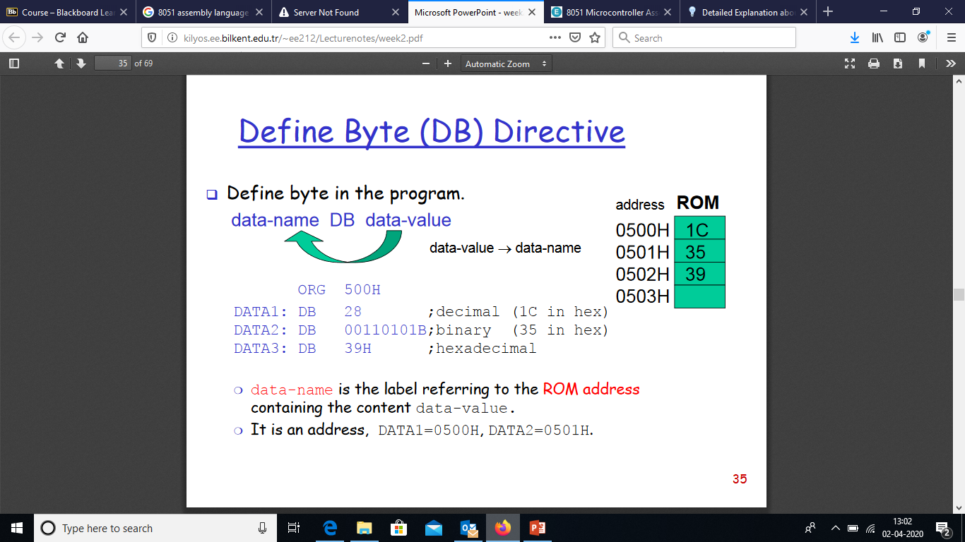

Slide 8
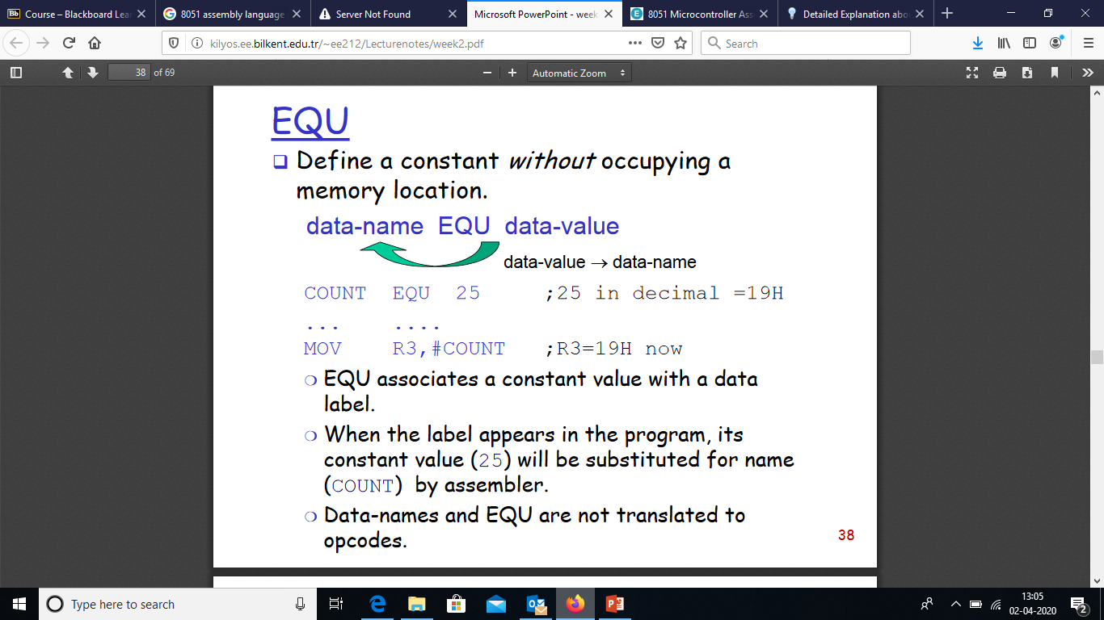

Slide 9
END:The END directive is used to indicate the end of the program.
Syntax:
reg equ,09h
—————– —————– MOV reg,#2h END

Slide 10
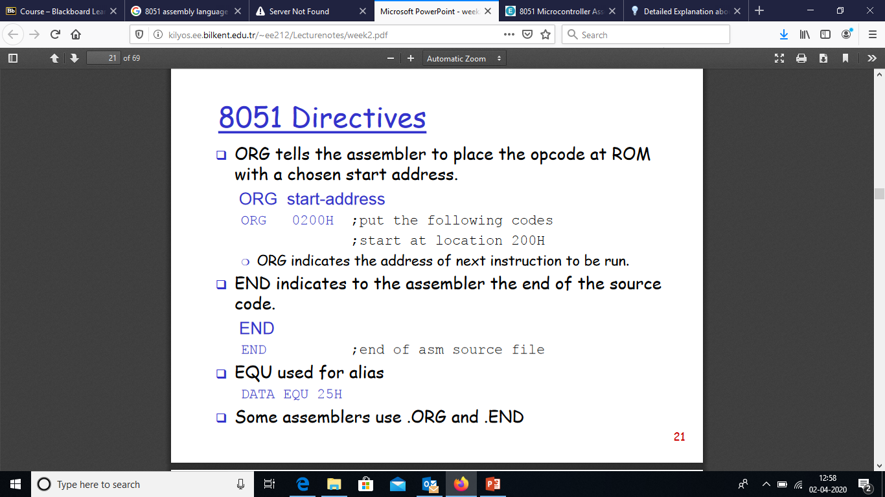

Slide 11
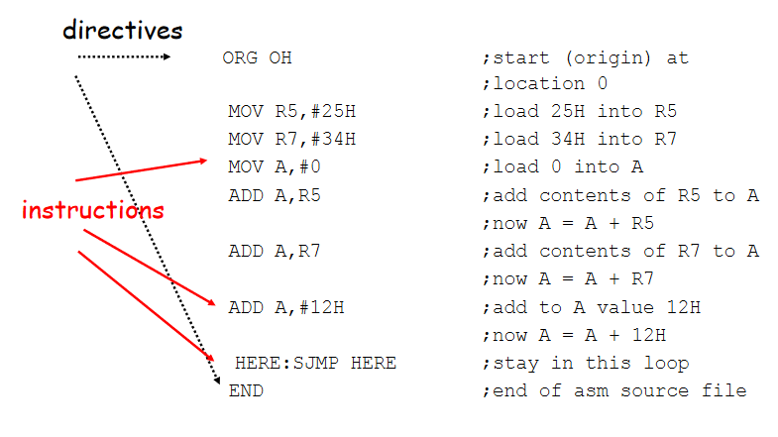

Slide 12
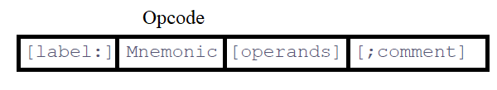
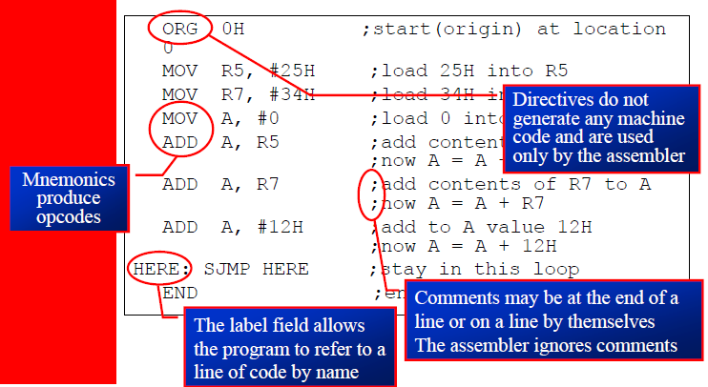
Assembly Programming Format
An Assembly language instruction consists of four fields:

Slide 13
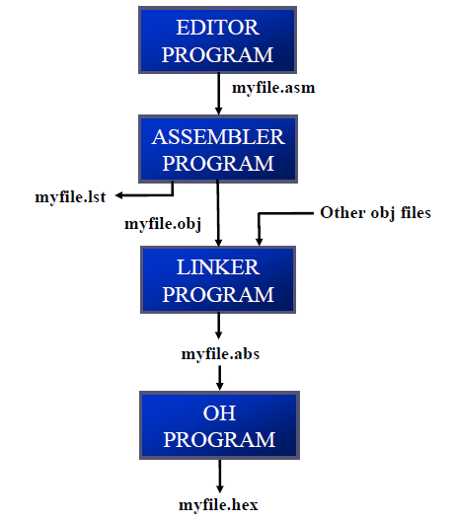
Flow to Run Code with Development Tools

Slide 14
The step of Assembly language are outlines as follows:
Editor: First we use an editor to type a program, many excellent editors or word processors are available that can be used to create and/or edit the program Notice that the editor must be able to produce an ASCII file
For many assemblers, the file names follow the usual DOS conventions, but the source file has the extension “asm“ or “src”, depending on which assembly you are using
Assembler: The “asm” source file containing the program code created in step 1 is fed to
an 8051 assembler :The assembler converts the instructions into machine code
The assembler will produce an object file and a list file
The extension for the object file is “obj” while the extension for the list file is “lst”

Slide 15
Linker and Loader : Assembler require a third step called linking
The linker program takes one or more object code files and produce an absolute object file with the extension “abs”
This abs file is used by 8051 trainers that have a monitor program
Object to Hex Converter (OH) : Next the “abs” file is fed into a program
called “OH” (object to hex converter) which creates a file with extension “hex” that is ready to burn into ROM
This program comes with all 8051 assemblers
Recent Windows-based assemblers combine step 2 through 4 into one step

