Slide 1
Real Time Operating Systems

Slide 2
Introduction to Real-Time Systems
What is a Real-Time System?
It Is defined as a system in which the time where the outputs are produced is significant (within specified bounds or deadlines)
.
RTS
Actuator Outputs
Sensor Data
Commands
Displays
Correctness depends on output values and the time at which
the inputs are processed and the outputs are produced

Slide 3
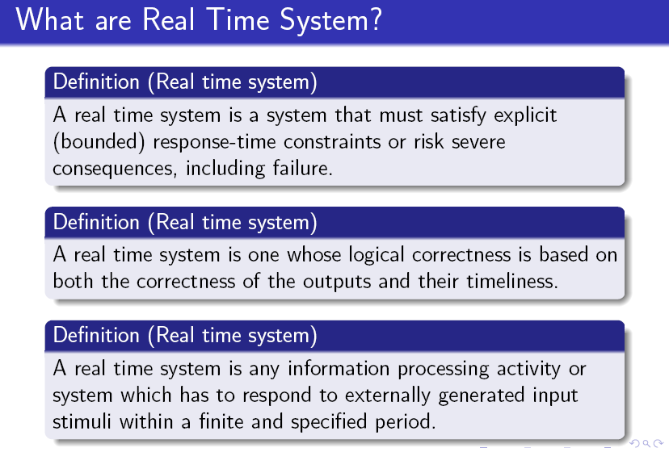

Slide 4
Introduction to Real-Time Systems
Real-time systems often are comprised of a controlling system, controlled system and environment.
A Controlling system: acquires information about the environment using sensors and controls the environment with actuators.
Timing constraints derived from physical impact of controlling systems activities. Hard and soft constraints.
Periodic Tasks: Time-driven recurring at regular intervals (e.g., sensors polling).
Aperiodic Tasks: event-driven (operator commands).

Slide 5
Reference model of real time system
A workload model
A resource model
Algorithms

Slide 6
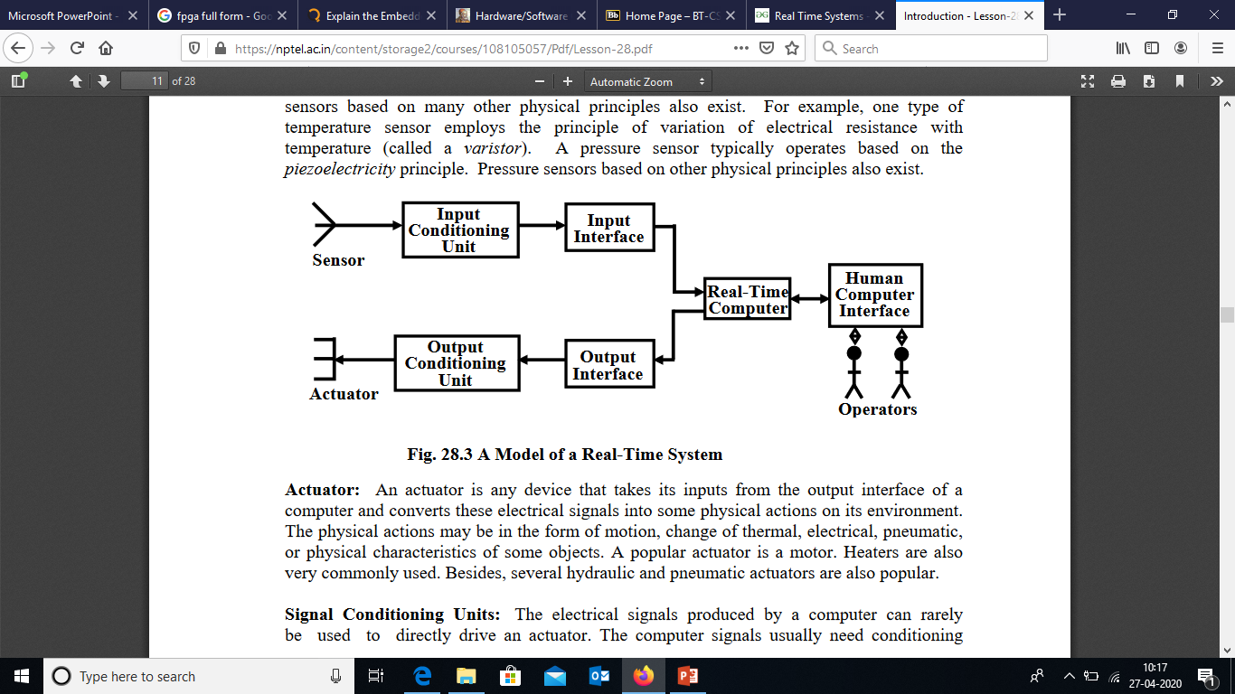
A basic model of real time systems

Slide 7
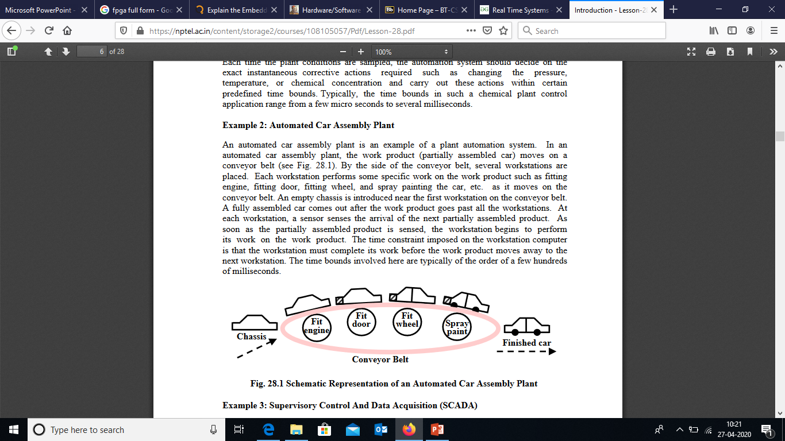
Applications
Automated Car Assembly Plant

Slide 8
Characteristics of RTS
TIME CONSTRAINT
NEW CORRECTNESS CRITERION
EMBEDDED
SAFETY CRITICALITY
CONCURRENCY
DISTRIBUTED & FEEDBACK STRUCTURE
TASK CRITICALITY
CUSTOM HARDWARE
REACTIVE
STABILITY
EXCEPTION HANDLING

Slide 9
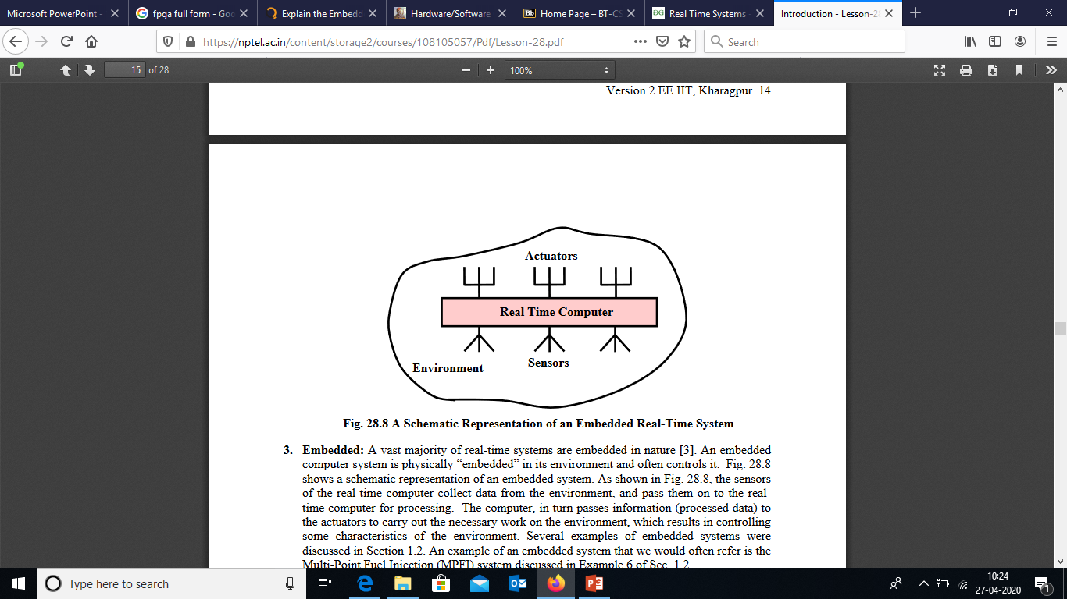
Embedded Real Time Systems

Slide 10
Typical Real-Time System
Operator Interface
Controlled System
Controlling
System
sensor
Environment
sensor
sensor
sensor
actuator
actuator
actuator
actuator

Slide 11
Examples of Real-Time Systems
Process Control and Manufacturing Systems
Operator
Commands
Displays
Controller
Sensor
Data
Control Signals
Raw Material
Plant
Finished Products

Slide 12
Real Time System Concept
Real-time systems are characterized by the severe consequences that result if logical as well as timing correctness properties of the system are not met.
There are two types of real-time systems: SOFT and HARD.
In a SOFT real-time system, tasks are performed by the system as fast as possible, but the tasks don’t have to finish by specific times.
In HARD real-time systems, tasks have to be performed not only correctly but on time.
Most real-time systems have a combination of SOFT and HARD requirements.
Real-time applications cover a wide range, but most real-time systems are embedded.
This means that the computer is built into a system and is not seen by the user as being a computer.
The following list shows a few examples of embedded systems.

Slide 13
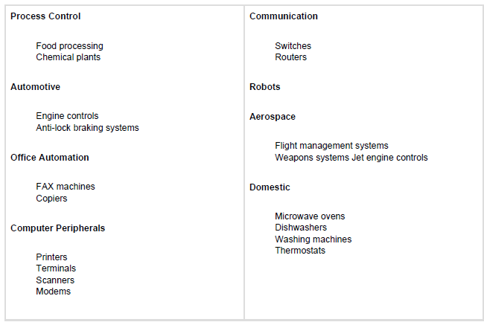
Examples

Slide 14
Task
A task (also called a thread) is a simple program that thinks it has the CPU all to itself.
The design process for a real-time application involves splitting the work to be done into tasks responsible for a portion of the problem

Slide 15
Each task typically is an infinite loop that can be in any one of five states: DORMANT, READY, RUNNING, WAITING (for an event), or ISR (interrupted).
The DORMANT state corresponds to a task that resides in memory but has not been made available to the multitasking kernel.
A task is READY when it can execute but its priority is less than the currently running task. A task is RUNNING when it has control of the CPU.
A task is WAITING when it requires the occurrence of an event (waiting for an I/O operation to complete, a shared resource to be available, a timing pulse to occur, time to expire, etc.).
Finally, a task is in the ISR state when an interrupt has occurred and the CPU is in the process

Slide 16
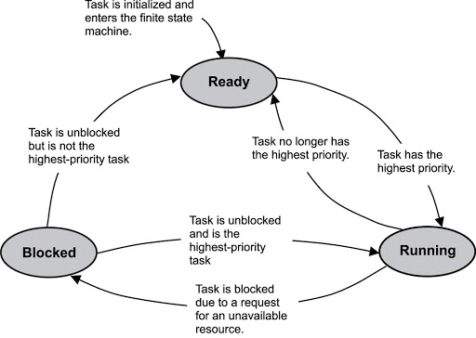

Slide 17
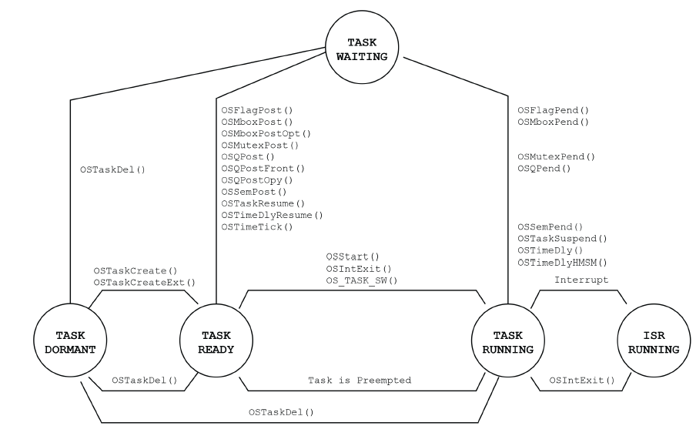
Task States

Slide 18
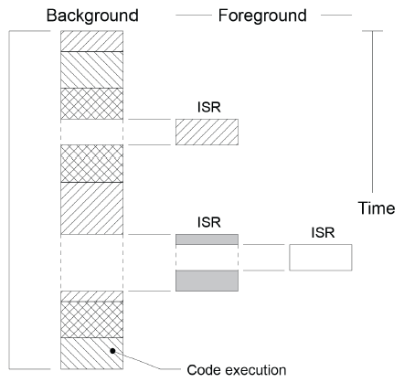
Foreground and Background Systems
Small systems of low complexity are generally designed as shown in Fig.
These systems are called foreground/background or super-loops.
An application consists of an infinite loop that calls modules (i.e., functions) to perform the desired operations (background).
Interrupt Service Routines (ISRs) handle asynchronous events (foreground).

Slide 19
Foreground is also called interrupt level; background is called task level.
Critical operations must be performed by the ISRs to ensure that they are dealt with in a timely fashion.
Because of this, ISRs have a tendency to take longer than they should.
Also, information for a background module made available by an ISR is not processed until the background routine gets its turn to execute. This is called the task level response.
The worst case task-level response time depends on how long the background loop takes to execute.
Because the execution time of typical code is not constant, the time for sucessive passes through a portion of the loop is non-deterministic.
Furthermore, if a code change is made, the timing of the loop is affected.

Slide 20
Multitasking
Multitasking is the process of scheduling and switching the CPU (Central Processing Unit) between several tasks; a single CPU switches its attention between several sequential tasks.
Multitasking is like foreground/background with multiple backgrounds. Multitasking maximizes the utilization of the CPU and also provides for modular construction of applications.
One of the most important aspects of multitasking is that it allows the application programmer to manage complexity inherent in real-time applications.
Application programs are typically easier to design and maintain if multitasking is used.

Slide 21
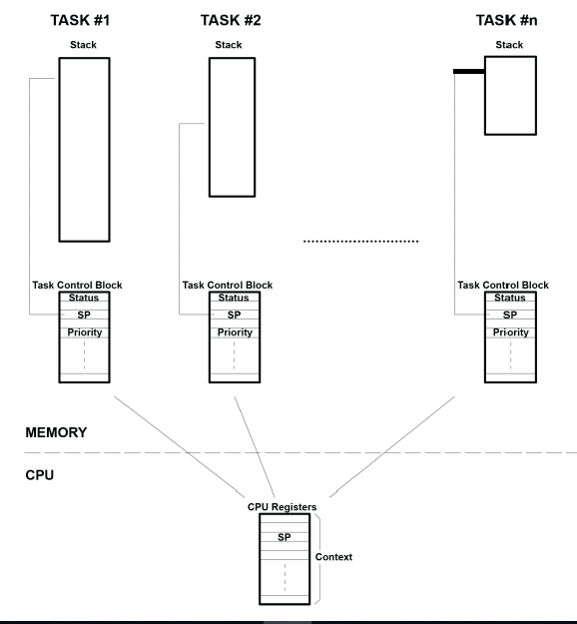
Example Multitasking

Slide 22
Kernel
The kernel is the part of a multitasking system responsible for the management of tasks (i.e., for managing the CPU’s time) and communication between tasks.
The fundamental service provided by the kernel is context switching.
The use of a real-time kernel generally simplifies the design of systems by allowing the application to be divided into multiple tasks managed by the kernel.
There are two types of priority-based kernels: non-preemptive and preemptive.
Kernel Objects : The various kernel objects are Tasks, Task Scheduler, Interrupt Service Routines, Semaphores, Mutexes, Mailboxes, Message Queues, Pipes, Event Registers, Signals and Timers

Slide 23
Non-Preemptive Kernel
Non-preemptive kernels require that each task does something to explicitly give up control of the CPU.
To maintain the illusion of concurrency, this process must be done frequently.
Non-preemptive scheduling is also called cooperative multitasking; tasks cooperate with each other to share the CPU.
Asynchronous events are still handled by ISRs.
An ISR can make a higher priority task ready to run, but the ISR always returns to the interrupted task.
The new higher priority task will gain control of the CPU only when the current task gives up the CPU.

Slide 24
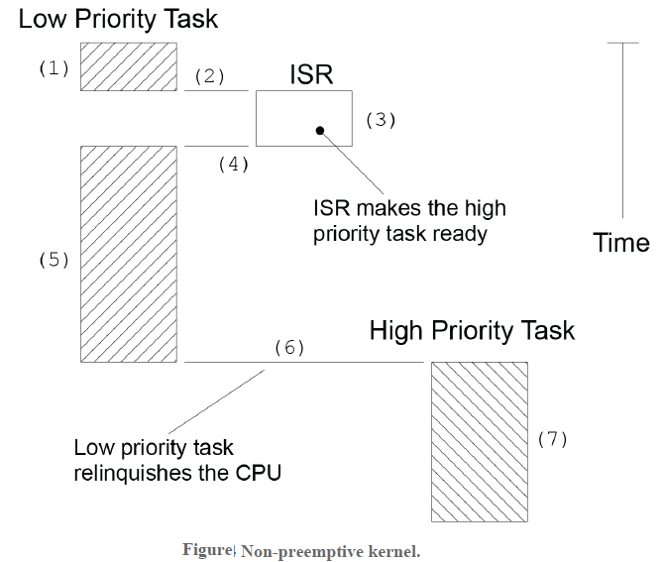
(1) A task is executing but gets interrupted.
(2) If interrupts are enabled, the CPU vectors (jumps) to the ISR.
(3) The ISR handles the event and makes a higher priority task ready to run.
(4) Upon completion of the ISR, a Return From Interrupt instruction is executed, and the

Slide 25
(5) The task code resumes at the instruction following the interrupted instruction.
(6) When the task code completes, it calls a service provided by the kernel to relinquish the CPU to another task.
(7) The kernel sees that a higher priority task has been made ready-to-run (it doesn’t necessarily knows that it was from an ISR nor does it care) and thus, the kernel performs a context switch so that it can run (i.e. execute) the higher priority task to handle the event signaled by the ISR.

Slide 26
The most important drawback of a non-preemptive kernel is responsiveness.
A higher priority task that has been made ready to run may have to wait a long time to run because the current task must give up the CPU when it is ready to do so.
As with background execution in foreground/background systems, task-level response time in a non-preemptive kernel is non-deterministic; you never really know when the highest priority task will get control of the CPU.
It is up to your application to relinquish control of the CPU.
To summarize, a non-preemptive kernel allows each task to run until it voluntarily gives up control of the CPU. An interrupt preempts a task. Upon completion of the ISR, the ISR returns to the interrupted task. Task-level response is much better than with a foreground/background system but is still non-deterministic. Very few commercial kernels are non-preemptive.

Slide 27
Preemptive Kernel
A preemptive kernel is used when system responsiveness is important.
Because of this, μC/OS-II and most commercial real-time kernels are preemptive.
The highest priority task ready to run is always given control of the CPU.
When a task makes a higher priority task ready to run, the current task is preempted (suspended) and the higher priority task is immediately given control of the CPU.
If an ISR makes a higher priority task ready, when the ISR completes, the interrupted task is suspended and the new higher priority task is resumed.

Slide 28
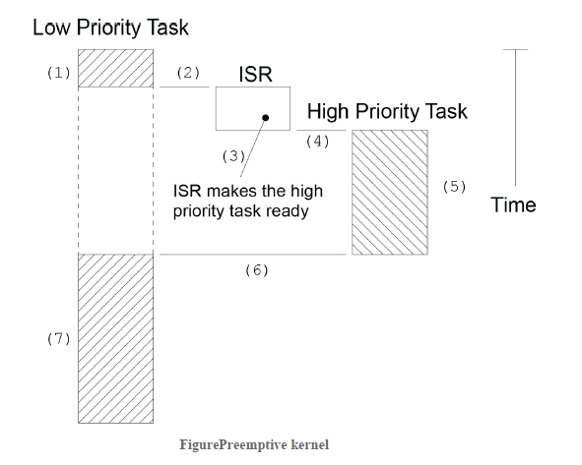
A task is executing but gets interrupted.
(2) If interrupts are enabled, the CPU vectors (jumps) to the ISR.
(3) The ISR handles the event and makes a higher priority task ready to run.

Slide 29
Upon completion of the ISR, a service provided by the kernel is invoked (i.e. a function provided by the kernel is called).
(4) & (5) This function knows that a more important task has been made ready-to-run and thus, instead of returning back to the interrupted task, the kernel will perform a context switch and execute the code of the more important task.
When the more important task is done, another function provided by the kernel is called to put the task to sleep waiting for the event (i.e. the ISR) to occur.
(6) & (7) The kernel then ‘sees’ that a lower priority task needs to execute and another context switch is done to resume execution of the interrupted task.

Slide 30
With a preemptive kernel, execution of the highest priority task is deterministic; you can determine when it will get control of the CPU. Task-level response time is thus minimized by using a preemptive kernel.
Application code using a preemptive kernel should not use non-reentrant functions, unless exclusive access to these functions is ensured through the use of mutual exclusion semaphores, because both a low- and a high-priority task can use a common function. Corruption of data may occur if the higher priority task preempts a lower priority task that is using the function.

Slide 31
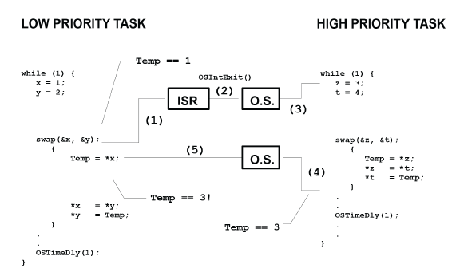
Non-reentrant function.

Slide 32
(1) When swap() is interrupted Temp contains 1.
(2) & (3) The ISR makes the higher priority task ready-to-run, so at the completion of the ISR, the kernel (assuming µC/OS-II) is invoked to switch to this task. The high-priority task sets Temp to 3 and swaps the contents of its variables correctly (i.e., z is 4 and t is 3).
(4) The high-priority task eventually relinquishes control to the low-priority task by calling a kernel service to delay itself for one clock tick (described later).
(5) The lower priority task is thus resumed. Note that at this point, Temp is still set to 3! When the low-priority task resumes execution, it sets y to 3 instead of 1.

Slide 33
Note that this is a simple example, so it is obvious how to make the code reentrant. You can make swap() reentrant with one of the following techniques:
Declare Temp local to swap().
Disable interrupts before the operation and enable them afterwards.
Use a semaphore (described later).
Other situations are not as easy to solve. An error caused by a non-reentrant function may not show up in your application during the testing phase; it will most likely occur once the product has been delivered.
If the interrupt occurs either before or after swap(), the x and y values for both tasks will be correct.

Slide 34
Kernel Objects : The various kernel objects are Tasks, Task Scheduler, Interrupt Service Routines, Semaphores, Mutexes, Mailboxes, Message Queues, Pipes, Event Registers, Signals and Timers

Slide 35
Scheduler
The scheduler, also called the dispatcher, is the part of the kernel responsible for determining which task will run next. Most real-time kernels are priority based.
Each task is assigned a priority based on its importance.
The priority for each task is application specific.
In a priority-based kernel, control of the CPU is always given to the highest priority task ready to run.

Slide 36
Round-Robin Scheduling
When two or more tasks have the same priority, the kernel allows one task to run for a predetermined amount of time, called a quantum, then selects another task.
This is also called time slicing.
The kernel gives control to the next task in line
If the current task has no work to do during its time slice or the current task completes before the end of its time slice or the time slice ends.

Slide 37
Task Priority
A priority is assigned to each task. The more important the task, the higher the priority given to it.
With most kernels, you are generally responsible for deciding what priority each task gets.
Static Priorities
Task priorities are said to be static when the priority of each task does not change during the application’s execution.
Each task is thus given a fixed priority at compile time.
All the tasks and their timing constraints are known at compile time in a system where priorities are static.

Slide 38
Dynamic Priorities
Task priorities are said to be dynamic if the priority of tasks can be changed during the application’s execution; each task can change its priority at run time.
This is a desirable feature to have in a real-time kernel to avoid priority inversions.
Priority Inversions
Priority inversion is a problem in real-time systems and occurs mostly when you use a real-time kernel. illustrates a priority inversion scenario. Task 1 has a higher priority than Task 2, which in turn has a higher priority than Task 3.

Slide 39
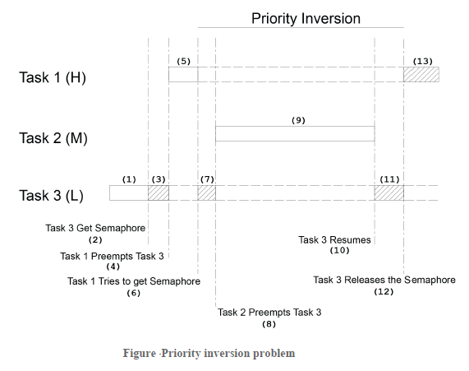

Slide 40
1) Task 1 and Task 2 are both waiting for an event to occur and Task 3 is executing.
(2) At some point, Task 3 acquires a semaphore, which it needs before it can access a shared resource.
(3) Task 3 performs some operations on the acquired resource.
(4) The event that Task 1 was waiting for occurs and thus, the kernel suspends Task 3 and start executing Task 1 because Task 1 has a higher priority.
(5)
(6) Task 1 executes for a while until it also wants to access the resource (i.e. it attempts to get the semaphore that Task 3 owns). Because Task 3 owns the resource, Task 1 is placed in a list of tasks waiting for the semaphore to be freed.
(7)
(8) Task 3 is resumed and continues execution until it is preempted by Task 2 because the event that Task2 was waiting for occurred.
(9)
(10) Task 2 handles the event it was waiting for and, when it’s done, the kernel relinquishes the CPU back to Task 3.
(11)
(12) Task 3 finishes working with the resource and releases the semaphore. At this point, the kernel knows that a higher priority task is waiting for the semaphore, and a context switch is done to resume Task 1.
(13) At this point, Task 1 has the semaphore and can access the shared resource.

Slide 41
Interrupt Service Routines (ISR):
An interrupt service routine (ISR), also known as an interrupt handler, is a callback subroutine in an operating system or device driver whose execution is triggered by the reception of an interrupt.
In a real-time embedded system ,there are two possible interrupts. one is the Hardware Interrupt and the other is the software Interrupt.
Hardware Interrupts are asynchronous interrupts which are triggered by an electric pulse ,where as software interrupts are synchronous interrupts and these are triggered by a command or instruction.
In real-time operating systems, the interrupt latency, interrupt response time and the interrupt recovery time are very important.
Interrupt Latency: It is the time between the generation of an interrupt by a device and the servicing of the device which generated the interrupt. For many operating systems, devices are serviced as soon as the device's interrupt handler is executed
Interrupt Response Time : Time between receipt of interrupt signal and starting the code that handles the interrupt is called interrupt response time.
Interrupt Recovery Time: Time required for CPU to return to the interrupted code/highest priority task is called interrupt recovery time.

Slide 42

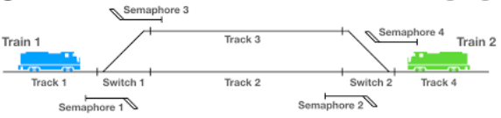
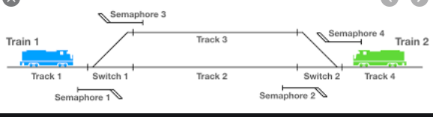
Semaphore
A semaphore is nothing but a value or variable or data which can control the allocation of a resource among different tasks in a parallel programming environment.
Semaphore is a signal between tasks/interrupts that does not carry any additional data.
The meaning of the signal is implied by the semaphore object, so you need one semaphore for each purpose.
The most common type of semaphore is a binary semaphore, that triggers activation of a task.
The typical design pattern is that a task contains a main loop with a RTOS call to “take” the semaphore.
If the semaphore is not yet signaled, the RTOS blocks the task from executing further until some task or interrupt routine “gives” the semaphore, i.e., signals it.
Example: Passing Trains in Real time from one platform at the same time

Slide 43
Use of Semaphore
Managing Shared Resource
Apart from managing shared resource, task synchronization can also be performed with the help of a semaphore. In this case semaphore will be like a flag not key.
Unilateral Rendezvous
This is one way synchronization which uses a semaphore as a flag to signal another task.
Bilateral Rendezvous
This is two way synchronization performed using two semaphores. A bilateral rendezvous is similar to a unilateral rendezvous, except both tasks must synchronize with one another before proceeding.
Operations on Semaphore
Basically, there are 3 operations related to the semaphore:
Create
Acquire
Release

Slide 44
Types of Semaphore
Binary Semaphore
Counting Semaphore
Mutex
Counting Semaphore
To handle more then one shared resource of same type, counting semaphore is used.
Mutual Exclusion Semaphore or Mutex
To avoid extended priority inversion, mutex can be used.

Slide 45
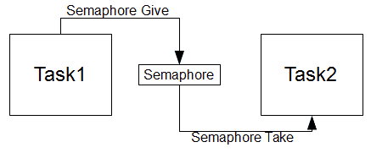
Binary Semaphore
Binary semaphore is used when there is only one shared resource.
A binary semaphore is a synchronization object that can have only two states 0 or 1. i.e not taken and taken.
Take : Taking a binary semaphore brings it in the “taken” state, trying to take a semaphore that is already taken enters the invoking thread into a waiting queue.
Release: Releasing a binary semaphore brings it in the “not taken” state if there are not queued threads. If there are queued threads then a thread is removed from the queue and resumed, the binary semaphore remains in the “taken” state. Releasing a semaphore that is already in its “not taken” state has no effect.
Take the signal - binary (1)
Release the signal- binary (0)

Slide 46
Counting Semaphore
A counting semaphore is a synchronization object that can have an arbitrarily large number of states. The internal state is defined by a signed integer variable, the counter.
The counter value (N) has a precise meaning: The Negative value indicates that , there are exactly -N threads queued on the semaphore.
The Zero value indicates that no waiting threads, a wait operation would put in queue the invoking thread.
The Positive value indicates that no waiting threads, a wait operation would not put in queue the invoking thread.
Two operations are defined for counting the semaphores.
Wait: This operation decreases the semaphore counter .If the result is negative then the invoking thread is queued.
Signal: This operation increases the semaphore counter .If the result is nonnegative then a waiting thread is removed from the queue and resumed.

Slide 47
Mutex:
Mutex means mutual exclusion A mutex is a synchronization object that can have only two states. They are not-owned and owned. Two operations are defined for mutexes
Lock: This operation attempts to take ownership of a mutex, if the mutex is already owned by another thread then the invoking thread is queued.
Unlock: This operation relinquishes ownership of a mutex. If there are queued threads then a thread is removed from the queue and resumed, ownership is implicitly assigned to the thread.
Mutex is basically a locking mechanism where a process locks a resource using mutex.
As long as the process has mutex, no other process can use the same resource. (Mutual exclusion ).
Once process is done with resource, it releases the mutex.
Here comes the concept of ownership.
Mutex is locked and released by the same process/thread.
It cannot happen that mutex is acquired by one process and released by other.
So, Unlike semaphores, mutexes have owners.
A mutex can be unlocked only by the thread that owns it .
Most RTOSs implement this protocol in order to address the Priority Inversion problem. Semaphores can also handle mutual exclusion problems but are best used as a communication mechanism between threads or between ISRs and threads.

Slide 48
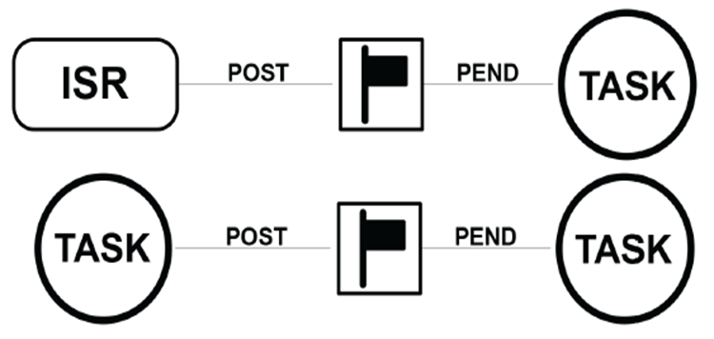
Task Syncronization :
A task can be synchronized with an ISR (or another task when no data is being exchanged) by using a semaphore as shown in Figure .
Note that, in this case, the semaphore is drawn as a flag to indicate that it is used to signal the occurrence of an event (rather than to ensure mutual exclusion, in which case it would be drawn as a key).
When used as a synchronization mechanism, the semaphore is initialized to 0.
Using a semaphore for this type of synchronization is called a unilateral rendezvous.
For example, a task can initiate an I/O operation and then waits for the semaphore.
When the I/O operation is complete, an ISR (or another task) signals the semaphore and the task is resumed. semaphore
It can be used as binary semaphore

Slide 49
Mailboxes: One of the important Kernel services used to sent the Messages to a task is the message mailbox. A Mailbox is basically a pointer size variable. Tasks or ISRs can deposit and receive messages (the pointer) through the mailbox. A task looking for a message from an empty mailbox is blocked and placed on waiting list for a time (time out specified by the task) or until a message is received. Message Queues: The Message Queues ,are used to send one or more messages to a task i.e the message queues are used to establish the Inter task communication. Basically Queue is an array of mailboxes. Tasks and ISRs can send and receive messages to the Queue through services provided by the kernel. Extraction of messages from a queue follow FIFO or LIFO structure. Event Registers: Some kernels provide a special register as part of each tasks control block .This register, called an event register. It consists of a group of binary event flags used to track the occurrence of specific events. Pipes: Pipes are kernel objects that are used to exchange unstructured data and facilitate synchronization among tasks. In a traditional implementation, a pipe is a unidirectional data exchange facility, as shown in below Figure.

Slide 50
Timers
A timer is the scheduling of an event according to a predefined time value in the future, like setting an alarm clock. For instance, the kernel has to keep track of different times.
A particular task may need to be executed periodically, say, every 10ms. A timer is used to keep track of this periodicity.
A task may be waiting in a queue for an event to occur. If the event does not occur for a specified time, it has to take appropriate action.
A task may be waiting in a queue for a shared resource. If the resource is not available for a specified time, an appropriate action has to be taken.
Memory Management
It is a service provided by a kernel which allots the memory needed ,either static or dynamic for various processes.
The manager optimizes the memory needs and memory utilization.
The memory manager allocates memory to the processes and manages it with appropriate protection. There may be static and dynamic allocations of memory.
The manager optimizes the memory needs and memory utilization.

Slide 51
Embedded Software Development Tools
HOST Machine
A computer system on which all the programming tools run –
Where the embedded software is developed, compiled, tested, debugged, optimized, and prior to its translation into target device.
TARGET Machine
After writing the program, compiled, assembled and linked, it is moved to target
After development, the code is cross-compiled, translated – cross-assembled, linked into target processor instruction set and located into the target.

Slide 53
EMBEDDED TOOLS
Compiler
Assembler
Linker
Locator
Debugger
Emulator
Simulator
Profiler

Slide 54
COMPILER
A software program that converts source code that in high level programming language into low level language.
A Native-compiler runs on a computer platform and produces code for that same computer platform.
A Cross-compiler runs on one computer platform and produces code for another computer platform.
ASSEMBLER
An Assembler is software program that converts source code written in assembly language into machine language.
The input to the Assembler must be assembly language.
An Assembler that runs on Host but produces binary instruction appropriate for Target is called Cross- Assembler.
LINKER
A linker or link editor is a program that takes one or more objects generated by compilers and assembles them into a single executable program or a library that can later be linked to in itself.
All of the object files resulting from compiling must be combined in a special way before the program can be executed.
LOCATOR
A Locator is the tool that performs the conversion from relocatable program to executable binary image.
It will produce an output file that contains a binary image that can be loaded into the target ROM.
You will have to provide information about the memory on the target board as input to the locator.
The locator uses this information to assign physical memory addresses to each of the code and data sections.

Slide 55
DEBUGGER
A debugger or debugging tool is a computer program that is used to test and debug other programs.
The code to be examined might alternatively be running on an instruction set simulator .
When the program crashes, the debugger shows the actual position in the original code if it is a source-level debugger.
If it is a low-level debugger or a machine-language debugger it shows that line in the program.
EMULATOR
An emulator is a piece of Hardware/Software that enables one computer system to run programs that are written for another computer system.
An emulator is used on the target processor (the processor for which the program is being written).
SIMULATOR
Simulator is a piece of Hardware/Software that simulates another system. for example a flight simulator allows you to experience what it is like to fly an aircraft, a driving simulator to experience driving etc..
Simulator tests the program on the development processor(the processor on which we are working).
PROFILER
A Software Program that gathers information about a program during execution.
It is used to know which areas of code to optimize Speed and Memory.
Profiler may show time elapsed in each function and its descendants number of calls , call-graph (some)

Slide 56
Getting embedded software into the target system: • The locator will build a file as an image for the target software. There are few ways to getting the embedded software file into target system. – PROM programmers – ROM emulators – In circuit emulators – Flash – Monitors

Slide 57
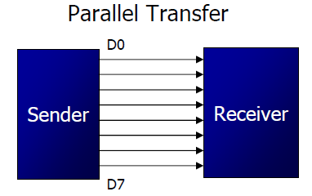
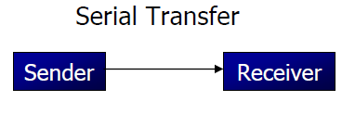
Fundamental of Serial Communication
Computers transfer data in two ways:
Parallel: Often 8 or more lines (wire conductors) are used to transfer data to a device that is only a few feet away
Serial: To transfer to a device located many meters away, the serial method is used. The data is sent one bit at a time
At the transmitting end, the byte of data must be converted to serial bits using parallel-in-serial-out shift register.
If data is to be transferred on the telephone line, it must be converted
from 0s and 1s to audio tones. This conversion is performed by a device called a modem, “Modulator/demodulator”

Slide 58
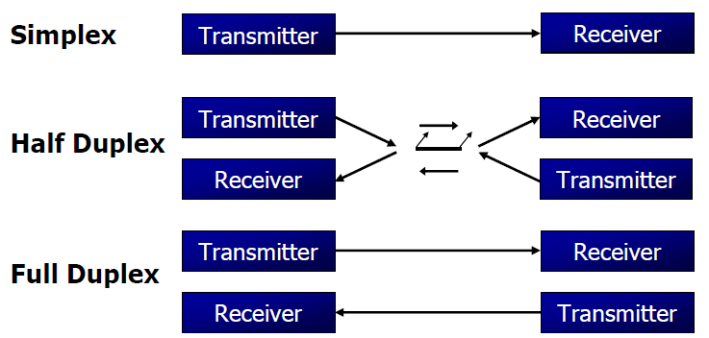
Modes of Serial Communication
Serial data communication uses two methods
Synchronous method transfers a block of data at a time
Asynchronous method transfers a single byte at a time
If data can be transmitted and received, it is a duplex transmission
If data transmitted one way a time, it is referred to as half duplex
If data can go both ways at a time, it is full duplex
Simplex is only one way communication from transmitter to receiver

Slide 59
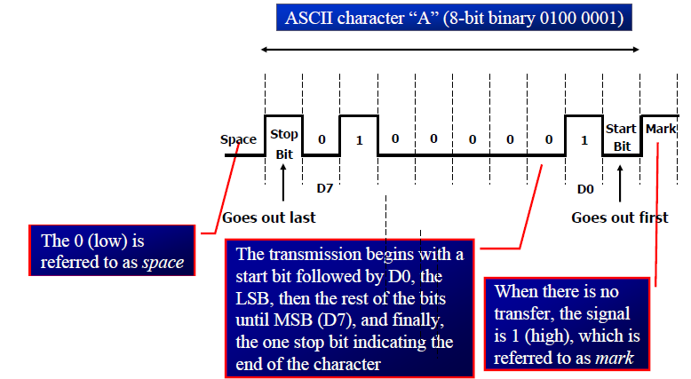
Asynchronous Data Format
The start bit is always one bit, but the
stop bit can be one or two bits
The start bit is always a 0 (low) and the
stop bit(s) is 1 (high)
There are special IC chips made by many
manufacturers for serial communications
UART (universal asynchronous Receiver transmitter)
USART (universal synchronous-asynchronous
Receiver-transmitter)

Slide 60
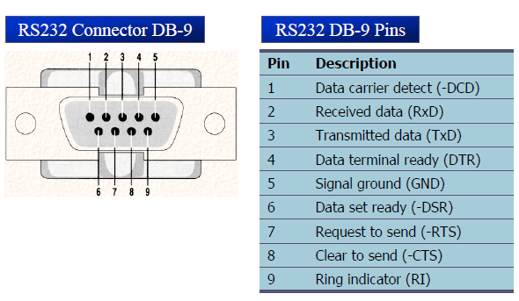
RS-232 and DB-9 Connector
An interfacing standard RS232 was set by the Electronics Industries Association (EIA) in 1960
The standard was set long before the advent of the TTL logic family, its input and output voltage levels are not TTL compatible
In RS232, a 1 is represented by -3 ~ -25 V, while a 0 bit is +3 ~ +25 V, making -3 to +3 undefined
Since not all pins are used in PC cables, IBM introduced the DB-9 version of the serial I/O standard

Slide 61
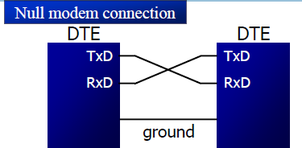
Current terminology classifies data communication equipment as
DTE (data terminal equipment) refers to terminal and computers that send and receive data
DCE (data communication equipment) refers to communication equipment, such as modems
The simplest connection between a PC and microcontroller requires a minimum of three pins, TxD, RxD, and ground
DTR (data terminal ready): When terminal is turned on, it sends out signal DTR to indicate that it is ready for communication
DSR (data set ready): When DCE is turned on and has gone through the self-test, it assert DSR to indicate that it is ready to communicate
RTS (request to send): When the DTE device has byte to transmit, it assert RTS to signal the modem that it has a byte of data to transmit
CTS (clear to send): When the modem has room for storing the data it is to receive, it sends out signal CTS to DTE to indicate that it can receive the data now
DCD (data carrier detect): The modem asserts signal DCD to inform the DTE that a valid carrier has been detected and that contact between it and the other modem is established
RI (ring indicator): An output from the modem and an input to a PC indicates that the telephone is ringing. It goes on and off in synchronous with the ringing sound
TXD- Transmit the data
RXD- Receive the data
GND- Ground

