Slide 1
CGPA CALCULATOR A GUI PROJECT
COUSE CODE : INT 213
SUBMITTED TO : MS CHAVI KAPOOR
SUBMITTED BY: Ayush sharma (11903484)
Abhishek Rana (11915679)
Rohan Pandey (11902091)

Slide 2
CONTENTS
OBJECTIVE
DESCRIPTION OF THE PROJECT
STUDENT ROLE AND RESPONSIBILITY
MODULE USED -TKINTER
LEARNING OUTCOME AND CONCLUSION
BIBLIOGRAPHY

Slide 3
OBJECTIVES
Create a GUI of CGPA Calculator and understand its working.
To create a user friendly interface which can be accessed by everyone easily.
To understand the working of various modules which are being used to create this interface.

Slide 4
DESCRIPTION OF THE PROJECT
The project includes the following:
The with 7 subjects with input fields in front of them where user is supposed to enter inputs.
Button to calculate Cgpa
Buttons to calculate Tgpa of 2 semesters
Display of results in message boxes

Slide 5
STUDENT ROLE AND RESPONSIBILITY
Ayush Sharma :
Design layout using GUI.
Program Logic to calculate TGPA and CGPA.
Designing functions for calculation of
CGPA using its formulas.
Abhishek Rana:
Making forms and text fields.
Creating action buttons.
Rohan Pandey :
Widgets (Labels)
Documentation(Report and ppt)

Slide 6
ABOUT THE PROJECT…
Include 6 different modules BMI Calculator, Vo2 Max Calculator, Report Generator, BMR Calculator, BFC Calculator and Calorie Calculator.
Includes SQL database connectivity that helps the use to store the report and then fetch it

Slide 7

Module used- Tkinter
Tkinter is the standard GUI library for Python. Python when combined with Tkinter provides a fast and easy way to create GUI applications. Tkinter provides a powerful object-oriented interface to the Tk GUI toolkit.

Slide 8
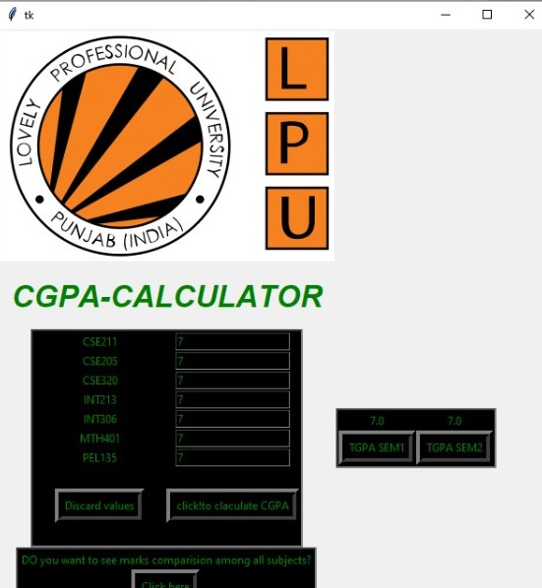
1. Interface

Slide 9
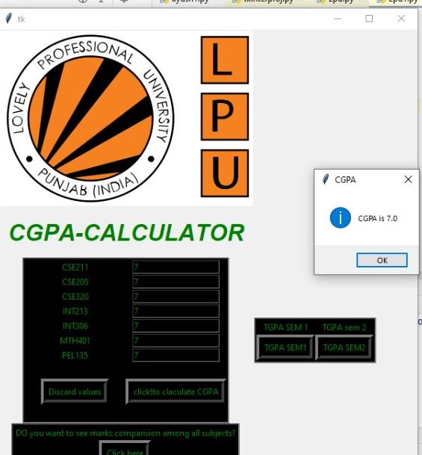
2. Display CGPA

Slide 10
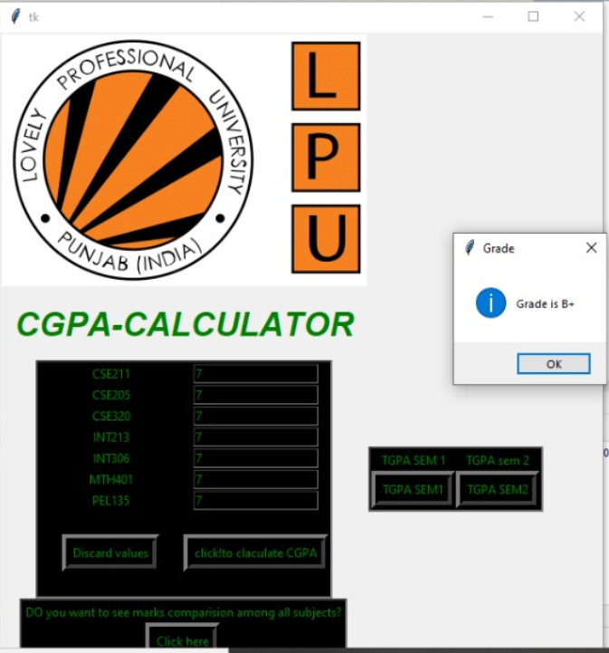
3. Display Grade

Slide 11
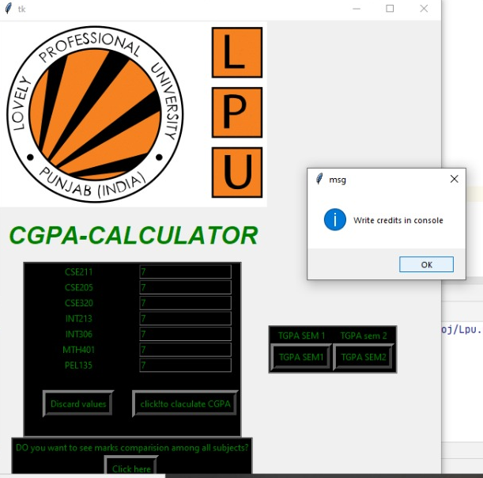
4. Prompt for calculating TGPA

Slide 12
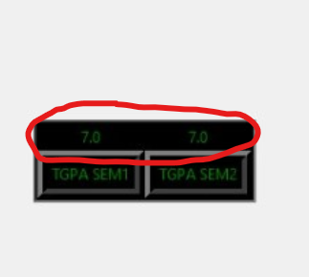
5. Display of TGPA

Slide 13
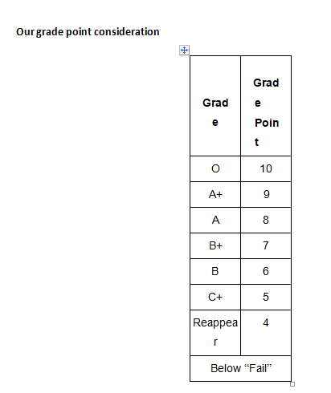

Slide 14
Learning Outcome and Conclusion
Learnt to make a GUI using Tkinter in Python.
We learnt the practical use of python and Tkinter to make an interactive graphical user interface.
We explored the usage of basic python statements like ‘If else’ and creating functions in implementing our project for CGPA calculator where the logic was developed using the basic if-else statements and method calls.
We learnt about the usage of Tkinter module for a full fledged project

Slide 15
BIBLIOGRAPHY
* https://www.tutorialspoint.com/python/python_gui_programming.htm
* https://readthedocs.org/projects/python-guide/downloads/pdf/latest/
* www.w3resource.com/python/python-tutorial.php

Slide 16
Thank You

