Slide 1

MINI PROJECT | FINAL EVALUATION
Real-Time Network Intrusion Detection System
using Packet Inspection and Web-Based Alerting
Rohan Pandey
Roll No. 2501720100117 | Section 2D
Guide: Mr. Vikas, Assistant Professor
Department of Computer Science & Engineering & Allied Branches
Lloyd Institute of Management and Technology | Session 2026-27
Notes:
Good morning. This is the final evaluation of my real-time network intrusion detection system. The project is complete: it captures live traffic, detects three attacks with transparent rules, and shows alerts on a web dashboard. I will cover the problem, the design, the implementation, the testing and the results.

Slide 2
Problem Statement
ATTACKS DETECTED
Small networks have no real-time way to see attacks as they happen.
Port Scan
tries every port to find an open one
Where: homes, hostels and college labs
Today: attacks pass unseen in the packets
Gap: tools are manual, complex or unexplainable
Need: light, explainable, alerts within a second
SYN Flood
floods a server with half-open connections
ARP Spoofing
puts the attacker in the middle of traffic
Real-Time NIDS | Rohan Pandey | Final Evaluation
2
Notes:
Homes, hostels and labs have no monitoring. Three common attacks leave clear patterns in packets but go unnoticed. Existing tools do not fit: Wireshark only captures and does not alert, Snort and Zeek need expert setup and write to log files, and machine learning systems cannot explain an alert. My system detects all three attacks, explains every alert, and shows them live.

Slide 3
Objectives: All Achieved
✓
Capture live TCP, UDP and ARP packets
✓
Detect port scans with a sliding-window rule
✓
Detect SYN floods from half-open handshakes
✓
Detect ARP spoofing from a trust table
✓
Alert pipeline to a Node.js and Express server
✓
Live web dashboard, updated without refresh
✓
Automated tests and measured performance
All seven objectives were met. All three attack rules are implemented, tested and shown live on the dashboard.
Real-Time NIDS | Rohan Pandey | Final Evaluation
3
Notes:
Every objective set in the synopsis has been achieved. Unlike the mid-term, where only the port-scan rule worked, all three rules are now complete, tested and demonstrated.

Slide 4
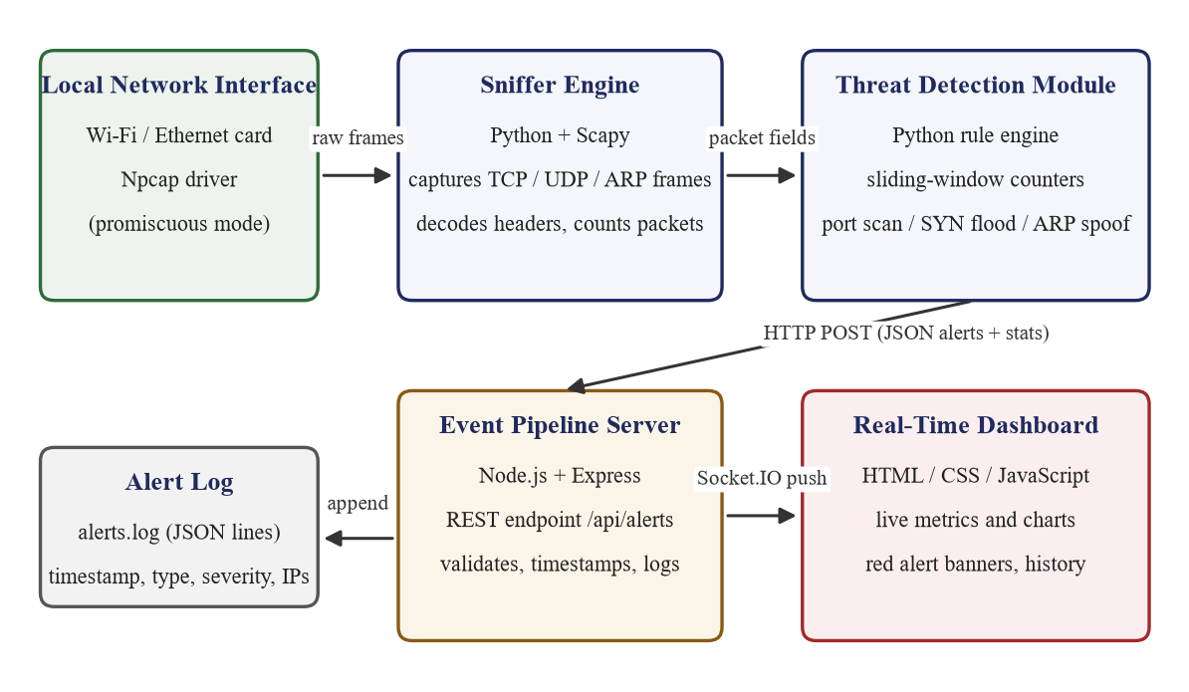
System Architecture
Real-Time NIDS | Rohan Pandey | Final Evaluation
4
Packets flow left to right; alerts flow from the detector to the browser. Python captures, Node.js serves, the browser displays.
Notes:
The sensor captures packets with Scapy and runs the rules. Alerts go as JSON over HTTP to the Node.js server, which logs them and pushes them to the dashboard through Socket.IO.

Slide 5
Technology Stack
CAPTURE
SENSOR
RULES
Npcap 1.89
Python 3.13 + Scapy 2.8
Python standard library
raw packets on Windows
decodes IP, TCP, UDP, ARP
deque window, set of ports
SERVER
LIVE PUSH
DASHBOARD
Node.js 24 + Express 5
Socket.IO 4
HTML, CSS, JS + Chart.js
receives alerts by HTTP POST
alerts reach the browser instantly
live chart, table and banner
Storage: JSON alert log Testing: unittest, Nmap, Wireshark Tools: VS Code, Git, GitHub
Real-Time NIDS | Rohan Pandey | Final Evaluation
5
Notes:
Each tool is used where it is strongest. The two halves talk over HTTP with small JSON messages, so each can be tested on its own.

Slide 6
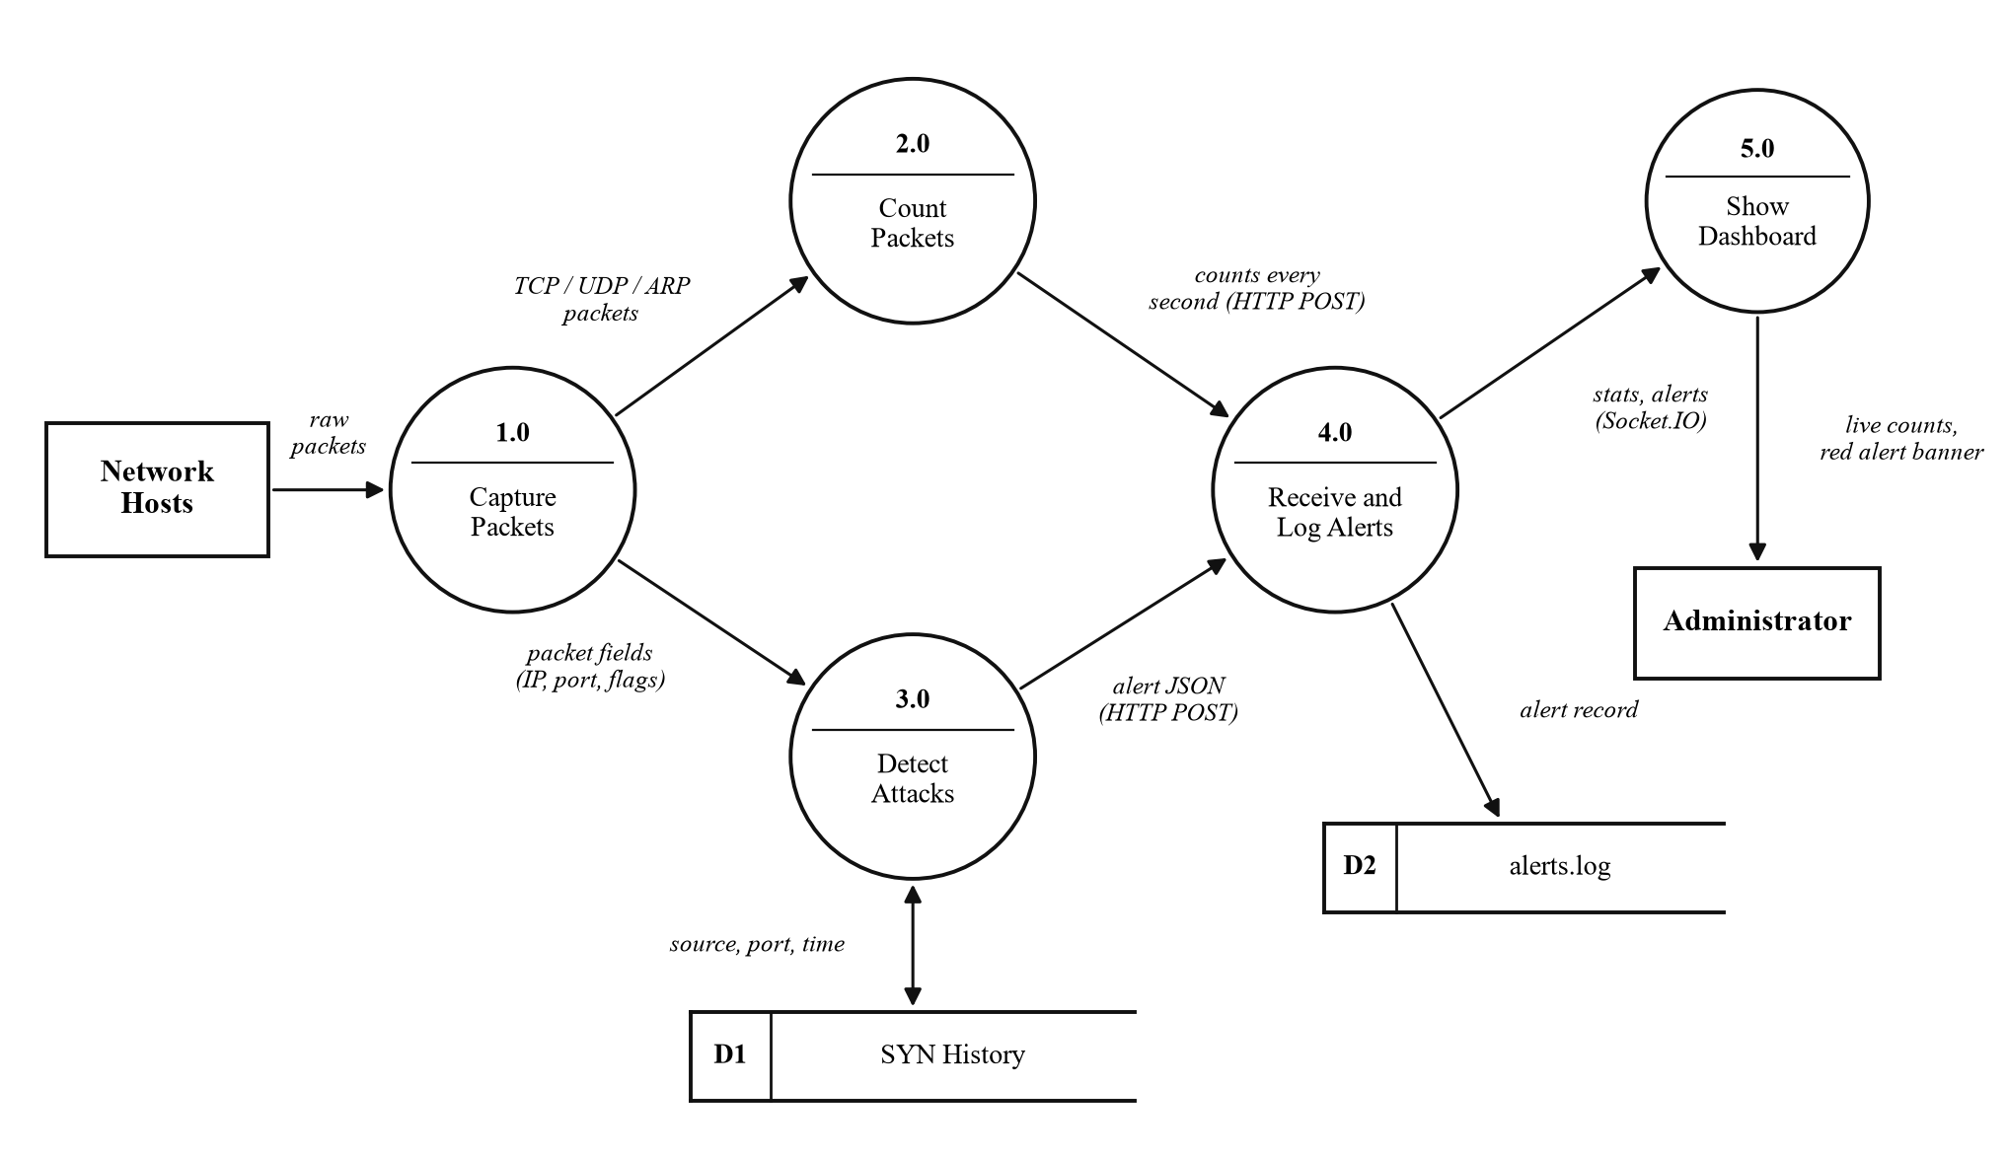
System Design
DESIGN ARTEFACTS
Context and level-1 DFDs
Use-case diagram
Sequence diagram
Component diagram
Deployment diagram
Flowchart of the port-scan rule
Level-1 Data Flow Diagram
All diagrams are in the report, numbered chapter-wise as Fig. 3.1 to 4.2.
Real-Time NIDS | Rohan Pandey | Final Evaluation
6
Notes:
The design was captured in standard diagrams: data-flow, use-case, sequence, component and deployment, plus a flowchart of the detection logic. The level-1 data-flow diagram shown here breaks the system into five processes.

Slide 7
Detection Rules
Port Scan
SYN Flood
ARP Spoofing
> 15 distinct ports
100+ half-open SYNs
gateway IP seen
from one source
to one host
with a different
within 5 seconds
few completed
MAC address
medium
high
critical
All rules are deterministic. Each keeps a few seconds of history in a sliding window, compares a count against a threshold, and raises an alert with a cool-down so one attack gives one alert.
Real-Time NIDS | Rohan Pandey | Final Evaluation
7
Notes:
Each rule is a simple threshold on a counter. The port scan counts distinct ports, the SYN flood counts half-open handshakes, and the ARP rule watches for a changed gateway MAC. Every alert can be explained by its counter and threshold, which is the key advantage over machine learning.

Slide 8
Testing
UNIT TESTS
INTEGRATION TESTS
10 / 10
tests passing
one per rule, with
positive and negative cases
Real port scan and SYN flood against the host
Alert reached the dashboard and log in a few ms
No false alarm during normal browsing
What the negative tests confirm
✓
Reply (SYN-ACK) packets are not a scan
✓
Slow activity below the threshold stays silent
✓
Completed handshakes are not a flood
✓
A port scan is not mistaken for a flood
✓
Genuine ARP replies raise no alarm
✓
A cool-down stops duplicate alerts
Real-Time NIDS | Rohan Pandey | Final Evaluation
8
Notes:
Ten unit tests feed crafted packets straight to the detector and all pass. The negative tests matter as much as the positive ones, because a detector that cries wolf would be ignored. Integration tests confirmed the whole pipeline with real attacks against my own machine.

Slide 9
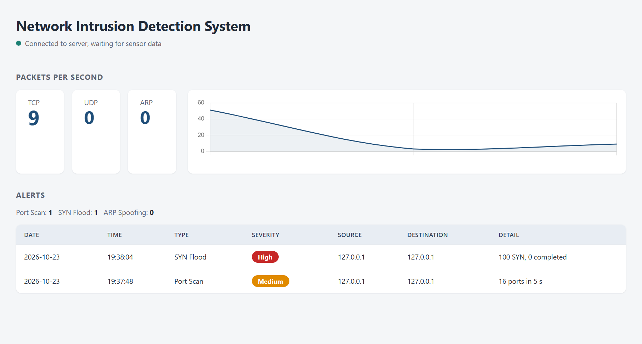
Results: Live Dashboard
3
attacks detected
~2 ms
detection latency
10/10
unit tests pass
~200
lines of code
Dashboard after detecting a port scan and a SYN flood
Real-Time NIDS | Rohan Pandey | Final Evaluation
9
Notes:
This is the real dashboard during testing. The medium port-scan alert and the high SYN-flood alert are both shown, with the live chart and the per-type totals. Detection latency was about two milliseconds, and no false alarm was raised during normal browsing.

Slide 10
Conclusion and Future Scope
A complete, working NIDS. All objectives met: live capture, three transparent detection rules, an alert pipeline, and a real-time dashboard, verified by ten unit tests and live attacks, in about 200 lines of code.
KEY STRENGTHS
FUTURE SCOPE
✓
Every alert traceable to a threshold
More rules: ICMP flood, DNS tunnelling
✓
Real-time: under one second
E-mail or messaging notifications
✓
Small, readable, easy to extend
Store alerts in SQLite, searchable
✓
Fails safely if the server is down
Authenticate the sensor to the server
Active response: firewall the attacker
Thank you. Questions are welcome. github.com/rohanpandey436/realtime-nids
Real-Time NIDS | Rohan Pandey | Final Evaluation
10
Notes:
In conclusion, the project is a complete and working intrusion detection system that meets every objective and is small enough to explain in full. The modular rule engine means each future extension can be added and tested on its own. Thank you, I am happy to take questions or show any part of the code or the live demo.

