Slide 1

MINI PROJECT | EVALUATION 1
Real-Time Network Intrusion Detection System
using Packet Inspection and Web-Based Alerting
Rohan Pandey
Roll No. 2501720100117 | Section 2D
Guide: Mr. Vikas
Department of Computer Science & Engineering
Lloyd Institute of Management and Technology, Greater Noida
Session 2026-27
Notes:
Good morning. My project is a real-time network intrusion detection system. It captures live packets, detects attacks with clear rules, and shows alerts instantly on a web dashboard.

Slide 2
Problem Statement
ATTACKS THIS SYSTEM TARGETS
Small networks have no real-time way to see attacks as they happen.
1
Port Scan
Tries every door to find an open one
Where: homes, hostels and college labs
Today: attacks pass unseen in the packets
Gap: tools are manual, complex or unexplainable
Need: light, explainable, alerts within a second
2
SYN Flood
Floods a server with half-open connections
3
ARP Spoofing
Puts the attacker in the middle of your traffic
Real-Time NIDS | Rohan Pandey | Evaluation 1
2
Notes:
Homes, hostels and college labs have almost no monitoring. Port scans, SYN floods and ARP spoofing leave clear patterns in packets, but nobody watches them. Existing tools are manual, need experts, or cannot explain their alerts. So I need something light, explainable and real time.

Slide 3
Objectives
1
Done
2
Done
3
Done
Capture live packets
Detect port scans
Live web dashboard
TCP, UDP and ARP from Wi-Fi
More than 15 ports in 5 seconds
Counts and red alerts, no refresh
4
Next
5
Next
6
Next
Detect SYN floods
Detect ARP spoofing
Test and measure
Many SYNs, no completed handshakes
Gateway IP with a new MAC address
Detection time and false alarms
Real-Time NIDS | Rohan Pandey | Evaluation 1
3
Notes:
These are my six objectives. The first three are working today: live capture, port scan detection and the live dashboard. SYN flood and ARP spoofing detection and the testing come in the next round.

Slide 4
Existing Systems and the Gap
Existing tool | What it does well | Gap for small networks
Wireshark | Captures and decodes every packet | Manual inspection, no automatic alerts
Snort, Suricata | Professional rule-based detection | Complex rules, expert setup, log files
Zeek | Deep analysis with scripts | Steep learning curve, no live dashboard
ML-based IDS | High accuracy on test datasets | Black box, needs training data
PROPOSED SYSTEM
Lightweight
Explainable
Live
About 150 lines, runs on a laptop
Every alert shows its threshold
Alert on the dashboard in under 1 second
Real-Time NIDS | Rohan Pandey | Evaluation 1
4
Notes:
Wireshark shows packets but does not warn. Snort and Suricata warn but need an expert. Zeek has no live view, and machine learning cannot explain itself. Mine is small, explains every alert and shows it live. It does not replace Snort; it is built for small networks and learning.

Slide 5
System Architecture
Network
packets
Sensor
fields
Detection Rules
Wi-Fi card and loopback adapter
Python and Scapy capture through Npcap
Port scan: working
SYN flood, ARP spoof: next
HTTP POST (JSON)
Administrator
views
Live Dashboard
Socket.IO
Server
Sees live counts and red alerts
HTML, CSS and JavaScript
Node.js and Express: check, log, forward
append
alerts.log (JSON lines)
Real-Time NIDS | Rohan Pandey | Evaluation 1
5
Notes:
Packets come from the Wi-Fi card and the loopback adapter. The Python sensor captures them with Scapy through Npcap and passes the fields to the detection rules. Alerts go as JSON by HTTP POST to the Node.js server, which saves them in alerts.log and pushes them to the dashboard through Socket.IO.

Slide 6
Technology Stack
CAPTURE
SENSOR
RULES
Npcap 1.89
Python 3.13 and Scapy 2.8
Python standard library
Reads raw packets on Windows
Decodes IP, TCP, UDP and ARP
deque window and set of ports
SERVER
LIVE PUSH
DASHBOARD
Node.js 24 and Express 5
Socket.IO 4
HTML, CSS, JavaScript
Receives alerts by HTTP POST
Alerts reach the browser instantly
Runs in any browser
Storage: alerts.log, SQLite planned
Testing: scan_test.py, Nmap, Wireshark
Tools: VS Code, Git
Real-Time NIDS | Rohan Pandey | Evaluation 1
6
Notes:
Npcap lets Windows programs read raw packets. Scapy splits each packet into layers. The rules use only Python's standard library. Node.js with Express receives alerts, Socket.IO pushes them live, and the dashboard is plain HTML, CSS and JavaScript.

Slide 7
Methodology
Development model: Incremental, each round adds a working module
Round 1
Done
Round 2
Next
Round 3
Next
Till 10 October
Till 30 October
November
Capture, port scan, server, dashboard
SYN flood and ARP spoofing rules
Testing, report and final demo
How the system works
1
2
3
4
5
Capture
Count
Detect
Deliver
Display
Scapy and Npcap with a packet filter
TCP, UDP and ARP every second
Rules run on every packet
HTTP POST to Express, saved to log
Socket.IO pushes to the dashboard
Real-Time NIDS | Rohan Pandey | Evaluation 1
7
Notes:
I follow the incremental model. Round 1, finished today, gives capture, port scan detection, the server and the dashboard. Round 2 adds SYN flood and ARP spoofing. Round 3 is testing and the report. Inside the system, each packet is captured, counted, checked by the rules, delivered to the server and displayed.

Slide 8
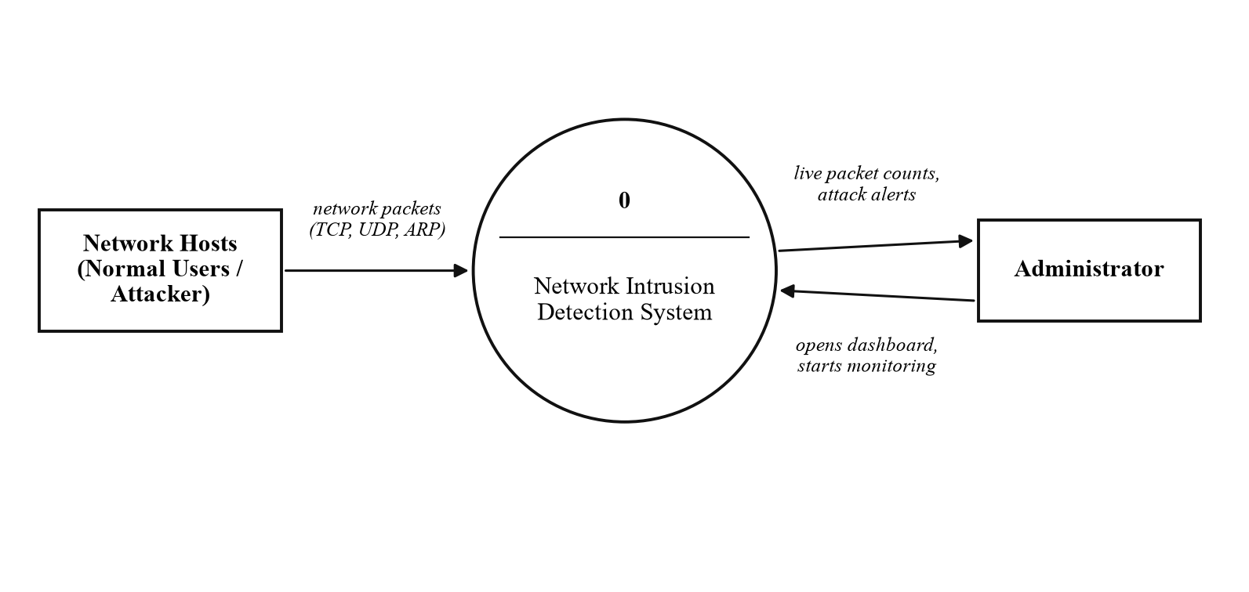
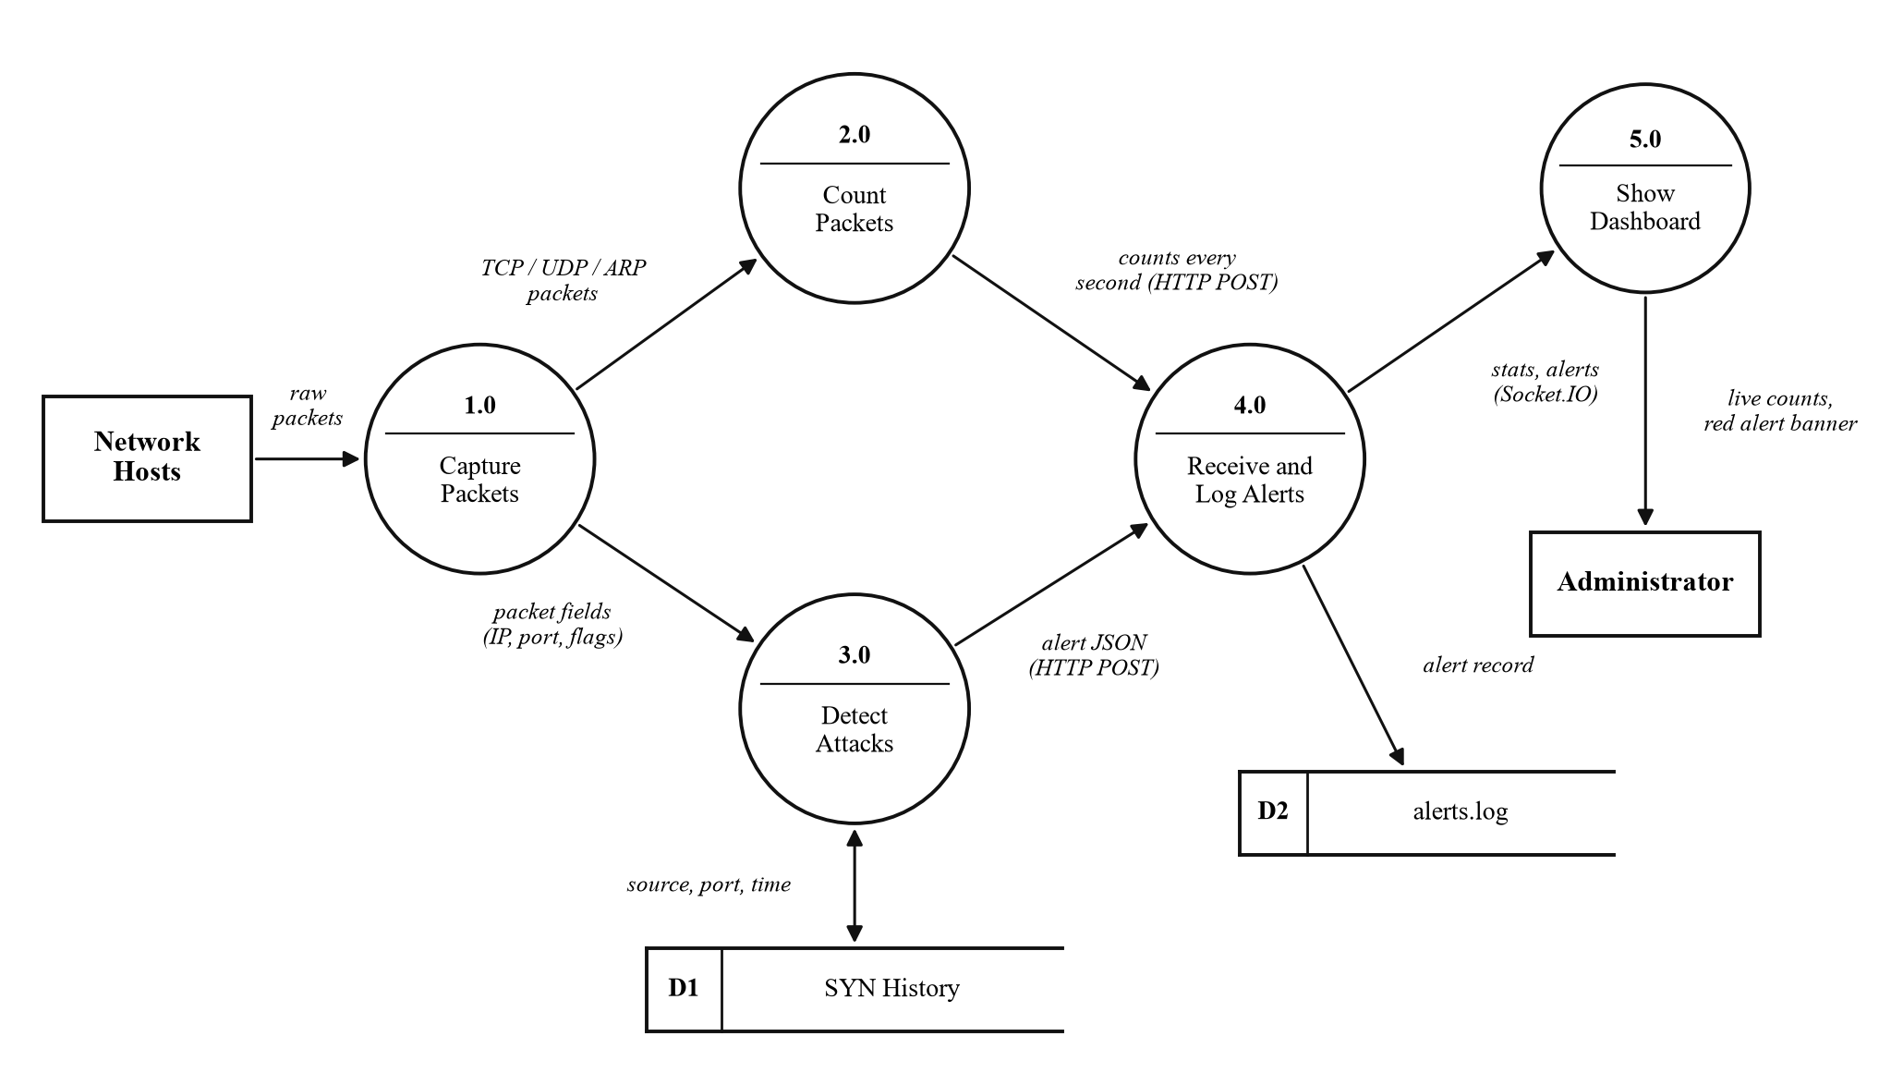
Design: Data Flow Diagrams
Fig. 3.1: Level 0 DFD, context diagram
Level 0: the whole system as one process
Level 1: five processes and two data stores
Data stores: SYN history and alerts.log
Fig. 3.2: Level 1 DFD
Real-Time NIDS | Rohan Pandey | Evaluation 1
8
Notes:
Level 0 shows the whole system as one process between the network hosts and the administrator. Level 1 breaks it into capture, count, detect, receive and log, and show dashboard, with two data stores: the SYN history in memory and the alert log file.

Slide 9
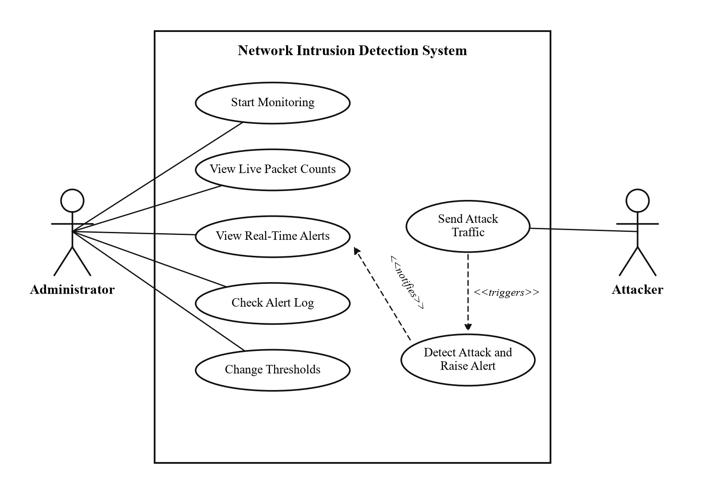
Design: Use Case and Data Storage
Administrator: starts monitoring, watches counts and alerts, checks the log
Attacker: sends traffic that triggers detection
System: detects the attack and notifies the admin
DATA STORAGE
SYN history: in memory, last 5 seconds
Alerts: alerts.log, one JSON line each
Planned: SQLite for alert search
Fig. 3.3: Use case diagram
Real-Time NIDS | Rohan Pandey | Evaluation 1
9
Notes:
The administrator starts monitoring and watches counts and alerts. The attacker's traffic triggers detection, which notifies the administrator. I do not use a database yet: recent SYN packets stay in memory for speed, and every alert is saved as a JSON line in alerts.log. SQLite is planned for searching alert history.

Slide 10
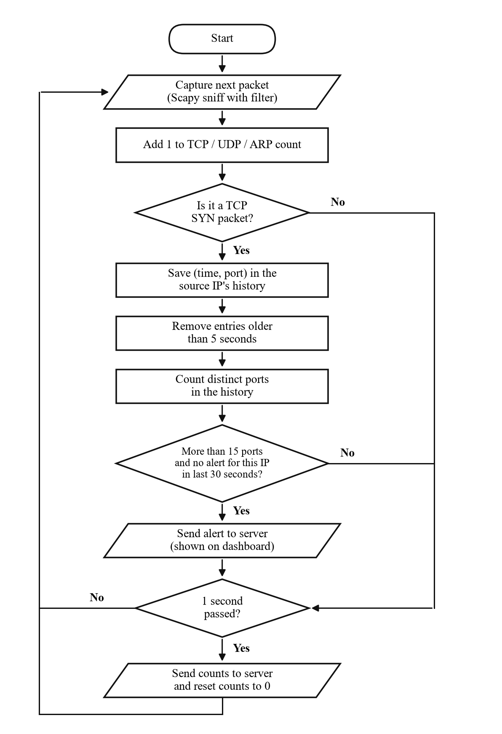
Port Scan Detection Logic
Alert when one IP sends SYN packets to more than 15 different ports within 5 seconds
15
5 s
30 s
port limit
sliding window
cool-down per IP
Why SYN only: a scanner knocks on every port with a SYN
Why a sliding window: a scan split across time is never missed
Why a cool-down: one scan gives one alert, not hundreds
Fig. 3.4: Port scan detection flowchart
Real-Time NIDS | Rohan Pandey | Evaluation 1
10
Notes:
For each source IP I keep the SYN packets of the last 5 seconds in a deque. If they reach more than 15 different ports, I raise an alert and stay quiet about that IP for 30 seconds. Only SYN packets count, because a scanner sends one SYN to each port.

Slide 11
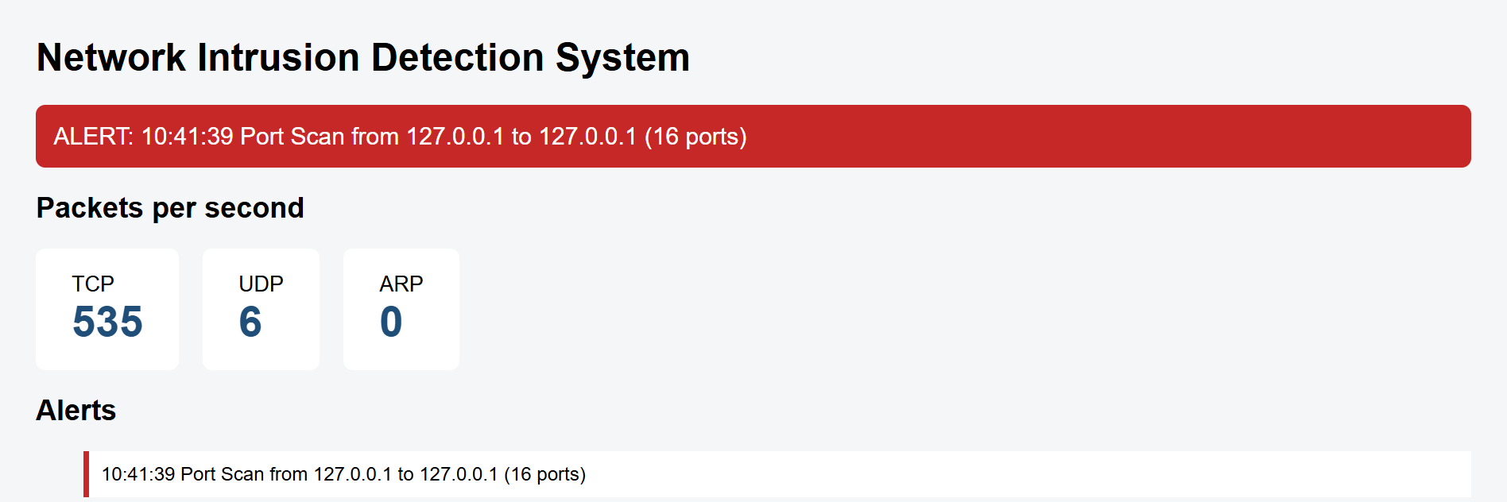
Progress and Live Demo
DONE
Live capture on Wi-Fi and loopback
Packet counts every second
Port scan detection
Alert log and live dashboard
Real dashboard during a test scan, 10 October 2026
NEXT, BY 30 OCTOBER
50%
of the system is working
Full pipeline with 1 of 3 attack rules
SYN flood rule
ARP spoofing rule
Demo: start server, start sensor, run a test scan, see the red alert
Alert history on page reload
Testing from a second device
Real-Time NIDS | Rohan Pandey | Evaluation 1
11
Notes:
This is a real screenshot taken this morning during a test scan. The full path from network card to browser works, with one of the three rules. Now I will show it live: start the server, start the sensor, run the scan script, and the red alert appears.

Slide 12
Thank You
Questions are welcome
Rohan Pandey | Roll No. 2501720100117 | Guide: Mr. Vikas
Notes:
Thank you. I am happy to take questions or show any part of the code.

