Slide 1
Military, Healthcare, and Education expenditure analysis of G20 Countries
Data Download
Data Cleaning
Python & Excel
Visualization
HTML, JavaScript & Google Visualization API
2012-2017
Data Sources:
www.sipri.org
2)www.data.worldbank.org
Rohan Thekanath

Slide 2
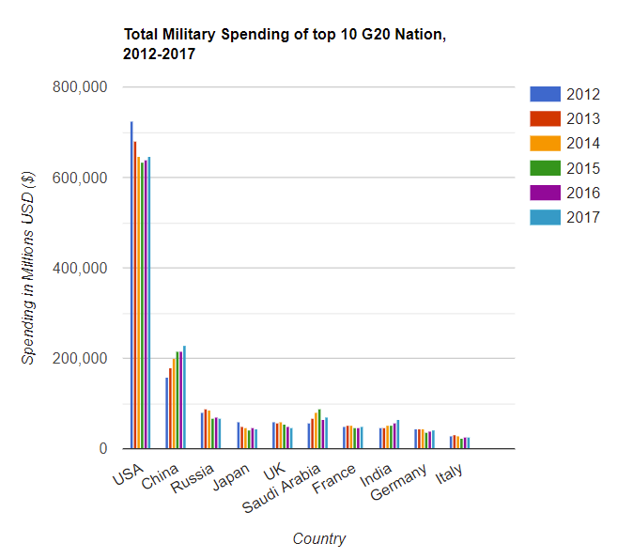
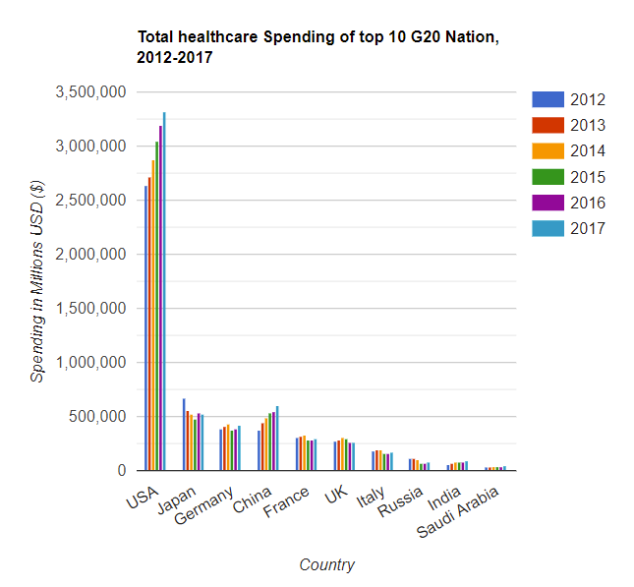
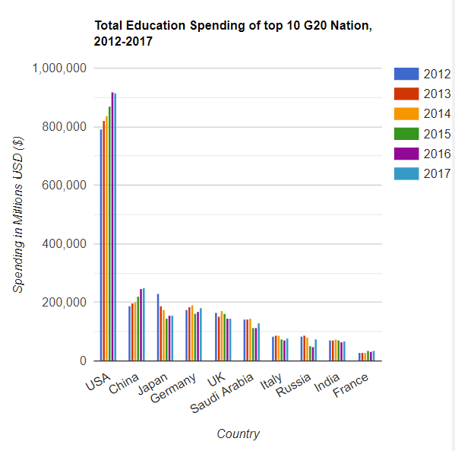
Comparing Education, Military & Healthcare expenditure of top 10 countries.
USA is the leading spender in all 3 categories. The year-on-year expenditure of USA shows an upward trend in Healthcare & Education but not in Military. China is the second highest spender in Military & Education.

Slide 3
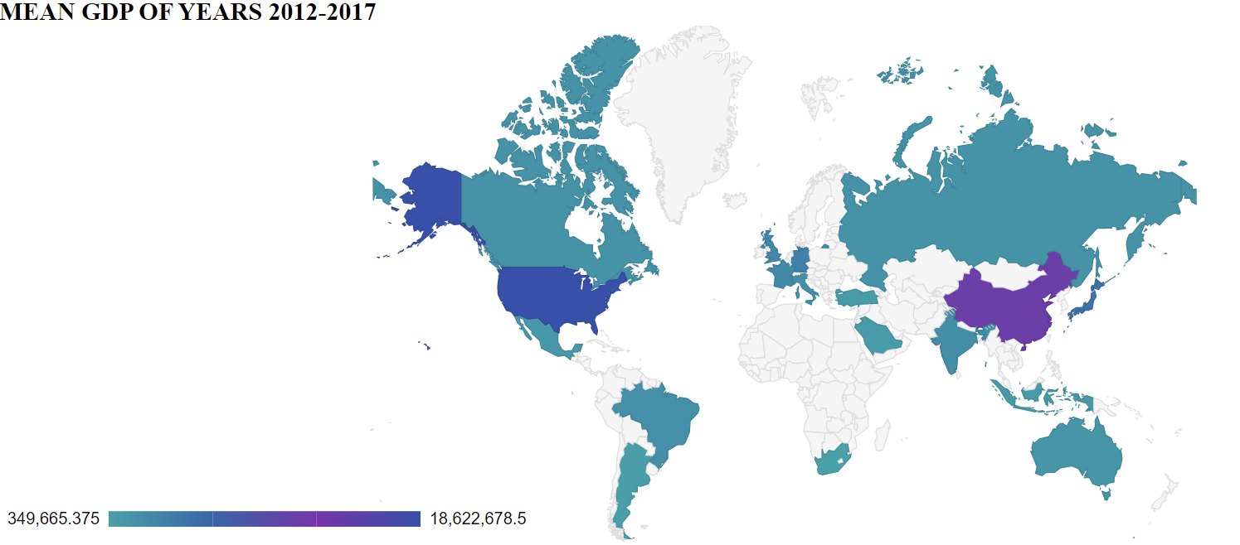
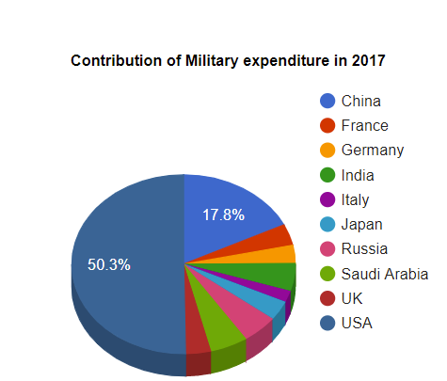
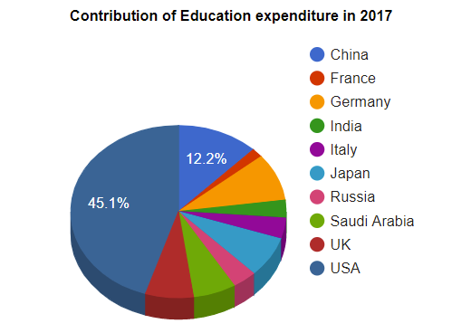
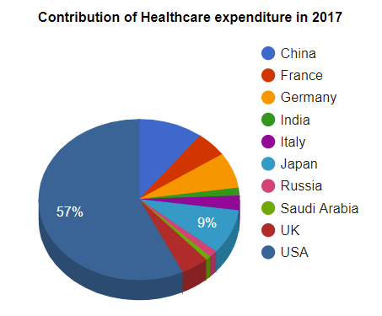
The mean GDP (2012-2017) of USA is the highest followed by China.
Among the top 10 countries, USA and China contribute the most in all 3 categories.

Slide 4
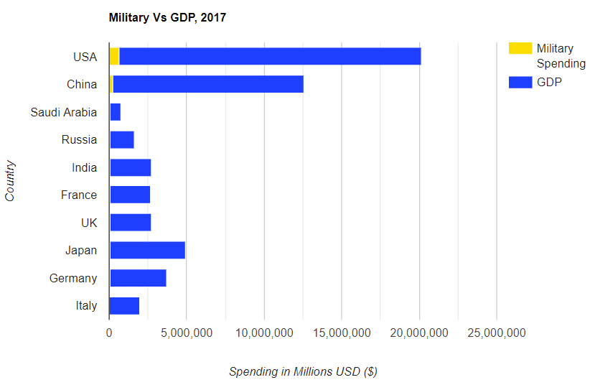
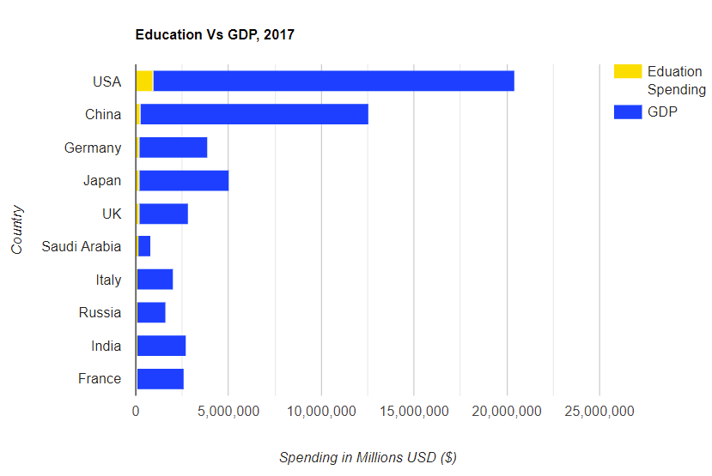
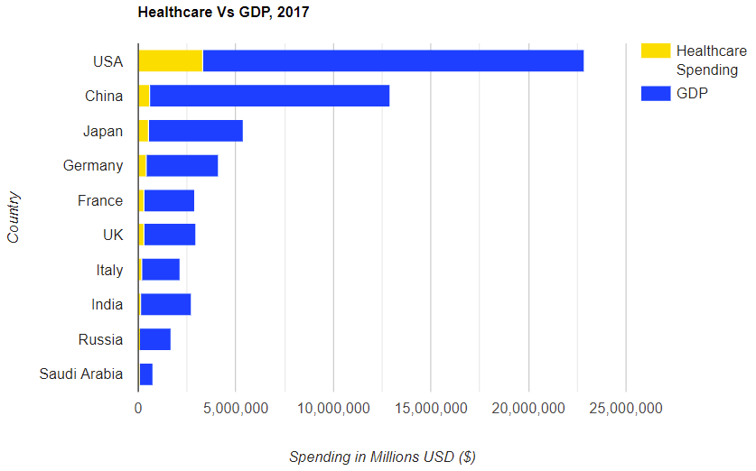
Comparing the spending data to that countries GDP
USA seems to be the highest spender in military & education as compared to its GDP. For Healthcare, USA is again ahead of the rest of the countries. The other countries like China, Japan, Germany, France & UK seem to be spending about the same amount as compared to their GDP.

Slide 5
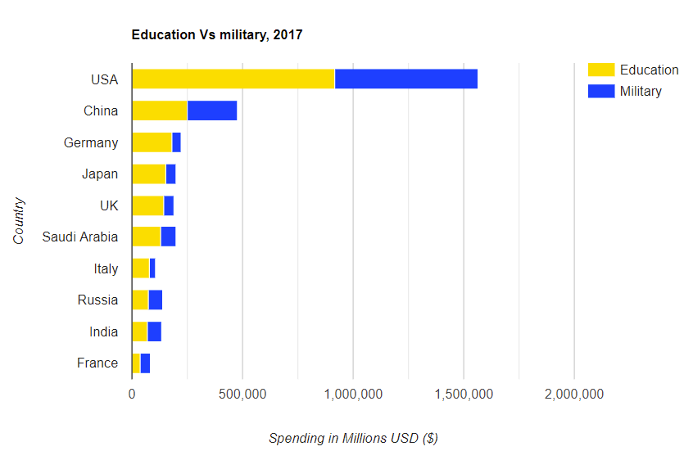
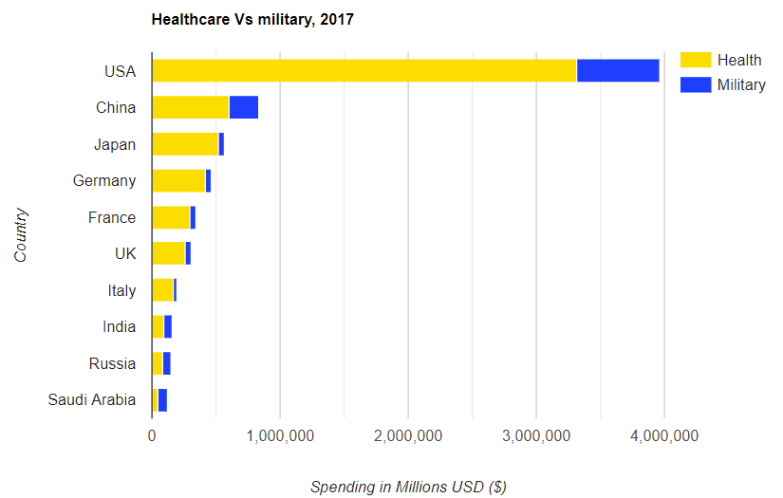
Comparing Education & Healthcare to Military expenditure of top 10 countries
The expenditure on Education & Healthcare is significantly larger than the expenditure on Military. This is true for all the top countries selected.

Slide 6
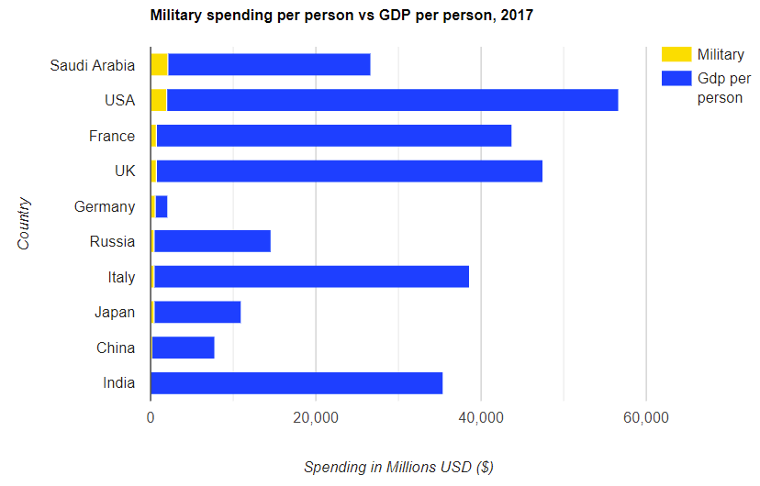
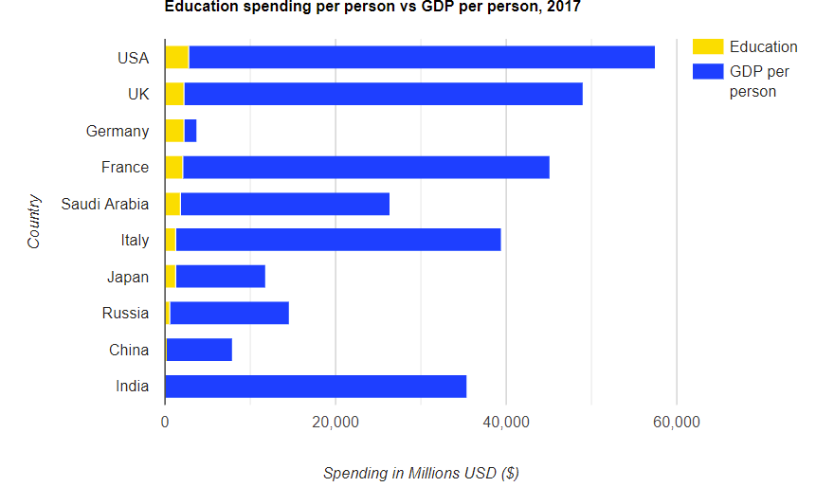
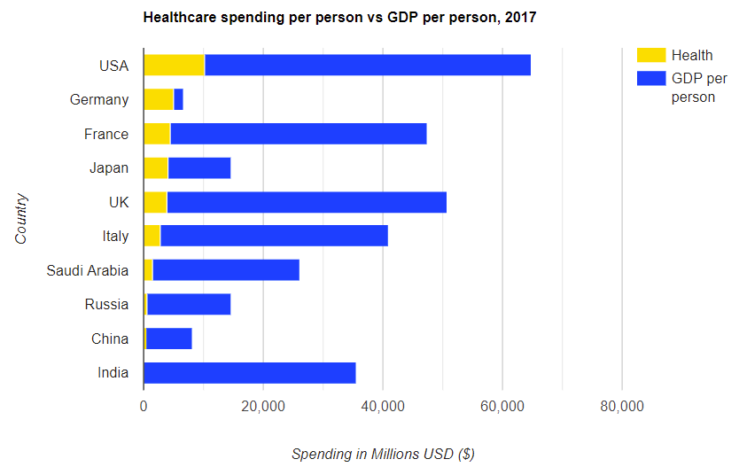
Comparing per person expenditure on Military, Healthcare, and Education to the per person GDP
All the mentioned countries are spending the most per person on Healthcare followed by Education and Military. Saudi Arabia spends the highest amount when we look at per person military expenditure. USA leads in Education & Healthcare

Slide 7
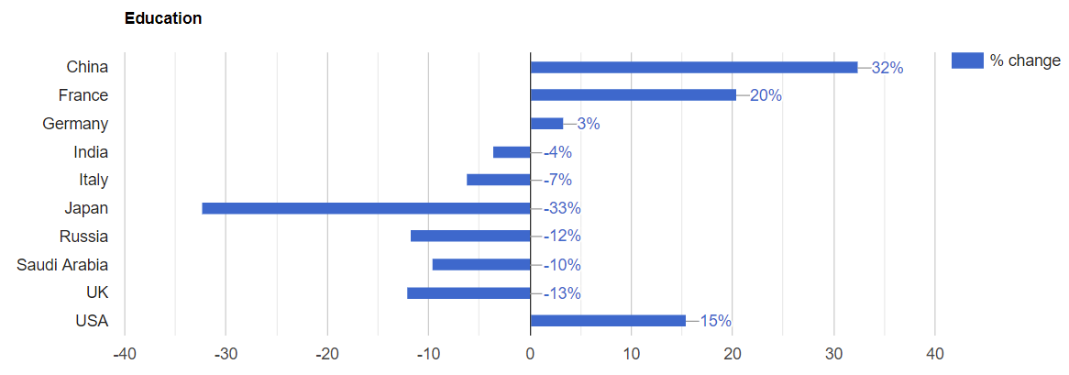
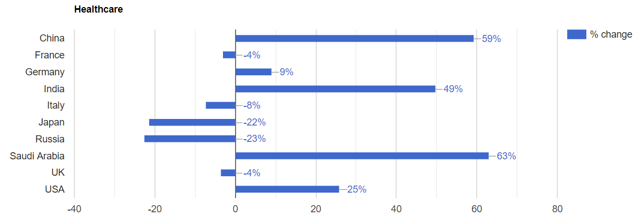
Fastest growing countries in Healthcare & Education spending in %
China has the highest change in Education growth followed by France and then USA. For Healthcare we can see that China, India & Saudi Arabia have been investing a lot in this area and the change is significantly higher in 2017 as compared to 2012.

