Slide 1
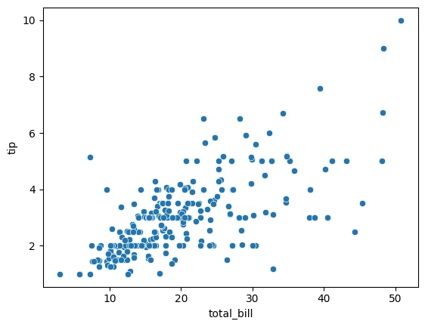
sns.scatterplot(x='total_bill', y='tip', data=tips)
The scatterplot shows a positive correlation between total_bill and tip — as the total bill increases, tips tend to increase as well, but not proportionally. There's more variation in tipping behavior at higher bill amounts.
Short Story:
In a bustling restaurant, most diners leave tips that rise with their bill—but the generosity isn’t fixed. While some big spenders tip well, others don’t go beyond the basics. It suggests that tipping behavior varies with individual generosity, not just bill size.

Slide 2
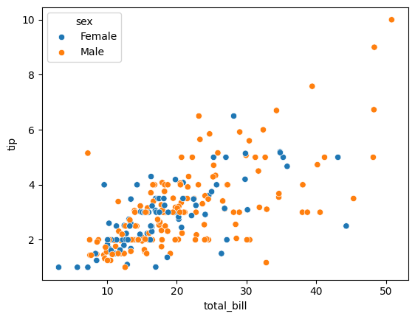
sns.scatterplot(x='total_bill', y='tip', hue='sex', data=tips)
Both males and females show a positive relationship between total_bill and tip. However, male customers appear more frequently in higher bill and higher tip ranges, indicating a tendency to spend and tip more on average.
Short Story:
At the restaurant, generosity isn’t just about the meal size—male customers more often sit at the higher end of the tip scale, suggesting they’re either spending more, tipping more, or both. Yet, females show consistent tipping patterns, often staying within moderate ranges.

Slide 3
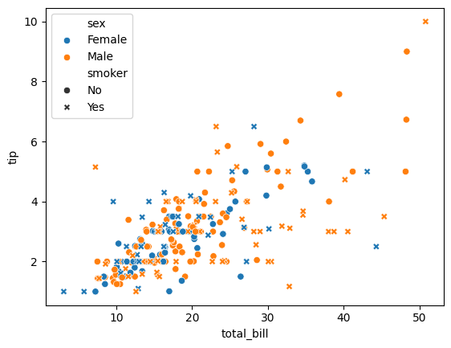
sns.scatterplot(x='total_bill', y='tip', hue='sex',style='smoker', data=tips)
Conclusion:
Smokers (marked by 'x') are spread across both low and high bill ranges but show more variation in tips.
Non-smokers tend to cluster with more consistent tipping patterns.
Male smokers appear more often at higher bills and tips than others.
Short Story:
In this dining story, male smokers are the unpredictable spenders—sometimes tipping big, sometimes not. Non-smokers, regardless of gender, tend to tip steadily, suggesting a more consistent behavior. Smoking may add variability, but generosity still seems to lean male.

Slide 4
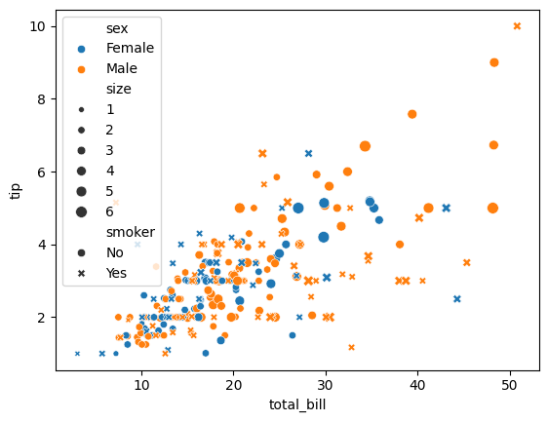
sns.scatterplot(x='total_bill', y='tip', hue='sex',style='smoker',size='size', data=tips)
🍽️ Full Dining Behavior Story (Gender, Smoking, Group Size)
Conclusion:
Larger groups (bigger dots) tend to spend and tip more.
Male, non-smoking groups show up prominently at higher bill and tip levels.
Smokers (marked with "x") tend to have more scattered tipping behavior across all group sizes.
Short Story:
At this restaurant, big spenders often come in bigger groups—especially non-smoking males who consistently leave higher tips. Smaller parties, especially smokers, are less predictable, showing wide variation in tipping. Group size, gender, and smoking together shape not just what’s on the table, but what’s left behind.

Slide 5
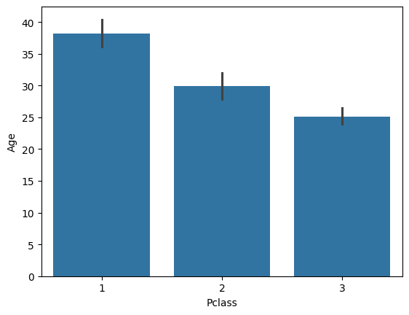
sns.barplot(x='Pclass',y='Age',data=titanic)
🚢 Titanic Passenger Age by Class
Conclusion:
Average age increases with class: 1st class passengers are oldest on average, while 3rd class passengers are youngest.
There's a clear social and economic stratification in age distribution across passenger classes.
Short Story:
Aboard the Titanic, first-class travelers were typically older, likely seasoned and wealthy. In contrast, younger passengers filled third class, possibly immigrants or working-class families chasing new dreams. The ship wasn't just divided by cabins—it reflected generational and societal divides.

Slide 6
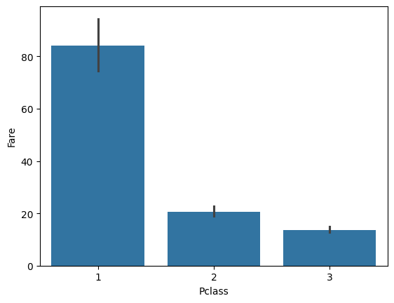
sns.barplot(x='Pclass',y='Fare',data=titanic)
💸 Titanic Fare by Class
Conclusion:
First-class passengers paid significantly higher fares—on average over 4 times that of third-class passengers.
Fare dropped sharply from 1st to 3rd class, reflecting strong economic segregation onboard.
Short Story:
Titanic wasn’t just a ship—it was a floating hierarchy. First-class passengers paid a premium for luxury, while third-class travelers paid a fraction, likely for crowded and basic conditions. The fare wasn’t just a price—it was a ticket into a different social world.

Slide 7
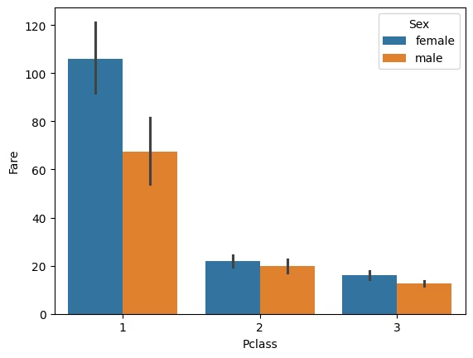
sns.barplot(x='Pclass',y='Fare',hue='Sex',data=titanic)
🎟 Titanic Fare by Class and Gender
Conclusion:
Female passengers in 1st class paid the highest average fares, noticeably more than 1st class males.
Across all classes, females generally paid slightly more than males.
The gender gap in fare is most pronounced in 1st class and shrinks in 2nd and 3rd classes.
Interpretation:
This suggests that female 1st-class passengers may have booked more expensive accommodations, possibly suites or family cabins, while males might have opted for relatively cheaper tickets. In lower classes, the pricing became more standardized.

Slide 8
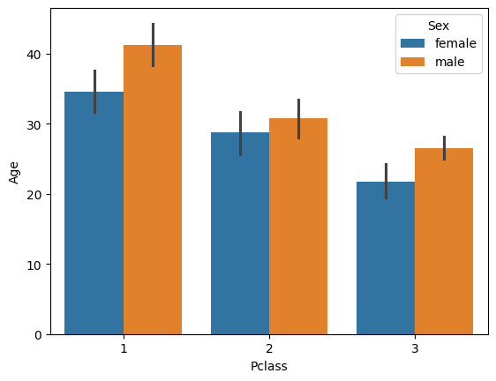
sns.barplot(x='Pclass',y='Age',hue='Sex',data=titanic)
📊 Conclusion & Data Story (Titanic Dataset)
Conclusion:
Average passenger age decreases with class (1st > 2nd > 3rd).
Males are consistently older than females in all classes.
First-class passengers are significantly older on average, especially men.
Short Story: On the Titanic, class reflected not just wealth but age. First-class travelers were the oldest—especially men—while third-class had younger passengers, particularly women. This age gap across class and gender hints at the socio-economic patterns of the era, where wealthier, likely more established individuals secured higher-class tickets.

Slide 9
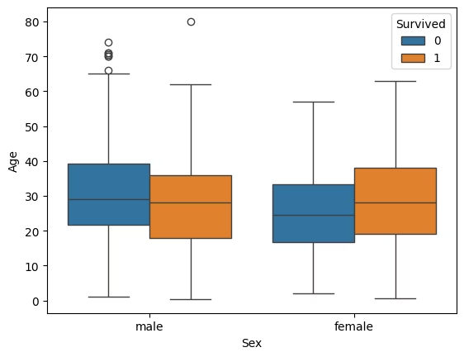
sns.boxplot(x='Sex',y='Age',hue='Survived',data=titanic)
📊 Conclusion & Data Story (Survival by Age and Sex)
Conclusion:
Among males, those who died were slightly older than those who survived.
Among females, survivors were generally younger than non-survivors.
Across both sexes, younger passengers had a better survival rate overall.
Short Story: Survival on the Titanic wasn’t just chance—it reflected age and gender. Women and younger passengers, especially young women, had a higher chance of survival. Meanwhile, many older men were left behind, echoing the ship’s “women and children first” evacuation priority.

Slide 10
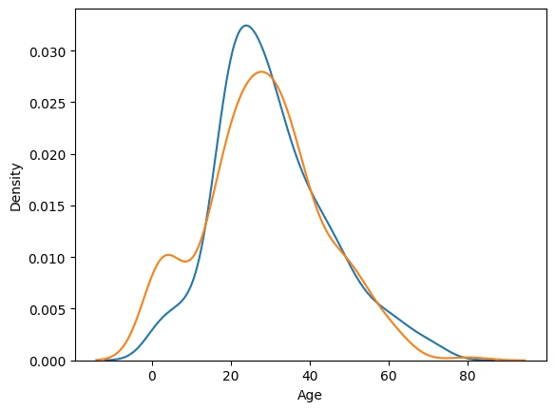
sns.distplot(titanic[titanic['Survived']==0]['Age'],hist=False) sns.distplot(titanic[titanic['Survived']==1]['Age'],hist=False)
📊 Conclusion & Data Story (Age Distribution by Survival)
Conclusion:
Survivors (orange line) had a higher density in the younger age range (especially infants and young adults).
Non-survivors (blue line) peaked more sharply around the 20–30 age range.
Very few older passengers survived, and most elderly fell under the non-survivor curve.
Short Story: Age shaped fate on the Titanic. Infants and young adults had a better shot at survival, while the 20–40 age group saw the most casualties. Older passengers rarely made it out alive—painting a sobering picture of how age intertwined with tragedy that night.

Slide 11
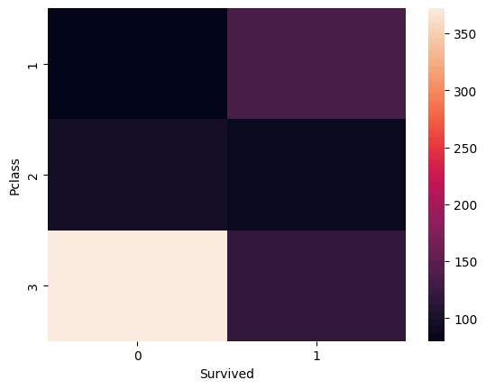
sns.heatmap(pd.crosstab(titanic['Pclass'],titanic['Survived']))
📊 Final Conclusion & Short Story (All Plots Combined)Key Insight from Heatmap:Most non-survivors were from 3rd class, shown by the darkest block on the left.1st class passengers had a relatively higher survival rate.Survival chances clearly dropped with lower class status
🧠 Short Data Story – Titanic: A Tragedy Told by Class, Age, and GenderThe Titanic’s fate was far from random. Data reveals a stark pattern: wealthier, older males in 1st class had higher average ages and better cabins—but many still perished. Women and children, especially in upper classes, were prioritized in evacuation, reflected by their higher survival rates and lower median ages. However, the third-class passengers, mostly young and poor, bore the worst—facing the highest death toll. Age, class, and gender weren’t just traits—they were predictors of survival on that cold night in 1912.

Slide 12
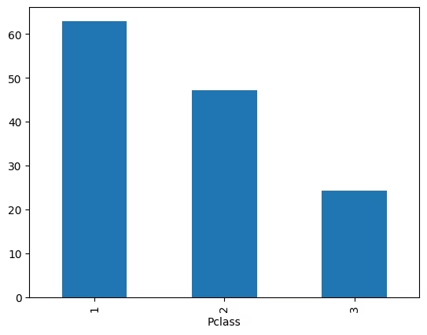
(titanic.groupby('Pclass')['Survived'].mean()*100).plot(kind='bar')
📊 Final Plot Insight: Survival Rate by Class (%)Conclusion:1st Class: ~63% survival rate2nd Class: ~47% survival rate3rd Class: ~24% survival rateInterpretation: Survival clearly favored the rich. First-class passengers were nearly three times more likely to survive than those in third class.
Titanic: A Tale of Inequality at SeaThe Titanic wasn’t just divided by decks—it was divided by fate. First-class passengers, typically older and wealthier, had the best odds of survival. Women and children in upper classes were prioritized, while third-class passengers—mostly young and poor—faced the worst. The data shows it clearly: survival depended not just on chance, but on class, age, and gender.

Slide 13
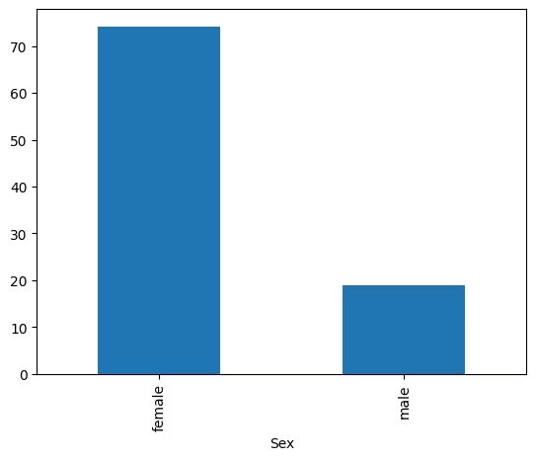
(titanic.groupby('Sex')['Survived'].mean()*100).plot(kind='bar')
📊 Final Plot Insight: Survival Rate by Gender (%)Conclusion:Females: ~74% survival rateMales: ~19% survival rateInterpretation: Gender played a critical role—women were nearly four times more likely to survive than men, reflecting the “women and children first” evacuation rule.
Titanic: A Story Etched in InequalityThe Titanic tragedy reveals stark truths hidden in data. Class, age, and gender deeply influenced survival.First-class passengers had a survival rate nearly 3× higher than third-class.Women had a 4× higher chance of survival than men.The young and wealthy were prioritized, while poorer, male passengers—especially in third class—were left behind.This wasn’t just a disaster—it was a reflection of societal structure frozen in time.

Slide 14
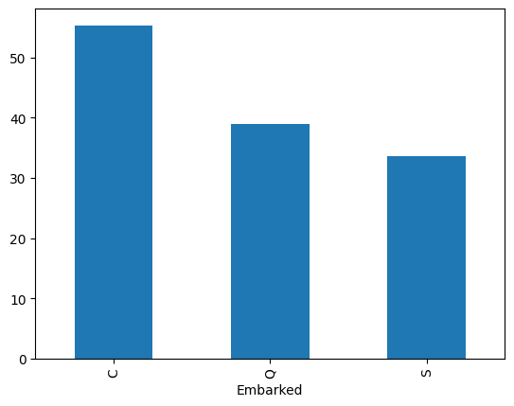
(titanic.groupby('Embarked')['Survived'].mean()*100).plot(kind='bar')
📊 Final Plot Insight: Survival Rate by Port of Embarkation (%)Conclusion:Cherbourg (C): ~56% survival rateQueenstown (Q): ~39% survival rateSouthampton (S): ~34% survival rateInterpretation: Passengers who boarded at Cherbourg had the highest survival rate—likely because many first-class passengers boarded there, showing how location indirectly reflected class and fate.
Titanic: When Survival Wasn't Just About LuckData from the Titanic disaster tells a haunting tale of privilege:Wealth mattered: First-class passengers had triple the survival rate of third-class.Gender mattered more: Women survived at 4× the rate of men.Even location mattered: Boarding at Cherbourg meant better odds—because wealthier passengers got on there.The Titanic didn’t just sink—it exposed the deep divides in society at sea.

Slide 15
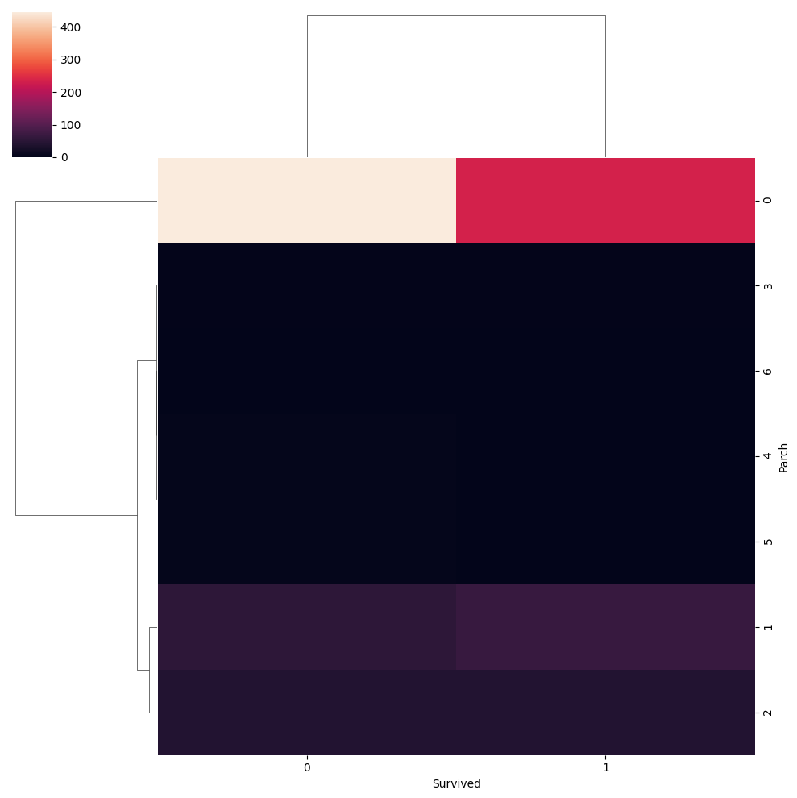
sns.clustermap(pd.crosstab(titanic['Parch'],titanic['Survived']))
This clustermap shows the relationship between the number of parents/children aboard (Parch) and survival (Survived), with hierarchical clustering to group similar patterns:
🔍 Interpretation:
Parch = 0 (Alone): Dominates the dataset and shows a significant number of non-survivors, but also many survivors
.Parch = 1 or 2: Shows better survival rates relative to how many people were in those groups. Suggests traveling with 1–2 family members improved survival odds.
Parch ≥ 3: Very few passengers fall into these groups, and survival drops significantly—likely due to difficulty moving or protecting a larger group during evacuation.
✅ Key Takeaway:Small families survived more often than large families or solo travelers.Emotional and logistical support in small family units may have helped in a chaotic crisis.

Slide 16
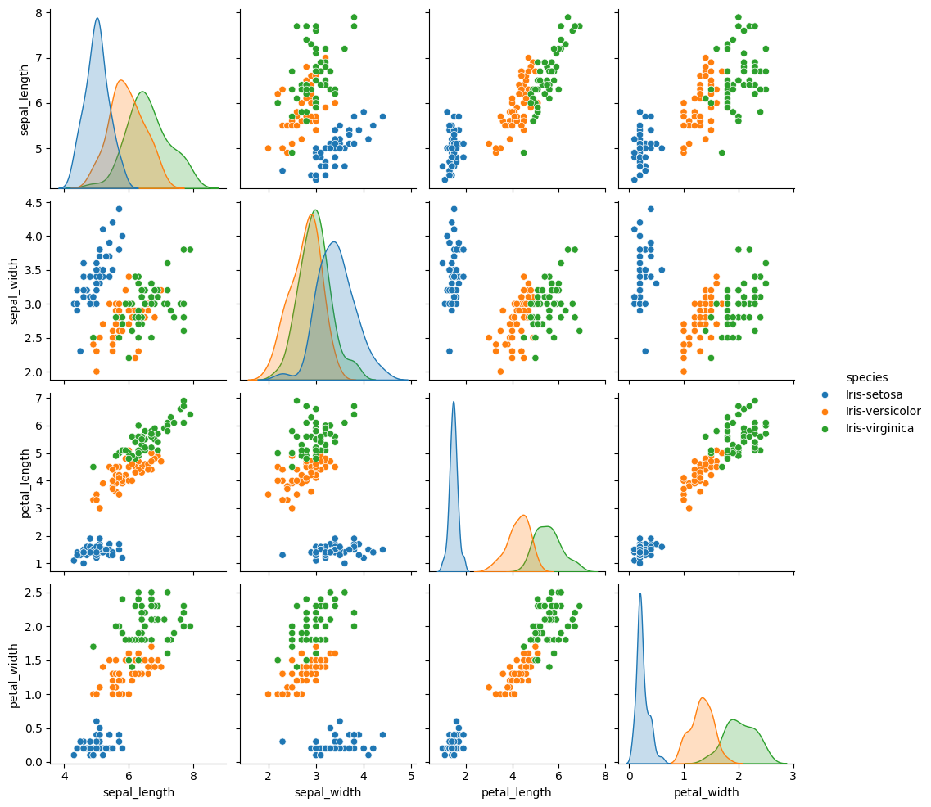
sns.pairplot(iris,hue='species')
📊 Data Story: Iris Species Differentiation
This pair plot illustrates the Iris dataset, showcasing how three species—Setosa, Versicolor, and Virginica—differ across four flower measurements.
🟦 Iris-setosa:
Clearly separated from the other two species, especially in petal length and width.
Smaller petal size and shorter sepal length.
🟧 Iris-versicolor & 🟩 Iris-virginica:
Show overlapping distributions, especially in sepal dimensions.
Virginica generally has larger petals, which helps differentiate it from Versicolor in the petal-related plots.
🔍 Key Insight:
Petal length and width are the most discriminative features, making them ideal for classifying the species, especially for distinguishing Setosa from the others.

Slide 17
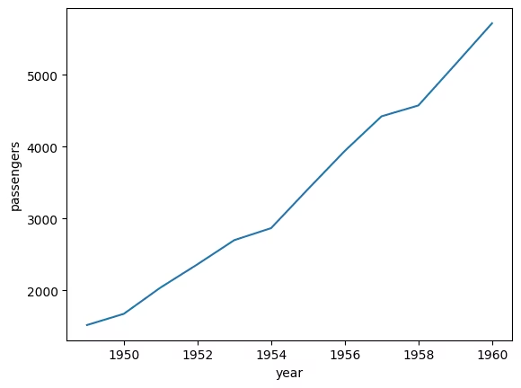
sns.lineplot(x='year', y='passengers', data=new)
📈 Data Story: Airline Passenger Growth (1949–1960)
This line plot tracks the steady growth of airline passengers over a decade.
✈️ Key Observations:
Passenger numbers more than tripled, rising from about 1,500 in 1949 to over 5,500 by 1960.
Growth appears consistent and accelerating, especially after 1955—possibly due to post-war economic expansion and greater access to air travel.
📌 Takeaway:
The 1950s marked a boom era for the airline industry, highlighting a shift toward air travel becoming a mainstream mode of transportation.

Slide 18
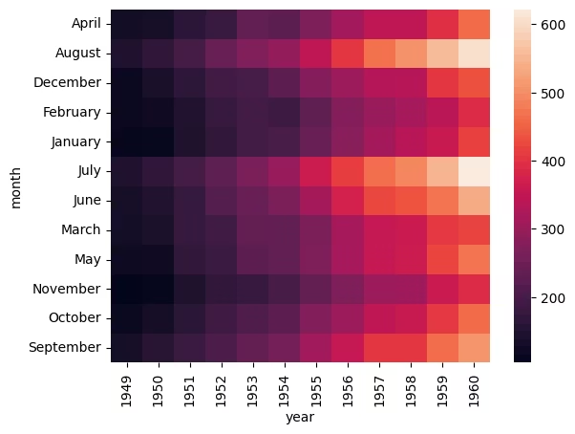
sns.heatmap(flights.pivot_table(values='passengers',index='month',columns='year'))
🔥 Data Story: Monthly Airline Passenger Trends (1949–1960)
This heatmap reveals seasonal patterns and growth in air travel across months and years.
🗓️ Key Insights:
Passenger counts increase over time, darkest shades (low traffic) dominate early years, while lighter shades (high traffic) appear from 1955 onward.
July and August consistently see peak travel, highlighting summer as the busiest travel season.
Off-season months like January and February remain lower, but still show steady growth.
📌 Takeaway:
Air travel in the 1950s grew rapidly, with strong seasonal spikes in summer months—suggesting both leisure travel demand and economic expansion.

Slide 19
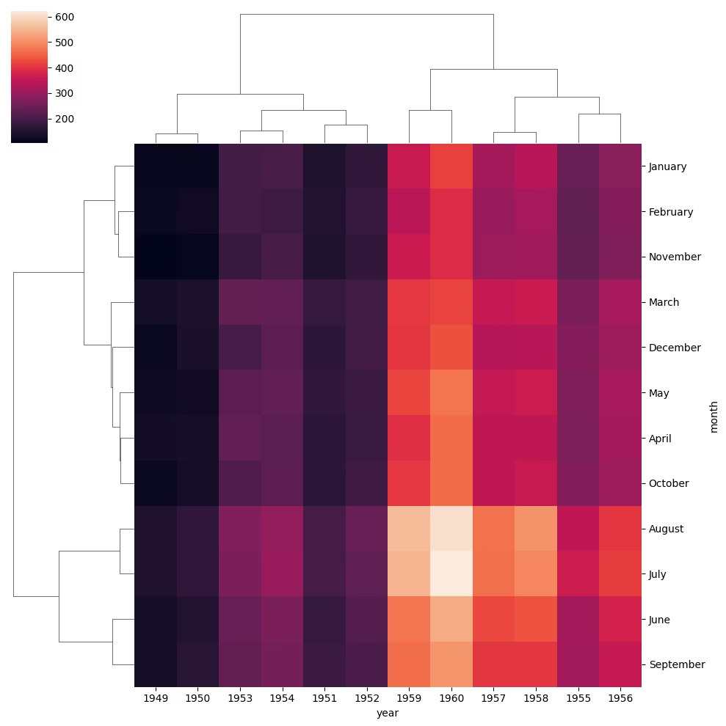
sns.clustermap(flights.pivot_table(values='passengers',index='month',columns='year'))
🧠 Data Story: Clustering Airline Travel Trends
This cluster map groups years and months with similar airline passenger patterns, offering deeper insight into seasonal and temporal behaviors.
🔍 Key Observations:
Summer months (June–August) are tightly clustered together with the highest traffic, consistently forming the peak season.
Years like 1959 and 1960 are grouped due to similarly high overall traffic volumes.
Early years (1949–1952) form a separate cluster due to lower passenger counts across all months.
📌 Takeaway:
Passenger traffic shows clear seasonality and a sharp long-term upward trend, with clustering revealing how travel behavior evolved over time—especially the dominance of summer peak travel in later years.

