Slide 1

Computer Vision SS2025
REAL-TIME
FACE DETECTION
Angel Lopez Hortelano
Begüm Sezer
Rohan Raj

Slide 2

PROJECT
OVERVIEW
Objectives:
Process real-time webcam video using OpenCV.
Apply multiple image filters and statistical analyses.
Detect and blur unknown faces using face recognition.
Stream processed frames using a virtual camera (pyvirtualcam).

Slide 3
CODE
ARCHITECTURE
Main Components:
capturing.py: Camera handling via pyvirtualcam
custom_processing(): Core processing function (generator).
overlays.py: Histogram plots, on-screen text
basics.py: Statistical tools and filters

Slide 4

WORKFLOW
03/15
REAL CAMERA
↓
FRAME GENERATOR (CUSTOM_PROCESSING)
↓
FILTERING & FACE RECOGNITION
↓
STATISTICS + HISTOGRAM + TEXT OVERLAY
↓
VIRTUAL CAMERA (PYVIRTUALCAM)

Slide 5
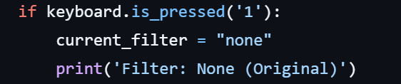
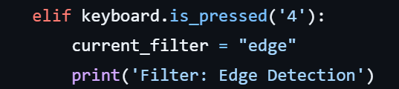
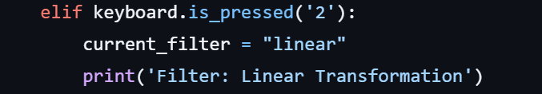
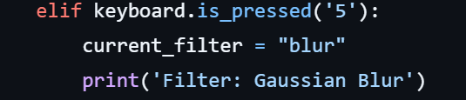
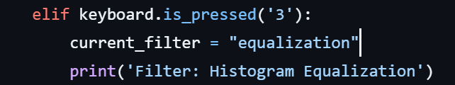
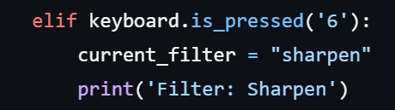
IMAGE PROCESSING FEATURES
Keyboard Controls
1: Original image
2: Linear transformation
3: Histogram equalization
4: Edge detection (Sobel)
5: Gaussian blur (15x15 kernel)
6: Sharpen filter

Slide 6
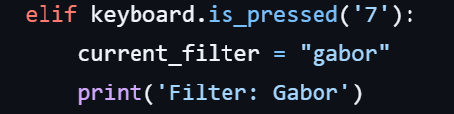
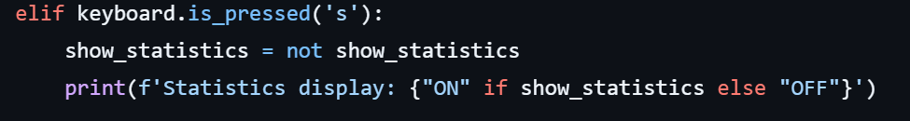
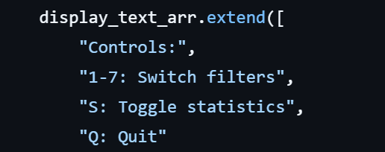
IMAGE PROCESSING FEATURES
Keyboard Controls
7: Gabor filter (theta=45°, frequency=0.6)
S: Toggle image statistics
Q: Quit

Slide 7

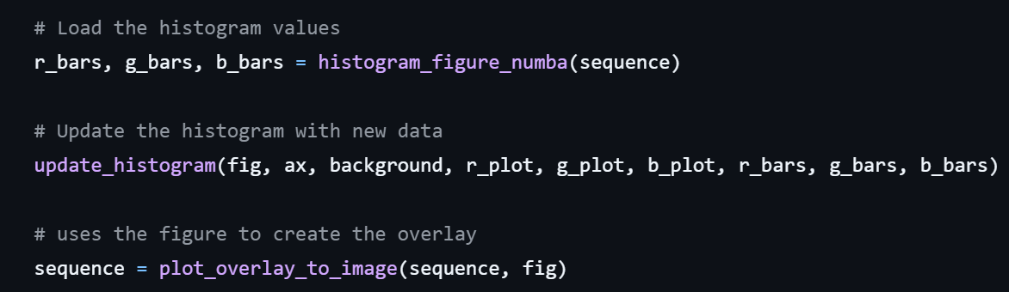
REAL TIME HISTOGRAM OVERLAY
Per-frame calculation:
Displays the live RGB histogram on top of the processed image.
Helps visually monitor how each filter affects pixel intensity distribution.

Slide 8
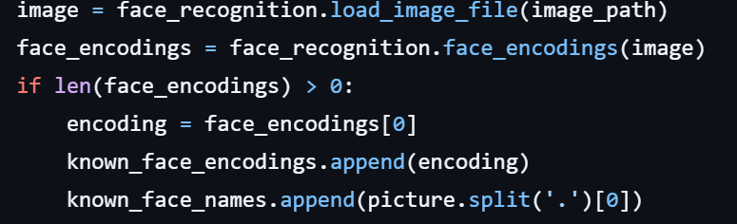
FACE DETECTION &
RECOGNITION
Initialization and Matching:
The system loads known faces from a folder and encodes them using face_recognition.
Each incoming frame is checked for faces.
Found faces are compared to known faces to find a match:

Slide 9
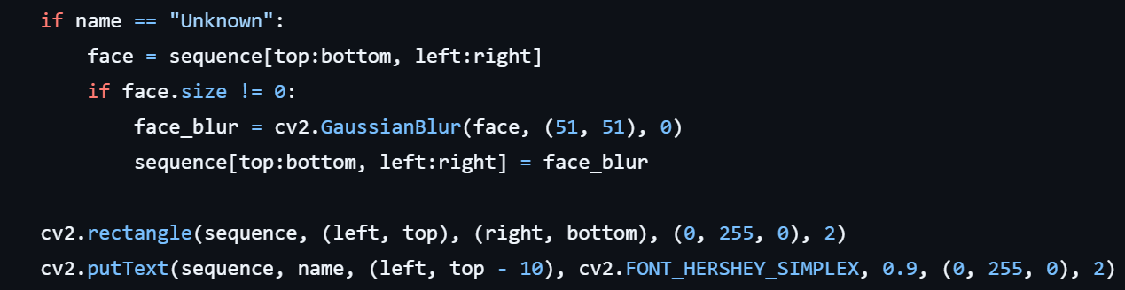
FACE DETECTION &
RECOGNITION
Privacy Blurring & Annotation:
If a face is detected but not recognized, it is blurred for privacy:
All detected faces are marked with a green rectangle and labeled:

Slide 10

DEMO
TIME

Slide 11
CONCLUSION
01
02
03
Built a flexible, real-time computer vision pipeline
Integrated filter controls, face recognition, statistics, and overlays
Output delivered via a virtual camera

Slide 12
THANK
YOU!

