Slide 1
DATALYSER
BY:AMANPREET SINGH,ROHAN ARORA,SAHIB SETHI

Slide 2
DATA PROCESSING
The collection and manipulation of items of data to produce meaningful information.
Consists of
Validation
Reading the data
Data Analysing

Slide 3
DATA ANALYSIYNG
Data analysis makes use of specialized and highly accurate algorithms and statistical calculations to provide the information in whichever way required.
Consists of
Sorting
Summarization
Analysis
Reporting

Slide 4
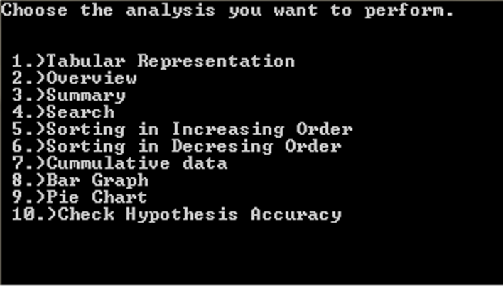
FUNCTIONS APPLIED ON DATa

Slide 5
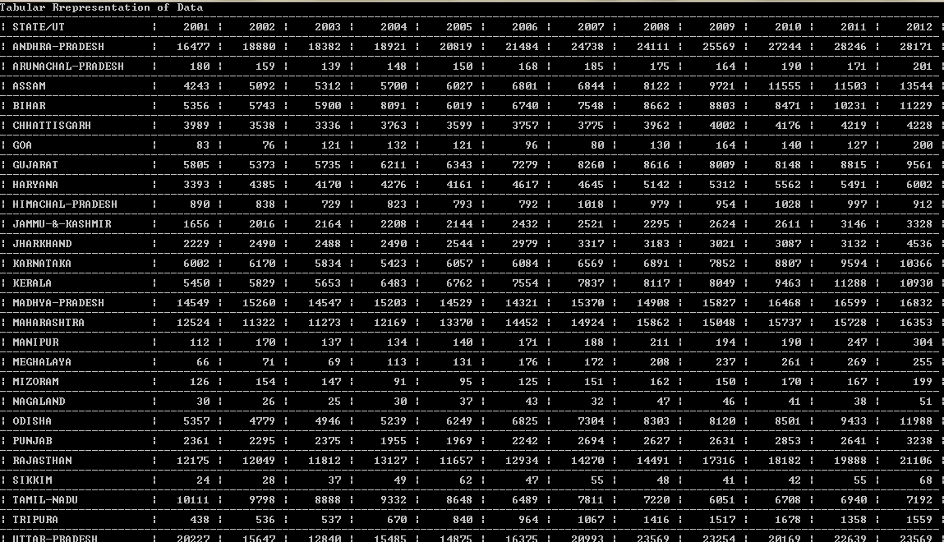
TABULAR VIEW OF DATA

Slide 6
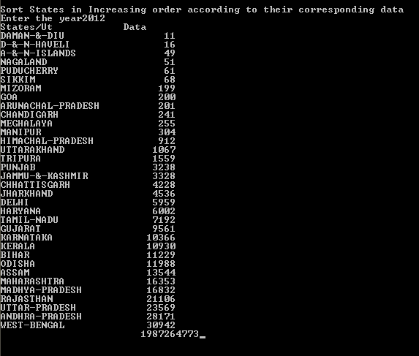
QUICK SORT(nlogn)

Slide 7
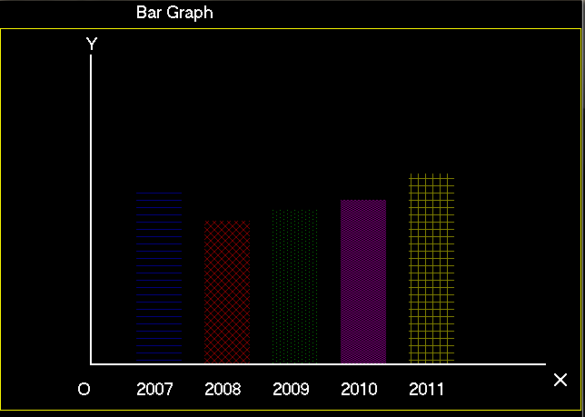
Pictorial representation of data

Slide 8
What all we have used
Open Souce Data from www.data.gov.in
Graphics Library (graphics.h)

Slide 9
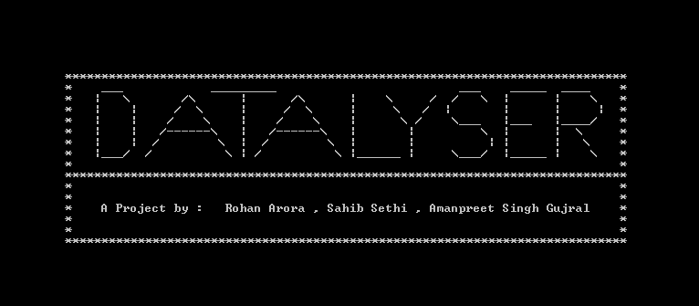
thankyou

