Slide 1

SAMBHRAM INSTITUTE OF TECHNOLOGY,BANGALORE Department of Computer Science Technology
Seminar on
“SOAP Performance and Enhancement In WS-Security”
FOR THE ACADEMIC YEAR
(2014-2015)
BY
Aditya kumar(1st11cs006) k rohan(1st11cs040)
Ankit shrivastava(1st11Cs011) kumar Pranav(1st11cs044)
Under the expert guidance of
Mr. srinath k.s(B.E.,MTECH.,MISTE)

Slide 2
CONTENTS
1. Abstract
2. Web Service
3. Existing System
4. Design and Implementation
5. Result Analysis
6. Conclusion and Future Work
7. Bibliography

Slide 3
1. ABSTRACT
Web Services promise a solution for representing data and accessing wide variety of services including Service Oriented Architecture (SOA) and other computing services like grid computing. It also provides flexibility and interconnection between different systems. The communication in Web Services uses Simple Object Access Protocol (SOAP) a simple, robust, and extensible protocol that is the most widely used for communication protocol in the Web services model. SOAP message that is being sent to the client needs to be secured from the attackers over the open internet and should also make sure that the response time is minimal.
In this paper, the SOAP message is encrypted whole or selective portion using AES encryption technique. The SAX parser is used to reduce the memory consumption and execution time for parsing WSDL, SOAP request, response documents. To optimize the SOAP performance, response time is analyzed for both complete and selective encrypted soap document and results are found satisfactory for selective encryption technique.

Slide 4
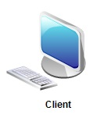

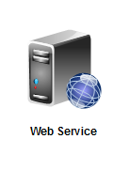
2. WEB SERVICES
Web services are self-contained, self -describing, modular applications that can be published, located, and invoked across the web.
XML
file
REQUEST
RESPONSE

Slide 5
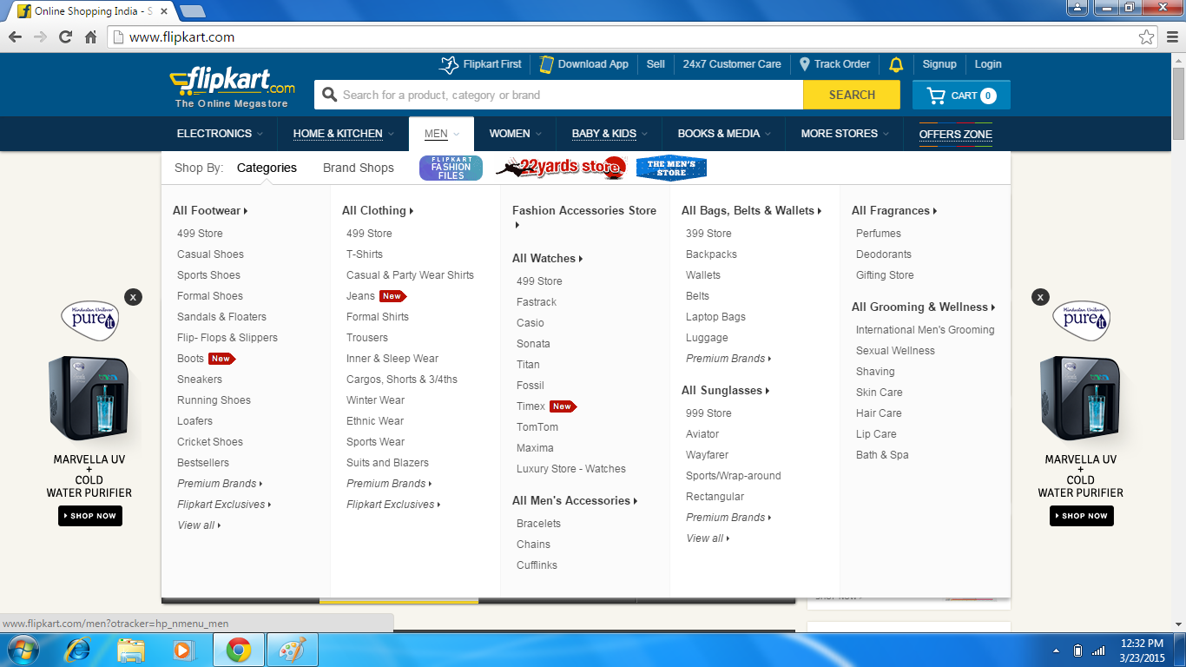

Slide 6
WEB SERVICES TECHNOLOGY STACK
IMPLEMENTATION(S)
Other Concern(s)
Electronic Business XML(ebXML)
Universal Description, Discovery and Integration(UDDI)
Web Services Description Language(WSDL)
Security
Quality of service
Management
Simple Object Access Protocol(SOAP)/Extensible Markup Language(XML)
Service Development
Hyper Text Transfer Protocol(HTTP)
File Transfer Protocol(FTP)
Simple Mail Transfer Protocol(SMTP)

Slide 7
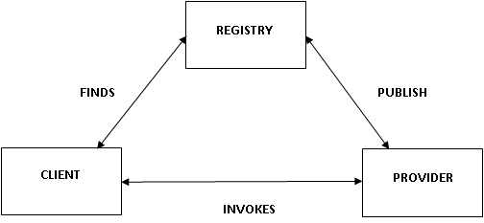
3. Existing System
A service-oriented architecture (SOA) is an architectural pattern in computer software design in which application components provide services to other components via a communications protocol, typically over a network.

Slide 8
4. Design and Implementation
Our design is primitively based on the SOA (Service Oriented Architecture). The components involved in the model are labelled as Provider, Registry and Client.
The Provider creates a web service and publishes its interface on the Registry.
The Client then finds the required web service on the Registry using various operations and binds to the provider invoking the required service.
The Provider reads in the request from the Client and responds accordingly.

Slide 9
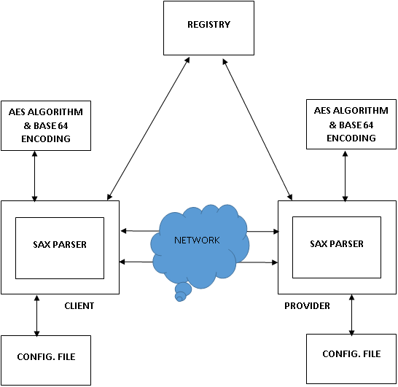
Proposed System

Slide 10
ENCRYPTION
Encryption is done to maintain the confidentiality of the data.
It is one of the techniques to prevent various types of attacks.
Encryption is implemented using AES Encryption technique with 128 bit key.
Encrypted file is encoded using base64 encoder.
SAX
PARSER
XML FILE
AES
Encryption
& Encoding
Encrypted File
Complete Encryption Model

Slide 11
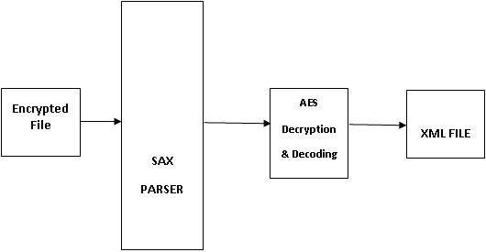
DECRYPTION
Base64 decoder is used to decode the encoded file.
Decoded file is decrypted with same 128 bit key.
SAX parser
Complete Decryption Model

Slide 12
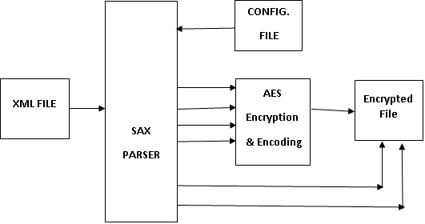
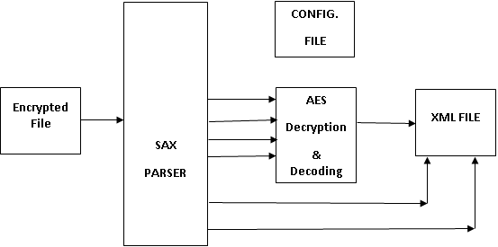
Selective Encryption and Decryption
Selective Encryption Model
Selective Decryption Model

Slide 13
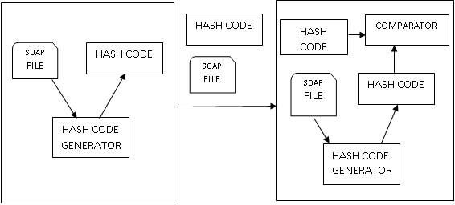
Hash Code Generation
Integrity of the file is validated using hash code.
Hash Code Generation

Slide 14
Web service communication scenarios
This type of communication occurs in three scenarios:
Server-Registry
Client-Registry
Client-Server

Slide 15
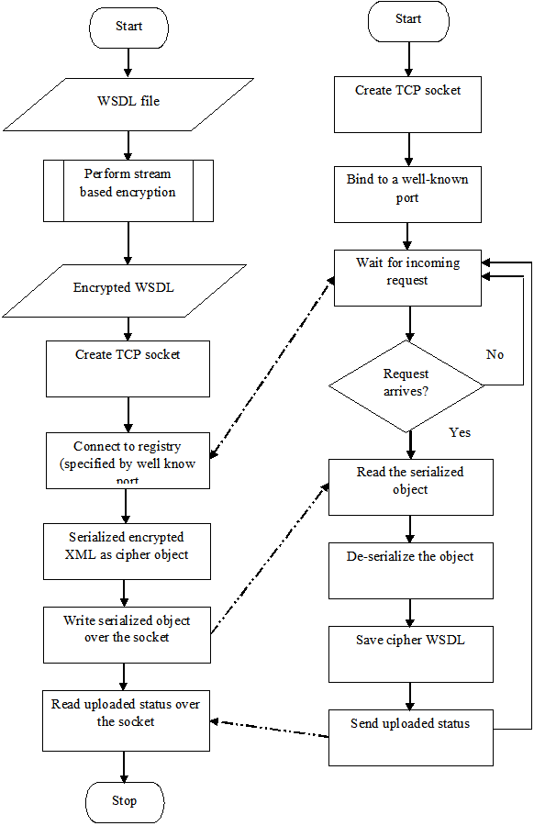
Provider–Registry Communication

Slide 16
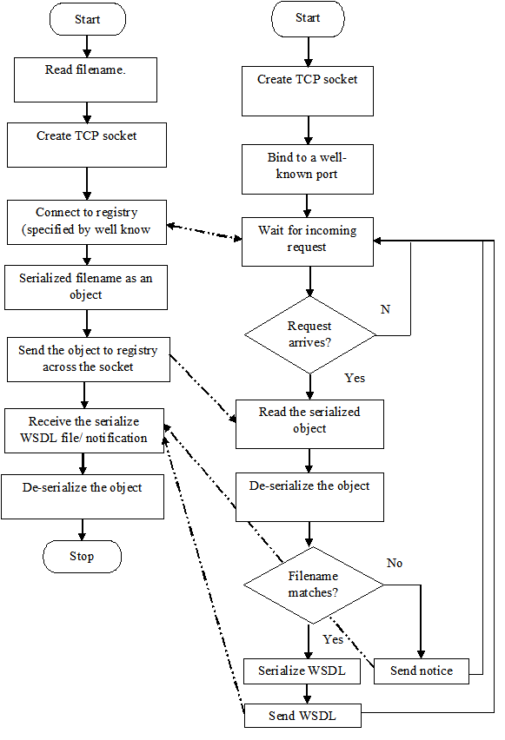
Client- registry communication

Slide 17
Client-provider Communication

Slide 18
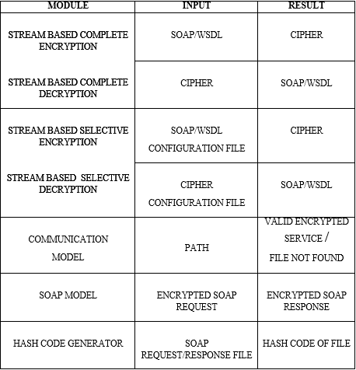
5. Results Analysis
Result and analysis describes detailed result of each module. The specific inputs and outputs obtained after processing stage of each module is described in the table given.
The test cases provided describes the module when specific inputs are being passed to these modules. Their respective outputs are recorded and tabulated as shown.

Slide 19
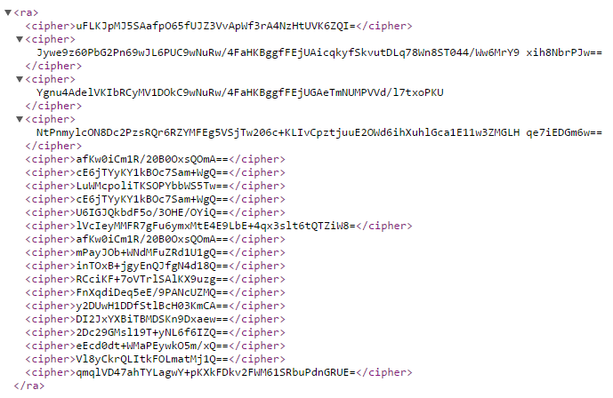
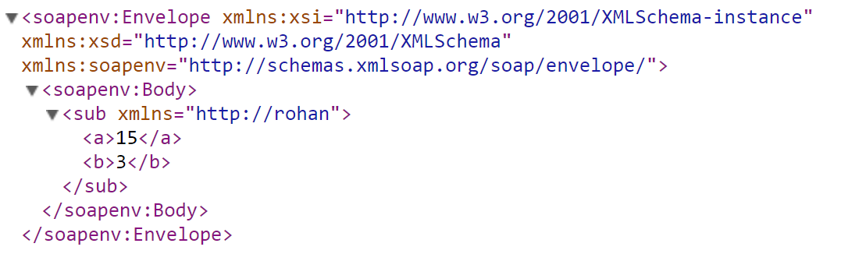
Basic Encryption
Input File
Output File

Slide 20
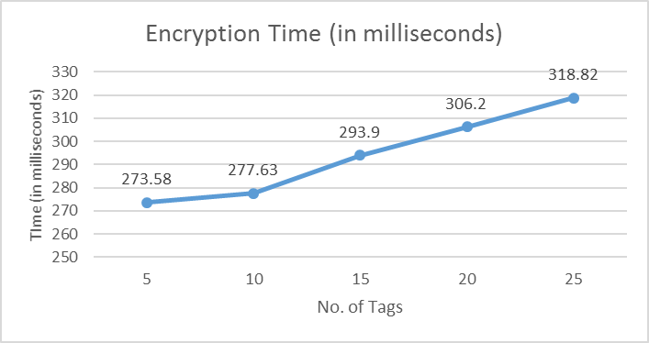
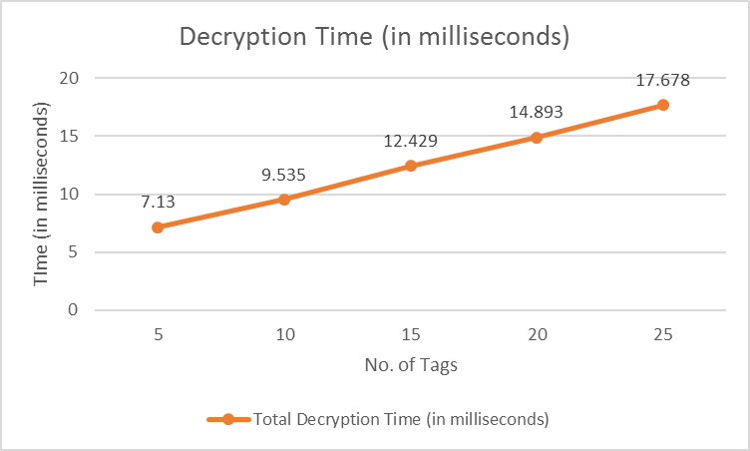
Number of Tags | Complete Encryption Time (in milliseconds) | Complete Decryption Time (in milliseconds)
5 | 273.58 | 7.13
10 | 277.63 | 9.535
15 | 293.9 | 12.429
20 | 306.2 | 14.893
25 | 318.82 | 17.678

Slide 21
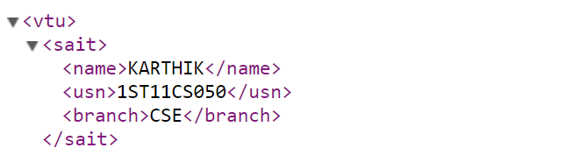
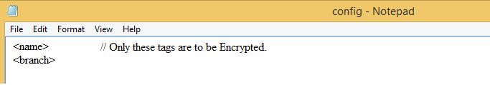
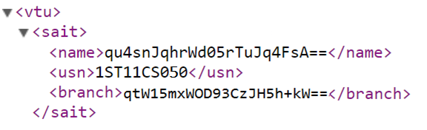
Selective Encryption
Input File
Configuration File
Output File

Slide 22
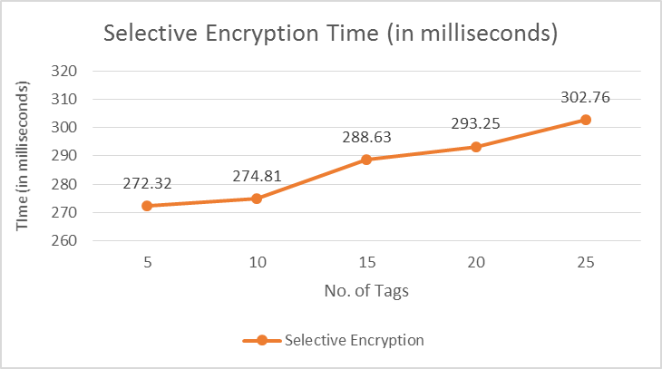
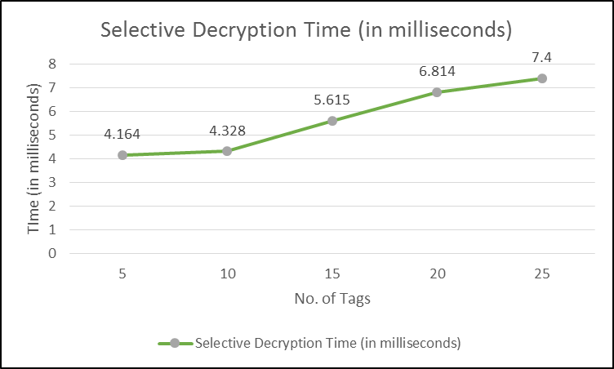
Number of Tags | Selective Encryption Time (in milliseconds) | Selective Decryption Time (in milliseconds)
5 | 272.32 | 4.164
10 | 274.81 | 4.328
15 | 288.63 | 5.615
20 | 293.25 | 6.814
25 | 302.76 | 7.4

Slide 23
COMPARISON : Complete vs Selective

Slide 24
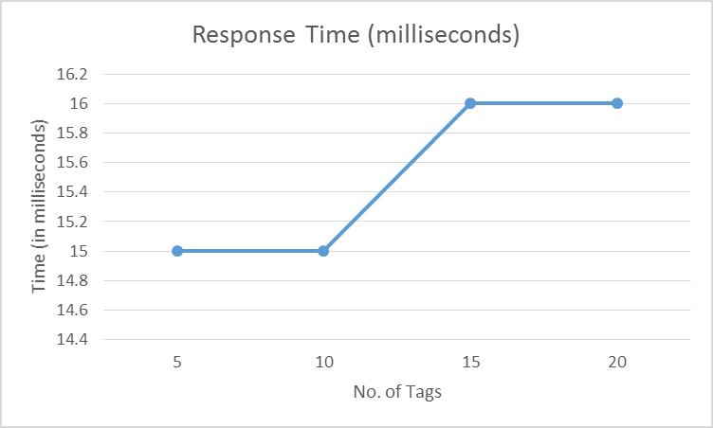
Response Time
Response time is the total amount of time it takes to respond to a request for service.
No.of Tags in SOAP | Response Time (in ms)
5 | 15
10 | 15
15 | 16
20 | 16

Slide 25
Deployment of Web Services using AXIS
Apache Axis is an Open Source SOAP server and client. Apache Axis is one of the best free tools available for implementing and deploying web services, and also for implementing the web service clients.
Axis implements the JAX-RPC API, one of the standard ways to program Java services.
Axis is compiled in the JAR file axis.jar; it implements the JAX-RPC API declared in the JAR files jaxrpc.jar and saaj.jar. It needs various helper libraries, for logging, WSDL processing and introspection.

Slide 26
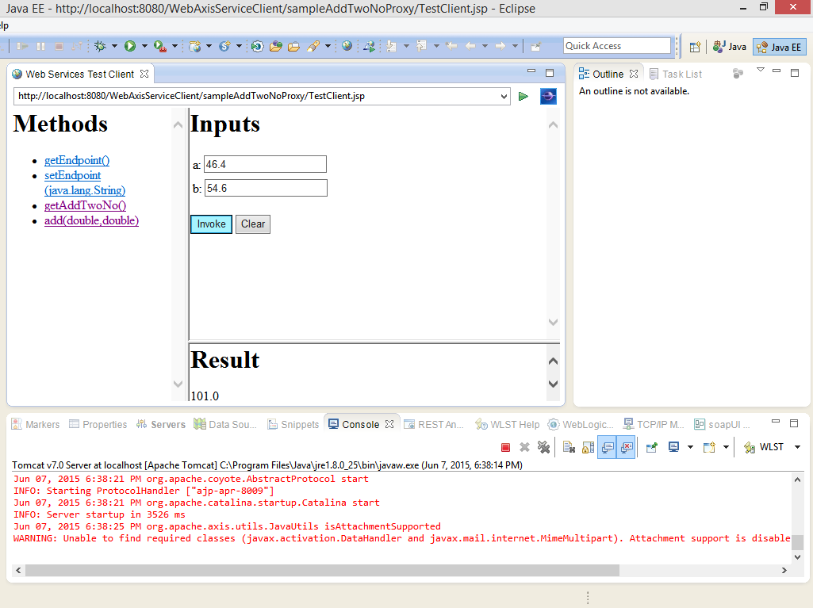
The given snapshot shows how a web service is implemented using Apache Axis Web Server. The server side is coded by the programmer.
The client side script is auto generated in Eclipse IDE and on client side details of all the services offered by server are present.
It is clear from the snapshot that a function for adding two numbers is offered by the server to its clients.
The client enters two “double” type numbers,’46.4’ and ‘54.6’. The result obtained is ‘101’.

Slide 27
Conclusion and Future Work
Streaming-based complete and selective XML encryption and decryption have been designed and implemented. It has shown many possible attacks on web service and also the countermeasures to avoid these attacks.
The results shows streaming-based XML encryption and decryption technique provides a better way of resisting XML attacks. The analysis reveals the use of stream based selective XML encryption and decryption is faster and less memory consumption compared to stream based complete XML encryption and decryption.
The streaming-based XML encryption and decryption has to be implemented to secure the web service and SOAP processing is done to enhance the performance of transformation by using selective encryption.
Further this design can be upgraded enhance the SOAP transformation to REST technique and to provide security against DOS attack and replay attack by implementing Access control and WS-Policy.

Slide 28
BIBLIOGRAPHY
[1] Esmiralda Moradianvand Anne Håkansson, “Possible attacks on XML Web Services”, IJCSNS International Journal of Computer Science and 154 Network Security, VOL.6 No.1B, January 2006, pp 154-170.
[2] Hashizume Keiko, Eduardo B Fernandez, “Symmetric encryption and XML encryption patterns”, Proceedings of the 16th Conference on Pattern Languages of Programs, pp.270-298, 2009.
[3] Meiko Jensen, Nils Gruschka, Ralph Herkenhoener and Luttenberger, N., (2007), “SOA and Web Services: New Technologies, New Standards – New Attacks” Fifth European Conference on Web Services, 0-7695-3044-3/07, 2007.
[4] Michael Schrefl, Katharina Grun, Jurgen Dorn, “SemCrypt - Ensuring Privacy of Electronic on Data Engineering Workshops (ICDEW)”, 2013 IEEE 29th International Conference on Data Engineering Workshops (ICDEW) 2005, pp. 1191, doi:10.1109/ICDE.2005.280 Documents Through Semantic-Based Encrypted Query Processing", ICDEW, 2005, 2013 IEEE 29th International Conference.
[5] Taflan I. Gundem and Mustafa F. Celikel, “Structure Encryption in XML”, Computer Engineering Dept., Boğaziçi University, 34342 Bebek, İstanbul, Turkey, pp. 1-13, 2008.
[6] Rupesh Kumar, Mario mumoz organero, rajat agarwal, “XML Secure Documents for a Secure E- Architecture”, pp. 35-45, 2010.

Slide 29
[7] Benjamin Sanno, “streaming-based encryption technique”, pp. 1-48, 2010.
[8] R.D. Cameron, K.S. Herdy, and D. Lin, “PARABIX: High Performance XML Parsing Using Parallel Bit Stream Technology,” Proc. Conf. Center for Advanced Studies on Collaborative Research: Meeting of Minds (CASCON ’08), vol. 17, pp. 222-235, 2008.
[9] J. Cheney, “Compressing XML with Multiplexed Hierarchical PPM Models,” Proc. Data Compression Conf., pp. 163-173, 2001.
[10] R. Chinnici, J.J. Moreau, A. Ryman, and S. Weerawarana, Web Services Description Language (WSDL) Version 2.0 Part 1: Core Language, W3C recommendation, http://www. w3.org/TR/wsdl20, Aug. 2009.
[11] K. Chiu and W. Lu, “A Compiler-Based Approach to SchemaSpecific XML Parsing,” Proc. Workshop High Performance XML Processing, 2004.
[12] K. Chiu, M. Govindaraju, and R. Bramley, “Investigating the Limits of SOAP Performance for Scientific Computing,” Proc. ACM Int’l Symp. High Performance Distributed Computing (HPDC), pp. 246-254, 2002.

