Slide 1
High-Throughput VLSI Architecture Design of Canonical Huffman Encoder
IMT22 VLSI Architecture Project Presentation
Github Repository Link : https://github.com/Ishaniiitb/Huffman_EncodingEncoding

Slide 2
The Team

Slide 3
The Team
The team consisted of the following members :
Serial Number | Name | Roll No | Email ID
1 | Aryan Mishra | IMT2022502 | aryan.mishra@iiitb.ac.in
2 | Divyansh Kumar | IMT2022509 | divyansh.kumar@iiitb.ac.in
3 | R Harshavardhan | IMT2022515 | r.harshavardhan@iiitb.ac.in
4 | Raghav Khurana | IMT2022550 | raghav.khurana@iiitb.ac.in
5 | Ishan Jha | IMT2022562 | ishan.jha@iiitb.ac.in
6 | Rohan Rajesh | IMT2022575 | rohan.rajesh@iiitb.ac.in

Slide 4
What is Huffman Encoding?

Slide 5
Key Idea
The following steps are performed sequentially in order to do Huffman Encoding :
Frequency Calculation of each symbol.
Construction of Huffman (Binary) Tree.
Assigning Binary code to each node(symbol) in the tree.
Assign shorter codes to symbols that appear more frequently and longer codes to symbols that appear less frequently, thereby minimizing the overall size of the encoded data.

Slide 6
1. Frequency Calculation
Analyse the input data to determine how often each symbol (i.e, a character in a string) appears.
This frequency count is essential because it dictates which symbols will receive shorter codes to optimize compression.
Here we take “Mississippi” as an example.
Symbol | Frequency
M | 1
I | 4
S | 4
P | 2

Slide 7
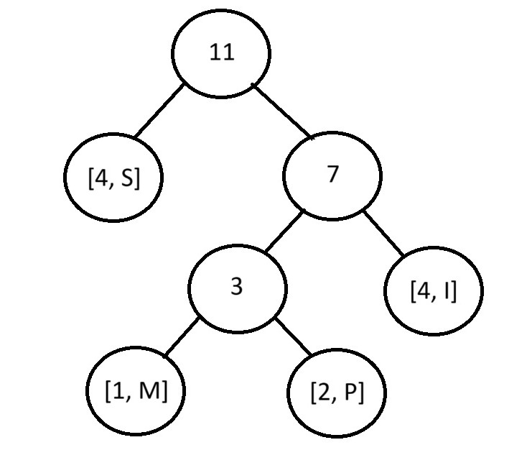
2. Construction of Tree
A binary tree is constructed based on frequency, with lower frequency symbols deeper in the tree.
Iteratively find the 2 least occurring symbols and join them to a parent node.

Slide 8
3. Encoding Using Tree
Symbol | Huffman Code
M | 100
I | 11
S | 0
P | 101
To find the encoding of each symbol, travel through the tree to reach the symbol node, each time the right branch is taken append “1” to the code, and if the left branch is taken append “0” to the code.

Slide 9
Canonical vs Regular Huffman

Slide 10
Canonical Huffman Coding
Canonical Huffman coding is a variation of the standard Huffman coding algorithm. While standard Huffman coding builds a tree that may yield different binary codes (depending on tie-breaking choices), canonical Huffman coding reassigns those codes in a standardized and deterministic way based solely on the code lengths.
While both methods use the same basic idea, i.e, assigning shorter codes to more frequent symbols, the canonical version standardizes how those codes are represented.

Slide 11
Canonical Huffman Coding
So for the same word “Mississippi”, in canonical Huffman coding we would get :
Symbol | Canonical Huffman Code
M | 110
I | 10
S | 0
P | 111

Slide 12
The Proposed Architecture

Slide 13
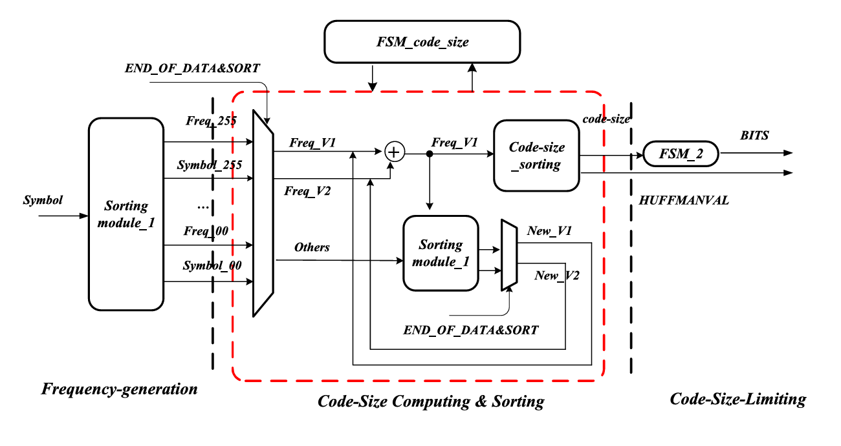
Proposed Architecture
The proposed architecture for performing a high throughput canonical Huffman coding is shown below :

Slide 14
Stage 1
Takes one symbol per cycle and then produces 256 sets of ordered frequencies.
Consists of two parts that operate in parallel: the frequency-statistics process and the frequency-sorting process.
Since there’s only two pipeline stages are inserted, the final sorting result can be obtained almost simultaneously when the last symbol is entered.
Improve the throughput
In traditional designs, the sorting module is not started until the frequency statistics of all the input symbols have been completed.

Slide 15
Stage 1
Frequency-Statistics & Sorting Stage :
To realize the parallel characteristics, we use 17 cells (Cell_0∼Cell_16) to store and update each symbol and its frequency.
Cell_16 module stores the symbol with the largest frequency, Cell_15 stores the symbol with the second largest frequency, and so on..
The architecture receives the input symbol. The symbols stored in each cell will be compared with new input.
The cell that stores the input will be positioned, and the frequency is added by 1.

Slide 16
Stage 1
Sorting-Module-1 :
The sorting module and the 17 cells are triggered by the clock synchronously and operate in parallel.
Thus a temporary frequency statistic and its sorted results are obtained at every clock cycle.
Consequently, the last symbol is imported, the precision frequency statistics of all these input symbols and the final correct sorted result will be produced simultaneously

Slide 17
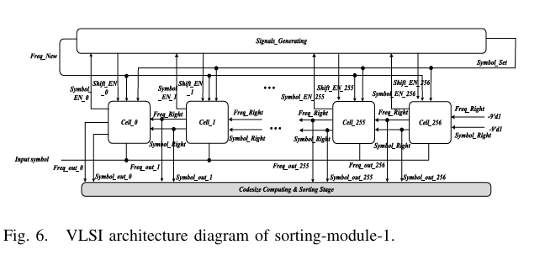
Stage 2
Sorting-module_1:
This module (reused from the Frequency-Generation stage) re-sorts the frequency list after a new node is created by combining V1 and V2.
This allows the FSM to efficiently find the new minimum and subminimum frequency nodes (new V1 and V2) in the next iteration.

Slide 18
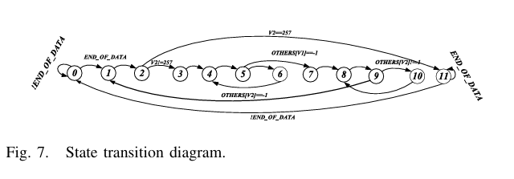
Stage 2
FSM_code_size:
If the signal END_OF_DATA = 1‘b1, which means all the 17 frequency sets have been ordered by the first stage, the FSM_code_size module starts to calculate the code-size process, re-order the updated frequency queue using Sorting module-1 and order the code-size queue executed by the Code-size_sorting module.

Slide 19
Stage 2
Code-size_sorting:
This module specifically sorts the calculated code sizes for the symbols.
When the computation of all the symbols’ code sizes has been completed, the code-size will be sorted from small to large to group all the symbols.

Slide 20
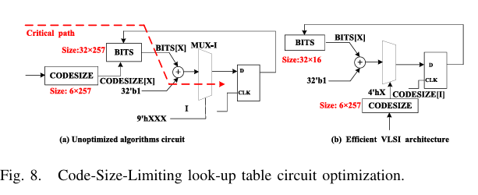
Stage 3
FSM_2:
Limits and redistributes code sizes by reducing long sizes (e.g., size >16) and increasing shorter ones to maintain valid, canonical Huffman structure.
Standard design uses three nested tables causing high delay and area; the proposed method flattens them and trims unused BITS entries to improve speed and efficiency.

Slide 21
Results

Slide 22
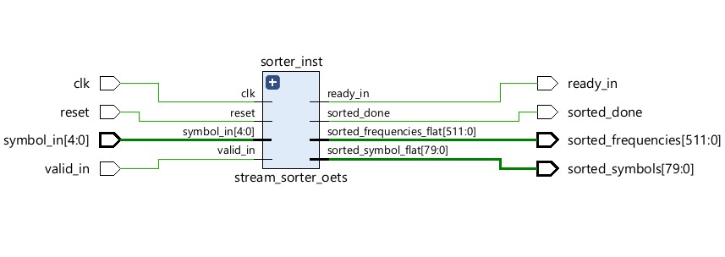
Stage 1 : Frequency-Generation
: Schematic generated from Vivado - frequency_generation_stage

Slide 23
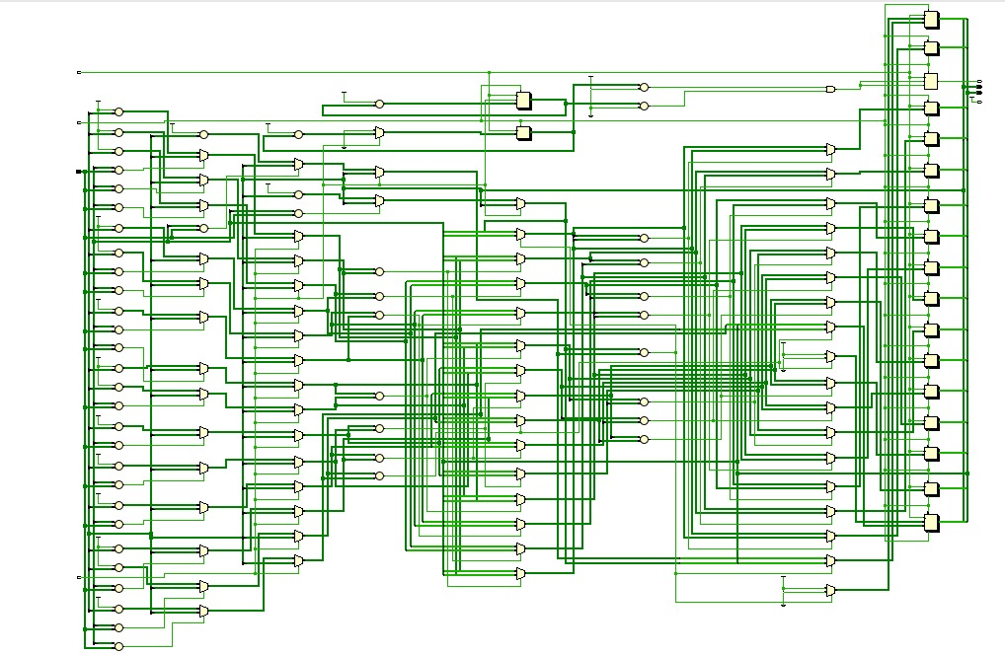
Stage 1 : Frequency-Generation
: Schematic generated from Vivado - stream_sorter_oets ( sorting module)

Slide 24
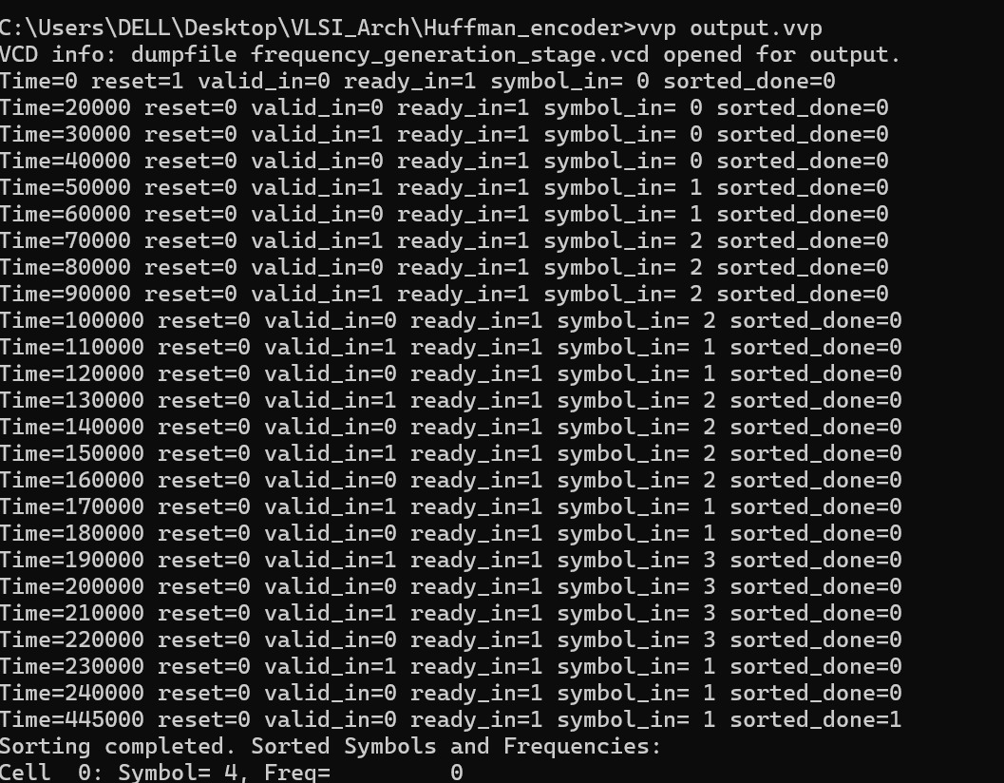
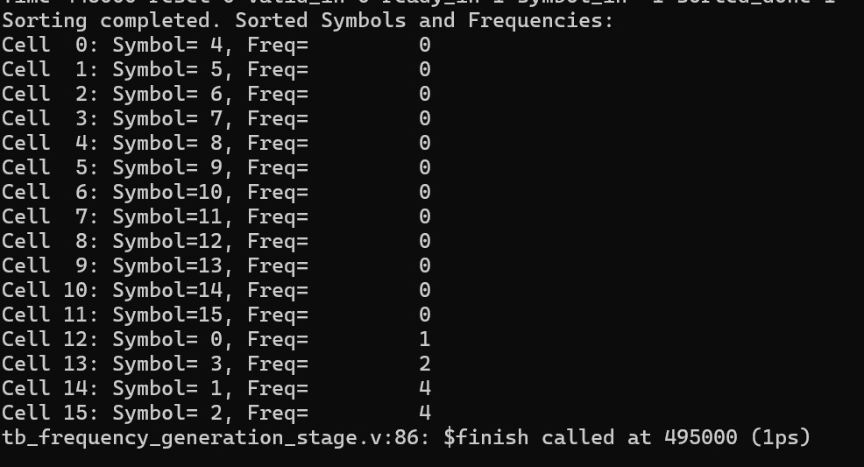
Stage 1 : Frequency-Generation
: Terminal output from iVerilog - frequency_generation_stage & stream_sorter_oets

Slide 25
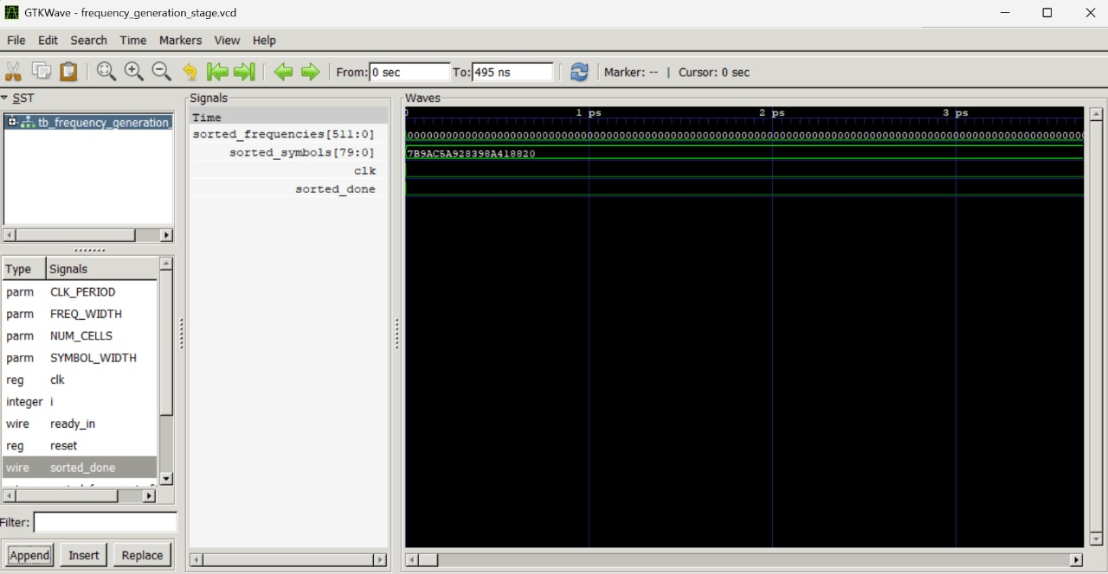
Stage 1 : Frequency-Generation
: gtkwavefrom iVerilog - frequency_generation_stage & stream_sorter_oets - First clock cycle

Slide 26
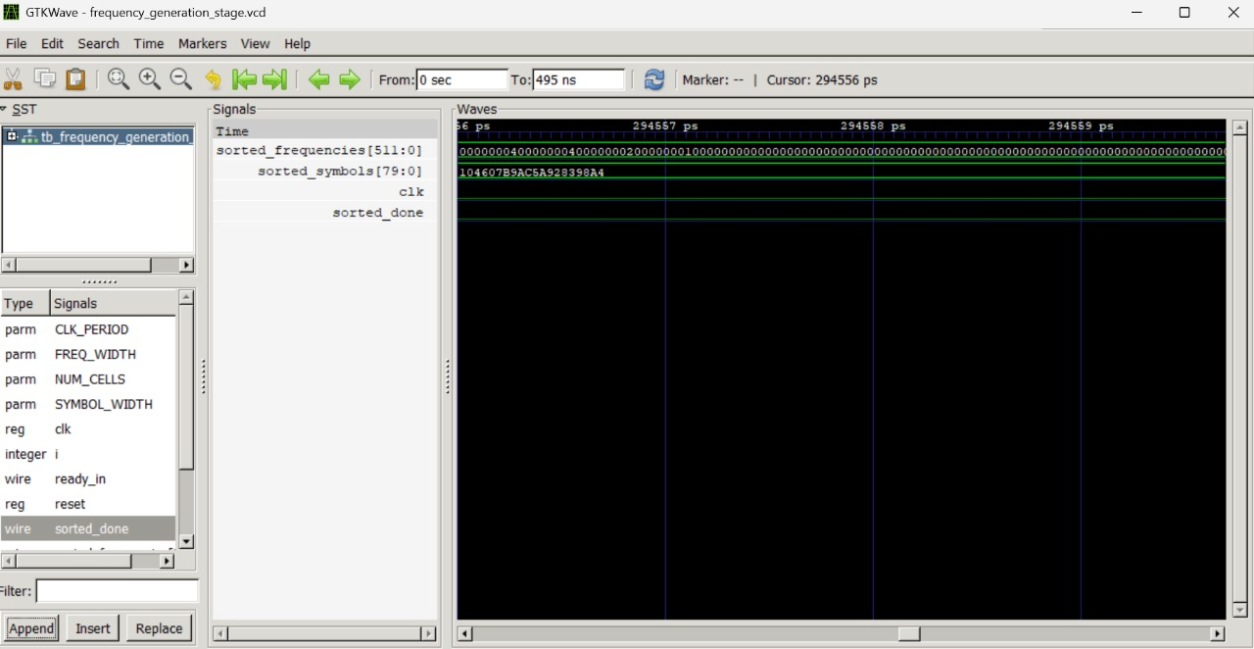
Stage 1 : Frequency-Generation
: gtkwavefrom iVerilog - frequency_generation_stage & stream_sorter_oets - Intermediate clock cycle

Slide 27
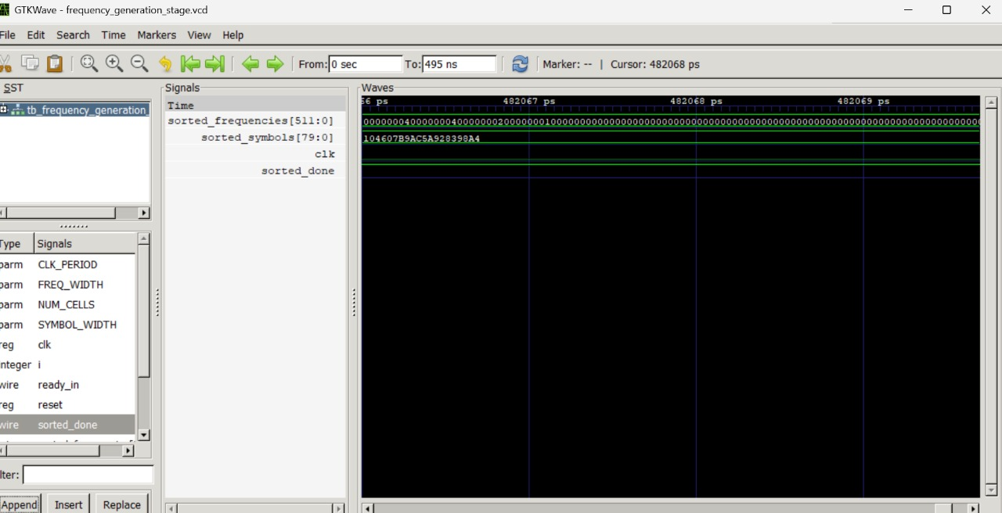
Stage 1 : Frequency-Generation
: gtkwavefrom iVerilog - frequency_generation_stage & stream_sorter_oets - Last clock cycle ( sorting completed)

Slide 28
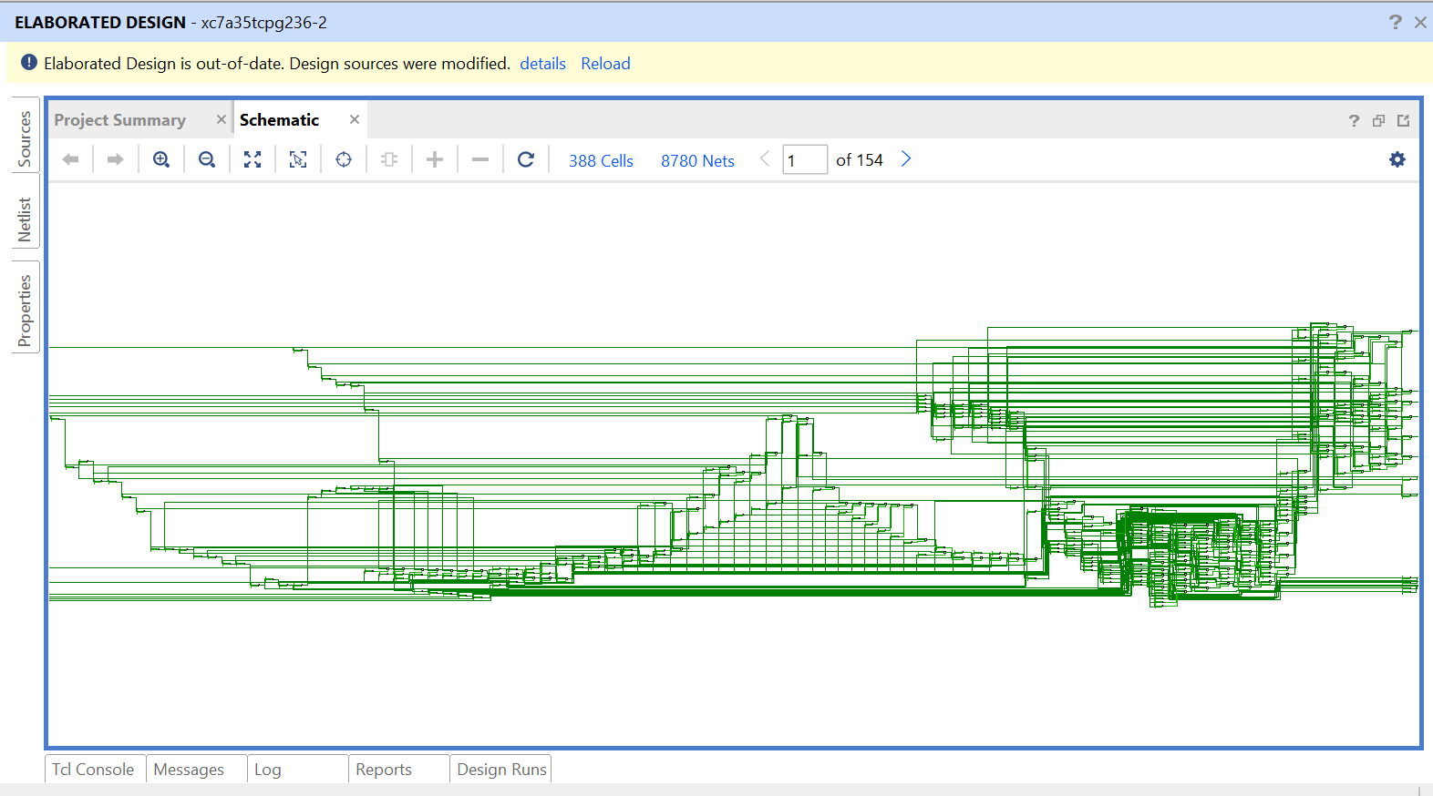
Stage 2 : Code-Size Computing & Sorting Stage
: Schematic generated from Vivado - Code-Size Computing Stage

Slide 29
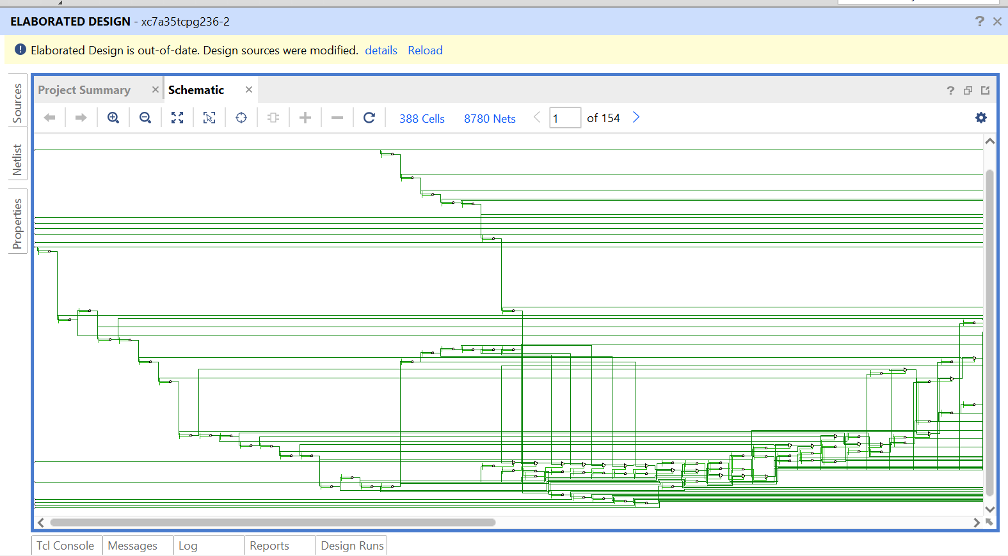
Stage 2 : Code-Size Computing & Sorting Stage
: Schematic generated from Vivado - Code-Size Computing Stage

Slide 30
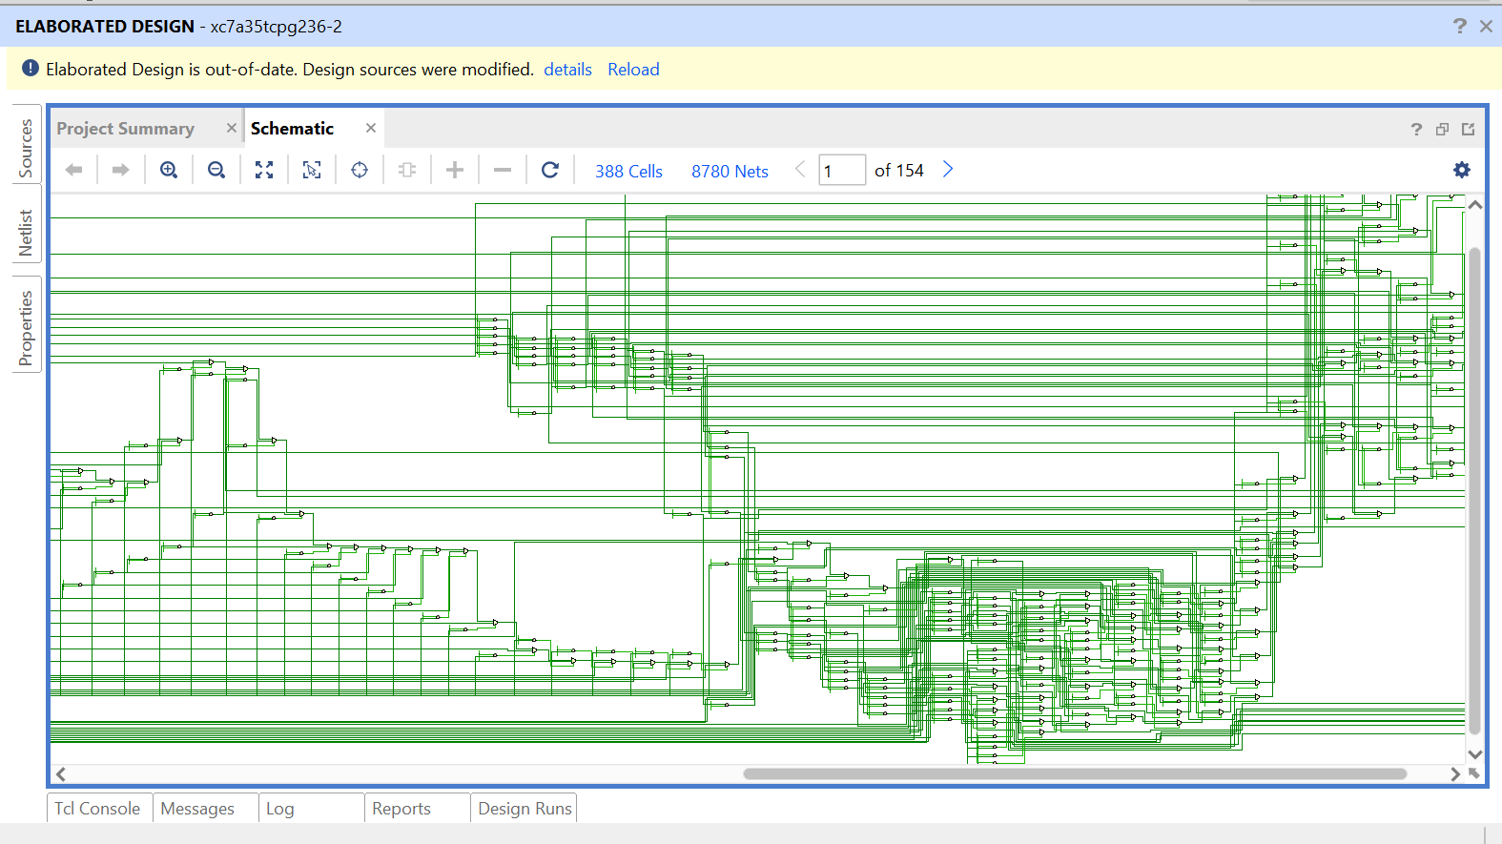
Stage 2 : Code-Size Computing & Sorting Stage
: Schematic generated from Vivado - Code-Size Computing Stage

Slide 31
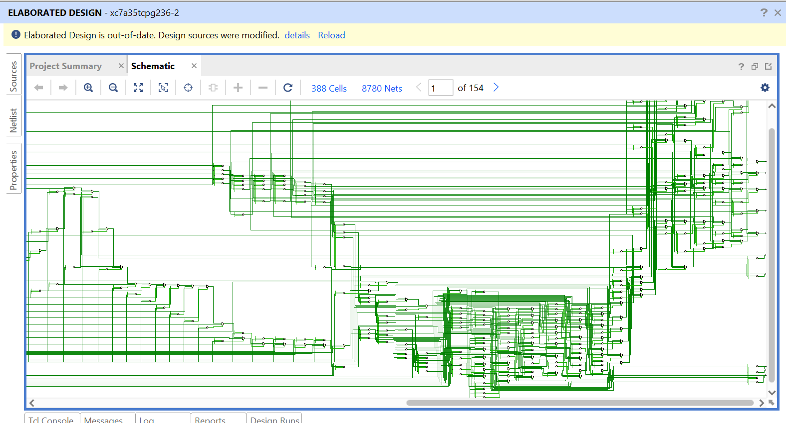
Stage 2 : Code-Size Computing & Sorting Stage
: Schematic generated from Vivado - Code-Size Computing Stage

Slide 32
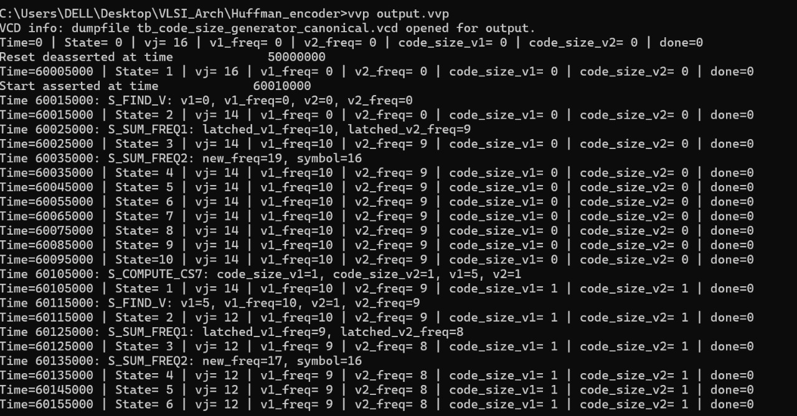
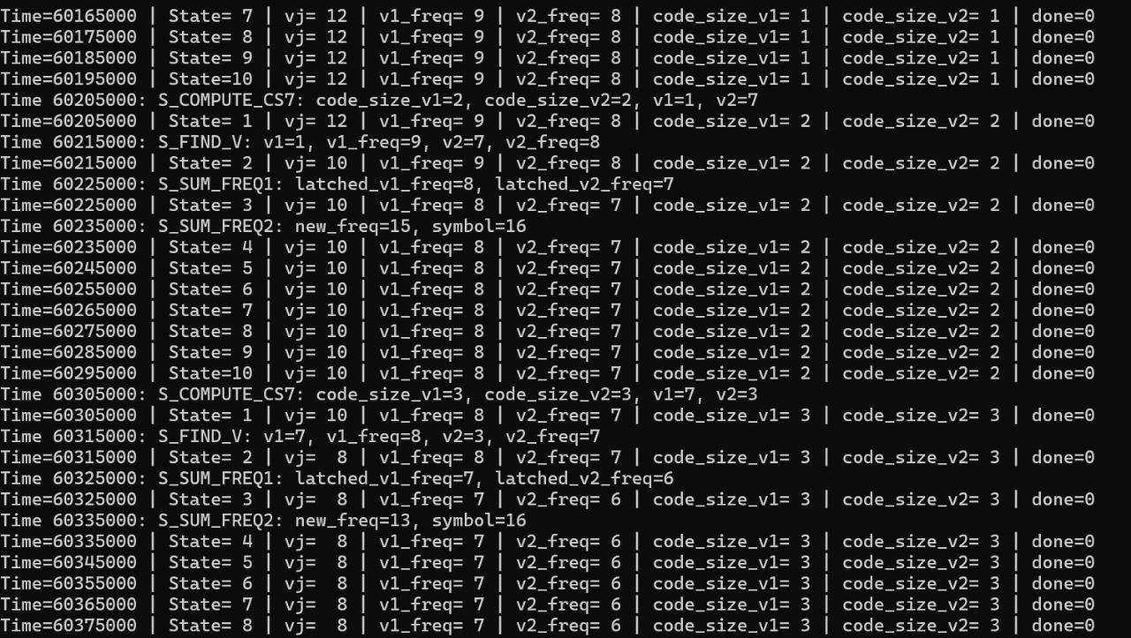
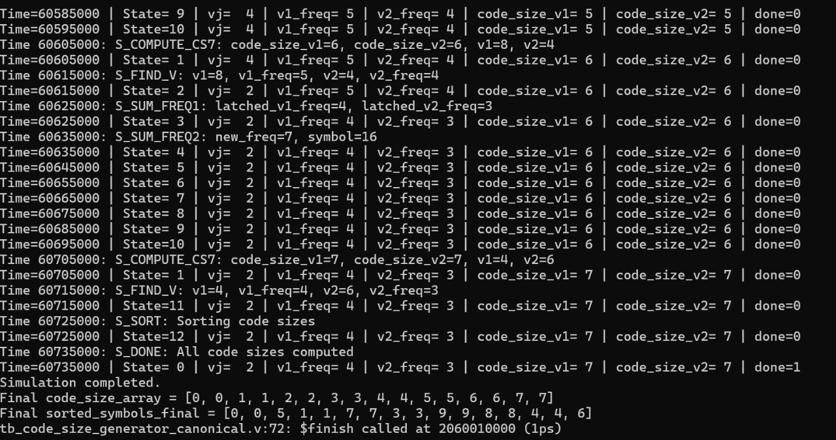
Stage 2 : Code-Size Computing & Sorting Stage
: Terminal output from iVerilog - Code-Size Computing Stage

Slide 33
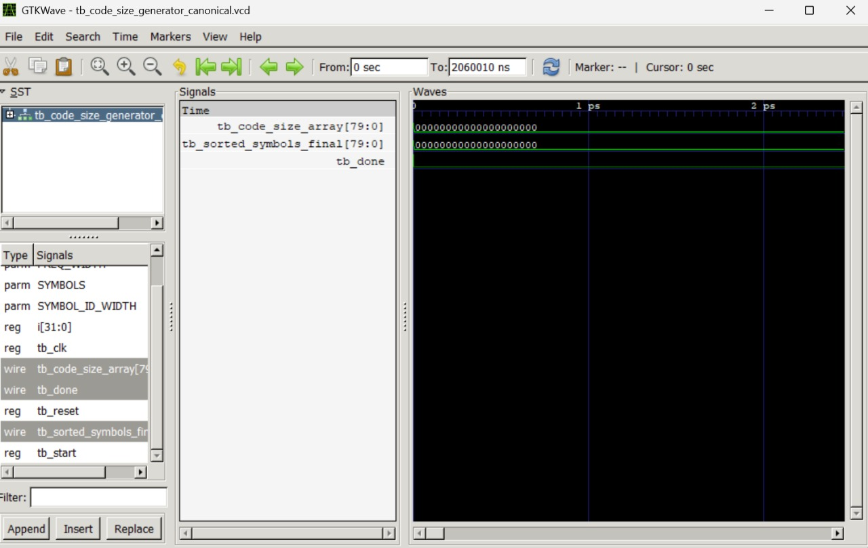
Stage 2 : Code-Size Computing & Sorting Stage
: gtkwavefrom iVerilog - Code-Size Computing Stage - First clock cycle

Slide 34
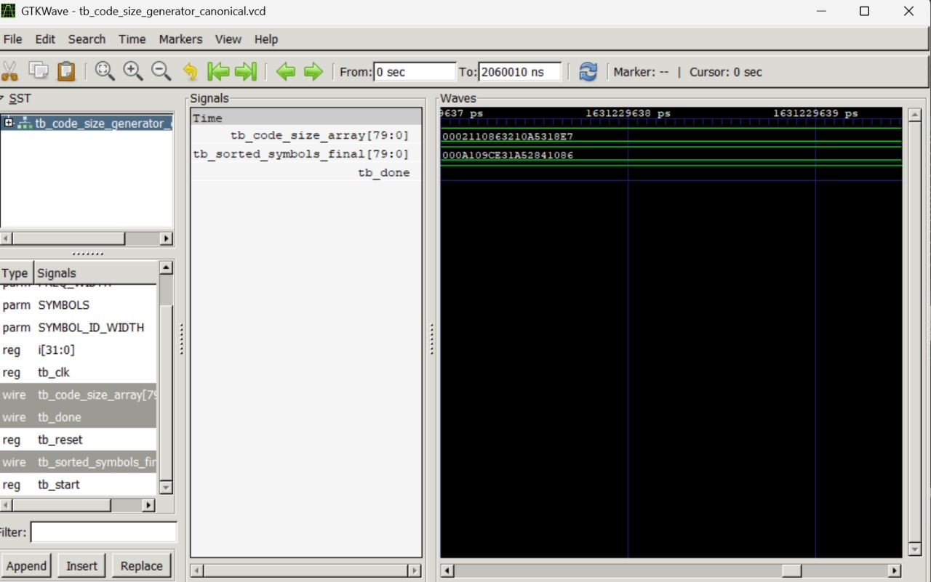
Stage 2 : Code-Size Computing & Sorting Stage
: gtkwavefrom iVerilog - Code-Size Computing Stage - Last clock cycle

Slide 35
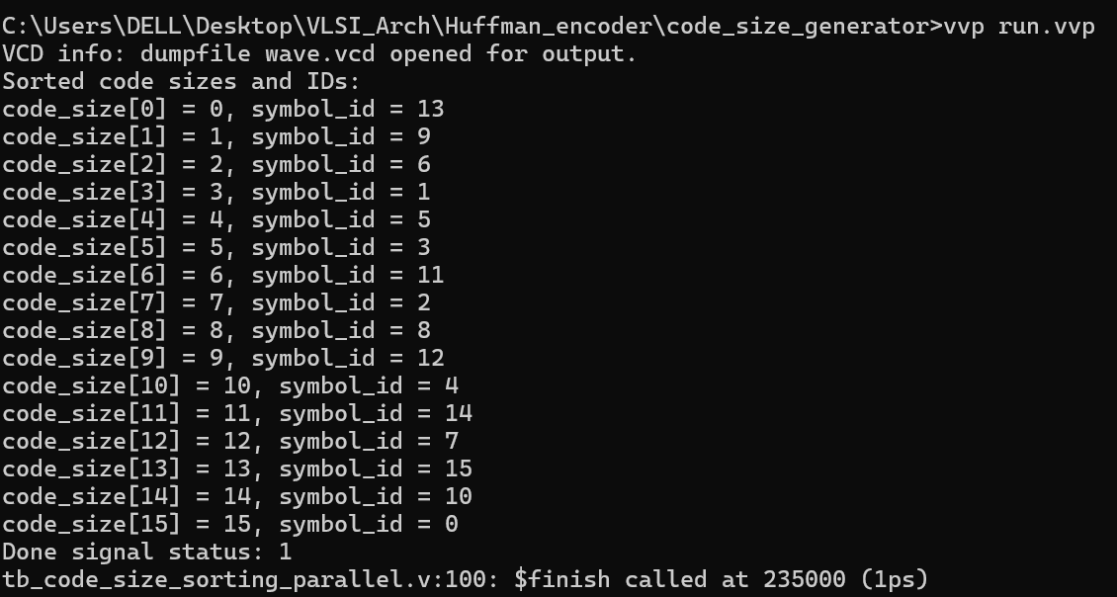
Stage 2 : Code-Size Computing & Sorting Stage
: Terminal output from iVerilog - Code-Size Sorting Stage

Slide 36
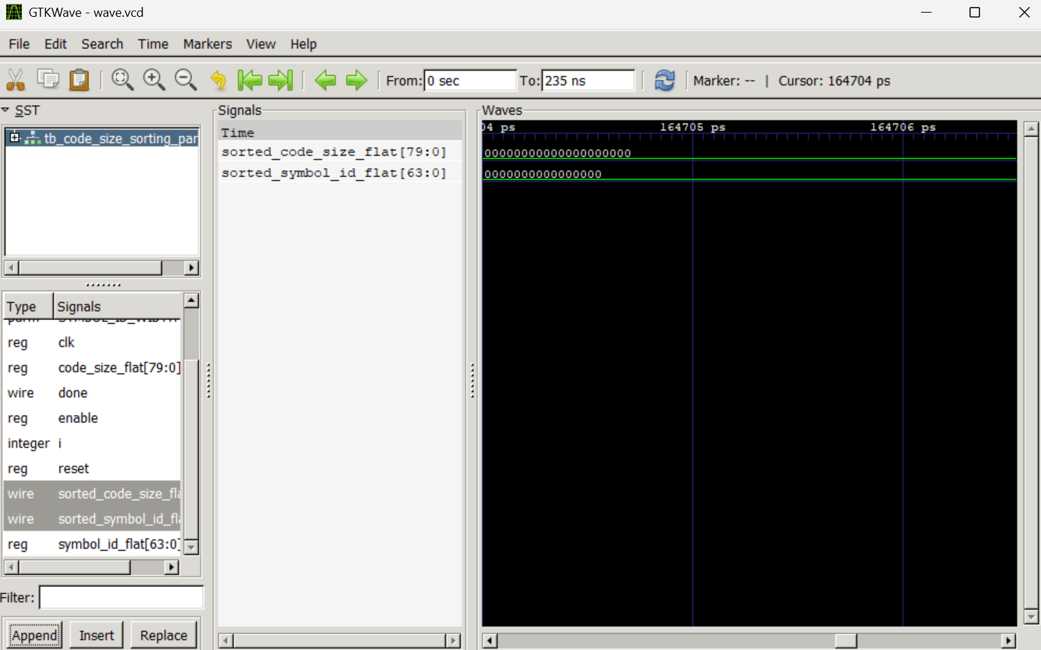
Stage 2 : Code-Size Computing & Sorting Stage
: gtkwavefrom iVerilog - Code-Size Sorting Stage - First clock cycle

Slide 37
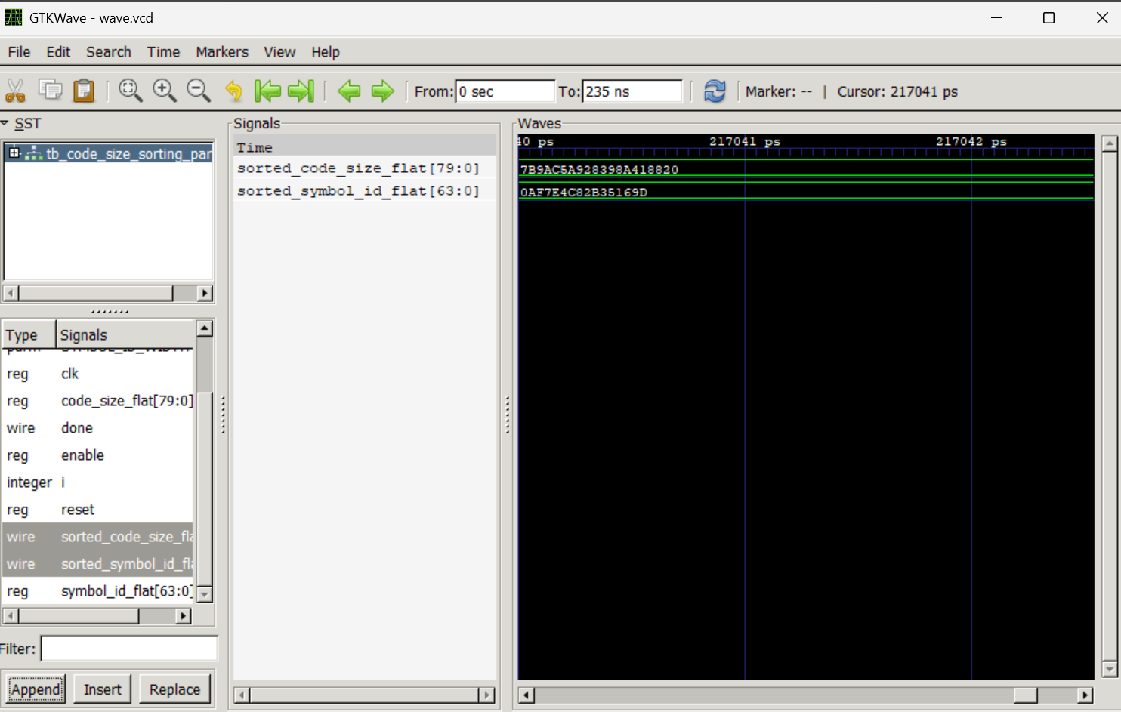
Stage 2 : Code-Size Computing & Sorting Stage
: gtkwavefrom iVerilog - Code-Size Sorting Stage - Last clock cycle

Slide 38
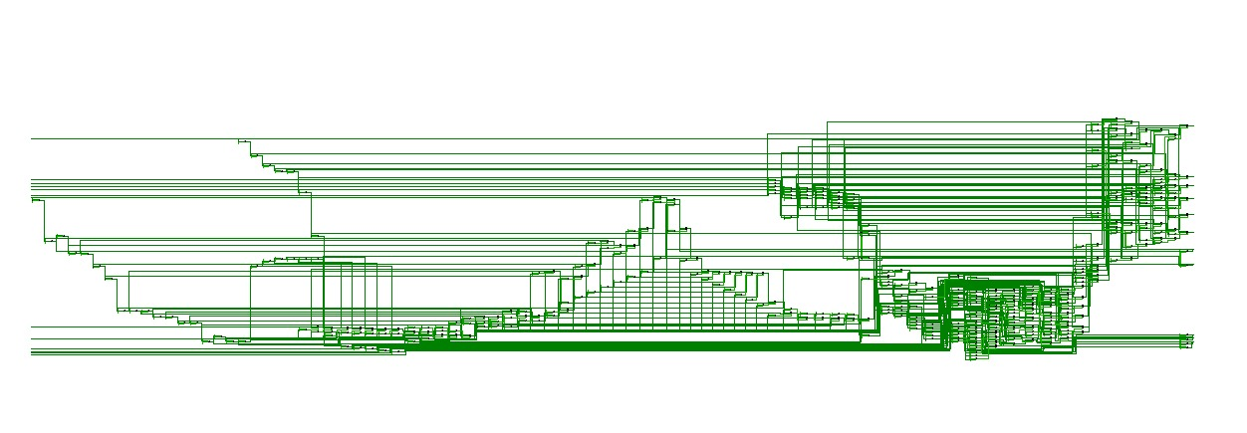
Stage 3 : Code-Size-Limiting Stage
: Schematic generated from Vivado - Code-Size Limiting Stage

Slide 39
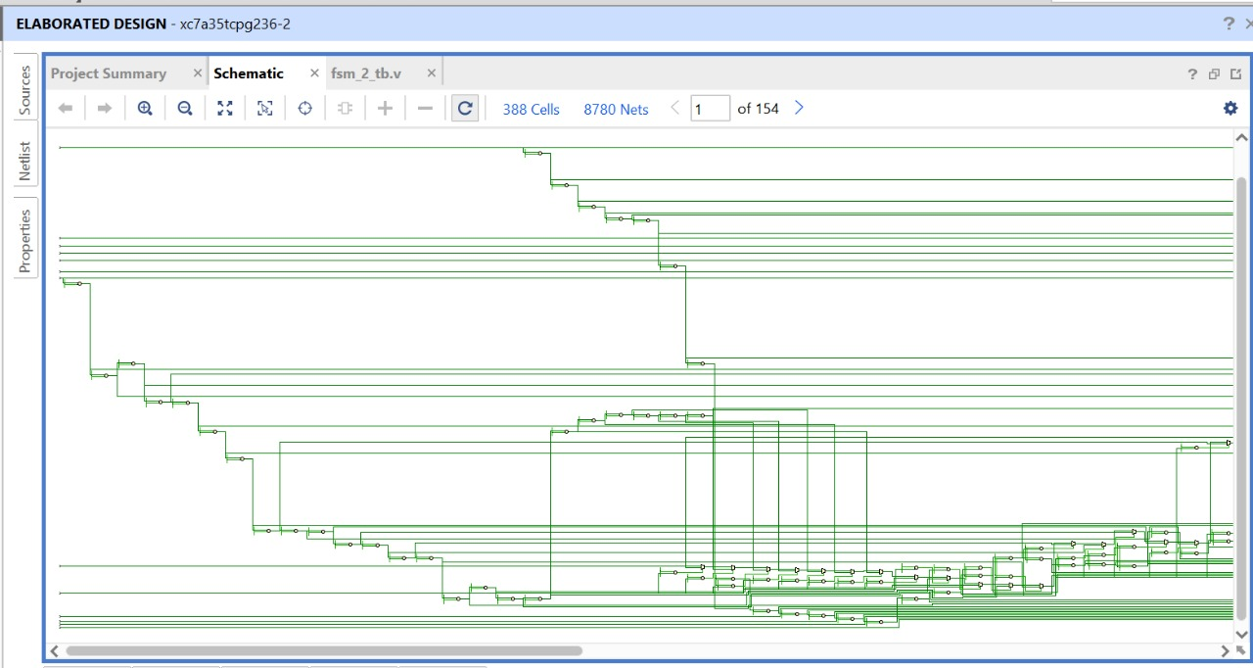
Stage 3 : Code-Size-Limiting Stage
: Schematic generated from Vivado - Code-Size Limiting Stage

Slide 40
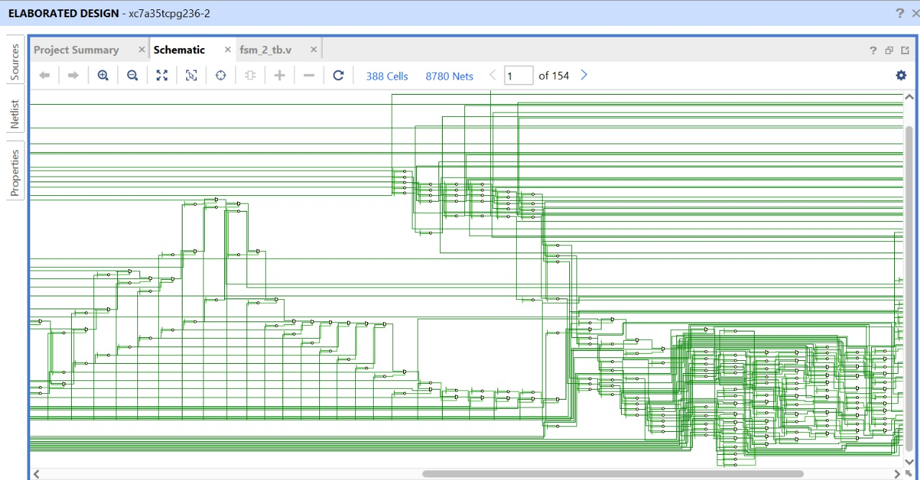
Stage 3 : Code-Size-Limiting Stage
: Schematic generated from Vivado - Code-Size Limiting Stage

Slide 41
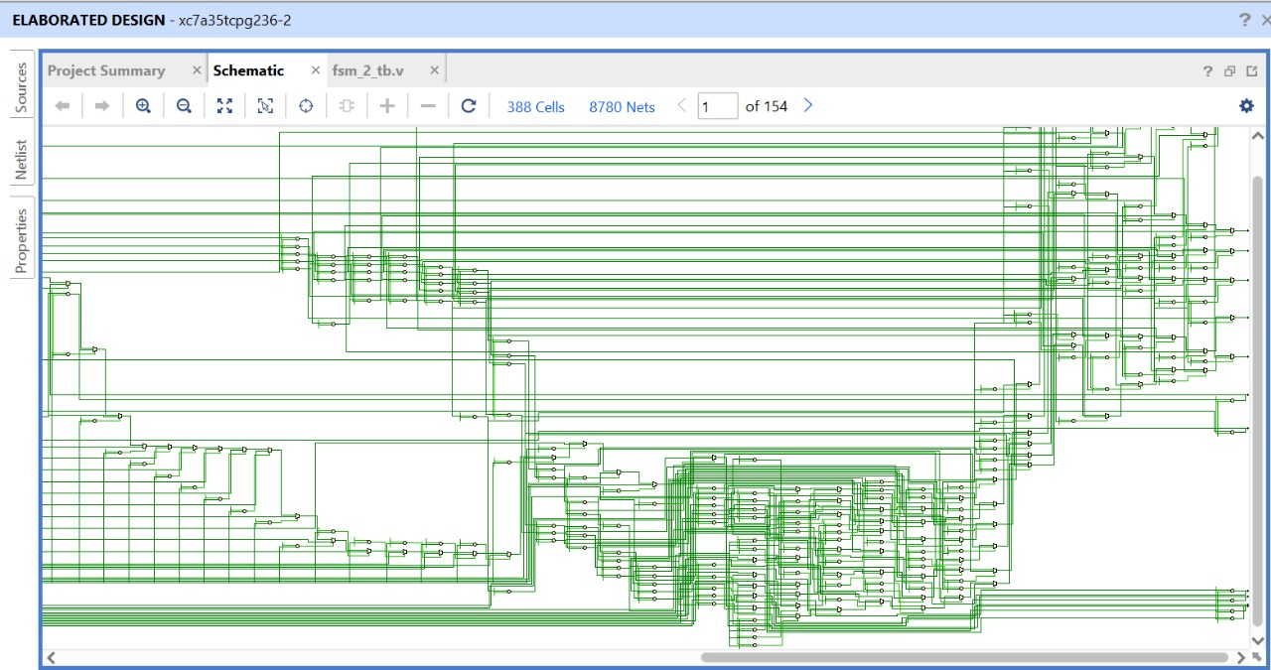
Stage 3 : Code-Size-Limiting Stage
: Schematic generated from Vivado - Code-Size Limiting Stage

Slide 42
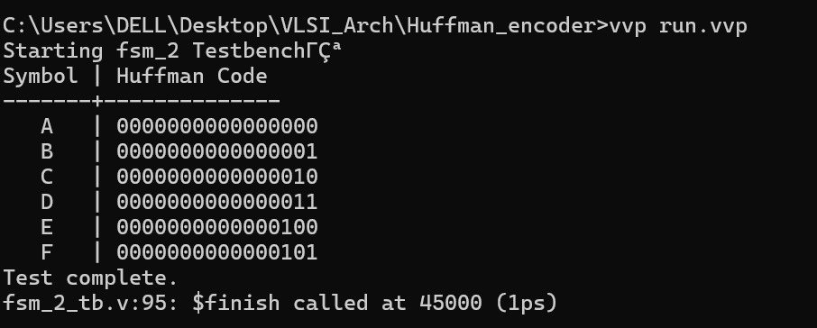
Stage 3 : Code-Size-Limiting Stage
: Terminal output from iVerilog - Code-Size Limiting Stage

Slide 43
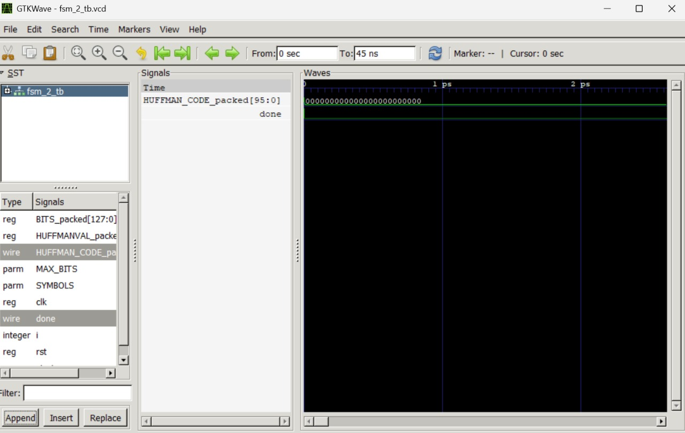
Stage 3 : Code-Size-Limiting Stage
: gtkwavefrom iVerilog - Code-Size Limiting Stage - First clock cycle

Slide 44
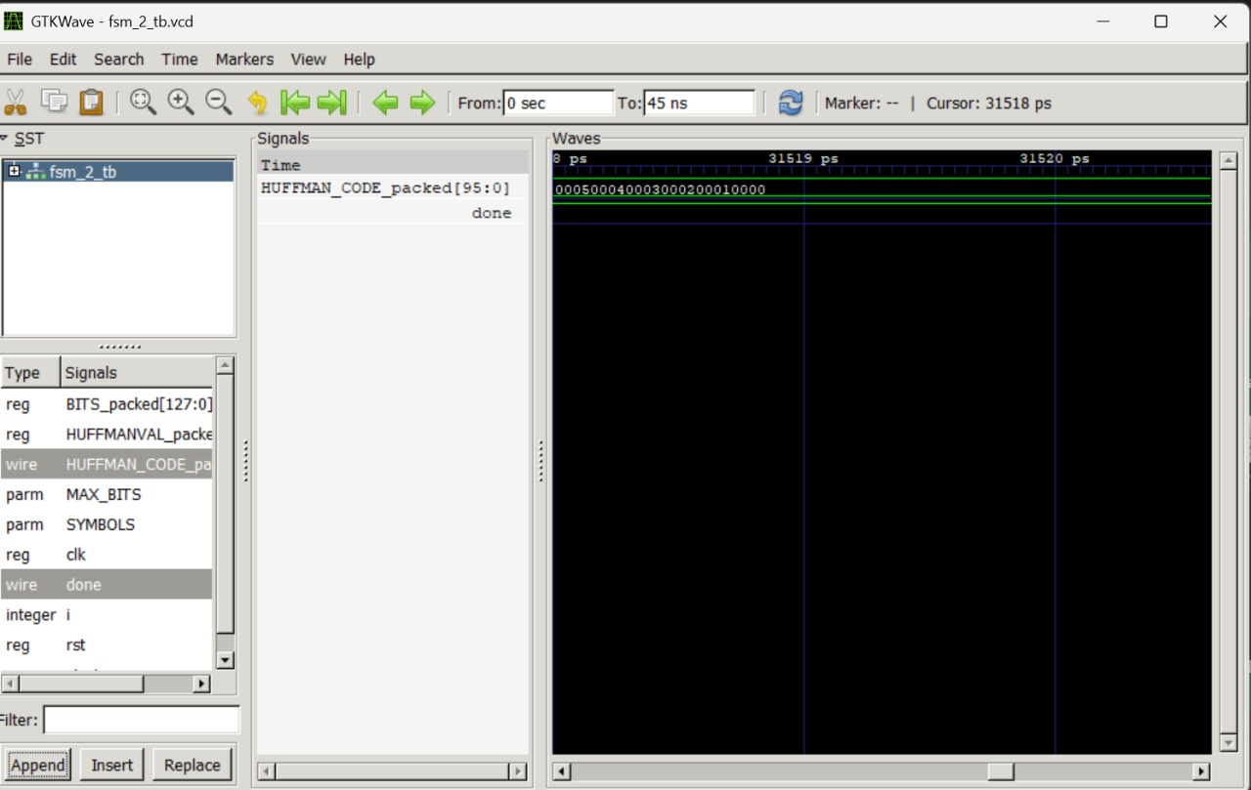
Stage 3 : Code-Size-Limiting Stage
: gtkwavefrom iVerilog - Code-Size Limiting Stage - Last clock cycle - After generating Huffman Code

Slide 45
Thank you

