Slide 1



EV Vehicle/Charging Demand Prediction
Name:- Rohan Raj Kumawat
AICTE Student ID: STU66537515d408a1716745493 AICTE Internship ID: INTERNSHIP_1748923002683e727a876ea

Slide 2

Learning Objectives
Understand the Importance of EV Forecasting Learn why forecasting electric vehicle (EV) adoption is crucial for urban planning and sustainable infrastructure development.
Define the Problem Statement Identify the objective of building a model to predict future EV adoption based on historical registration and usage trends.
Explore the Dataset Composition Analyze the dataset structure, including key attributes like date, vehicle type, county, and registration counts.
Differentiate EV Categories Distinguish between Battery Electric Vehicles (BEVs), Plug-in Hybrid Electric Vehicles (PHEVs), and non-electric vehicles.
Apply Regression Modeling Techniques Learn how to apply regression models to forecast future EV adoption across different regions and vehicle types.
Interpret Forecasting Results for Planning Understand how forecasting outcomes can inform decisions on charging station placement and policy making.
GOAL
Source :
https://github.com/rohanrajkumawat/EV_Charging_predication2.git

Slide 3
Tools and Technology used
Python Used as the primary programming language for data preprocessing, analysis, and model development.
Pandas & NumPy For efficient data manipulation, cleaning, and numerical computations on large datasets.
Scikit-learn Used to build and evaluate regression models for forecasting EV adoption trends.
Matplotlib & Seaborn For data visualization to explore trends, correlations, and prediction outputs.
Joblib To save and load machine learning models efficiently for later use in deployment.
Streamlit Used to build an interactive web dashboard that displays EV adoption forecasts and insights in real-time.

Slide 4
Methodology
Data Collection Collected monthly vehicle registration data from Washington State Department of Licensing, including EV and non-EV counts.
Data Cleaning & Preprocessing Handled missing values, filtered relevant columns (e.g., BEVs, PHEVs), and converted dates into time series format.
Exploratory Data Analysis (EDA) Analyzed historical trends, vehicle types, and regional adoption patterns using visualizations and descriptive statistics.
Feature Engineering Created new features like EV percentage, regional aggregates, and time-based indicators (e.g., year, month).
Model Development Trained regression models (e.g., Linear Regression, Random Forest) to forecast future EV adoption based on historical data.
Model Evaluation & Deployment Evaluated model performance using metrics like MAE and R², then deployed the final model via a Streamlit dashboard.

Slide 5
Problem Statement:
Rising EV Adoption Electric vehicle (EV) usage is rapidly increasing, creating a need for better infrastructure planning.
Infrastructure Challenges Unplanned growth can lead to shortages in charging stations and reduced user satisfaction.
Data-Driven Forecasting Needed Forecasting EV adoption using historical data can help in proactive infrastructure and policy planning.
Rich Dataset Available Dataset includes EV registration counts, vehicle types (BEV, PHEV), usage, and regional data from 2017–2024, Data spans 260 counties/regions in Washington State.
Predict Future Trends Objective is to use past trends to predict how EV adoption will grow in future months or years.
Support Sustainable Goals Accurate forecasts aid in achieving sustainability and energy-efficiency goals in transportation planning.

Slide 6
Solution:
Interactive Forecasting Dashboard The solution uses a responsive Streamlit web app to provide an interactive interface for forecasting Electric Vehicle (EV) adoption across Washington State counties.
Machine Learning-Based Predictions The EV growth is predicted using a pre-trained machine learning model (forecasting_ev_model.pkl) that accounts for historical data trends, seasonality, and engineered features like lag values and growth slopes.
Dynamic Data Visualization Built-in Plotly charts display historical and forecasted EV adoption data with interactive features such as zoom, hover, and comparison between multiple counties.
User-Driven Forecast Customization Users can control forecast period (1–5 years), select a primary county, and optionally enable multi-county comparison to see how different counties perform over time.
Real-Time Data Insights The dashboard generates KPI metrics, bar charts, line graphs, and pie charts to summarize key insights such as top-performing counties and overall adoption trends.
Optimized Performance with Caching Use of @st.cache_data and @st.cache_resource optimized for performance, avoiding unnecessary re-computations.
Algorithms Used
Random Forest Regression: For predictive modeling, Numpy Polyfit: To calculate growth slope (linear tren estimation), Rolling Mean & Percentage Change: Time-series statistical analysis for input features
Github repo link:-https://github.com/rohanrajkumawat/EV_Charging_predication2.git
Deploy link:- https://evchargingpredication2-6bwbmcyja7glrzpkhh4ran.streamlit.app/

Slide 7
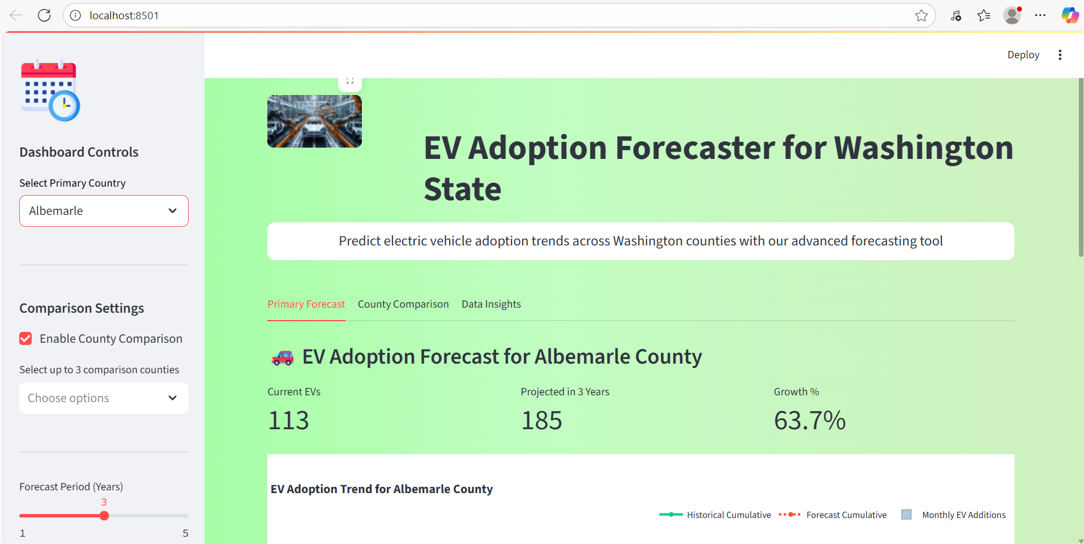
Screenshot of Output:

Slide 8
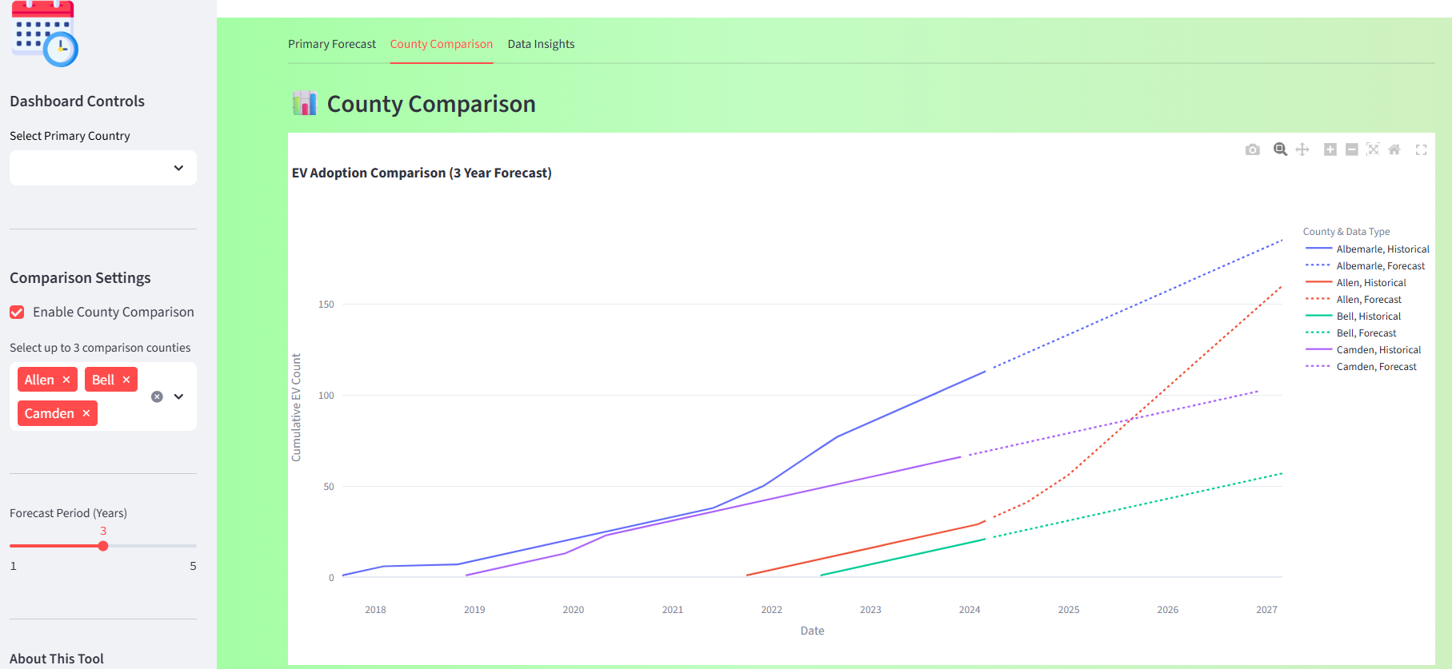
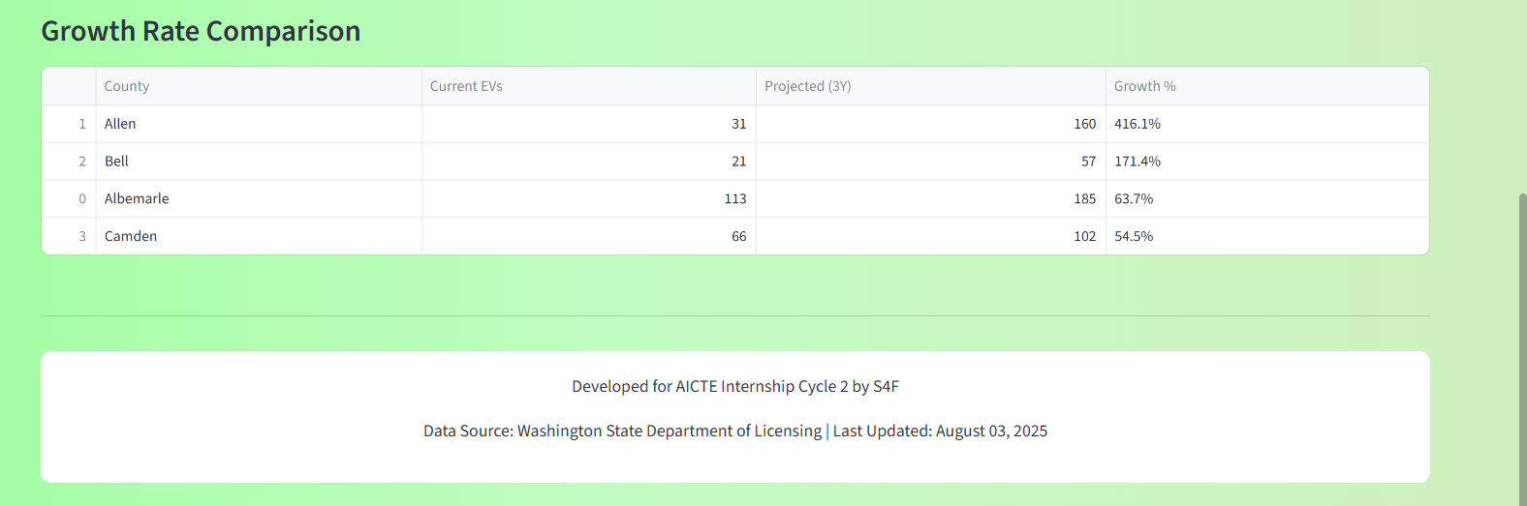
Screenshot of Output:

Slide 9
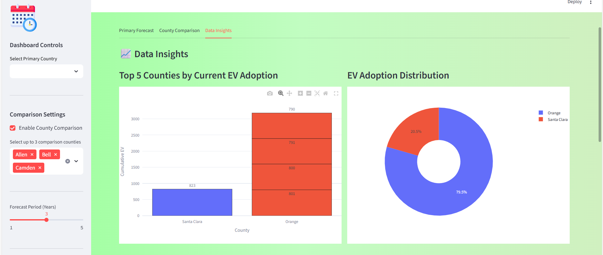
Screenshot of Output:

Slide 10
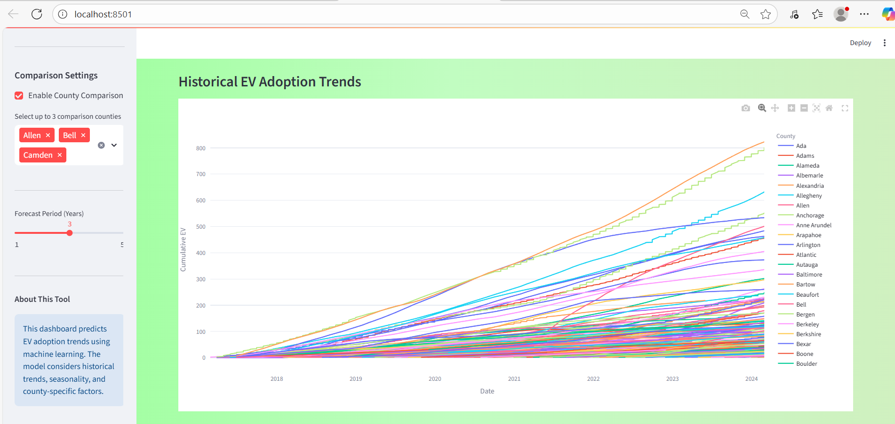
Screenshot of Output:

Slide 11
Conclusion:
Accurate Forecasting is Critical Predicting EV adoption trends is essential for efficient urban and transportation planning.
Historical Data Holds Value Past registration data provides reliable insights into future EV growth patterns.
Regression Models Are Effective Machine learning models like linear regression and random forest can accurately forecast EV demand.
BEVs Show Steady Growth Battery Electric Vehicles have shown consistent growth, indicating strong adoption momentum.
Regional Patterns Matter EV adoption varies significantly by county, highlighting the need for localized infrastructure planning.
Visual Dashboards Aid Decision-Making Tools like Streamlit enable easy sharing of insights with planners and policymakers.
Data-Driven Planning Reduces Risk Anticipating charging needs and EV load helps avoid bottlenecks and enhances user satisfaction.
Supports Sustainability Goals Forecasting helps align infrastructure with green initiatives and long-term environmental goals.

