Slide 1
Managing Bond Portfolios
11
Bodie, Kane, and Marcus
Essentials of Investments, 9th Edition

Slide 2
11.1 Interest Rate Risk
Interest Rate Sensitivity
Bond prices and yields are inversely related
Increase in bond’s yield to maturity results in smaller price change than yield decrease of equal magnitude
Long-term bond prices more sensitive to interest rate changes than short-term bonds
As maturity increases, sensitivity of bond prices to changes in yields increases at decreasing rate

Slide 3
11.1 Interest Rate Risk
Interest Rate Sensitivity
As maturity increases, sensitivity of bond prices to changes in yields increases at decreasing rate
Interest rate risk is inversely related to bond’s coupon rate; low-coupon bonds are more sensitive to interest rates
Sensitivity of bond’s price-to-yield change is inversely related to current yield to maturity

Slide 4
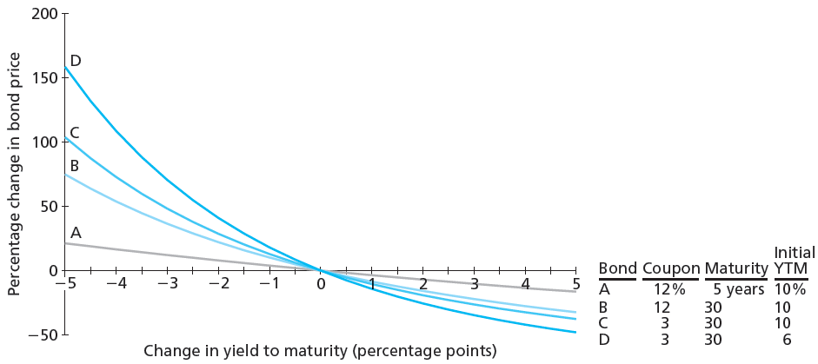
Figure 11.1 Change in Bond Prices as a Function of Change in Yield to Maturity

Slide 5
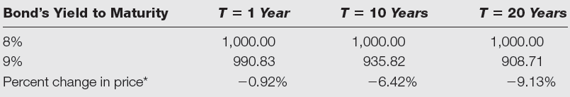
Table 11.1 Annual Coupon Prices
Prices of 8% annual coupon bonds
*Equals value of bond at a 9% yield to maturity minus value of bond at (the original) 8% yield, divided by the value at 8% yield.

Slide 6
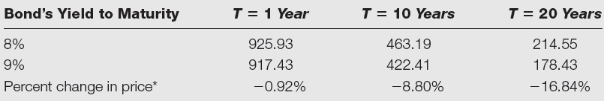
Table 11.2 Zero-Coupon Bond Prices
Prices of zero-coupon bonds
*Equals value of bond at a 9% yield to maturity minus value of bond at (the original) 8% yield, divided by the value at 8% yield.

Slide 7
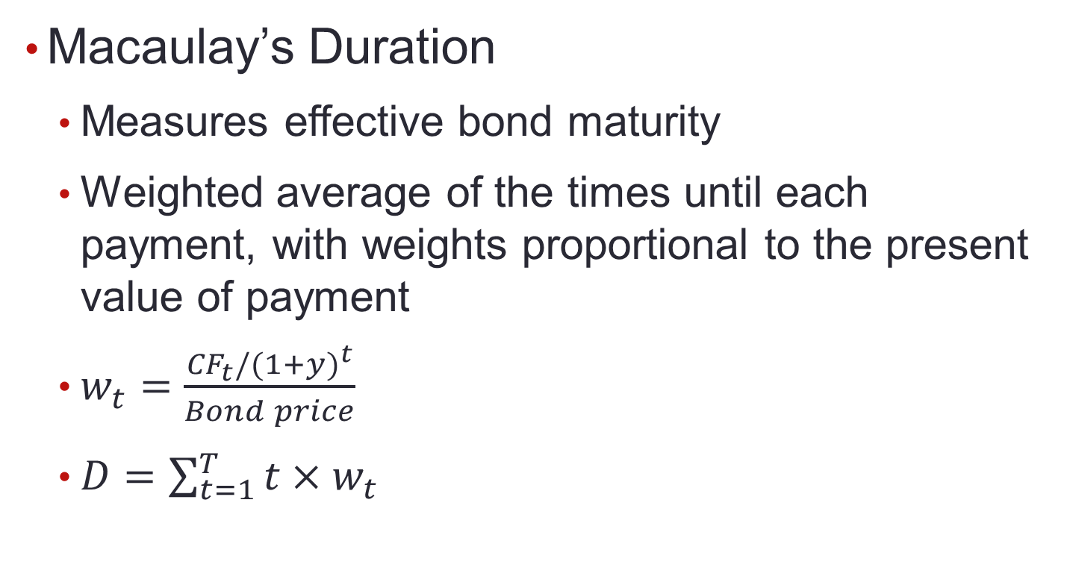
11.1 Interest Rate Risk

Slide 8
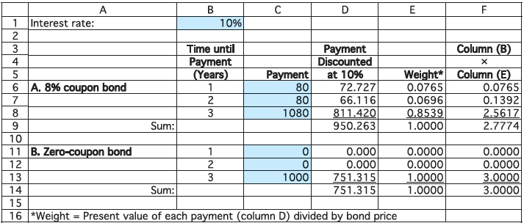
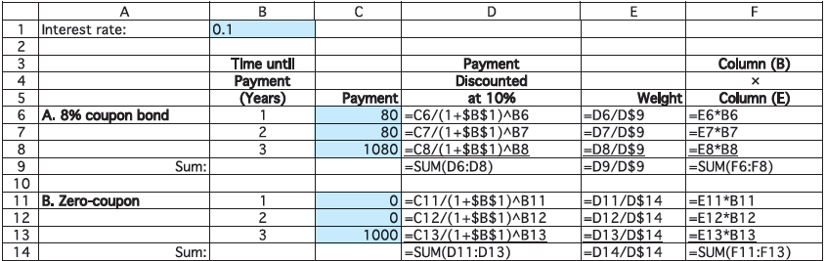
Spreadsheet 11.1 Calculation of Duration of Two Bonds

Slide 9
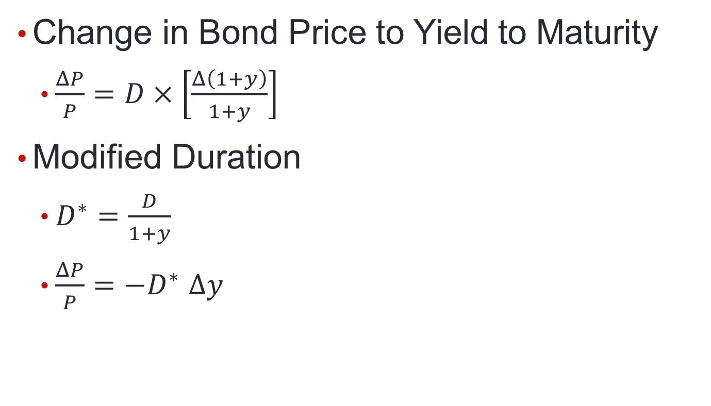
11.1 Interest Rate Risk

Slide 10
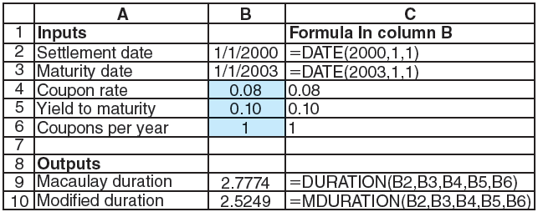
Spreadsheet 11.2 Computing Duration

Slide 11
11.1 Interest Rate Risk
What Determines Duration?
Zero-coupon bond’s duration is time to maturity
Time/yield to maturity constant, bond’s duration and interest-rate sensitivity higher when coupon price lower
Coupon rate constant, bond’s duration and interest-rate sensitivity generally increase with time to maturity; duration always increases with maturity for bonds at or above par

Slide 12
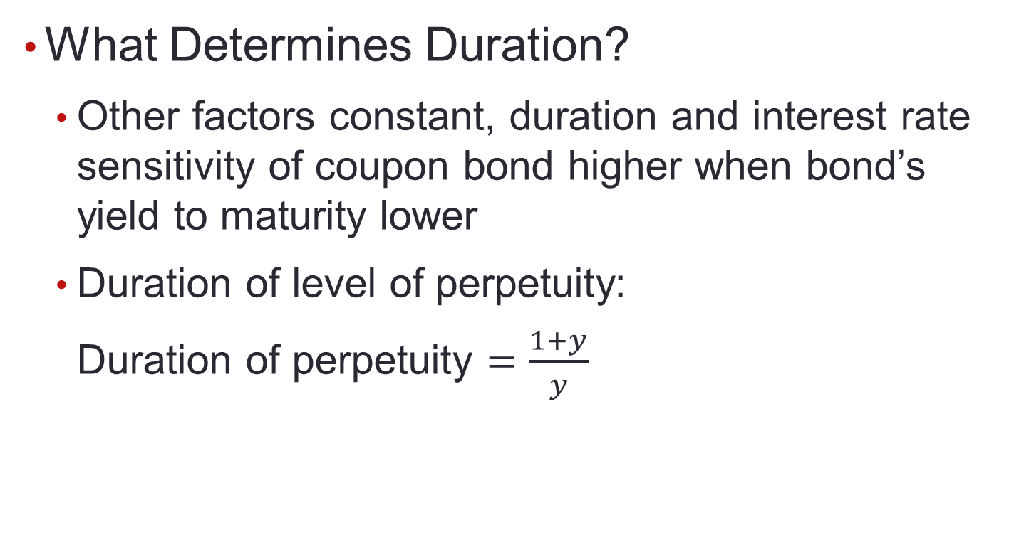
11.1 Interest Rate Risk

Slide 13
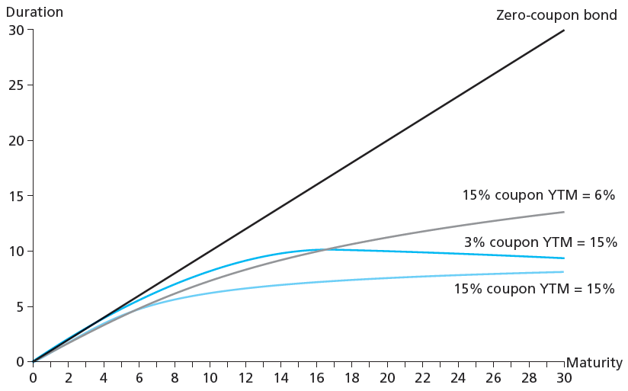
Figure 11.2 Duration as Function of Maturity

Slide 14
Table 11.3 Annual Coupon Bond Duration
Durations of annual coupon bonds (initial bond yield = 6%)
 | Coupon Rates (% per year)
Years to Maturity | 4% | 6% | 8% | 10%
1 | 1.000 | 1.000 | 1.000 | 1.000
5 | 4.611 | 4.465 | 4.342 | 4.237
10 | 8.281 | 7.802 | 7.445 | 7.169
20 | 13.216 | 12.158 | 11.495 | 11.041
Infinite (perpetuity) | 17.667 | 17.667 | 17.667 | 17.667

Slide 15
11.2 Passive Bond Management
Immunization
Strategy to shield net worth from interest rate movements
Rebalancing
Realigning proportions of assets in portfolio as needed

Slide 16
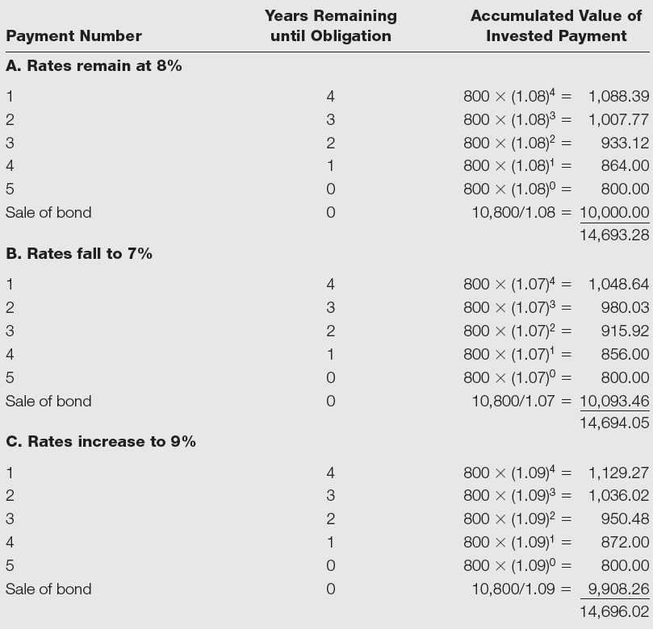
Table 11.4 Terminal Value of Bond Portfolio after Five Years

Slide 17
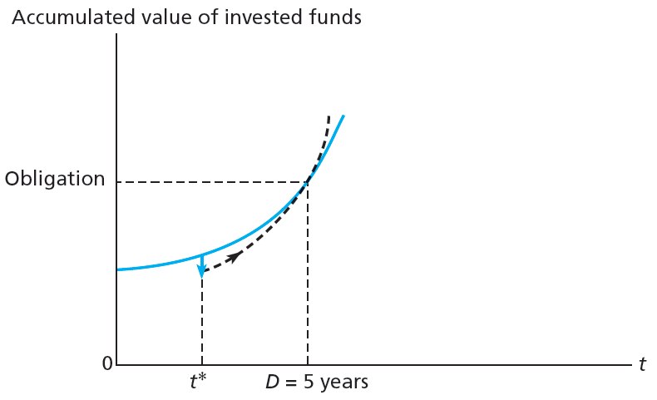
Figure 11.3 Growth of Invested Funds

Slide 18
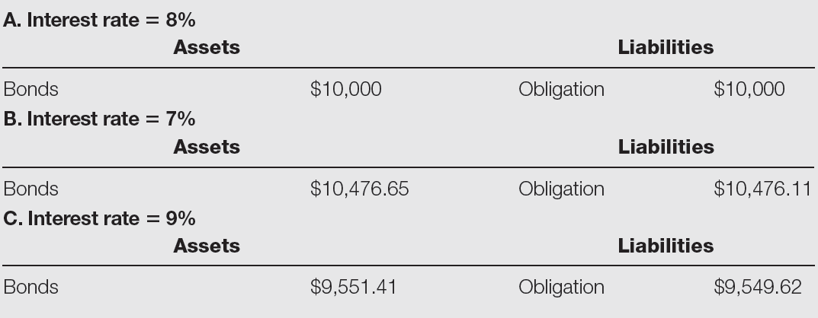
Table 11.5 Market Value Balance Sheets

Slide 19
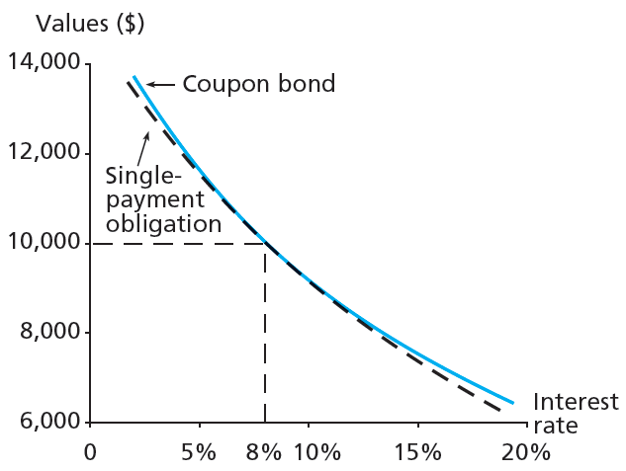
Figure 11.4 Immunization

Slide 20
11.2 Passive Bond Management
Cash Flow Matching and Deduction
Cash flow matching
Matching cash flows from fixed-income portfolio with those of obligation
Deduction strategy
Multi-period cash flow matching

Slide 21
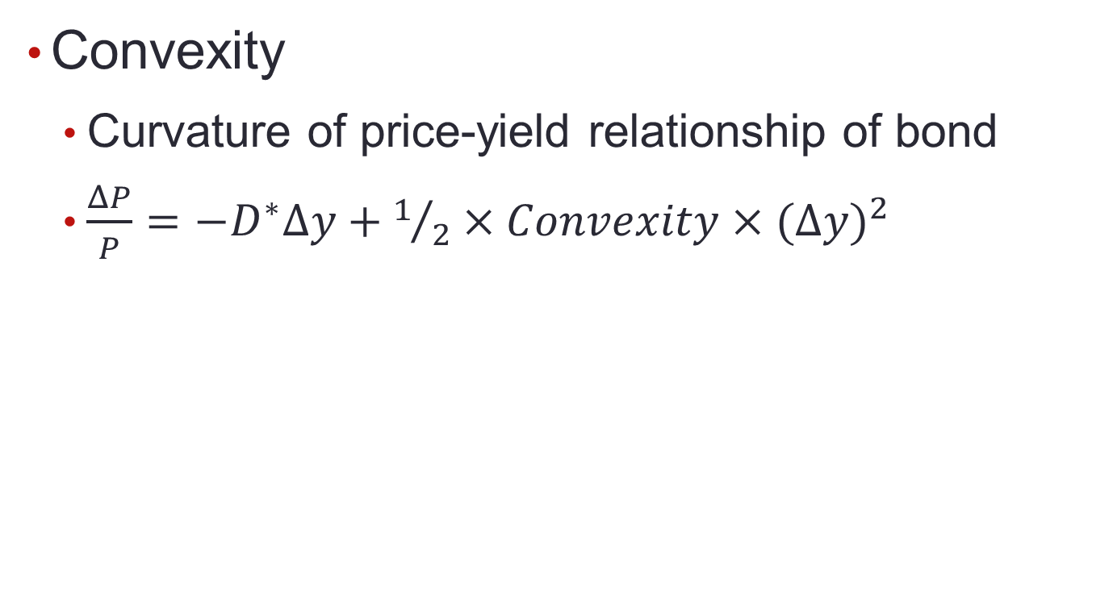
11.3 Convexity

Slide 22
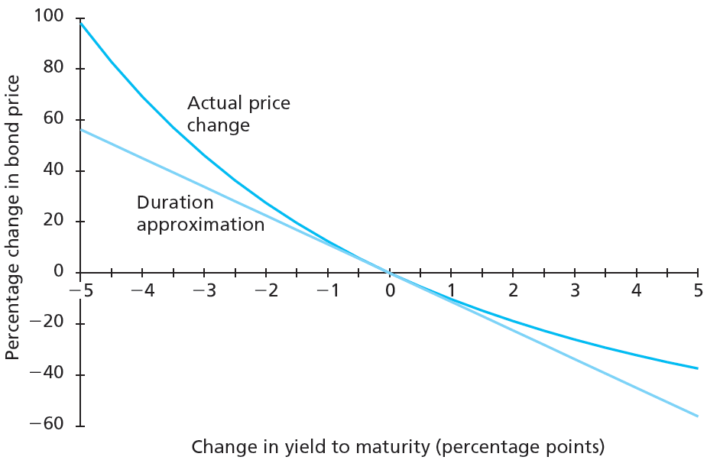
Figure 11.5 Bond Price Convexity

Slide 23
11.3 Convexity
Why Do Investors Like Convexity?
More convexity = greater price increases, smaller price decreases when interest rates fluctuate by larger amounts

Slide 24
11.4 Active Bond Management
Sources of Potential Profit
Substitution swap
Exchange of one bond for bond with similar attributes and better price
Intermarket swap
Switching from one segment of bond market to another
Rate anticipation swap
Switch made in response to forecasts of interest rate changes

Slide 25
11.4 Active Bond Management
Sources of Potential Profit
Pure yield pickup swap
Moving to higher yield bonds, usually with longer maturities
Tax swap
Swapping two similar bonds to receive tax benefit
Horizon analysis
Forecast of bond returns based largely on prediction of yield curve at end of investment horizon

Slide 26
11.4 Active Bond Management
Example of Fixed-Income Investment Strategy
Key features
Firms respect market prices
To have value, information cannot already be reflected in prices
Interest rate movements extremely hard to predict

