Slide 1
FUTURES
Pankaj Vajpayee

Slide 2
Session objectives
Hedging
Basic principles of hedging
Short hedge
Long hedge
Hedge ratio
Advantages of hedging
Limitations of hedging: Basis risk
Pricing futures - Cost of Carry
Recap

Slide 3

Hedging using futures
The purpose of hedging is to remove uncertainty, not to improve the average wealth of the hedger. It is like insurance, it doesn’t make you wealthier, on average, it just insure that you won’t have massive losses.
  A company that knows it will sell an asset in the future (i.e. is naturally long the asset, i.e. they physically have it right now) can hedge by going short a futures contract. Essentially, the natural long position and the short futures position will cancel each other out. If you are a natural short (i.e. must buy in the future), then you want to take a long position in the contract to hedge.

Slide 4
Long and short hedges
A long futures hedge is appropriate when you know you will purchase an asset in the future and want to lock in the price.
A short futures hedge is appropriate when you know you will sell an asset in the future and want to lock in the price.

Slide 5
Hedging with futures
Today is April 2008. A crude exploration company is supposed to deliver one lakh barrels in December 2008to a refiner at the then prevailing rate. However in December Crude oil prices are expected to rule low. To protect itself from downward price movement the company decided to trade in MCX platform to hedge its price risk. In April 2008, the company sells 1000 contracts (100 barrels each) of MCX Crude Oil December contract at Rs.2,000 per barrel. The Company pays suppose only 5% of the total value as deposit (margin) with the exchange. Calculate the profit and loss in the transaction if:
a) By December 2008, the spot market price is Rs.1900 per barrel.
b) By December 2008 the spot market price is Rs.2100 per barrel.

Slide 6
Hedging with futures
SPOT MARKET | FUTURE MARKET | SPOT MARKET | FUTURE MARKET
April 2008 | Sells December 08 contract at Rs.2000 per barrel | April 2008 | Sells December 08 contract at Rs.2000 per barrel
December 2008 Sells Rs.1900 per barrel | Buys Dec 08 contract at Rs.1900 per barrel | December 2008 Sells Rs.2100 per barrel | Buys Dec 08 contract at Rs.2100 per barrel
Loses Rs.100 per barrel | Profits Rs.100 per barrel | Profits Rs.100 per barrel | Loses Rs.100 per barrel
Transaction resulted in no profit no loss |  | Transaction resulted in no profit no loss

Slide 7
Hedging using futures (advantages)
Hedging stretches the marketing period.
Hedging protects inventory values.
Hedging permits forward pricing of the products.

Slide 8
Hedging using futures (limitations)
There are at least 3 major reasons hedging does not always work perfectly:
  The asset whose price is to be hedged may not be exactly the same as the asset underlying the futures contract (heating oil vs. jet fuel).
  The hedger may be uncertain as to the exact date when the asset will be bought or sold.
  The hedge may require the futures contract to be closed out before the expiration date.
These problems generate what is sometimes known as basis risk.

Slide 9
Hedging using futures
The basis is defined as:
  If the spot and the futures are the same asset, the basis should be zero at expiration. If the spot rises by more than the futures price, the basis increases, and this is called strengthening of the basis, the opposite is weakening of the basis.
  basis= spot price of asset to be hedged - futures price of contract used

Slide 10
Hedging using futures
Size of the Hedge
An important issue is how many contracts to use to create the hedge. The hedge ratio is the ratio of the size of the position taken in futures contracts divided by the size of the exposure:
HR = (size of futures position)/(size of exposure)
It is not always the case that the optimal ratio is 1.

Slide 11
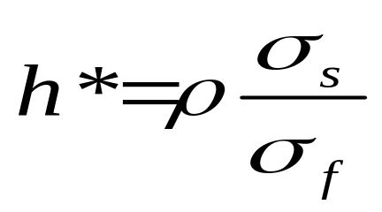
Optimal hedge ratio
Proportion of the exposure that should optimally be hedged is
where
σ_{S} is the standard deviation of ΔS, the change in the spot price during the hedging period.
σ_{f} is the standard deviation of ΔF, the change in the futures price during the hedging period.
ρ is the coefficient of correlation between ΔS and ΔF.

Slide 12
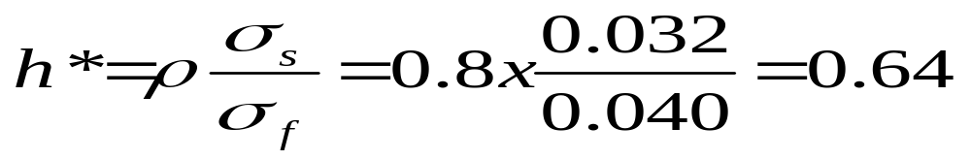
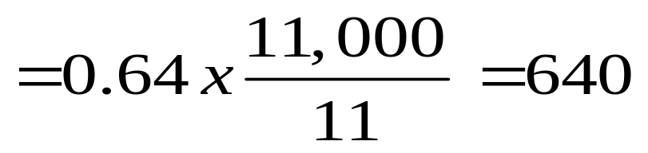
Hedging using futures
A company will require 11,000 bales of cotton in three months. The standard deviation of of the change in in the price per quintal of cotton over a three month period is calculated as 0.032. The company chooses to hedge by buying future contracts on cotton. The standard deviation of the change in the cotton futures price over a three month period is 0.40 and the coefficient of correlation between the change in the cotton futures price is 0.8. The unit of trading is 11 bales. What is the optimal hedge ratio? How many cotton contracts should it buy?
Take a long position in 640 cotton futures to get an effective hedge
Optimal hedge ratio
Number of contracts

Slide 13

Cost of carry
The cost of carry, c, is the storage cost plus the interest costs less the income earned
For an investment asset; F₀ = S₀e^{cT}
For a consumption asset; F₀ ≤ S₀e^{cT}

Slide 14
Recap
Hedging involves:
  Taking a futures position opposite to one’s cash market position
  Taking a futures position identical to one’s cash market position
  Taking a futures market position
  Willingly taking a risk
Ans : a

Slide 15
Recap
The number of futures contracts required to buy or sell to provide the maximum offset of risk is calculated using:
  Basis Risk
  Hedge Ratio
  Swap Ratio
  None of these
Ans : b

Slide 16
Recap
Incorrect matching of the offsetting investments in hedging gives rise to:
  Basis risk
  Price Risk
  Market Risk
  None of the above
Ans : a

Slide 17
Recap
Hedgers:
  Protect their existing exposures
  Willingly take risks
  Profit from price differentials
  All of the above
Ans : a

Slide 18
Recap
The __________ model is used for pricing futures contracts.
  Black and Scholes
  Cost of Carry
  Miller
  Time Value
Ans : b

Slide 19
Recap
When the futures price happens to be higher than the fair value of the futures contract, arbitragers profit by
Selling futures
Buying the underlying asset
Selling futures and buying the underlying asset
Selling the underlying asset and buying futures
Ans : c

Slide 20
Recap
What is the fair value of one-month futures if the spot value of gold is Rs.6000 per 10 grams ? The money can be invested at 10% p.a. and warehousing costs are Rs.25
6025
6075.40
6090
6050.30
Ans : b; F = 6025e^{0.10x0.0833}

Slide 21
THANK YOU
THANK YOU

