Slide 1

OPTIONS
Pankaj Vajpayee

Slide 2
Session objectives
Options: Meaning and type of options
Common terminology used in options
Factors affecting option premium
Option pricing

Slide 3
Option contracts defined
An option is a derivative security which gives the holder the right, but not the obligation, to buy or sell an underlying asset by a certain date for a certain price.
A call option gives the holder the right to buy, while a put option gives the right to sell the underlying asset. The price designated in the contract is known as the exercise or strike price. The time to expiration is calculated based on the time from the value date to the expiration date.
American-style options can be exercised at anytime up to expiration, while European-style options can only be exercised at expiration.

Slide 4
Advantages of Options
The options can be used to have the following benefits :
Protect value of assets from decline in market place
Increase income against current asset holding
Prepare to buy an asset at a lower price
Position an investor for a big market move even when he does not know which way the prices will move
Benefit from a asset price rise without incurring the cost of buying the stock outright.

Slide 5
Option contracts defined (Cont’d)
Question:
An option gives the holder...
A. the obligation to buy the underlying asset.
B. the right to sell the underlying asset.
C. the obligation to buy or sell the underlying asset.
D. the right to buy or sell the underlying asset.
Ans : D

Slide 6
Option contracts defined (Cont’d)
Question:
What is the difference between an American option and a European option?
An American option is traded on American exchanges, while European options are traded on European exchanges.
An American option is written on an the assets of an American company, while a European option is written on the assets of a European company.
An American option can only be exercised at expiration, while a European option can be exercised at anytime up to expiration.
An American option can be exercised at anytime up to expiration, while a European option can be exercised only at expiration.
Ans: D

Slide 7
Intrinsic and time value
The premium, or price of an option, can be divided into two components, intrinsic and time value. Intrinsic value is the payoff if the option were to be exercised immediately. Intrinsic value is always greater than or equal to zero. For example, a certain asset is trading for Rs30. The intrinsic value of a Rs 25 call is therefore Rs 5.
Usually the price of an option in the marketplace will be greater than its intrinsic value. The difference between the market value of an option and its intrinsic value is called the time value (or extrinsic value) of an option. An option is trading at parity when the price of the option is equal to its intrinsic value (the time value is zero).

Slide 8
Intrinsic and time value
Question
What is the intrinsic value of a Rs.30 put if the underlying asset is trading at Rs.23?
A. zero
B. Rs.7
C. –Rs.7
D. There is not enough information to determine the intrinsic value.
Ans : B

Slide 9
Option pricing
E.g. Option Premium Rs1.50
Asset price Rs10.00
Exercise price Rs 9.00
===================
Intrinsic Value Rs 1.00
Time Value Rs 0.50
Option Premium Rs 1.50
Time Value
Longer the option has to run, the greater the time value.
Reflects potential volatility of share
Intrinsic Value
Option is “in the money”.
No intrinsic value - option is “out of the money”

Slide 10
Intrinsic and time value
Question:
A certain underlying asset is trading at Rs.50. A Rs.42 call is trading in the marketplace for Rs.10. What is the time value of the option?
A. zero
B. Rs 8
C. Rs 2
D. Rs 10
Ans : C. Intrinsic Value = Rs50-42 = Rs8;
Time Value = Option Value – Intrinsic value

Slide 11
Brief Recap

Slide 12
What are options
An option;
  gives the buyer the right but not the obligation,
  to buy (call option) OR sell (put option)
  a specified “face” amount (face amount)
  of an underlying asset (equity, bonds, stock index etc)
  At a specified “strike” price
  At a specified future date (Expiry/Delivery)

Slide 13
What are options (Cont’d)
The option seller/writer must comply with option buyer’s decision to “exercise” or “abandon” the option.
The option comes at a price (referred to as the premium). The premium is payable at time of purchase.
Options hedges the adverse price movements while allowing you to enjoy favourable markets movements.

Slide 14
Options
Right (not obligation) to buy or sell security
At Specified price
Within specified period
At the end of a
specified period
American Option
European Option
Call option (right to buy)
Put option (right to sell)

Slide 15

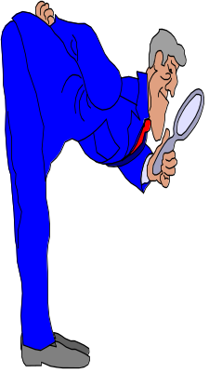

Call option
Option Writer
Option Holder
Option premium
Rs1.50 per share
1000 shares
Rs9.00
Choice
Ex. option at any time during 3 months
Current
share price
Rs10.00
Lapse the option
lose Rs1.50 per option
3 months
Strike price Rs9.00
How much must share price be to make profit ?

Slide 16


Put option
Option Writer
Option Holder
Option premium
Rs2.80 per share
1000 shares
Rs15.00
Choice
Ex. option at any time during 3 months
Current
share price
Rs13.00
Lapse the option
lose Rs2.80 per option
Strike price Rs15.00
How much must share price be to make profit?

Slide 17
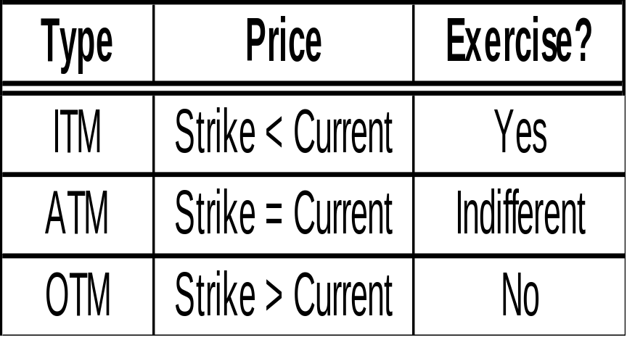
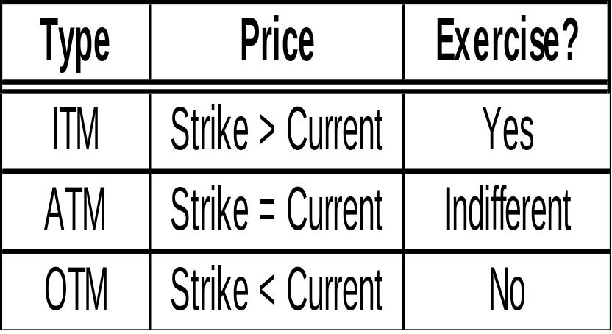
Strike vs current price
“In the money” (ITM), “At the money” (ATM) and “Out of money” (OTM) options
CALL
PUT
Current = Prevailing traded price

Slide 18
In the money, at the money,
Out of Money Options
CALL OPTION
Exercise Price = Rs.100
MARKET PRICE
Rs.80 : Out of the money option
Rs.100 : At the money option
Rs.120 : In the money option
PUT OPTION
Exercise Price = Rs.100
MARKET PRICE
Rs.80 : In the money option
Rs.100 : At the money option
Rs.120 : Out of the money option

Slide 19
Money ness of options
Question
The underlying asset of a Rs.55 call is trading at Rs.48. This call would be considered...
A. In-the-money.
B. At-the-money.
C. Out-of-the-money.
Ans : C

Slide 20
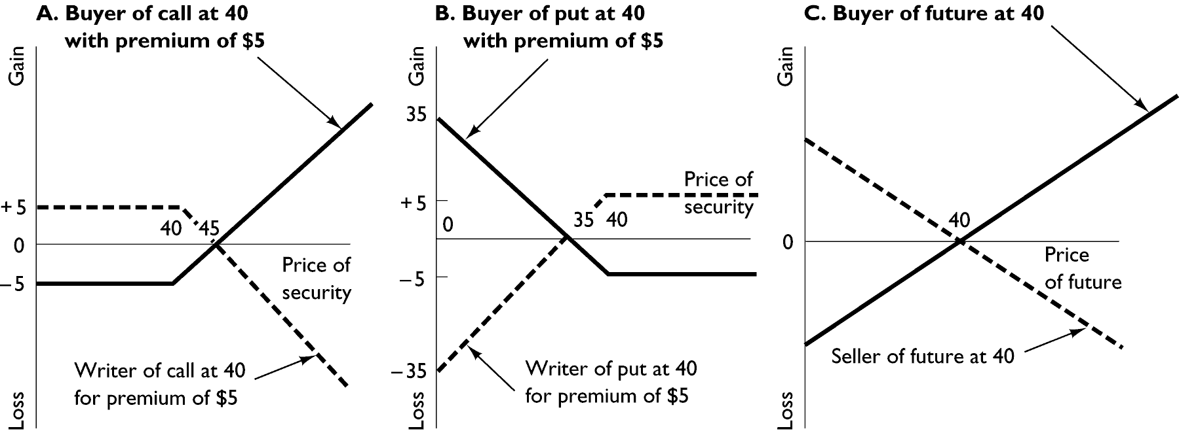
Gains and losses on options and futures contracts

Slide 21
Buyer and seller of options
A person who has purchased an option is considered to be long the option (owner). A person who has sold the option is considered short the option (seller). However, these terms (long and short) are also used to refer to a position in the market. A person who thinks that the market will rise (or is bullish about the market) will make a long market position (buy a call or sell a put), while a person who thinks that the market will decline (or is bearish about the market) will make a short market position (sell a call or buy a put).
The owner of a call (put) benefits from price increases (decreases) in the stock with limited downside risk. The most that can be lost is the price or premium of the option. However, the seller of a call (put) benefits from price decreases (increases) with unlimited loss potential and limited gains. The most that can be gained is the premium of the option.

Slide 22
Covered and naked options
Covered option -- writer either owns the security involved in the contract or has limited his or her risk with other contracts.
Naked option -- writer does not have or has not made provision to limit the extent of risk.

Slide 23
Types of options
Question:
An investor is bullish about the market for a particular underlying asset. Which of the following strategies might this investor pursue?
A. Long a put.
B. Short a put.
C. Short a call.
D. None of the above
Ans : B

Slide 24
Types of options
Question:
A trader is bearish about the market for a certain underlying
asset. Which of the following strategies might this trader
pursue?
A. Long a put.
B. Short a put.
C. Long a call.
D. Short a call.
E. A & D.
Ans: E

Slide 25
Option pricing
Factors affecting option prices
  Underlying asset Price
  Time remaining until expiration
  Volatility of underlying Stock Price
  Exercise Price
  Interest rates
  Dividends (in case of financial assets)

Slide 26
Price Sensitivity of Options
Factors Affecting Option Price (Increase) | Value of the Call
Asset Price
Exercise Price
Time to expiry
Interest Rates
Volatility

Slide 27
Option Pricing Models
Binomial Model
Black- Scholes Model

Slide 28
THANK YOU
THANK YOU

