Slide 1
Introduction to
Binomial Trees

Slide 2
A Simple Binomial Model
A stock price is currently $20
In three months it will be either $22 or $18
Stock Price = $22
Stock price = $20
Stock Price = $18

Slide 3
A Call Option
A 3-month call option on the stock has a strike price of 21.
Stock Price = $22
Option Price = $1
Stock price = $20
Option Price=?
Stock Price = $18
Option Price = $0

Slide 4
Setting Up a Riskless Portfolio
Consider the Portfolio: long Δ shares short 1 call option
Portfolio is riskless when 22Δ – 1 = 18Δ or
  Δ = 0.25
22Δ – 1
18Δ

Slide 5
Valuing the Portfolio
(Risk-Free Rate is 12%)
The riskless portfolio is:
long 0.25 shares short 1 call option
The value of the portfolio in 3 months is 22×0.25 – 1 = 4.50
The value of the portfolio today is 4.5e ^{– 0.12×0.25} = 4.3670

Slide 6
Valuing the Option
The portfolio that is
long 0.25 shares short 1 option
is worth 4.367
The value of the shares is 5.000 (= 0.25×20 )
The value of the option is therefore 0.633 (= 5.000 – 4.367 )

Slide 7
Generalization
A derivative lasts for time T and is dependent on a stock
S₀
ƒ_{u}
S₀
ƒ
S₀d
ƒ_{d}

Slide 8
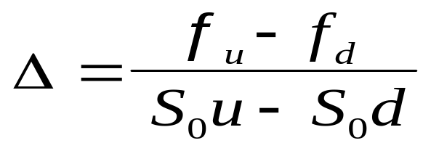
Generalization
(continued)
Consider the portfolio that is long Δ shares and short 1 derivative
The portfolio is riskless when S₀uΔ – ƒ_{u} = S₀d Δ – ƒ_{d} or
S₀ uΔ – ƒ_{u}
S₀– f
S₀dΔ – ƒ_{d}

Slide 9
Generalization
(continued)
Value of the portfolio at time T is S₀u Δ – ƒ_{u}
Value of the portfolio today is (S₀u Δ – ƒ_{u} )e^{–rT}
Another expression for the portfolio value today is S₀Δ – f
Hence ƒ = S₀Δ – (S₀u Δ – ƒ_{u} )e^{–rT}

Slide 10
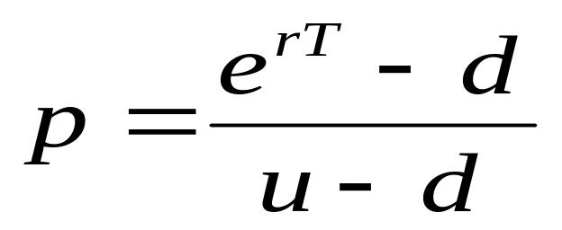
Generalization
(continued)
Substituting for Δ we obtain
ƒ = [ p ƒ_{u} + (1 – p )ƒ_{d} ]e^{–rT}
where

Slide 11
Risk-Neutral Valuation
ƒ = [ p ƒ_{u} + (1 – p )ƒ_{d} ]e^{-rT}
The variables p and (1 – p ) can be interpreted as the risk-neutral probabilities of up and down movements
The value of a derivative is its expected payoff in a risk-neutral world discounted at the risk-free rate
S₀u
ƒ_{u}
p
S₀
ƒ
S₀d
ƒ_{d}
(1 – p )

Slide 12
Irrelevance of Stock’s Expected Return
When we are valuing an option in terms of the underlying stock the expected return on the stock is irrelevant

Slide 13
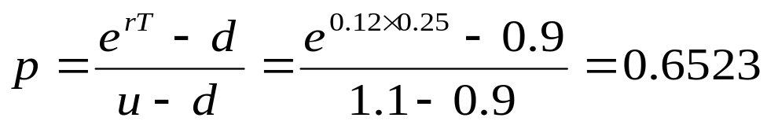
Original Example Revisited
S₀u = 22
ƒ_{u} = 1
Since p is a risk-neutral probability 20e^{0.12 ×0.25} = 22p + 18(1 – p ); p = 0.6523
Alternatively, we can use the formula
p
S₀
ƒ
S₀d = 18
ƒ_{d} = 0
(1 – p )

Slide 14
Valuing the Option
S₀u = 22
ƒ_{u} = 1
The value of the option is
e^{–0.12×0.25} [0.6523×1 + 0.3477×0]
= 0.633
0.6523
S₀
ƒ
S₀d = 18
ƒ_{d} = 0
0.3477

Slide 15
A Two-Step Example
Each time step is 3 months
24.2
22
20
19.8
18
16.2

Slide 16
Valuing a Call Option
Value at node B = e^{–0.12×0.25}(0.6523×3.2 + 0.3477×0) = 2.0257
Value at node A = e^{–0.12×0.25}(0.6523×2.0257 + 0.3477×0)
= 1.2823
24.2
3.2
D
22
B
20
1.2823
2.0257
19.8
0.0
A
E
18
C
0.0
16.2
0.0
F

Slide 17
A Put Option Example; K=52
72
0
D
60
B
50
4.1923
1.4147
48
4
A
E
40
C
9.4636
32
20
F

Slide 18
What Happens When an Option is American
72
0
D
60
B
50
5.0894
1.4147
48
4
A
E
40
C
12.0
32
20
F

Slide 19
Delta
Delta (Δ) is the ratio of the change in the price of a stock option to the change in the price of the underlying stock
The value of Δ varies from node to node

