Slide 1
Investments: Background and Issues
1

Slide 2
1.1 Real versus Financial Assets
Nature of Investment
Reduce current consumption for greater future consumption
Real Assets
Used to produce goods and services: Property, plants and equipment, human capital, etc.
Financial Assets
Claims on real assets or claims on real-asset income

Slide 3
Table 1.1 Balance Sheet, U.S. Households, 2011
Assets | $ Billion | % Total |  | Liabilities and Net Worth | $ Billion | % Total
Real assets
Real estate | 18,117 | 25.2% |  | Mortgages | 10,215 | 14.2%
Consumer durables | 4,665 | 6.5% |  | Consumer credit | 2,404 | 3.3%
Other | 303 | 0.4% |  | Bank and other loans | 384 | 0.5%
Total real assets | 23,085 | 32.1% |  | Security credit | 316 | 0.4%
 |  |  |  | Other | 556 | 0.8%
 |  |  |  | Total liabilities | 13,875 | 19.3%
Financial assets
Deposits | 8,038 | 11.2%
Life insurance reserves | 1,298 | 1.8%
Pension reserves | 13,419 | 18.7%
Corporate equity | 8,792 | 12.2%
Equity in noncorp. business | 6,585 | 9.2%
Mutual fund shares | 5,050 | 7.0%
Debt securities | 4,129 | 5.7%
Other | 1,536 | 2.1%
Total financial assets | 48,847 | 67.9% |  | Net worth | 58,058 | 80.7%
TOTAL | 71,932 | 100.0% |  |  | 71,932 | 100.0%
Note: Column sums may differ from total because of rounding error. SOURCE: Flow of Funds Accounts of the United States, Board of Governors of the Federal Reserve System, June 2011.

Slide 4
1.1 Real versus Financial Assets
All financial assets (owner of the claim) are offset by a financial liability (issuer of the claim)
When all balance sheets are aggegated, only real assets remain
Net wealth of economy: Sum of real assets

Slide 5
Table 1.2 Domestic Net Worth, 2011
Assets |  | $ Billion
Commercial real estate |  | 14,248
Residential real estate |  | 18,117
Equipment and software |  | 4,413
Inventories |  | 1,974
Consumer durables |  | 4,665
TOTAL |  | 43,417
Note: Column sums may differ from total because of rounding error.
SOURCE: Flow of Funds Accounts of the United States, Board of Governors of the Federal Reserve System, June 2011.

Slide 6
1.2 Financial Assets
Major Classes of Financial Assets or Securities
Fixed-income (debt) securities
Money market instruments
Bank certificates of deposit, T-bills, commercial paper, etc.
Bonds
Preferred stock
Common stock (equity)
Ownership stake in entity, residual cash flow
Derivative securities
Contract, value derived from underlying market condition

Slide 7
1.3 Financial Markets and the Economy
Informational Role of Financial Markets
Do market prices equal the fair value estimate of a security's expected future risky cash flows?
Can we rely on markets to allocate capital to the best uses?
Other mechanisms to allocate capital?
Advantages/disadvantages of other systems?

Slide 8
1.3 Financial Markets and the Economy
Consumption Timing
Consumption smoothes over time
When current basic needs are met, shift consumption through time by investing surplus

Slide 9
1.3 Financial Markets and the Economy
Risk Allocation
Investors can choose desired risk level
Bond vs. stock of company
Bank CD vs. company bond
Risk-and-return trade-off

Slide 10
1.3 Financial Markets and the Economy
Separation of Ownership and Management
Large size of firms requires separate principals and agents
Mitigating Factors
Performance-based compensation
Boards of directors may fire managers
Threat of takeovers

Slide 11
1.3 Financial Markets and the Economy
Example 1.1
In February 2008, Microsoft offered to buy Yahoo at $31 per share when Yahoo was trading at $19.18
Yahoo rejected the offer, holding out for $37 a share
Proxy fight to seize control of Yahoo's board and force Yahoo to accept offer
Proxy failed; Yahoo stock fell from $29 to $21
Did Yahoo managers act in the best interests of their shareholders?

Slide 12
1.3 Financial Markets and the Economy
Corporate Governance and Corporate Ethics
Businesses and markets require trust to operate efficiently
Without trust additional laws and regulations are required
Laws and regulations are costly
Governance and ethics failures cost the economy billions, if not trillions
Eroding public support and confidence

Slide 13
1.3 Financial Markets and the Economy
Corporate Governance and Corporate Ethics
Accounting scandals
Enron, WorldCom, Rite-Aid, HealthSouth, Global Crossing, Qwest
Misleading research reports
Citicorp, Merrill Lynch, others
Auditors: Watchdogs or consultants?
Arthur Andersen and Enron

Slide 14
1.3 Financial Markets and the Economy
Corporate Governance and Corporate Ethics
Sarbanes-Oxley Act:
Requires more independent directors on company boards
Requires CFO to personally verify the financial statements
Created new oversight board for the accounting/audit industry
Charged board with maintaining a culture of high ethical standards

Slide 15
1.4 The Investment Process
Asset Allocation
Primary determinant of a portfolio's return
Percentage of fund in asset classes
Stocks 60%
Bonds 30%
Alternative assets 6%
Money market securities 4%
Security selection and analysis
Choosing specific securities within asset class

Slide 16
1.5 Markets Are Competitive
Risk-Return Trade-Off
Assets with higher expected returns have higher risk
Stock portfolio loses money 1 of 4 years on average
Bonds
Have lower average rates of return (under 6%)
Have not lost more than 13% of their value in any one year
 | Average Annual Return | Minimum (1931) | Maximum (1933)
Stocks | About 12% | −46% | 55%

Slide 17
1.5 Markets Are Competitive
Risk-Return Trade-Off
How do we measure risk?
How does diversification affect risk?

Slide 18
1.5 Markets Are Competitive
Efficient Markets
Securities should be neither underpriced nor overpriced on average
Security prices should reflect all information available to investors
Choice of appropriate investment-management style based on belief in market efficiency

Slide 19
1.5 Markets Are Competitive
Active versus Passive Management
Active management (inefficient markets)
Finding undervalued securities (security selection)
Market timing (asset allocation)
Passive management (efficient markets)
No attempt to find undervalued securities
No attempt to time
Holding a diversified portfolio
Indexing; constructing “efficient” portfolio

Slide 20
1.6 The Players
Business Firms (net borrowers)
Households (net savers)
Governments (can be both borrowers and savers)
Financial Intermediaries (connectors of borrowers and lenders)
Commercial banks
Investment companies
Insurance companies
Pension funds
Hedge funds

Slide 21
1.6 The Players
Investment Bankers
Firms that specialize in primary market transactions
Primary market
Newly issued securities offered to public
Investment banker typically “underwrites” issue
Secondary market
Preexisting securities traded among investors

Slide 22
1.6 The Players
Investment Bankers
Commercial and investment banks' functions and organizations separated by law 1933-1999
Post-1999: Large investment banks independent from commercial banks
Large commercial banks increased investment-banking activities, pressuring investment banks’ profit margins
September 2008: Mortgage-market collapse
Major investment banks bankrupt; purchased/reorganized

Slide 23
1.6 The Players
Investment Bankers
Investment banks may become commercial banks
Obtain deposit funding
Have access to government assistance
Major banks now under stricter commercial bank regulations

Slide 24
Table 1.3 Balance Sheet of Commercial Banks, 2011
Assets | $ Billion | % Total |  | Liabilities and Net Worth | $ Billion | % Total
Real assets |  |  |  | Liabilities
Equipment and premises | 110.4 | 0.9% |  | Deposits | 8,674.6 | 71.4%
Other real estate | 46.6 | 0.4% |  | Debt and other borrowed funds | 1,291.8 | 10.6%
Total real assets | 157.0 | 1.3% |  | Federal funds and repurchase agreements | 499.1 | 4.1%
 |  |  |  | Other | 308.4 | 2.5%
 |  |  |  | Total liabilities | 10,773.9 | 88.6%
Financial assets
Cash | 1,066.3 | 8.8%
Investment securities | 2,406.1 | 19.8%
Loans and leases | 6,279.1 | 51.6%
Other financial assets | 1,153.9 | 9.5%
Total financial assets | 10,905.4 | 89.7%
Other assets
Intangible assets | 373.9 | 3.1%
Other | 721.0 | 5.9%
Total other assets | 1,094.9 | 9.0% |  | Net worth | 1,383.4 | 11.4%
TOTAL | 12,157.3 | 100.0% |  |  | 12,157.3 | 100.0%
Note: Column sums may differ from total because of rounding error. SOURCE: Federal Deposit Insurance Corporation, www.fdic.gov, July 2011.

Slide 25
Table 1.4 Balance Sheet of Nonfinancial U.S. Business, 2011
Assets |  | $ Billion | % Total |  | Liabilities and Net Worth |  |  |  | $ Billion | % Total
Real assets |  |  |  |  | Liabilities
Equipment and software |  | 4,109 | 14.6% |  | Bonds and mortgages |  |  |  | 5,321 | 18.9%
Real estate |  | 7,676 | 27.2% |  | Bank loans |  |  |  | 538 | 1.9%
Inventories |  | 1,876 | 6.7% |  | Other loans |  |  |  | 1,227 | 4.4%
Total real assets |  | 13,661 | 48.5% |  | Trade debt |  |  |  | 1,863 | 6.6%
 |  |  |  |  | Other |  |  |  | 4,559 | 16.2%
Financial assets |  |  |  |  | Total liabilities |  |  |  | 13,509 | 47.9%
Deposits and cash |  | 1,009 | 3.6%
Marketable securities |  | 899 | 3.2%
Trade and consumer credit |  | 2,388 | 8.5%
Other |  | 10,239 | 36.3%
Total financial assets |  | 14,535 | 51.5%
TOTAL |  | 28,196 | 100.0% |  | Net worth |  |  |  | 14,687 | 52.1%
 |  |  |  |  |  |  |  |  | 28,196 | 100.0%
Note: Column sums may differ from total because of rounding error. SOURCE: Flow of Funds Accounts of the United States, Board of Governors of the Federal Reserve System, June 2011.

Slide 26
1.6 The Players
Venture Capital and Private Equity
Venture capital
Investment to finance new firm
Private equity
Investments in companies not traded on stock exchange

Slide 27
1.7 The Financial Crisis of 2008
Changes in Housing Finance
Low interest rates and a stable economy created housing market boom, driving investors to find higher-yield investments
1970s: Fannie Mae and Freddie Mac bundle mortgage loans into tradable pools (securitization)
Subprime loans: Loans above 80% of home value, no underwriting criteria, higher default risk

Slide 28
1.7 The Financial Crisis of 2008
Mortgage Derivatives
CDOs: Consolidated default risk of loans onto one class of investor, divided payment into tranches
Ratings agencies paid by issuers; pressured to give high ratings

Slide 29
1.7 The Financial Crisis of 2008
Credit Default Swaps
Insurance contract against the default of borrowers
Issuers ramped up risk to unsupportable levels
AIG sold $400 billion in CDS contracts

Slide 30
1.7 The Financial Crisis of 2008
Systemic Risk
Risk of breakdown in financial system — spillover effects from one market into others
Banks highly leveraged; assets less liquid
Formal exchange trading replaced by over-the-counter markets — no margin for insolvency protection

Slide 31
1.7 The Financial Crisis of 2008
The Shoe Drops
September 7, 2008: Fannie Mae and Freddie Mac put into conservatorship
Lehman Brothers and Merrill Lynch verged on bankruptcy
September 17: Government lends $85 billion to AIG
Money market panic freezes short-term financing market

Slide 32
1.7 The Financial Crisis of 2008
Dodd-Frank Reform Act
Called for stricter rules for bank capital, liquidity, risk management
Mandated increased transparency
Clarified regulatory system
Volcker Rule: Limited banks’ ability to trade for own account

Slide 33
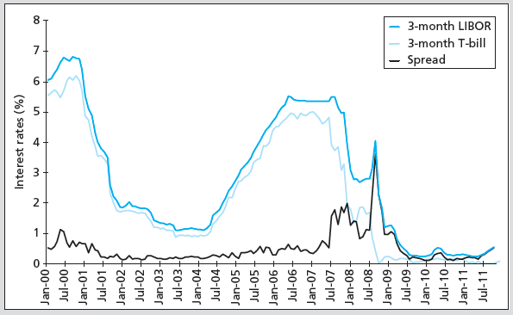
Figure 1.1 Short-Term LIBOR and Treasury-Bill Rates and the TED Spread

Slide 34
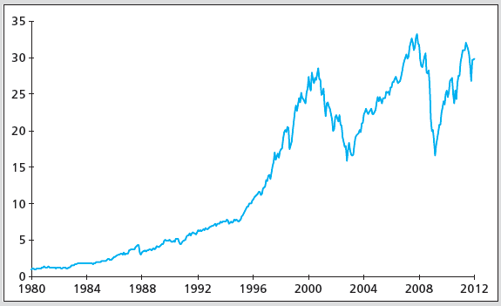
Figure 1.2 Cumulative Returns
Cumulative returns on a $1 investment in the S&P 500 index

Slide 35
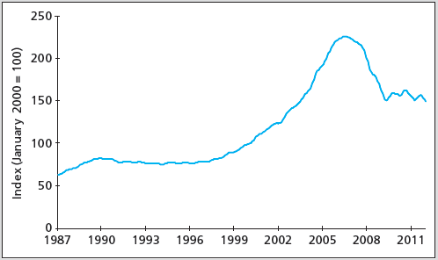
Figure 1.3 Case-Shiller Index of U.S. Housing Prices

Slide 36
1.8 Text Outline
Part One: Introduction to Financial Markets, Securities, and Trading Methods
Part Two: Modern Portfolio Theory
Part Three: Debt Securities
Part Four: Equity Security Analysis
Part Five: Derivative Markets
Part Six: Active Investment Management Strategies: Performance Evaluation, Global Investing, Taxes, and the Investment Process

