Slide 1
Asset Classes and Financial Instruments
2

Slide 2
2.1 The Money Market
Money Market Instruments
Treasury Bills
Certificates of Deposit
Commercial Paper
Bankers’ Acceptances
Eurodollars
Repos and Reverses
Brokers’ Funds
Federal Funds
LIBOR (London Interbank Offer Rate)

Slide 3
2.1 The Money Market
Treasury Bills
Issuer: Federal government
Denomination: $100, commonly $10,000
Maturity: 4, 13, 26, or 52 weeks
Liquidity: High
Default risk: None
Interest type: Discount
Taxation: Federal owed; exempt from state and local

Slide 4
2.1 The Money Market
Certificates of Deposit (CDs)
Issuer: Depository institutions
Denomination: Any, $100,000 or more marketable
Maturity: Varies, typically 14-day minimum
Liquidity: CDs of 3 months or less are liquid if marketable
Default: First $100,000 ($250,000) insured
Interest type: Add on
Taxation: Interest income fully taxable

Slide 5
2.1 The Money Market
Commercial Paper (CP)
Issuer: Large creditworthy corporations, financial institutions
Denomination: Minimum $100,000
Maturity: Maximum 270 days, usually 1-2 months
Liquidity: CP of 3 months or less is liquid if marketable
Default risk: Unsecured, rated, mostly high quality
Interest type: Discount
Taxation: Interest income fully taxable
New Innovation: Asset-backed commercial paper

Slide 6
2.1 The Money Market
Bankers’ Acceptances
Originate when a purchaser authorizes a bank to pay a seller for goods at later date (time draft)
When purchaser’s bank “accepts” draft, it becomes contingent liability of the bank and a marketable security
Eurodollars
Dollar-denominated (time) deposits held outside U.S.
Pay higher interest rate than U.S. deposits

Slide 7
2.1 The Money Market
Federal Funds
Depository institutions must maintain deposits with Federal Reserve Bank
Federal funds—trading in reserves held on deposit at Federal Reserve
Key interest rate for economy
LIBOR (London Interbank Offer Rate)
Rate at which large banks in London (and elsewhere) lend to each other
Base rate for many loans and derivatives

Slide 8
2.1 The Money Market
Repurchase Agreements (RPs) and Reverse RPs
Short-term sales of securities with an agreement to repurchase the securities at higher price
RP is a collateralized loan; many RPs are overnight, though “term” RPs may have a 1-month maturity
Reverse RP is lending money and obtaining security title as collateral
“Haircuts” may be required, depending on collateral quality

Slide 9
2.1 The Money Market
Brokers’ Calls
Call money rate applies for investors buying stock on margin
Loan may be “called in” by broker

Slide 10
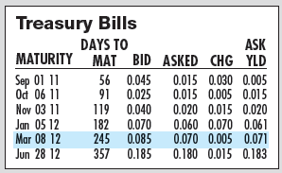
Figure 2.1 Treasury Bills (T-Bills)
Source: The Wall Street Journal Online, July 7, 2011.

Slide 11
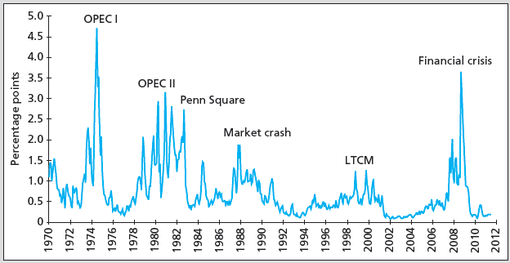
Figure 2.2 Spreads on CDs and Treasury Bills

Slide 12
2.1 The Money Market
MMMF and the Credit Crisis of 2008
2005-2008: Money market mutual funds (MMMFs) grew 88%
MMMFs had their own crisis in 2008: Lehman Brothers
Reserve Primary Fund “broke the buck”
Run on money market funds ensued
U.S. Treasury temporarily offered to insure all money funds

Slide 13
2.1 The Money Market
Money Market Instrument Yields
Yields on money market instruments not always directly comparable
Factors influencing “quoted” yields
Par value vs. investment value
360 vs. 365 days assumed in a year (366 leap year)
Simple vs. compound interest

Slide 14
2.1 The Money Market
Bank Discount Rate (T-bill quotes)
Example: 90-day T-bill, P = $9,875
− P
x
r
=
$10,000
360
$10,000 = Par
BD
$10,000
n
r_{BD} = bank discount rate
P = market price of the T-bill
n = number of days to maturity
$10,000
-
$9,875
360
r
=
×
=
5%
BD
90
$10,000

Slide 15
2.1 The Money Market
Bond Equivalent Yield
Can’t compare T-bill directly to bond
360 vs. 365 days
Return is figured in par vs. price paid
Adjust bank discount rate to make it comparable

Slide 16
2.1 The Money Market
Bond Equivalent Yield
Example Using Sample T-Bill
P = price of the T-bill
n = number of days to maturity
r_{BD} = 5%
P
10,000
−
×
365
r
=
BEY
P
n
10,000
−
9,875
×
365
r
=
BEY
9,875
90
r_{BEY} = .0127 × 4.0556 = .0513 = 5.13%

Slide 17
2.1 The Money Market
Effective Annual Yield
Example Using Sample T-Bill
r_{BD} = 5%
r_{BEY} = 5.13%
r_{EAY} =
r_{EAY} = 5.23%
P = price of the T-bill
n = number of days to maturity
r_{EAY} =
r_{EAY} = 5.23%

Slide 18
2.1 The Money Market
Money Market Instruments
Treasury bills: Discount
Certificates of deposit: BEY
Commercial paper: Discount
Bankers’ acceptances: Discount
Eurodollars: BEY
Federal funds: BEY
Repurchase agreements and reverse RPs: Discount

Slide 19
2.2 The Bond Market
Capital Market—Fixed-Income Instruments
Government Issues—U.S. Treasury Bonds and Notes
Bonds vs. notes
Denomination
Interest type
Risk? Taxation?
Variation: Treasury Inflation Protected Securities (TIPS)
Principal adjusted for increases in the Consumer Price Index
Marked with a trailing “i” in quote sheets

Slide 20
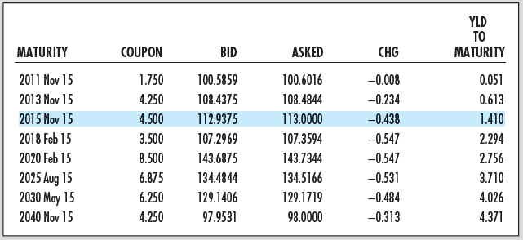
Figure 2.3 Listing of Treasury Issues
Source: Compiled from data from The Wall Street Journal Online, July 6, 2011.

Slide 21
2.2 The Bond Market
Government Issues
Agency issues (federal government)
Most are home-mortgage-related
Issuers: FNMA, FHLMC, GNMA, Federal Home Loan Banks
Risks of these securities?
Implied backing by the government
In September 2008, federal government took over FNMA and FHLMC

Slide 22
2.2 The Bond Market
Government Issues
Municipal bonds
Issuer?
Differ from treasuries and agencies?
Risk?
G.O. vs. revenue
Industrial development
Taxation?
r_{tax exempt} = r_{taxable} x (1 – Tax rate)
r = Interest rate

Slide 23
Table 2.2 Equivalent Taxable Yields
 | Tax-Exempt Yield
Marginal Tax Rate | 1% | 2% | 3% | 4% | 5%
20% | 1.25% | 2.50% | 3.75% | 5.00% | 6.25%
30 | 1.43 | 2.86 | 4.29 | 5.71 | 7.14
40 | 1.67 | 3.33 | 5.00 | 6.67 | 8.33
50 | 2.00 | 4.00 | 6.00 | 8.00 | 10.00
r_{tax exempt} = r_{taxable} x (1 – Tax rate)

Slide 24
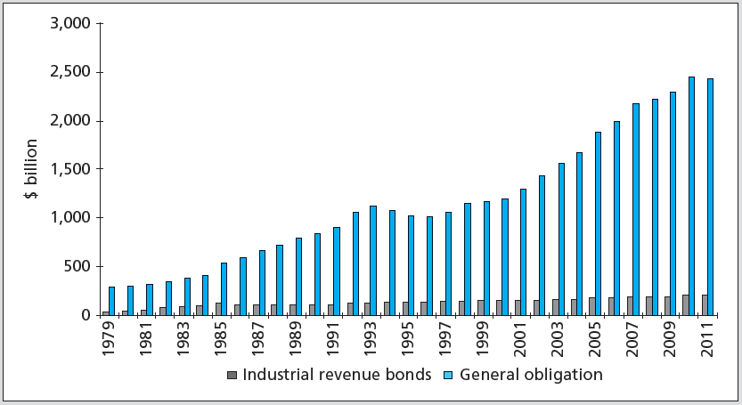
Figure 2.4 Outstanding Tax-Exempt Debt

Slide 25
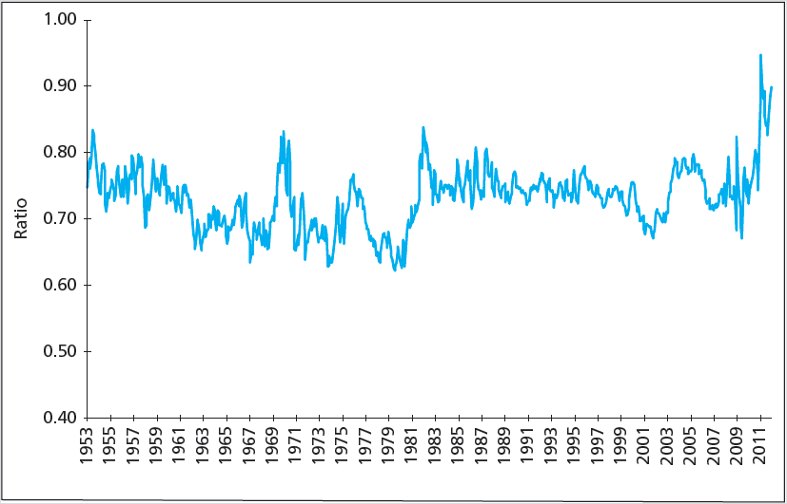
Figure 2.5 Yield Ratio: Tax-Exempt to Taxable Bonds

Slide 26
2.2 The Bond Market
Private Issues
Corporate Bonds
Investment grade vs. speculative grade
Mortgage-Backed Securities
Backed by pool of mortgages with “pass-through” of monthly payments; covers defaults
Collateral
Traditionally all mortgages conform, since 2006 Alt-A and subprime mortgages are included in pools
Private banks purchased and sold pools of subprime mortgages
Issuers assumed housing prices would continue to rise

Slide 27
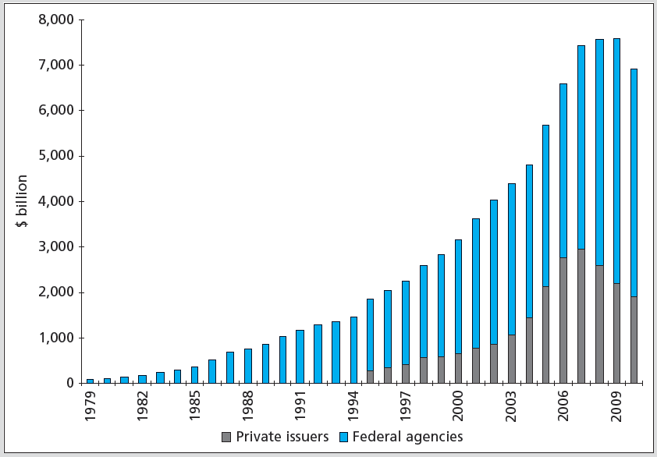
Figure 2.6 Mortgage-Backed Securities Outstanding

Slide 28
Table 2.7 The U.S. Bond Market
Sector | Size ($ billion) | % of Market
Treasury | 9,434.6 | 29.5%
Federal agency and gov't sponsored enterprise | 6,437.3 | 20.1%
Corporate | 4,653.9 | 14.6%
Tax-exempt* | 2,636.7 | 8.3%
Mortgage-backed | 6,908.0 | 21.6%
Other asset-backed | 1,877.9 | 5.9%
Total | 31,948.4 | 100.0%
* Includes private purpose tax-exempt debt. Source: Flow of Funds Accounts of the United States: Flows & Outstanding, Board of Governors of the Federal Reserve System, June 2011.

Slide 29
2.3 Equity Securities
Capital Market-Equity
Common stock
Residual claim
Limited liability
Preferred stock
Fixed dividends: Limited gains, nonvoting
Priority over common
Tax treatment: Preferred/common dividends not tax-deductible to issuing firm; corporate tax exclusions on 70% of dividends earned

Slide 30
2.3 Equity Securities
Capital Market-Equity
Depository receipts
American Depository Receipts (ADRs), also called American Depository Shares (ADSs)
Certificates traded in the U.S. representing ownership in foreign security

Slide 31
2.3 Equity Securities
Capital Market-Equity
Capital gains and dividend yields
Buy a share of stock for $50, hold for 1 year, collect $1 dividend, and sell stock for $54
What were dividend yield, capital gain yield, and total return? (Ignore taxes)
Dividend yield = Dividend / P_{buy} = $1/$50 = 2%
Capital gain yield = (P_{sell} – P_{buy}) / P_{buy} = ($54 – $50)/$50 = 8%
Total return = Dividend yield + Capital gain yield = 2% + 8% = 10%

Slide 32
2.4 Stock and Bond Market Indexes
Uses
Track average returns
Compare performance of managers
Base of derivatives
Factors in constructing/using index
Representative?
Broad/narrow?
How is it constructed?

Slide 33
2.4 Stock and Bond Market Indexes
Construction of Indexes
How are stocks weighted?
Price weighted (DJIA)
Market value weighted (S&P 500, NASDAQ)
Equally weighted (Value Line Index)
How much money do you put in each stock in the index?

Slide 34
2.4 Stock and Bond Market Indexes
Constructing Market Indexes
Weighting schemes
Price-weighted average: Computed by adding prices of stocks and dividing by “divisor”
Market value-weighted index: Return equals weighted average of returns of each component security, with weights proportional to outstanding market value
Equally weighted index: Computed from simple average of returns

Slide 35
2.4 Stock and Bond Market Indexes
Stock | Price_{B} | Quantity_{B} | P₁ | Q₁
A | $10 | 40 | $15 | 40
B | 50 | 80 | 25 | 160
C | 140 | 50 | 150 | 50
Price-Weighted Series
Time 0 index value: (10 + 50 + 140)/3 = 200/3 = 66.7
Time 1 index value: (10 + 25 + 140)/Denom = 66.67
Denominator = 2.624869
Time 1 index value: (15 + 25 + 150)/2.624869 = 72.38
Other problems:
Similar % change movements in higher-price stocks cause proportionally larger changes in the index
Splits arbitrarily reduce weights of stocks that split in index

Slide 36
2.4 Stock and Bond Market Indexes
Stock | Price_{B} | Quantity_{B} | P₁ | Q₁
A | $10 | 40 | $15 | 40
B | 50 | 80 | 25 | 160
C | 140 | 50 | 150 | 50
Value-Weighted Series
Index_{V} =
Equal-Weighted Series
wlog invest $300 in each
Index_{E} =

Slide 37
2.4 Stock and Bond Market Indexes
 |  |  | Case 1 |  | Case 2
Stock | P_{B} | Q_{B} | P₁ | Q₁ | P₁ | Q₁
A | $10 | 40 | $12 | 40 | $10 | 40
B | 100 | 80 | 100 | 80 | 100 | 80
C | 50 | 200 | 50 | 200 | 60 | 200
Why do the two differ?
Case 1: 20% change in price of small-cap firm
Index_{V} =
wlog invest $100 in each stock
Index_{E} =

Slide 38
2.4 Stock and Bond Market Indexes
 |  |  | Case 1 |  | Case 2
Stock | P_{B} | Q_{B} | P₁ | Q₁ | P₁ | Q₁
A | $10 | 40 | $12 | 40 | $10 | 40
B | 100 | 80 | 100 | 80 | 100 | 80
C | 50 | 200 | 50 | 200 | 60 | 200
Case 1 VW = 100.43
Case 1 EW = 106.67
Why do the two differ?
Case 2: 20% change in price of large-cap firm
Index_{V} =
Assume $100 investment in each stock
Index_{E} =

Slide 39
2.4 Stock and Bond Market Indexes
Examples of Indexes—Domestic
Dow Jones Industrial Average (30 stocks)
Standard & Poor’s 500 Composite
NASDAQ Composite (>3,000 firms)
Wilshire 5000 (>6,000 stocks)

Slide 40
2.5 Derivative Markets
Derivative Asset/Contingent Claim
Security with payoff that depends on the price of other securities
Listed Call Option
Right to buy an asset at a specified price on or before a specified expiration date
Listed Put Option
Right to sell an asset at a specified exercise price on or before a specified expiration date

Slide 41
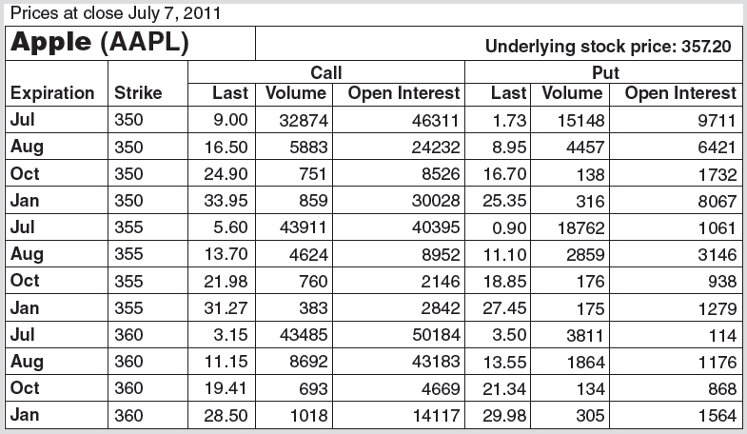
Figure 2.9 Stock Options on Apple

Slide 42
2.5 Derivative Markets
Using the Stock Options on Apple
The right to buy 100 shares of stock at a stock price of $355 using the July contract would cost $560 (ignoring commissions)
Is this contract “in the money”?
When should you buy this contract?
Stock price was equal to $357.20; you will make money if stock price increases above $357.20 + $5.60 = $362.80 by contract expiration
When should you write it?

Slide 43
2.5 Derivative Markets
Using the Stock Options on Apple
The right to buy 100 shares of stock at a stock price of $355 using the July contract would cost $90 (ignoring commissions)
Is this contract “in the money”?
Why do the two option prices differ?

Slide 44
2.5 Derivative Markets
Using the Stock Options on Apple
Look at Figure 2.9 to answer the following questions
How does the exercise or strike price affect the value of a call option? A put option? Why?
How does a greater time to contract expiration affect the value of a call option? A put option? Why?
How is “volume” different from “open interest”?

Slide 45
2.5 Derivative Markets
Futures Contracts
Purchaser (long) buys specified quantity at contract expiration for set price
Contract seller (short) delivers underlying commodity at contract expiration for agreed-upon price
Futures: Future commitment to buy/sell at preset price
Options: Holder has future right to buy/sell

Slide 46
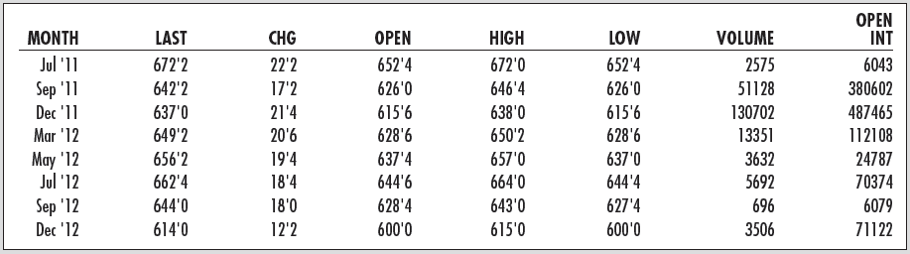
Figure 2.10 Futures Contracts
Corn futures prices in the Chicago Board of Trade, July 8, 2011

Slide 47
2.5 Derivative Markets
Corn futures prices in the Chicago Board of Trade, July 8, 2011
Contract size: 5,000 bushels of corn
Price quote for Dec. 12 contract: 614’0 translates to a price of $6.14 + 0/8 cent per bushel, or $6.14
If you bought the Dec. 12 contract, what are you agreeing to do?
Purchase 5,000 bushels of corn in December for 5,000 × $6.14 = $30,700
What is your obligation if you sell the Dec. 12 contract?
How does this contract differ from an option?

Slide 48
2.5 Derivative Markets
Derivatives Securities
Options
Basic Positions
Call (Buy/Sell?)
Put (Buy/Sell?)
Terms
Exercise price
Expiration date
Futures
Basic Positions
Long (Buy/Sell?)
Short (Buy/Sell?)
Terms
Delivery date
Deliverable item

