Slide 1
Bond Prices and Yields
10
Bodie, Kane, and Marcus
Essentials of Investments, 9th Edition

Slide 2
10.1 Bond Characteristics
Bond
Security that obligates issuer to make payments to holder over time
Face Value, Par Value
Payment to bondholder at maturity of bond
Coupon Rate
Bond’s annual interest payment per dollar of par value
Zero-Coupon Bond
Pays no coupons, sells at discount, provides only payment of par value at maturity

Slide 3
Figure 10.1 Prices/Yields of U.S. Treasury Bonds
U.S. Treasury Quotes: Treasury note and bond data are representative over-the-counter quotations as of 3pm Eastern time.
Maturity | Coupon | Bid | Asked | Change | Asked Yield
8/15/2012 | 1.750 | 101.570 | 101.594 | -0.016 | 0.151
8/15/2014 | 4.250 | 111.547 | 111.594 | -0.094 | 0.358
12/31/2015 | 2.125 | 105.789 | 105.820 | -0.164 | 0.769
8/15/2017 | 4.750 | 120.219 | 120.266 | -0.234 | 1.234
2/15/2020 | 8.500 | 152.063 | 152.094 | -0.344 | 1.847
8/15/2023 | 6.250 | 137.406 | 137.438 | -0.688 | 2.598
2/15/2027 | 6.625 | 145.547 | 145.594 | -0.719 | 2.941
2/15/2031 | 5.375 | 130.266 | 130.297 | -0.953 | 3.263
11/15/2039 | 4.375 | 111.766 | 111.813 | -0.813 | 3.697
5/15/2041 | 4.375 | 111.719 | 111.750 | -0.938 | 3.718

Slide 4
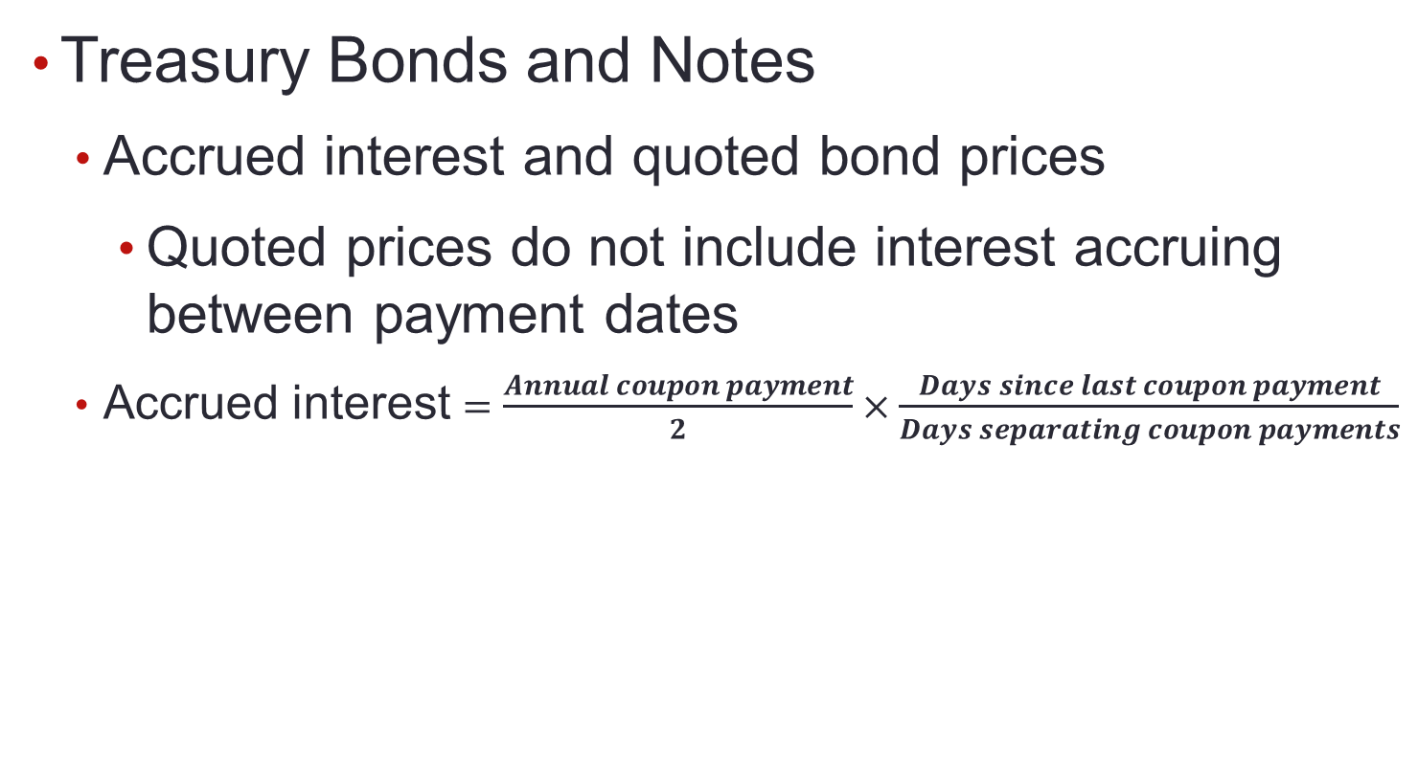
10.1 Bond Characteristics

Slide 5
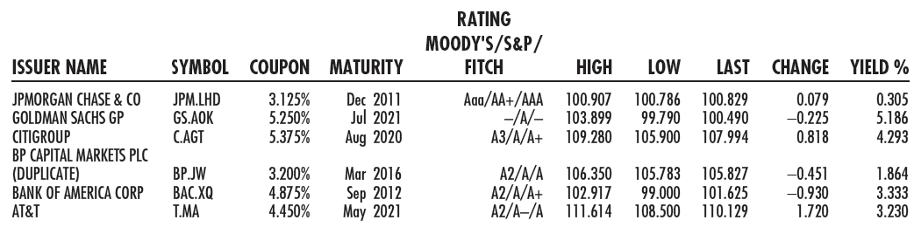
Figure 10.2 Listing of Corporate Bonds

Slide 6
10.1 Bond Characteristics
Corporate Bonds
Call provisions on corporate bonds
Callable bonds: May be repurchased by issuer at specified call price during call period
Convertible bonds
Allow bondholder to exchange bond for specified number of common stock shares

Slide 7
10.1 Bond Characteristics
Corporate Bonds
Puttable bonds
Holder may choose to exchange for par value or to extend for given number of years
Floating-rate bonds
Coupon rates periodically reset according to specified market date

Slide 8
10.1 Bond Characteristics
Preferred Stock
Commonly pays fixed dividend
Floating-rate preferred stock becoming more popular
Dividends not normally tax-deductible
Corporations that purchase other corporations’ preferred stock are taxed on only 30% of dividends received

Slide 9
10.1 Bond Characteristics
Other Domestic Issuers
State, local governments (municipal bonds)
Federal Home Loan Bank Board
Farm Credit agencies
Ginnie Mae, Fannie Mae, Freddie Mac

Slide 10
10.1 Bond Characteristics
International Bonds
Foreign bonds
Issued by borrower in different country than where bond sold, denominated in currency of market country
Eurobonds
Denominated in currency (usually that of issuing country) different than that of market

Slide 11
10.1 Bond Characteristics
Innovation in the Bond Market
Inverse floaters
Coupon rate falls when interest rates rise
Asset-backed bonds
Income from specified assets used to service debt
Pay-in-kind bonds
Issuers can pay interest in cash or additional bonds
Catastrophe bonds
Higher coupon rates to investors for taking on risk

Slide 12
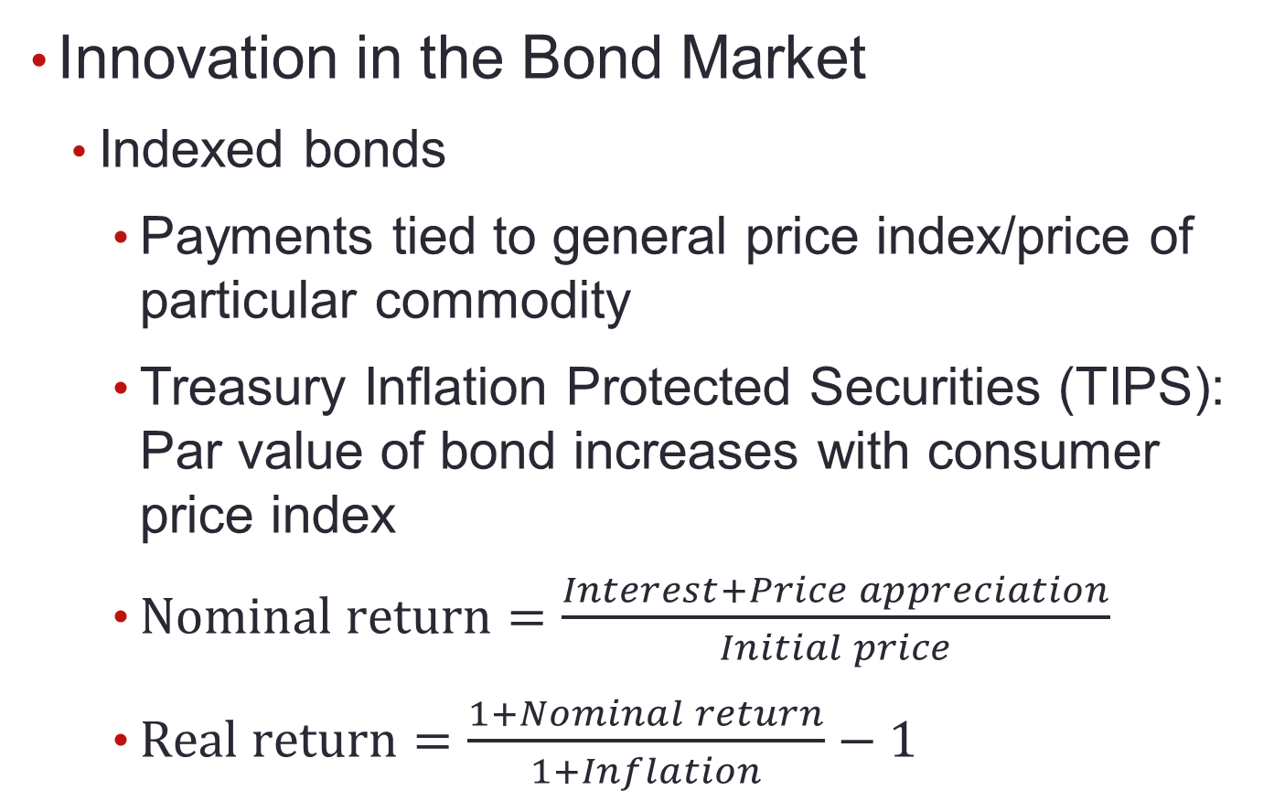
10.1 Bond Characteristics

Slide 13
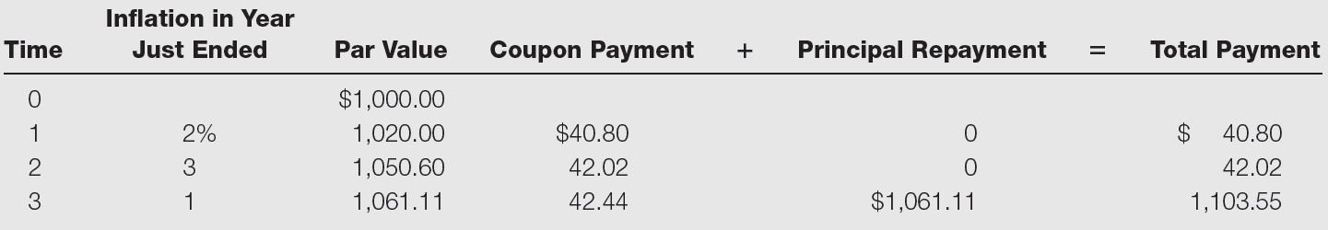
Table 10.1 Principal and Interest Payments
Principal and interest payments for a Treasury Inflation Protected Security

Slide 14
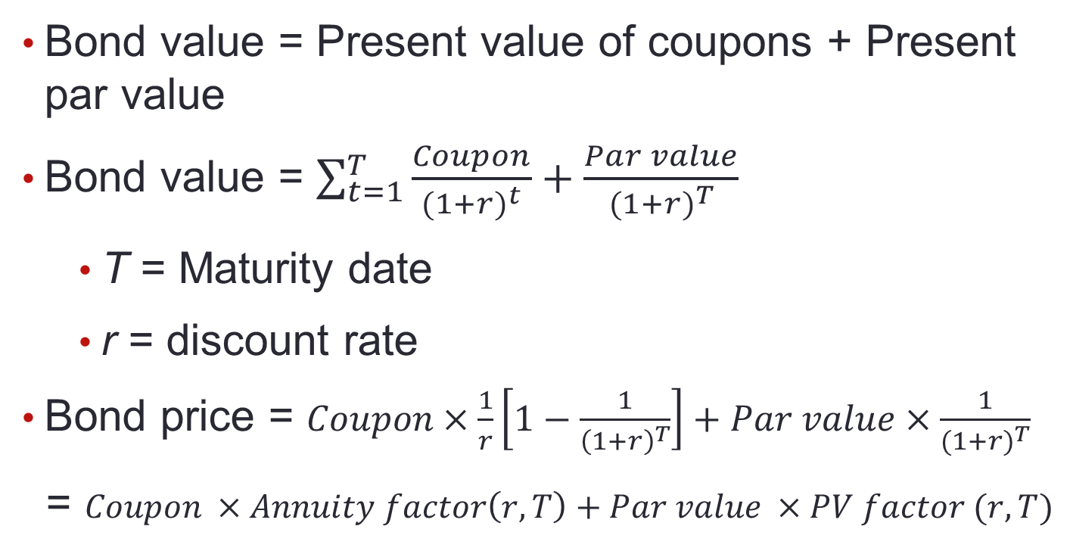
10.2 Bond Pricing

Slide 15
10.2 Bond Pricing
Prices fall as market interest rate rises
Interest rate fluctuations are primary source of bond market risk
Bonds with longer maturities more sensitive to fluctuations in interest rate

Slide 16
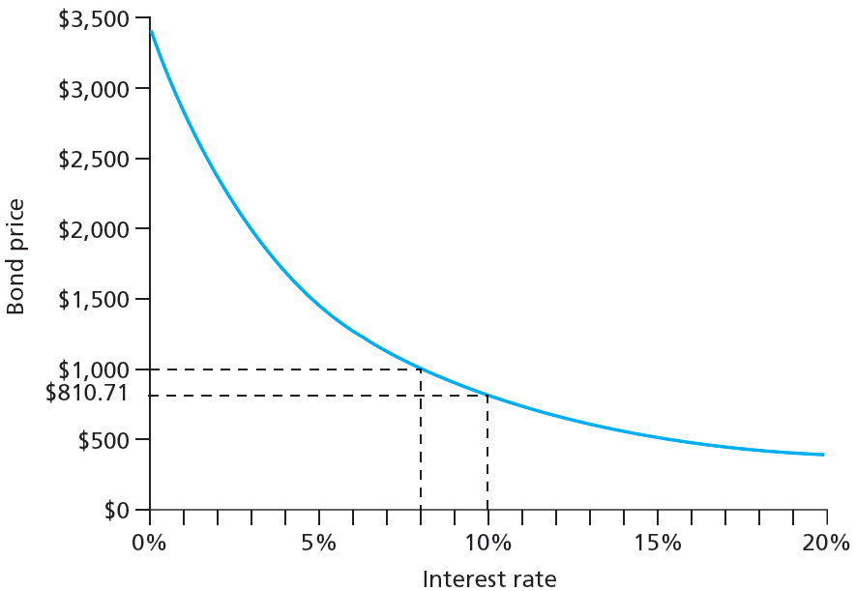
Figure 10.3 Inverse Relationship between Bond Prices and Yields

Slide 17
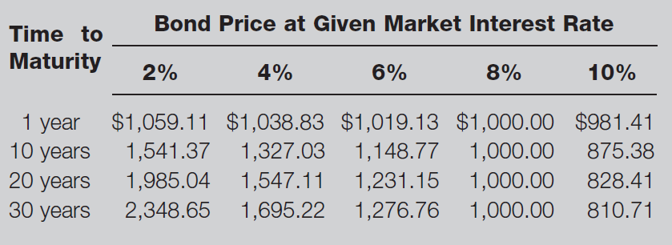
Table 10.2 Bond Prices at Different Interest Rates

Slide 18
10.2 Bond Pricing
Bond Pricing between Coupon Dates
Invoice price = Flat price + Accrued interest
Bond Pricing in Excel
=PRICE (settlement date, maturity date, annual coupon rate, yield to maturity, redemption value as percent of par value, number of coupon payments per year)

Slide 19
Spreadsheet 10.1 Valuing Bonds
 | 6.25% coupon bond, |  | 4.375% coupon bond, |  | 8% coupon bond,
 | maturing August 15, 2023 | Formula in column B | maturing Nov 15, 2039 |  | 30-year maturity
Settlement date | 8/15/2011 | =DATE(2011,8,15) | 8/15/2011 |  | 1/1/2000
Maturity date | 8/15/2023 | =DATE(2023,8,15) | 11/15/2039 |  | 1/1/2030
Annual coupon rate | 0.0625 |  | 0.04375 |  | 0.08
Yield to maturity | 0.02598 |  | 0.03697 |  | 0.1
Redemption value (% of face value) | 100 |  | 100 |  | 100
Coupon payments per year | 2 |  | 2 |  | 2
Flat price (% of par) | 137.444 | =PRICE(B4,B5,B6,B7,B8,B9) | 111.819 |  | 81.071
Days since last coupon | 0 | =COUPDAYBS(B4,B5,2,1) | 92 |  | 0
Days in coupon period | 184 | =COUPDAYS(B4,B5,2,1) | 184 |  | 182
Accrued interest | 0 | =(B13/B14)*B6*100/2 | 1.094 |  | 0
Invoice price | 137.444 | =B12+B15 | 112.913 |  | 81.071

Slide 20
10.3 Bond Yields
Yield to Maturity
Discount rate that makes present value of bond’s payments equal to price.
Current Yield
Annual coupon divided by bond price
Premium Bonds
Bonds selling above par value
Discount Bonds
Bonds selling below par value

Slide 21
Spreadsheet 10.2 Finding Yield to Maturity
 | Semiannual coupons |  | Annual coupons
Settlement date | 1/1/2000 |  | 1/2/2000
Maturity date | 1/1/2030 |  | 1/2/2030
Annual coupon rate | 0.08 |  | 0.08
Bond price (flat) | 127.676 |  | 127.676
Redemption value (% of face value) | 100 |  | 100
Coupon payments per year | 2 |  | 1
Yield to maturity (decimal) | 0.0600 |  | 0.0599
The formula entered here is =YIELD(B3,B4,B5,B6,B7,B8)

Slide 22
10.3 Bond Yields
Yield to Call
Calculated like yield to maturity
Time until call replaces time until maturity; call price replaces par value
Premium bonds more likely to be called than discount bonds

Slide 23
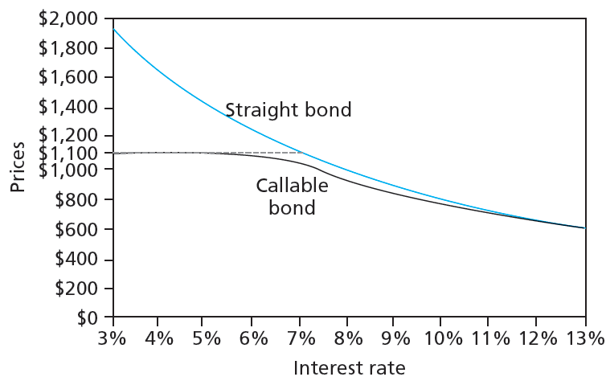
Figure 10.4 Bond Prices: Callable and Straight Debt

Slide 24
10.3 Bond Yields
Realized Compound Returns versus Yield to Maturity
Realized compound return
Compound rate of return on bond with all coupons reinvested until maturity
Horizon analysis
Analysis of bond returns over multiyear horizon, based on forecasts of bond’s yield to maturity and investment options
Reinvestment rate risk
Uncertainty surrounding cumulative future value of reinvested coupon payments

Slide 25
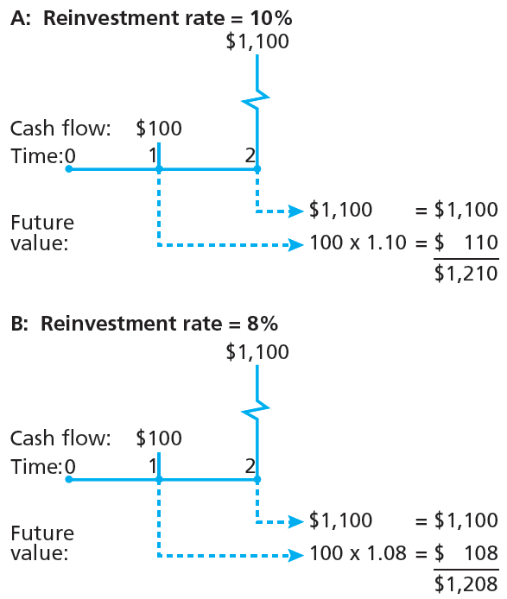
Figure 10.5 Growth of Invested Funds

Slide 26
10.4 Bond Prices Over Time
Yield to Maturity versus Holding Period Return (HPR)
Yield to maturity measures average RoR if investment held until bond matures
HPR is RoR over particular investment period; depends on market price at end of period

Slide 27
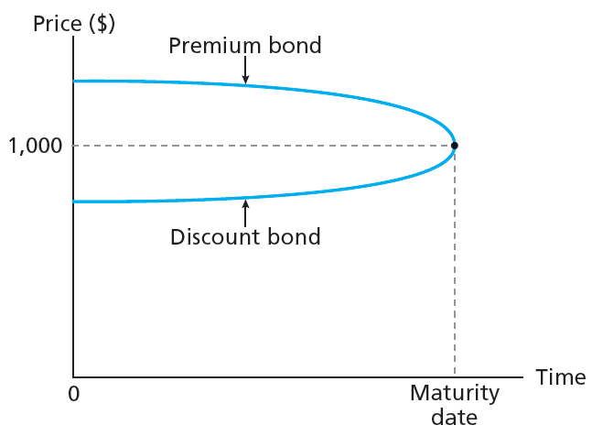
Figure 10.6 Price Paths of Coupon Bonds in Case of Constant Market Interest Rates

Slide 28
10.4 Bond Prices Over Time
Zero-Coupon Bonds and Treasury STRIPS
Zero-coupon bond: Carries no coupons, provides all return in form of price appreciation
Separate Trading of Registered Interest and Principal of Securities (STRIPS): Oversees creation of zero-coupon bonds from coupon-bearing notes and bonds

Slide 29
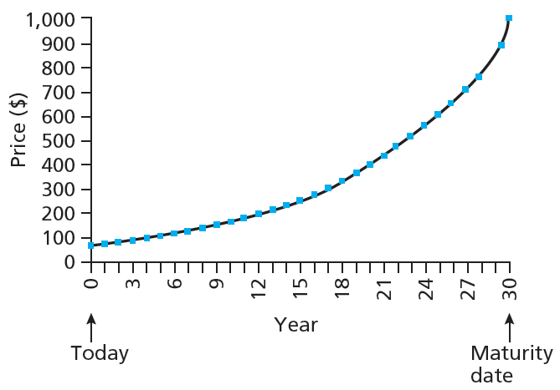
Figure 10.7 Price of 30-Year Zero-Coupon Bond over Time at Yield to Maturity of 10%

Slide 30
10.4 Bond Prices Over Time
After-Tax Returns
Built-in price appreciation on original-issue discount bonds constitutes implicit interest payment to holder
IRS calculates price appreciation schedule to determine taxable interest income for built-in appreciation

Slide 31
10.5 Default Risk and Bond Pricing
Investment grade bond
Rated BBB and above by S&P or Baa and above by Moody’s
Speculative grade or junk bond
Rated BB or lower by S&P, Ba or lower by Moody’s, or unrated

Slide 32
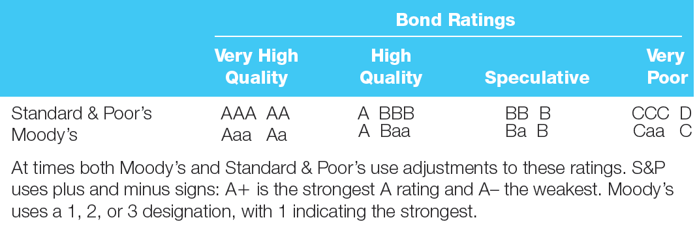
Figure 10.8 Bond Rating Classes

Slide 33
10.5 Default Risk and Bond Pricing
Determinants of Bond Safety
Coverage ratios: Company earnings to fixed costs
Leverage ratio: Debt to equity
Liquidity ratios
Current: Current assets to current liabilities
Quick: Assets excluding inventories to liabilities
Profitability ratios: Measures of RoR on assets or equity
Cash flow-to-debt ratio: Total cash flow to outstanding debt

Slide 34
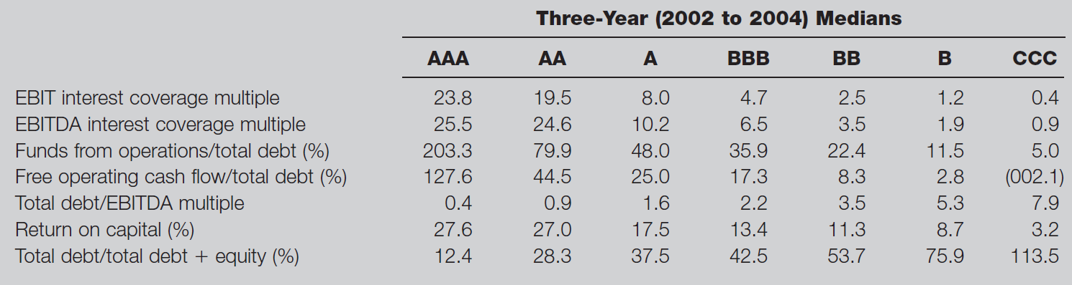
Table 10.3 Financial Ratios and Default Risk

Slide 35
10.5 Default Risk and Bond Pricing
Bond Indentures
Indenture
Defines contract between issuer and holder
Sinking fund
Indenture calling for issuer to periodically repurchase some proportion of outstanding bonds before maturity

Slide 36
10.5 Default Risk and Bond Pricing
Bond Indentures
Subordination clause
Restrictions on additional borrowing stipulating senior bondholders paid first in event of bankruptcy
Collateral
Specific asset pledged against possible default
Debenture
Bond not backed by specific collateral

Slide 37
10.5 Default Risk and Bond Pricing
Yield to Maturity and Default Risk
Stated yield is maximum possible yield to maturity of bond
Default premium
Increment to promised yield that compensates investor for default risk

Slide 38
Figure 10.10 Yield Spreads between Corporate and 10-Year Treasury Bonds

Slide 39
10.5 Default Risk and Bond Pricing
Credit Default Swaps (CDS)
Insurance policy on default risk of corporate bond or loan
Designed to allow lenders to buy protection against losses on large loans
Later used to speculate on financial health of companies

Slide 40
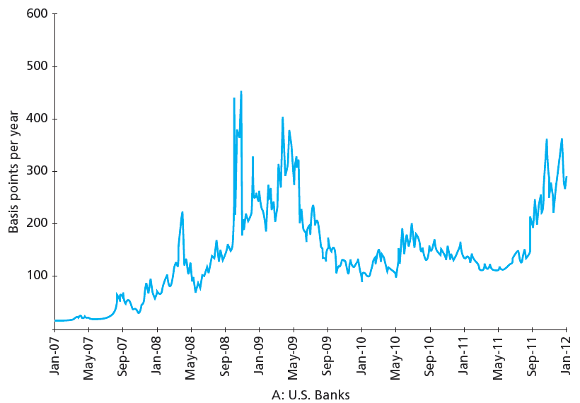
Figure 10.11A Prices of CDSs, U.S. Banks

Slide 41
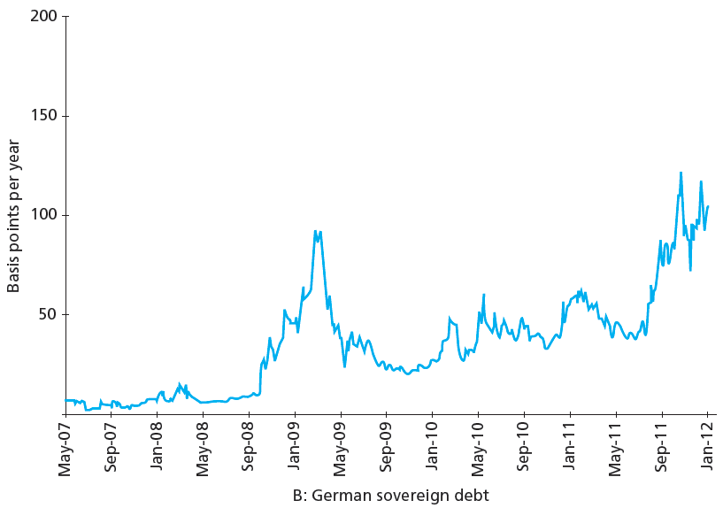
Figure 10.11B Prices of CDSs, German Sovereign Debt

Slide 42
10.6 The Yield Curve
Yield Curve
Graph of yield to maturity as function of term to maturity
Term Structure of Interest Rates
Relationship between yields to maturity and terms to maturity across bonds
Expectations Hypothesis
Yields to maturity determined solely by expectations of future short-term interest rates

Slide 43
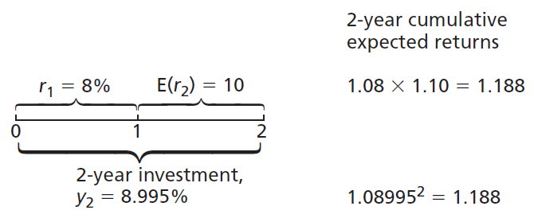
Figure 10.13 Returns to Two 2-Year Investment Strategies

Slide 44
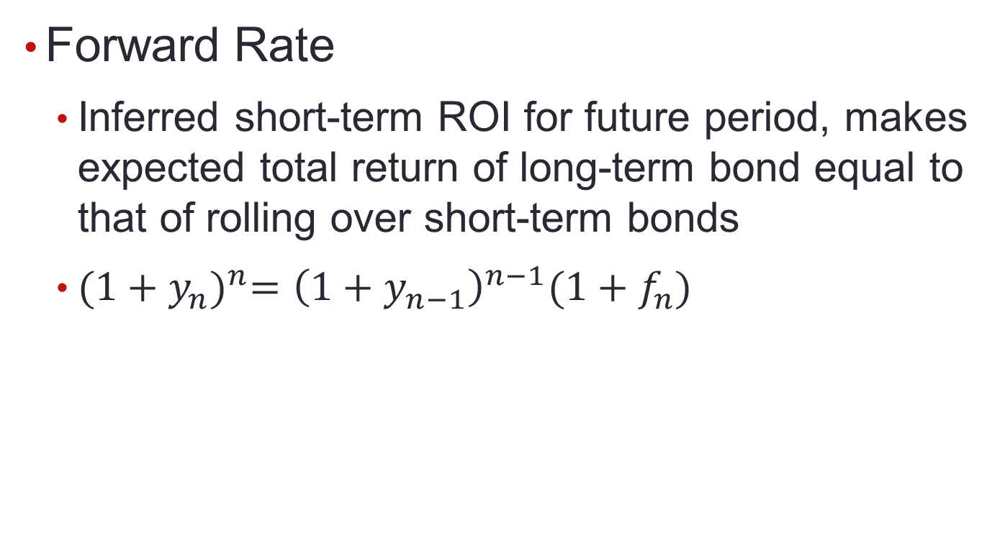
10.6 The Yield Curve

Slide 45
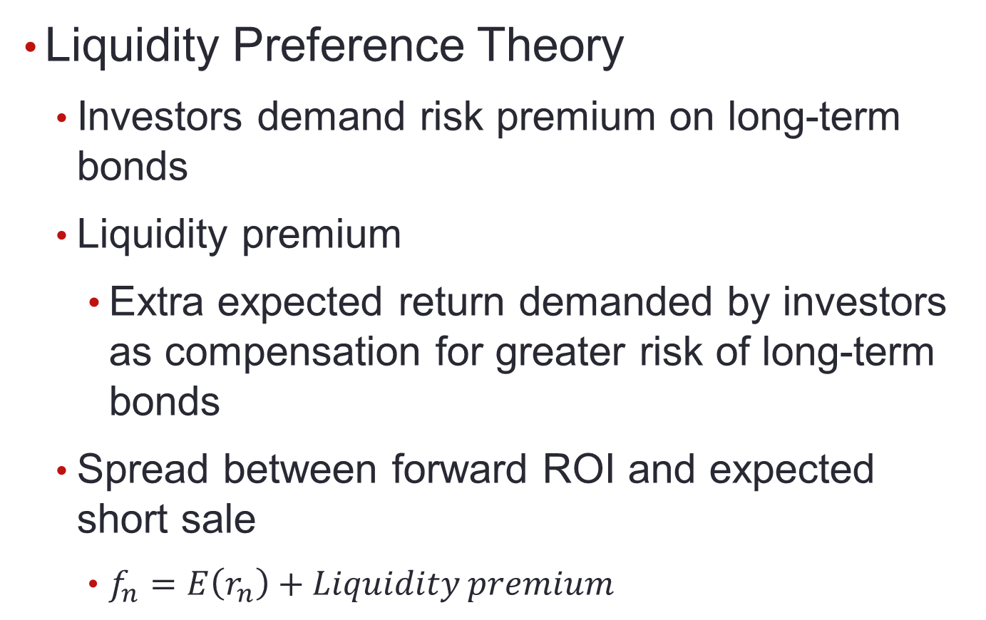
10.6 The Yield Curve

Slide 46
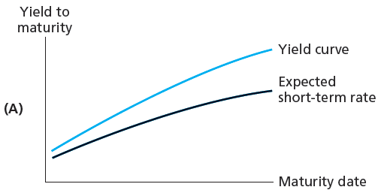
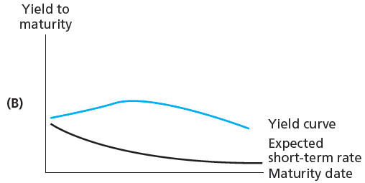
Figure 10.14 Illustrative Yield Curves

Slide 47
Figure 10.15 Term Spread: Yields on 10-Year versus 90-day Treasury Securities

