Slide 1
TrekGuide Connect
Your Ultimate Trekking Companion

Slide 2
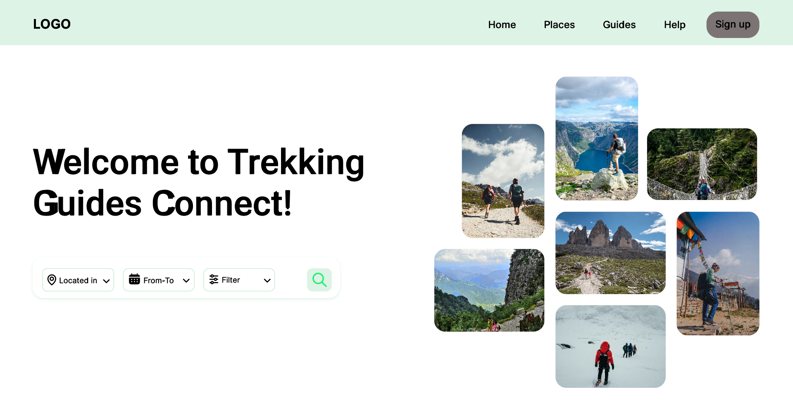

Slide 3
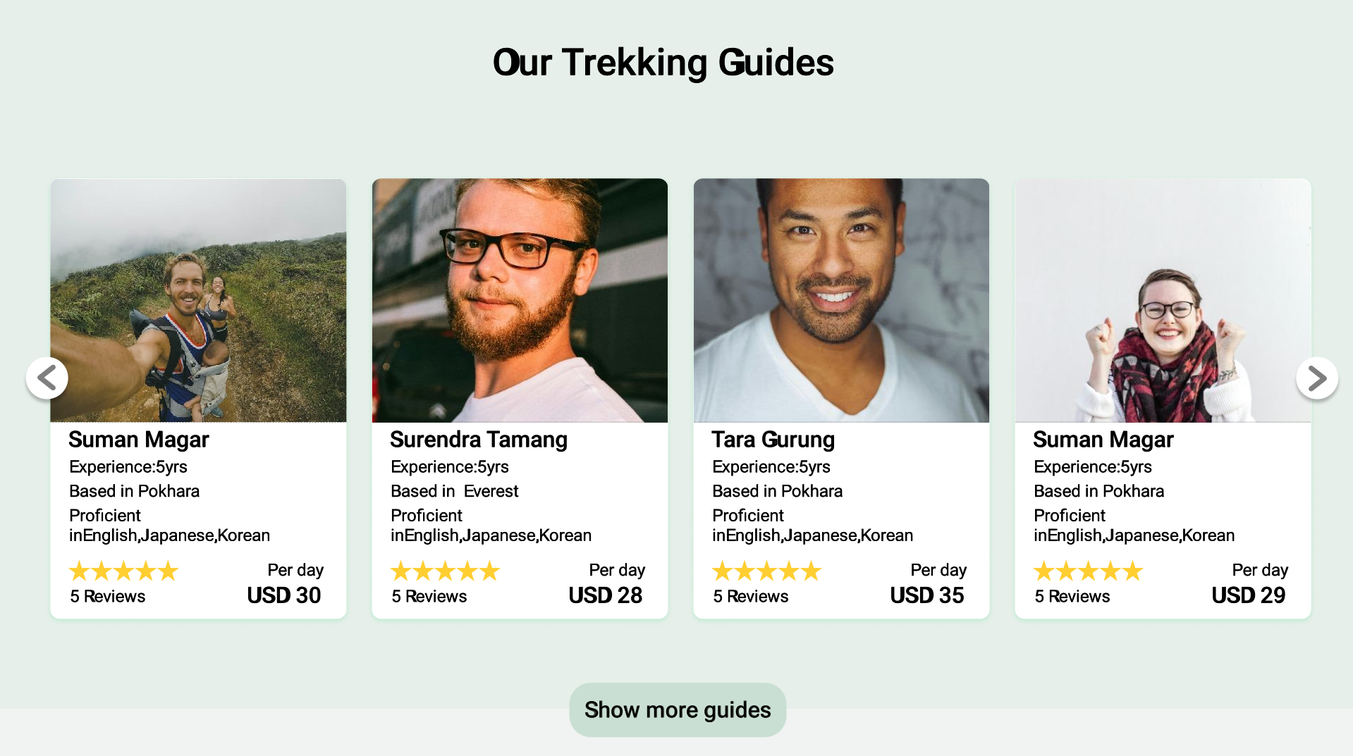

Slide 4
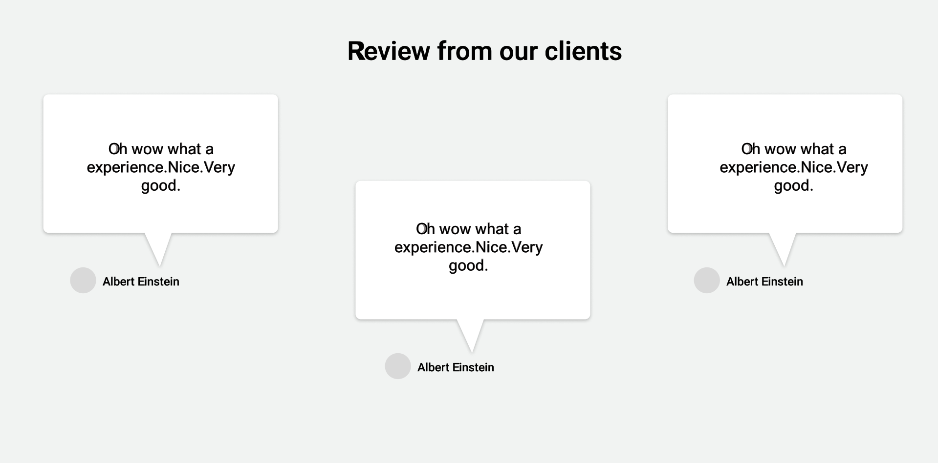

Slide 5
Features of our Platform
Trekking guide detail profile
Interview with Trekking Guide
Book Guide as per your need
Rating/Review your guide & Experience Sharing
Secured Payment (Payment released after trek is done)

Slide 6
Facts
Source: Nepal Tourism Statistics 2022 (MoCTCA)

Slide 7
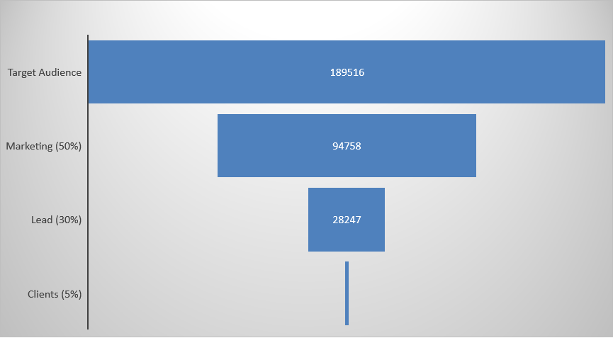
Funneling
1421

Slide 8
Business Model
Commission Based (20%)
Average trekking guide charges $25 per day.
The Foreign Trekkers pays 20% extra.
($30 per day)

Slide 9
Business Model
5 days average trekking
Our yearly commission
Assuming 1$ = Rs. 125
1421 * 5 * $5
$35,525
Gross margin : NRs. 44,40,625

Slide 10
USP
Huge database of government verified trekking guides
25,483

Slide 11
Budgeting
1st Year Cost
Software Development Cost | 17.5 Lakhs
Marketing cost | 12.5 Lakhs
Operation cost | 5 Lakhs
Total | 35 Lakhs

Slide 12
Let’s provide the best trekking experience. Thank You
Tara Prasad Gurung
Surendra Tamang
Rohan Raj Poudel

