Slide 1
Big Data Analysis
Overview for Mid-term Exam

Slide 2
Types of Attributes
Understanding the type of attributes is important because
It affects code implementation, especially for strongly typed languages such as Java
Example: Should you represent zipcode as string or numeric?
It affects the type of analysis you can perform
Example: Is it ok to calculate average GPA?

Slide 3
Types of Attributes
Attribute type depends on the properties of its values
Distinctness: we can check for = or ≠
Order: we can perform > or < comparison tests
Addition: we can add or subtract the values
Multiplication: we can multiply or divide the values

Slide 4
Example
Classify each attribute as nominal, ordinal, interval, or ratio
Name | Academic status | Zipcode | Height | Height Above 1.65m | Grade (Points) | Grade (GPA)
John | Sophomore | 48824 | 1.75m | 0.10m | 88 | 3.5
Mary | Senior | 48864 | 1.70m | 0.05m | 96 | 4.0
Jill | Freshman | 48824 | 1.65m | 0m | 84 | 3.0
Lee | Freshman | 48911 | 1.60m | -0.05m | 80 | 3.0
Hints:
Jill and Mary are two different names
Mary is a more “senior” student than Jill
John is taller than Mary
The height difference between John and Mary is the same as the height difference between Mary and Jill
The height difference between John and Jill is not twice the height difference between Mary and Jill
The grade difference between Mary and Jill is not the same as the grade difference between Mary and Lee

Slide 5
Valid Operations on Attributes
Attribute type affects the mathematical operations you can perform on the attribute values
Example:
calculating average GPA is not statistically meaningful ☺
Attribute type | Mathematical Operations
Nominal | mode, entropy, contingency correlation, χ2 test
Ordinal | median, percentiles, rank correlation, run tests, sign tests
Interval | mean, standard deviation, Pearson's correlation, t and F tests
Ratio | geometric mean, harmonic mean, percent variation

Slide 6
DROP TABLE
Delete a table from the database
After deletion, the table can no longer be used in queries, updates, or any other commands since its description no longer exists
Example: DROP TABLE USER;

Slide 7
ALTER TABLE
Add a new column to an existing table:
ALTER TABLE USER ADD BIRTHDATE DATETIME;
Remove a column from an existing table:
ALTER TABLE USER DROP COLUMN BIRTHDATE;
Modify an existing column in a table:
ALTER TABLE USER MODIFY BIRTHDATE INTEGER DEFAULT 1900;
Modify constraints of a table:
ALTER TABLE EDIT DROP PRIMARY KEY;

Slide 8

INSERT or DELETE Operation
INSERT INTO Article VALUES (‘Database’, ‘$@%@23’);
INSERT INTO Article VALUES (‘Michigan’, ‘#525s36’);
DELETE FROM Article WHERE Title=‘Database’;
DELETE FROM Article WHERE Content=‘#525s35’;

Slide 9
Retrieval Queries in SQL
Basic form of the SQL retrieval queries:
SELECT <attribute list>
FROM <table list>
WHERE <condition>
<attribute list> is a list of column names whose values are to be retrieved by the query
<table list> is a list of table names required to process the query
<condition> is a conditional (Boolean) expression that identifies the rows to be retrieved by the query

Slide 10
Missing Values
Reasons for missing values
Information is not collected (e.g., people decline to give their age and weight)
Attributes may not be applicable to all cases (e.g., annual income is not applicable to children)
Handling missing values
Eliminate Data Objects with Missing Values
Estimate the Missing Values (Imputation methods)
Ignore the Missing Value During Analysis
Replace with all possible values (weighted by their probabilities)

Slide 11
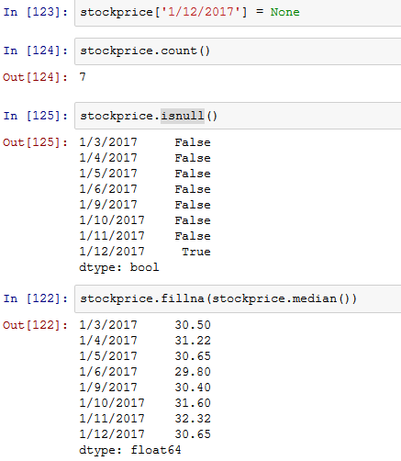
Series: Dealing with Missing Values
Set price for 1/12/2017 to missing value
Count number of non-missing values
Check whether value is missing

Slide 12
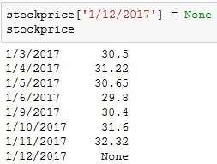
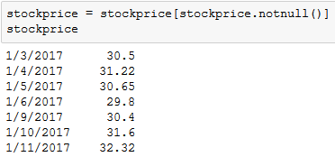
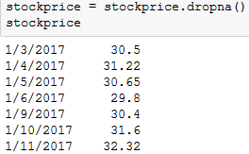
Series: Dealing with Missing Values
Discard data with missing values
For a complete list of methods available for Pandas Series, go to http://pandas.pydata.org/pandas-docs/stable/generated/pandas.Series.html

Slide 13
Aggregation
Sometimes, less is more
Aggregation combines two or more observations into a single observation
Purpose
Data reduction
smaller data set means less memory and processing time
Change of scale
aggregation generates a coarser-level view of the data
More “stable” data
aggregated data tends to have less variability (less noisy)

Slide 14
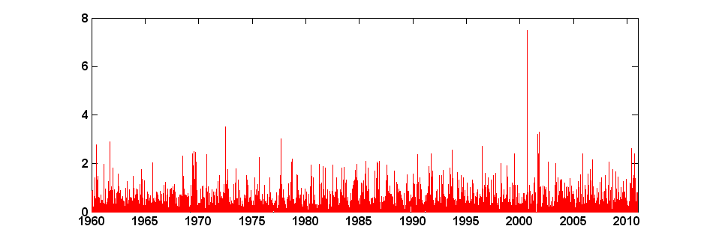
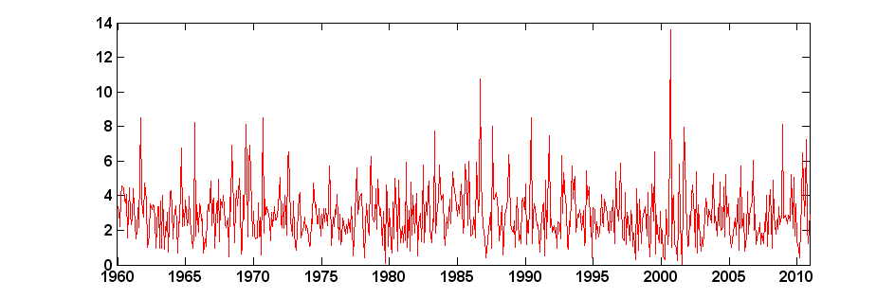
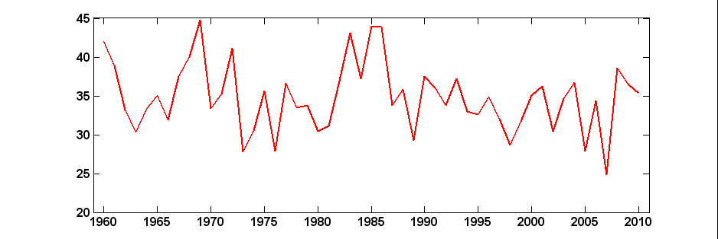
Aggregation
Precipitation at Maple City, Michigan
Harder to detect trends/patterns
Daily precipitation
Monthly precipitation
Annual precipitation
Long-term trends and cycles are easier to discern

Slide 15
Discretization
Ordinal attribute
shirt size (small/medium/large), hurricane (category 1 – 5)
Numeric attribute:
Weight, height, salary, # days since Jan 1 2000.
Discretization is used to split the range of a numeric attribute into discrete number of intervals
Age can be discretized into [child, young adult, adult, and senior].
There may be no apparent relationship between age attribute and tendency to buy a particular product
But the relationship may exist only among certain age groups (e.g.young adults)

Slide 16
Unsupervised Discretization
Equal interval width
Split the range of the numeric attribute into equal length intervals (bins)
Pros: cheap and easy to implement
Cons: susceptible to outliers
Equal frequency
Split the range of the numeric attribute in such a way that each interval (bin) has the same number of points
Pros: robust to outliers
Cons: more expensive (must sort data), may not be consistent with inherent structure of the data

Slide 17
Multivariate Statistics
Covariance
Measures the strength of association between a pair of quantitative variables
Given $x=\left(x_{1},x_{2},…,x_{n}\right)$ and $y=\left(y_{1},y_{2},…,y_{n}\right)$, the correlation between x and y is given by
$$r\left(x,y\right)=\frac{\sum_{i=1}^{n}{\left(x_{i}−\overline{x}\right)\left(y_{i}−\overline{y}\right)}}{n−1}$$
where
$\overline{x}$ and $\overline{y}$ are the mean values of $x$ and $y$.
Values range from -∞ to +∞ (scale dependent)

Slide 18
Multivariate Statistics
Correlation coefficient
A normalized measure of association between a pair of quantitative variables
Given $x=\left(x_{1},x_{2},…,x_{n}\right)$ and $y=\left(y_{1},y_{2},…,y_{n}\right)$, the correlation between x and y is given by
$$r\left(x,y\right)=\frac{\sum_{i=1}^{n}{\left(x_{i}−\overline{x}\right)\left(y_{i}−\overline{y}\right)}}{\sqrt{\sum_{i=1}^{n}{{\left(x_{i}−\overline{x}\right)}^{2}}}\sqrt{\sum_{i=1}^{n}{{\left(y_{i}−\overline{y}\right)}^{2}}}}=\frac{1}{n−1}\sum_{i=1}^{n}{\left(\frac{x_{i}−\overline{x}}{s_{x}}\right)}\left(\frac{y_{i}−\overline{y}}{s_{y}}\right)$$
where
$\overline{x}$ and $\overline{y}$ are the mean values of $x$ and $y$.
$s_{x}$ and$s_{y}$ are the standard deviations of $x$ and $y$.
values range from -1 to +1

Slide 19
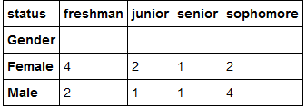
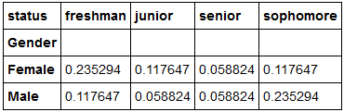
Mutual Information
Measure of association between two qualitative variables
Given a pair of variables $X$ and $Y$, their mutual information is given by
$$I\left(X,Y\right)=\sum_{x,y}{p\left(X=x,Y=y\right)\log{\frac{p(X=x,Y=y)}{p\left(X=x\right)p(Y=y)}}}$$
Joint frequency distribution
Joint probability distribution

Slide 20
Misra Gries (Streaming/Online Algorithm)
An approximate online learning algorithm
Let
m be the length of the data stream
n be the number of unique items
k-1 is the number of memory buffers available to store counters
Goal:
Identify all items whose frequency > m/k
Constraint
Storage complexity ~ O(k) instead of O(n)

Slide 21
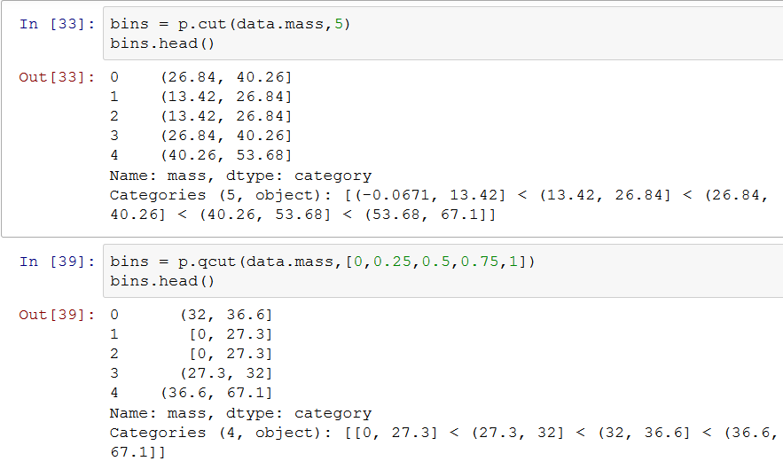
Python Example
Discretize into 5 equal-width bins
Discretize into 5 equal-frequency bins (values are the quantiles)

Slide 22
Supervised Discretization Example
Age | Buy
10 | No
15 | No
18 | Yes
19 | Yes
24 | No
29 | Yes
30 | Yes
31 | Yes
40 | No
44 | No
55 | No
64 | No
Let “Buy” be the class attribute
Suppose we’re interested to discretize the Age attribute
We also want the intervals (bins) to contain data points from the same class (i.e., we want the bins to be as close to homogeneous as possible)

Slide 23
Example
Age | Buy
10 | No
15 | No
18 | Yes
19 | Yes
24 | No
29 | Yes
30 | Yes
31 | Yes
40 | No
44 | No
55 | No
64 | No
Equal width: interval = (64-10)/3 = 54/3 = 18
Equal frequency:
Both approaches can produce intervals that contain non-homogeneous classes

Slide 24
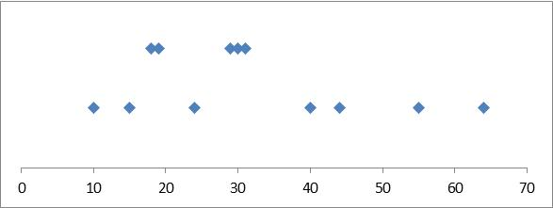
Supervised Discretization
Age | Buy
10 | No
15 | No
18 | Yes
19 | Yes
24 | No
29 | Yes
30 | Yes
31 | Yes
40 | No
44 | No
55 | No
64 | No
Yes
No
Supervised discretization:
In supervised discretization, our goal is to ensure that each bin contains data points from one class.

Slide 25
Entropy-based Discretization
A widely-used supervised discretization method
Entropy is a measure of impurity
Higher entropy implies data points are from a large number of classes (heterogeneous)
Lower entropy implies most of the data points are from the same class
Where p_{j} is the proportion of data points belonging to class j

Slide 26
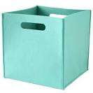
Entropy
Suppose you want to discretize age of users based on whether they buy or don’t buy a product
Age | Buy
10 | No
15 | No
18 | Yes
19 | Yes
24 | No
29 | Yes
30 | Yes
31 | Yes
40 | No
44 | No
55 | No
64 | No
Class here is Yes or No (whether the user buys a product)
For each bin, calculate the proportion of data points belonging to each class

Slide 27
Entropy
Where p_{j} is the fraction of data objects belonging to class j
P(Yes) = 0/6 = 0 P(No) = 6/6 = 1
Entropy = – 0 log 0 – 1 log 1 = – 0 – 0 = 0
P(Yes) = 1/6 P(Yes) = 5/6
Entropy = – (1/6) log₂ (1/6) – (5/6) log₂ (1/6) = 0.65
P(Yes) = 2/6 P(No) = 4/6
Entropy = – (2/6) log₂ (2/6) – (4/6) log₂ (4/6) = 0.92
As the bin becomes less homogeneous, entropy increases

Slide 28
Entropy-based Discretization
Recursively find the best partition that minimizes entropy
Split point = 35.5

Slide 29
Entropy-based Discretization
Find the next best partition that minimizes entropy
Split point = 16.5
Split point = 35.5

Slide 30
Decision Tree Induction Algorithm
1. Start with an initial node (let D₀ be the training instances)
2. Check whether a leaf node needs to be expanded (based on stopping criteria)
If not needed, then assign a class to the node based on the majority class of training instances in D₀.
D₀
D₀
Class=No
?
Home Owner
Yes
No
D₁
D₂
b. Else
i. Find the best attribute split condition
Ii, Distribute the training instances to their corresponding child nodes based on the outcome of the split condition.
3. Repeat Step 2 for each leaf node that has not been tested

Slide 31
Design Issues for Decision Tree Classifier
Which attribute to use when expanding a node?
Need a measure to evaluate how good is the attribute split
What is the stopping condition?
Stop splitting if all the instances belong to the same class or have identical attribute values
Early termination (to avoid overfitting the training data, see next lecture)

Slide 32
How to determine the Best Split
Greedy approach:
Nodes that have purer class distribution after splitting are preferred
D₀
D₀
X
Y
Yes
No
Yes
No
D₁
D₂
D₁
D₂
Y is preferred over X to split the data D₀

Slide 33
Finding the Best Split
For each candidate attribute
Compute impurity measure of each child node
Compute the weighted average impurity measure of the children
Choose the attribute split condition that produces the lowest weighted impurity measure
I₁
I₂
…..
I_{p}

Slide 34
Measures of Node Impurity
Consider a k-class problem where the class label is either {1, 2, 3, …, k}
Let p(j) be the proportion of training instances of class j
2 popular measures for node impurity:

Slide 35
Example: Gini Index of a Single Node
P(C1) = 0/6 = 0 P(C2) = 6/6 = 1
Gini = 1 – P(C1)² – P(C2)² = 1 – 0 – 1 = 0
P(C1) = 1/6 P(C2) = 5/6
Gini = 1 – (1/6)² – (5/6)² = 0.278
P(C1) = 2/6 P(C2) = 4/6
Gini = 1 – (2/6)² – (4/6)² = 0.444

Slide 36
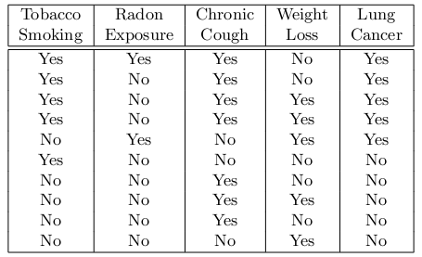
Example: Diagnosing Lung Cancer
Training instances:
Initial Tree:
?
Yes: 5 No: 5
Node is impure; so we need to expand it

Slide 37
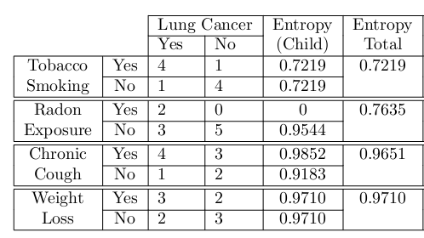
Example
Best split condition
Yes: 5 No: 5
Current Tree:
Tobacco Smoking
Yes
No
Yes: 4 No: 1
Yes: 1 No: 4

Slide 38
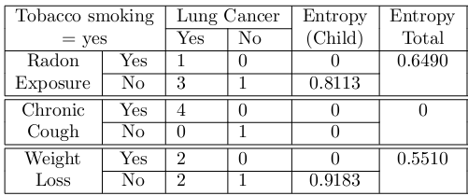
Example
Best split condition
Yes: 5 No: 5
Current Tree:
Tobacco Smoking
Yes
No
Chronic Cough
Yes: 1 No: 4
Yes
No
Yes: 4 No: 0
Yes: 0 No: 1

Slide 39
Example
Best split condition
Current Tree:
Tobacco Smoking
Yes
No
Chronic Cough
Yes: 1 No: 4
Yes
No
Yes
No

Slide 40
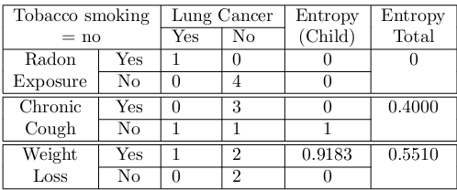
Example
Best split condition
Current Tree:
Tobacco Smoking
Yes
No
Chronic Cough
Radon Exposure
Yes
No
Yes
Yes
No
Yes: 1 No: 0
Yes: 0 No: 4

Slide 41
Example
Best split condition
Final Tree:
Tobacco Smoking
Yes
No
Chronic Cough
Radon Exposure
Yes
No
Yes
Yes
No
Yes
No

Slide 42
Alternative Measures for Classification
Confusion matrix:
 | PREDICTED CLASS
ACTUAL CLASS |  | Class = + | Class = -
 | Class = + | 0 | 10
 | Class = - | 90 | 900
Accuracy = 90% (but you misclassify all the positive classes)
Assume minority class as positive class (i.e., the class you’re more interested in predicting correctly):

Slide 43
Model Selection Using Validation Set
A general model selection approach that does not depend on the predictive modeling technique used
Divide the training data into two parts:
“Training” set: for model building
Validation set: for estimating generalization error; choose the model parameter that gives the lowest error on validation set
Drawback:
Less data would be available for training

Slide 44
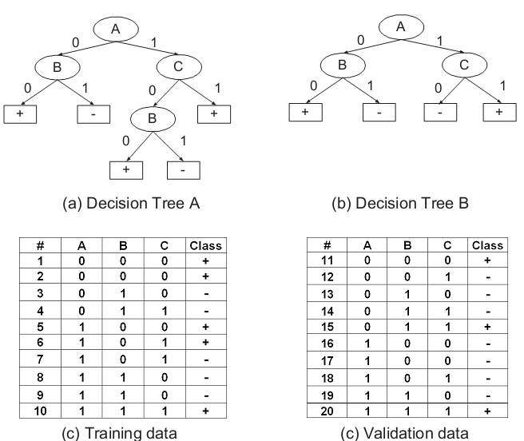
Example
Training errors:
Tree A: 10%
Tree B: 20%
Validation errors:
Tree A: 50%
Tree B: 30%
So, tree B is preferred over A

Slide 45
Alternative Measures for Classification
Confusion matrix:
 | PREDICTED CLASS
ACTUAL CLASS |  | Class = + | Class = -
 | Class = + | 0 | 10
 | Class = - | 90 | 900
Accuracy = 90% (but you misclassify all the positive classes)
Assume minority class as positive class (i.e., the class you’re more interested in predicting correctly):

Slide 46
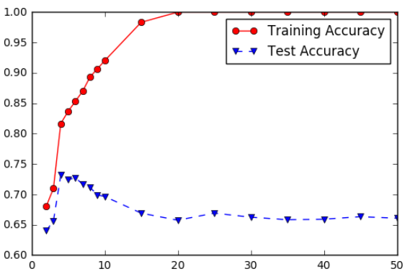
Model Overfitting and Underfitting
Underfitting: when model is too simple, both training and test accuracies are poor
Overfitting: when model is too complex, training accuracy is high but test accuracy is low

Slide 47
Rule Evaluation Measures
Given an association rule X → Y
Support: measures the rule prevalence (i.e., how often it can be applied to the data)
Confidence (c): measures the strength of implication
I is an indicator function
T is number of transactions
Number of transactions that contain X and Y
Number of transactions that contain X

Slide 48
Rule Evaluation Measures: Examples

Slide 49
Apriori Algorithm
Anti-monotone property of support:
Support of an itemset Y will never exceed the support of its subsets
Apriori principle:
If an itemset is infrequent, then all of its supersets must also be infrequent

Slide 50
Association Rule Generation
In general, confidence does not have an anti-monotone property
c(ABC →D) can be larger or smaller than c(AB →D)
But confidence of rules generated from the same itemset has an anti-monotone property
E.g., Suppose {A,B,C,D} is a frequent 4-itemset: c(ABC → D) ≥ c(AB → CD) ≥ c(A → BCD)
Confidence is anti-monotone w.r.t. increasing number of items on the RHS of the rule

