Slide 1
What Makes a University “Good”?
Rohan Raval
Yaser Qazi

Slide 2
World Rankings
Factors Affecting Rank
Research, Quality of Education, Quality of Faculty
How to determine that?
Sources
CWUR, TIMES, SHANGHAI

Slide 3
Research

Slide 4
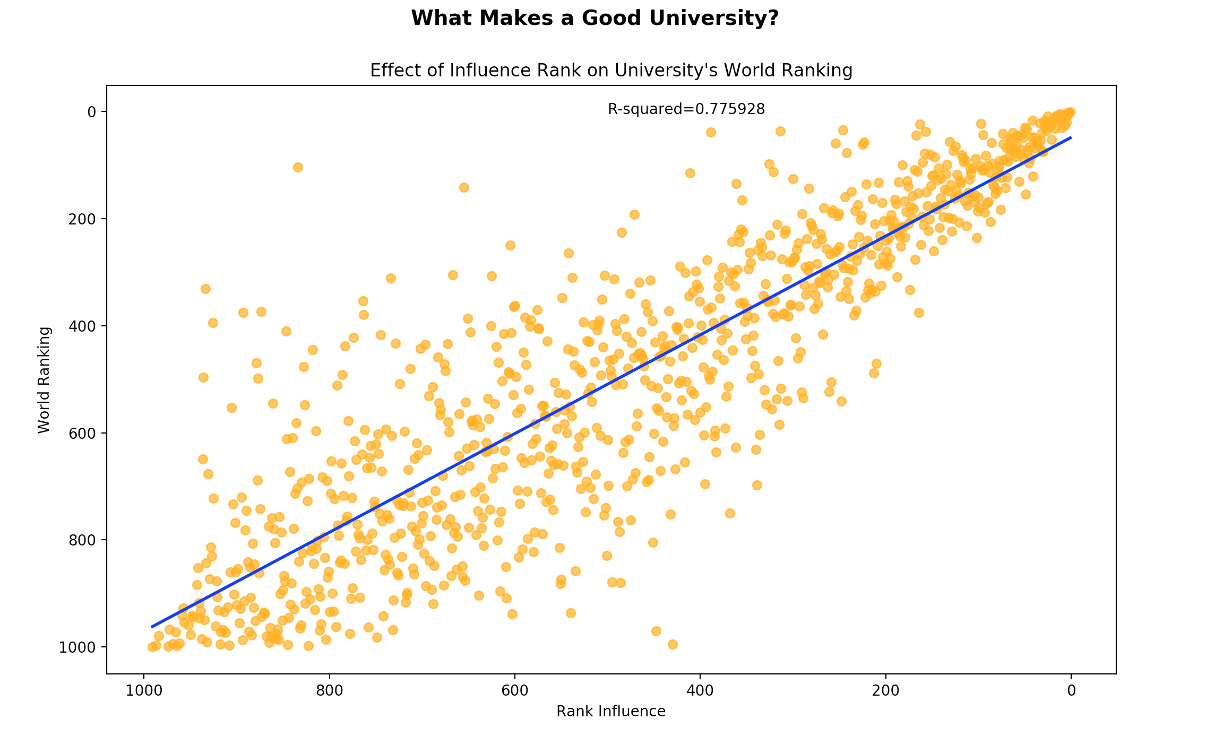
Research – Influence Score (Times)

Slide 5
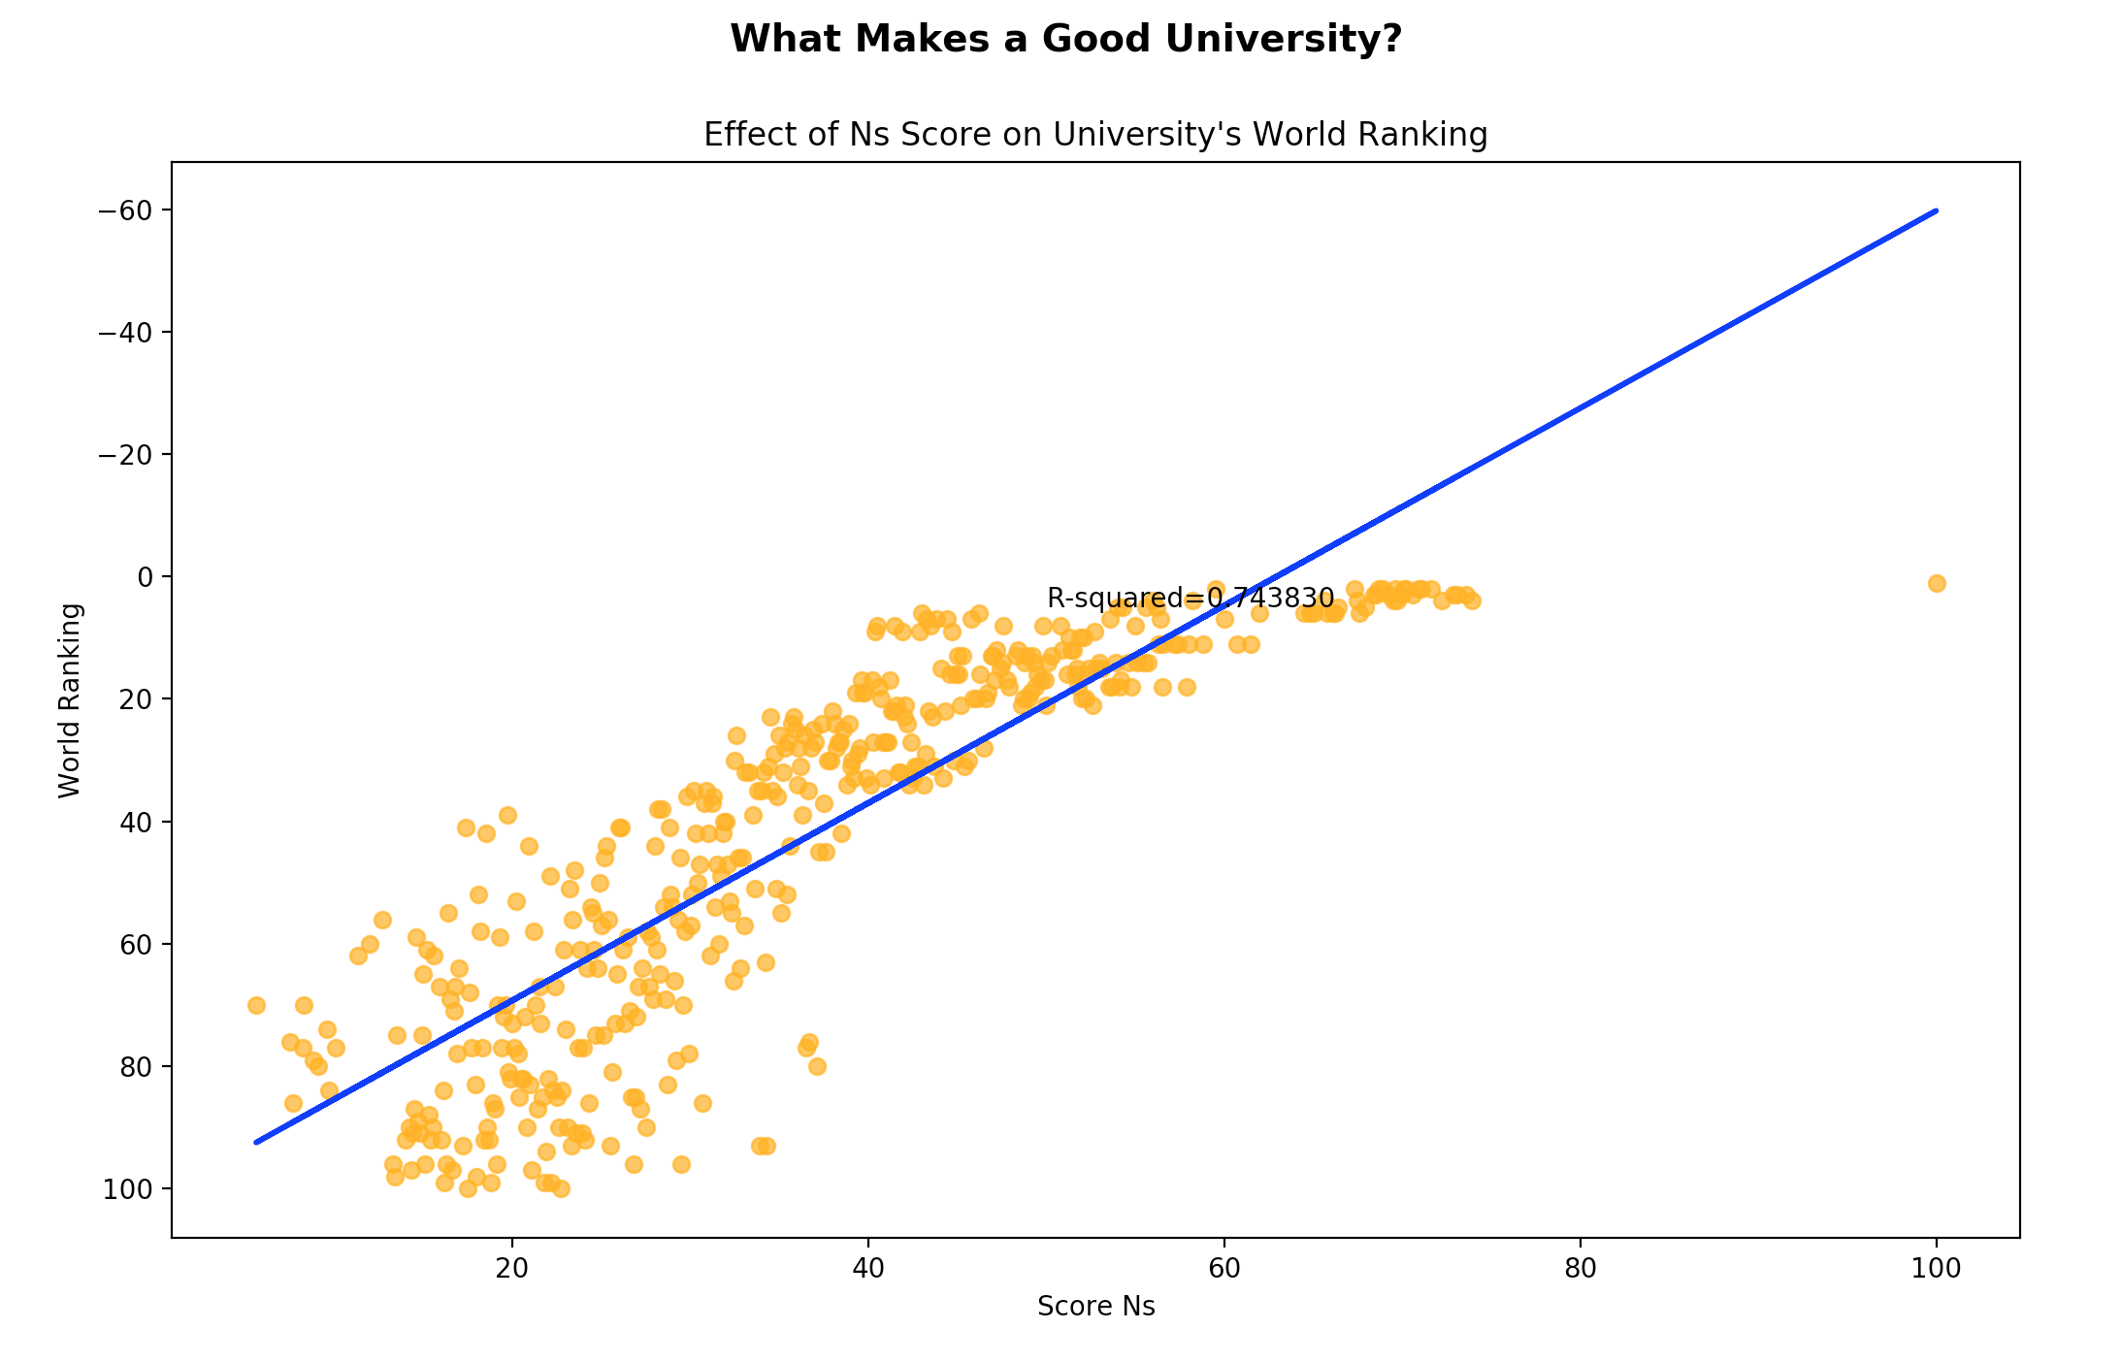
Research – Nature & Science Score (Shanghai)

Slide 6
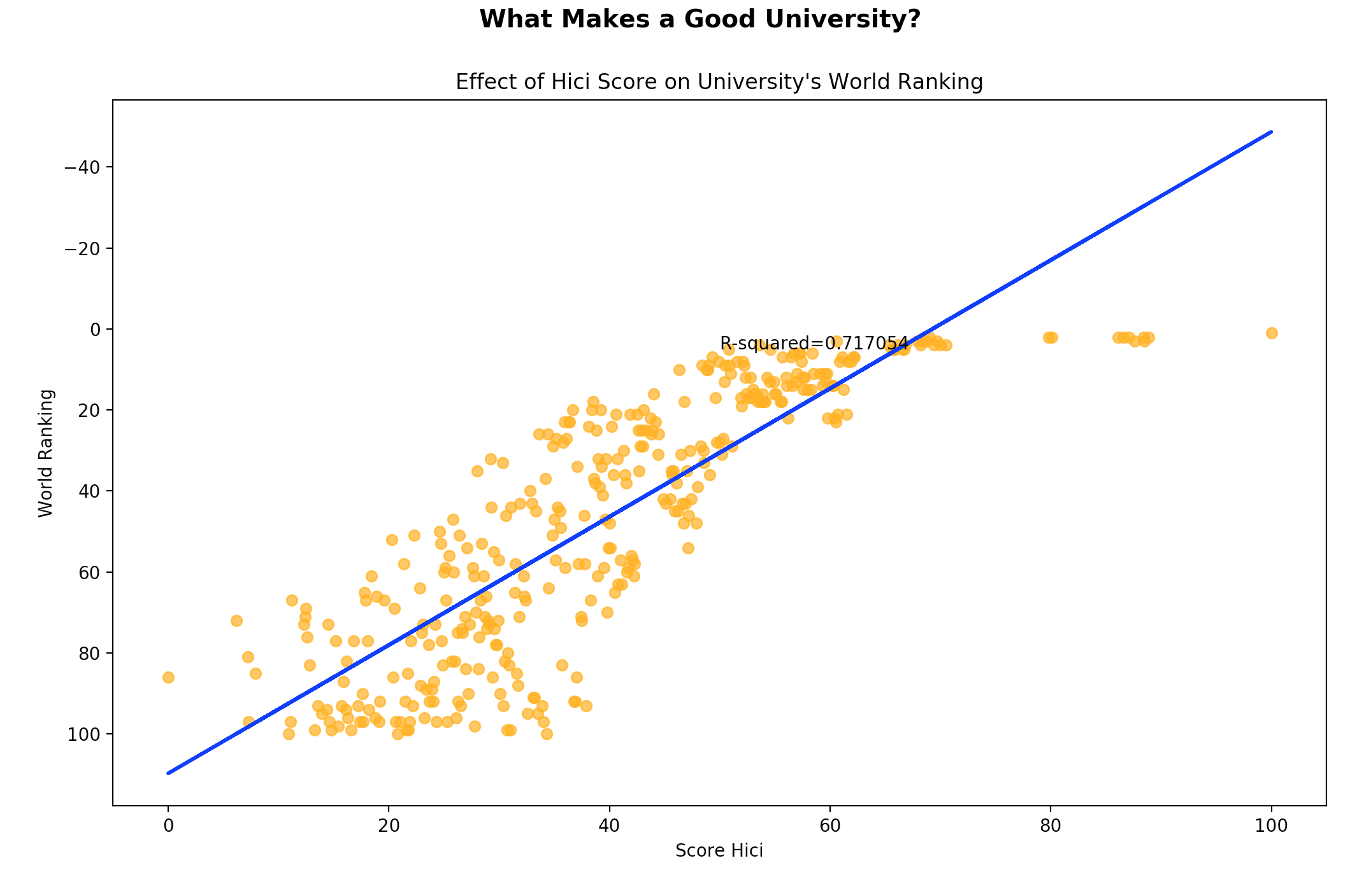
Research – Highly Cited (TS) Score (Shanghai)

Slide 7
Quality of Faculty

Slide 8
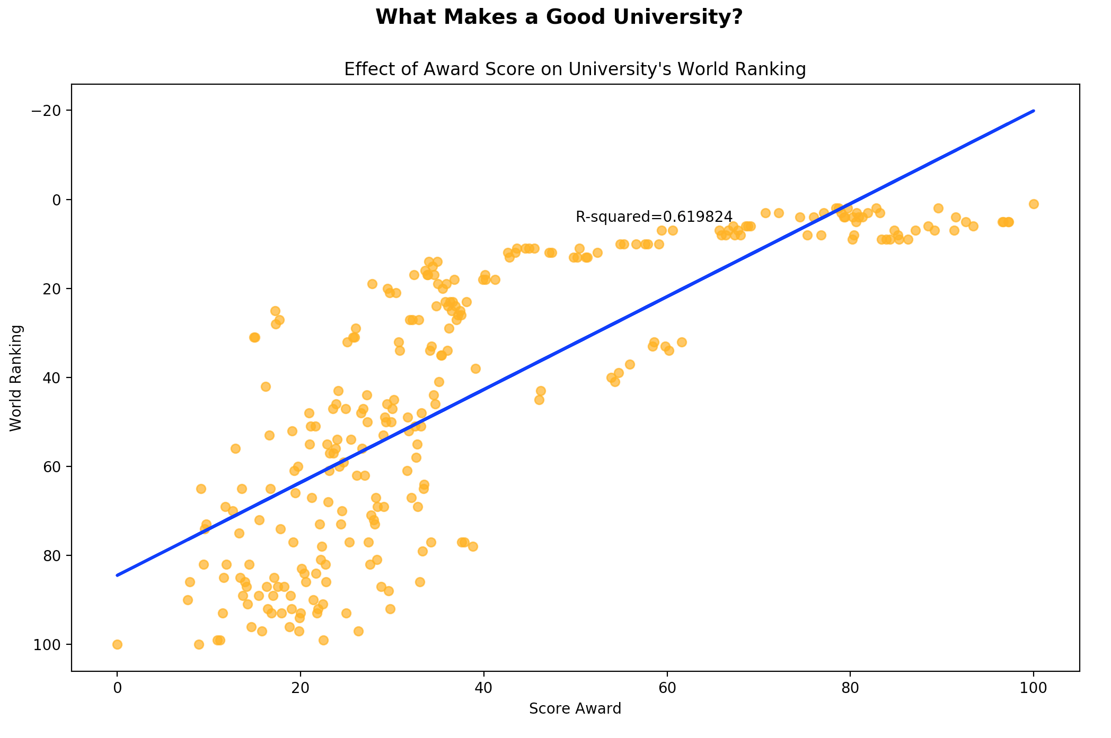
Research – Faculty Award Score (Shanghai)
Notes:
d

Slide 9
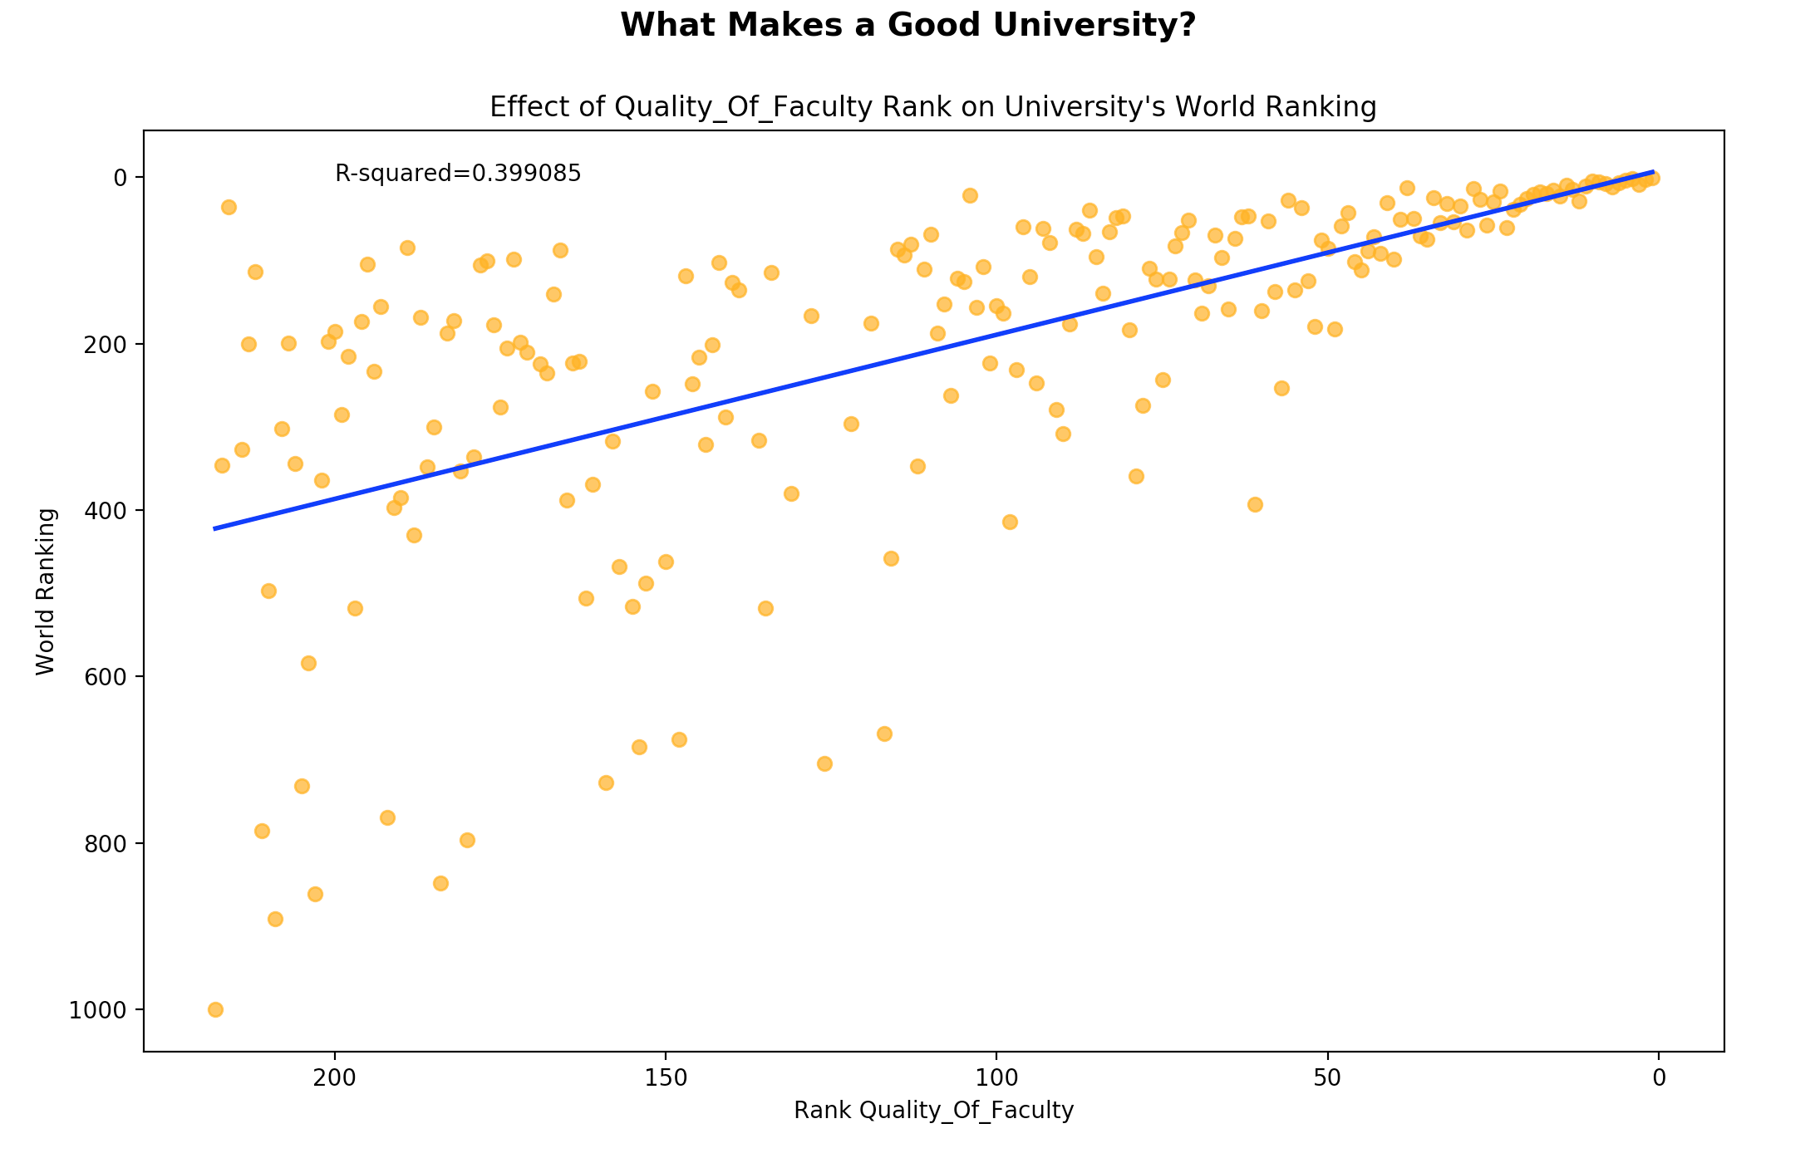
Faculty – Quality of Faculty Rank (CWUR)

Slide 10
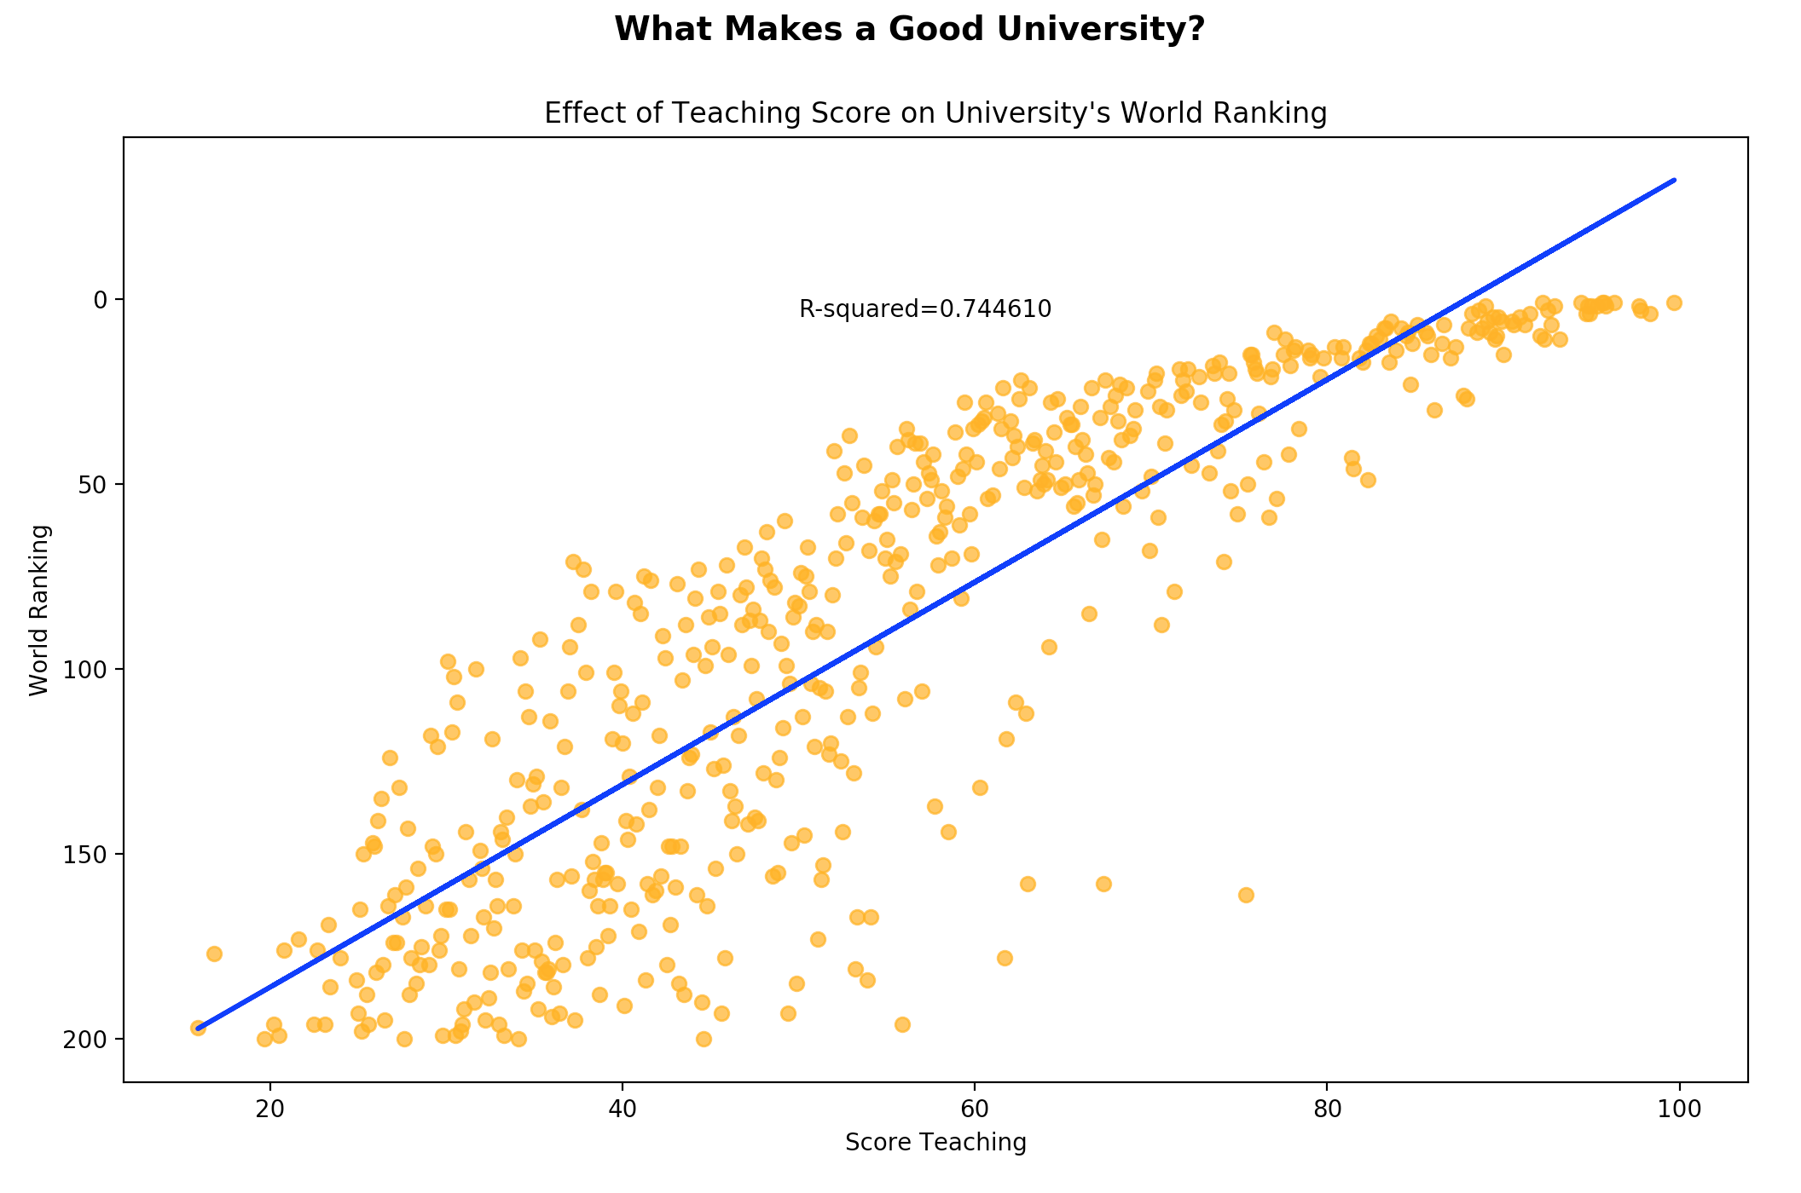
Faculty – Teaching [reputation] (Times)

Slide 11
Quality of Education

Slide 12
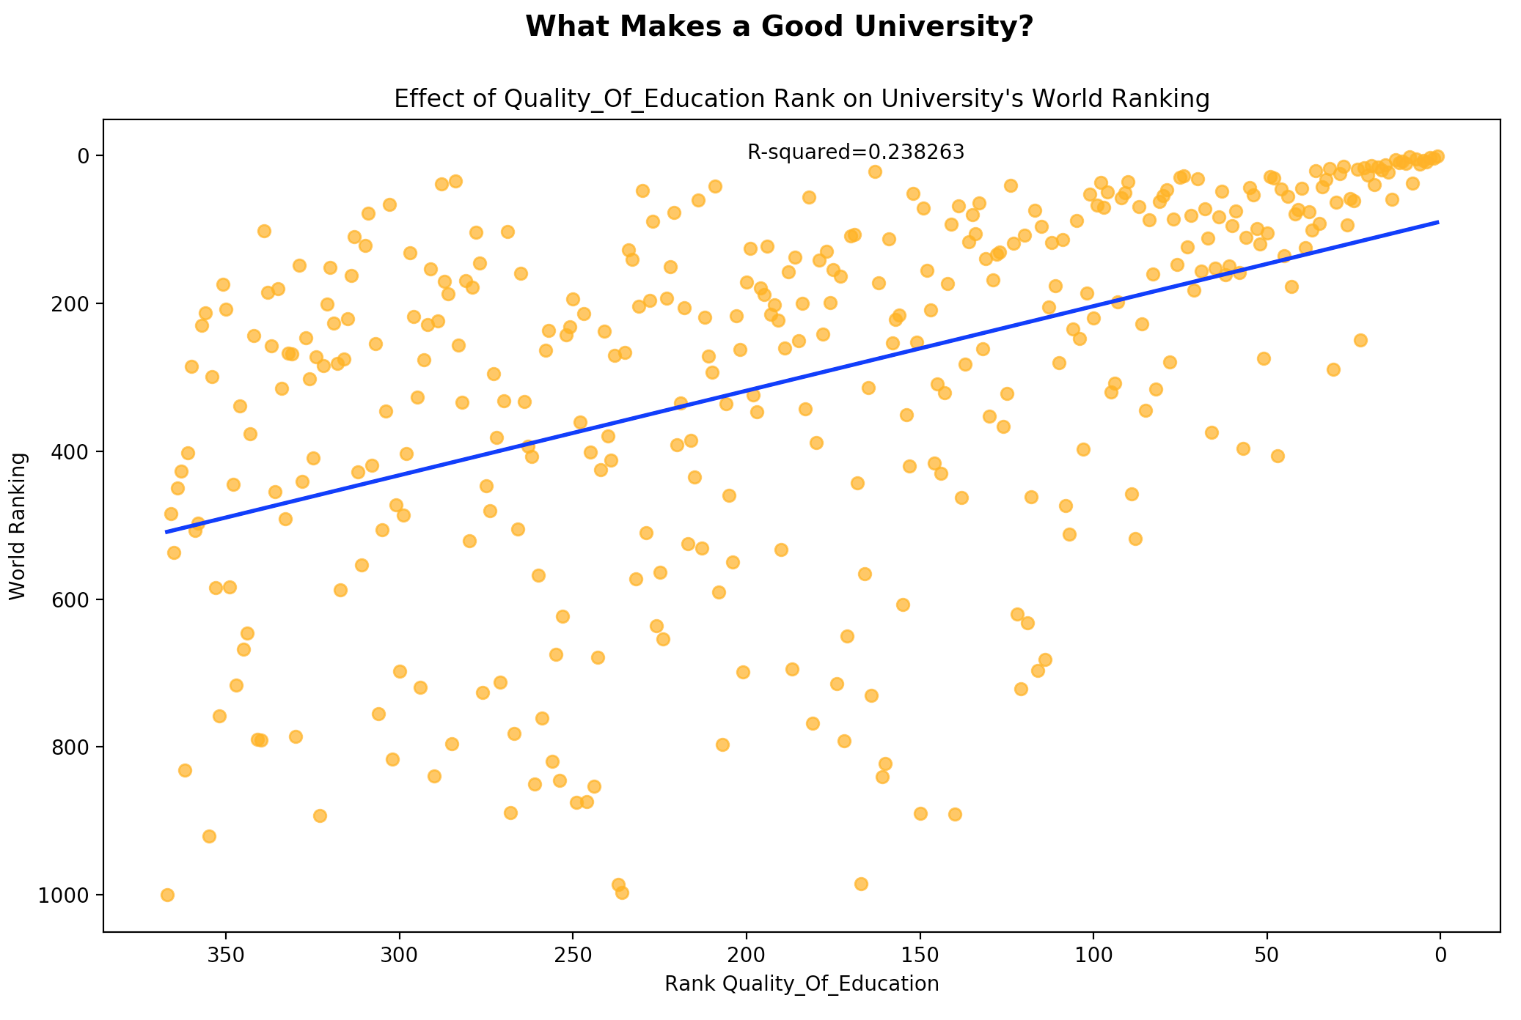
Faculty – Quality of Education Rank (CWUR)

Slide 13
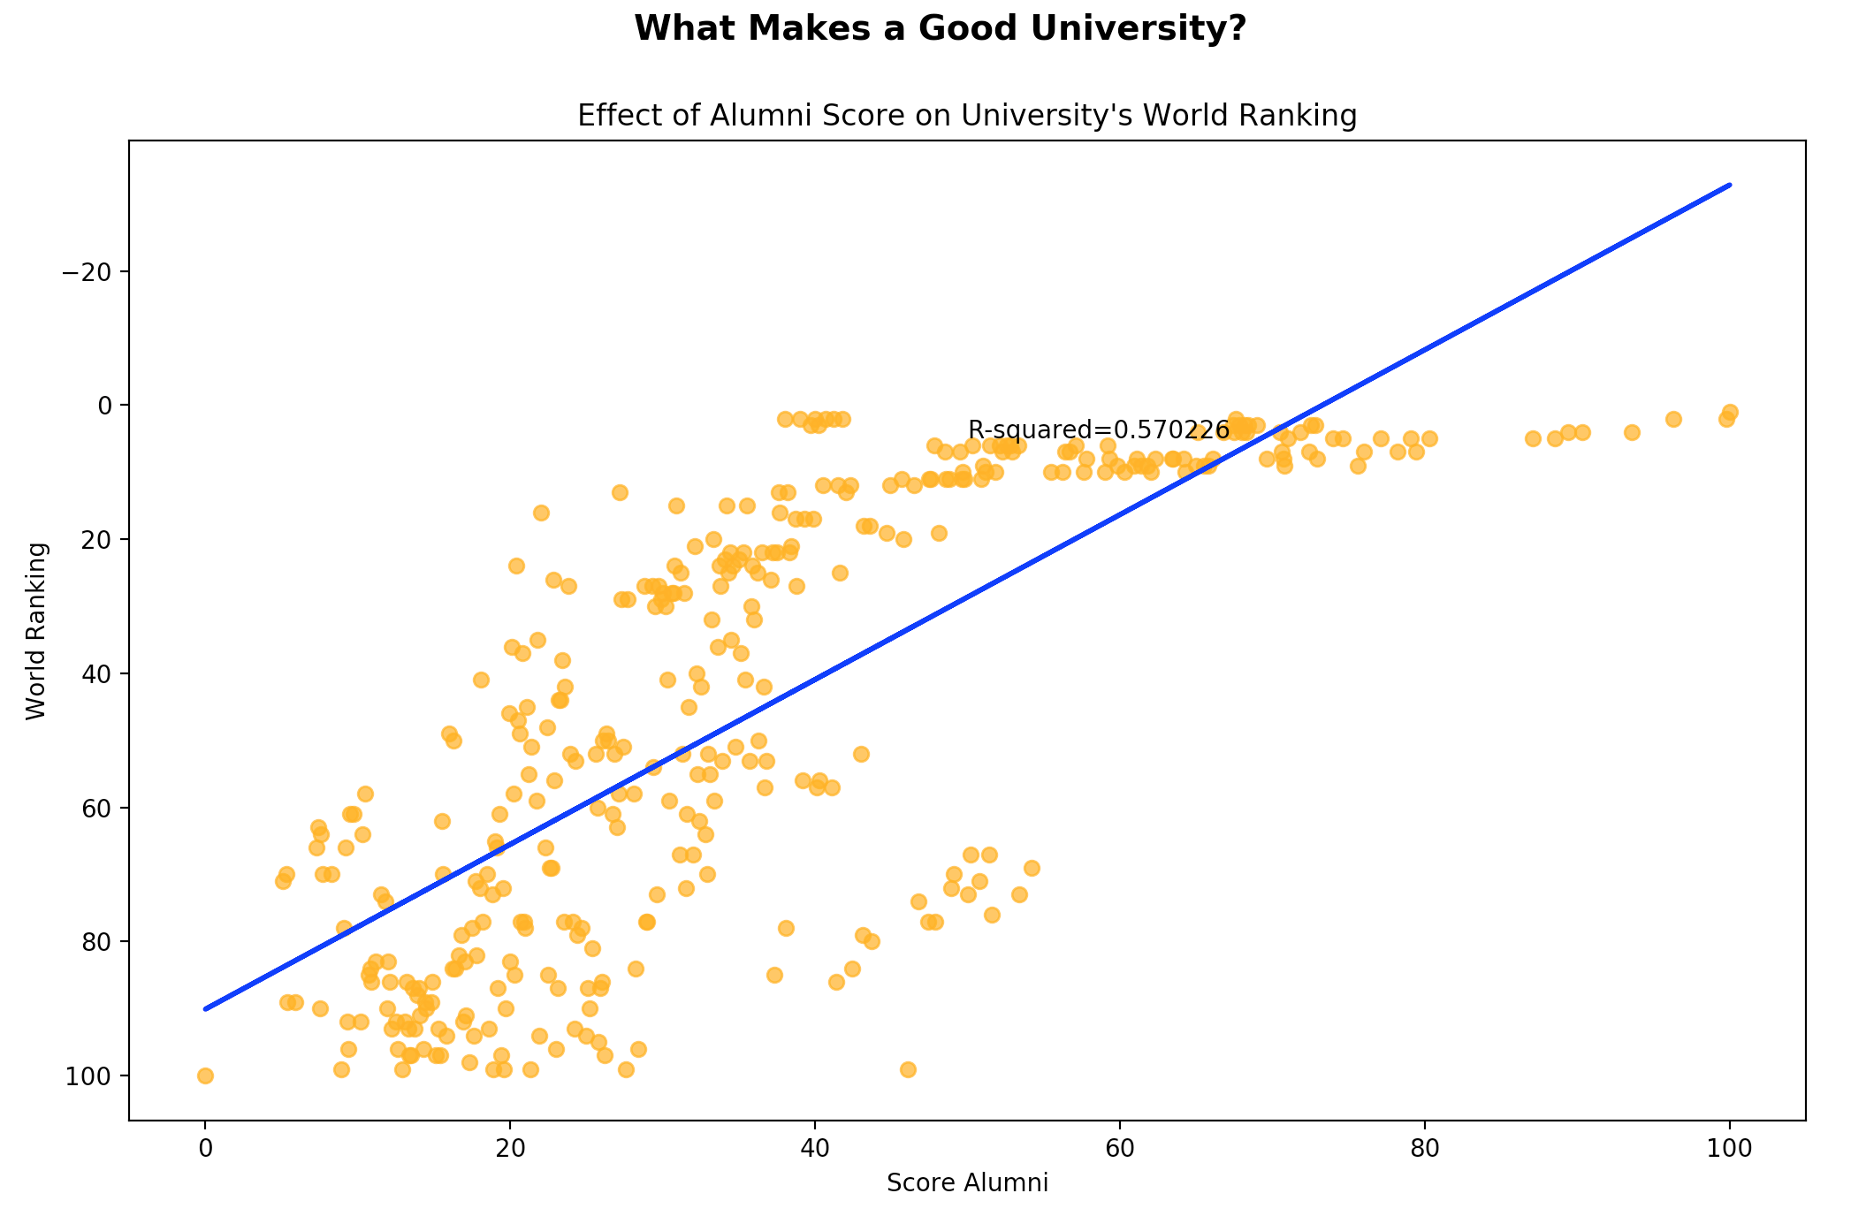
Faculty – Alumni Award Score (Shanghai)

Slide 14
Factors that Don’t Matter

Slide 15
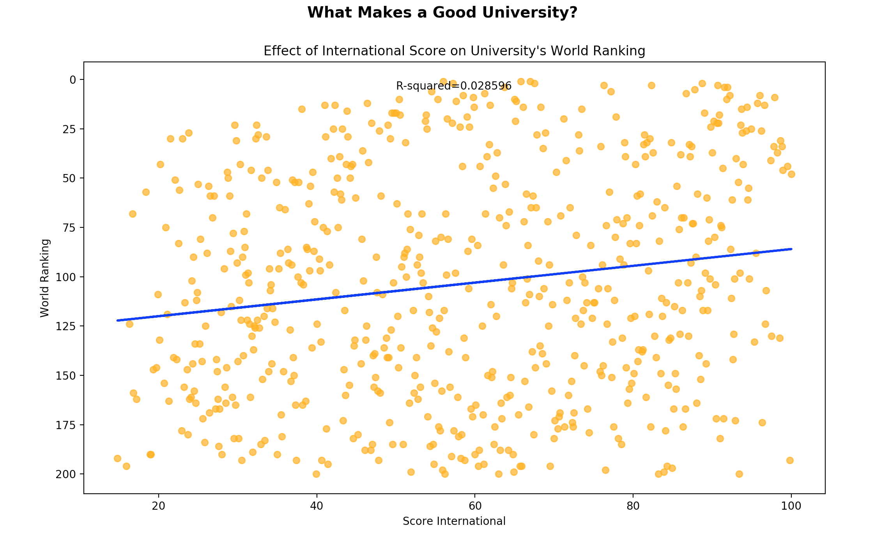
International (Times)

Slide 16
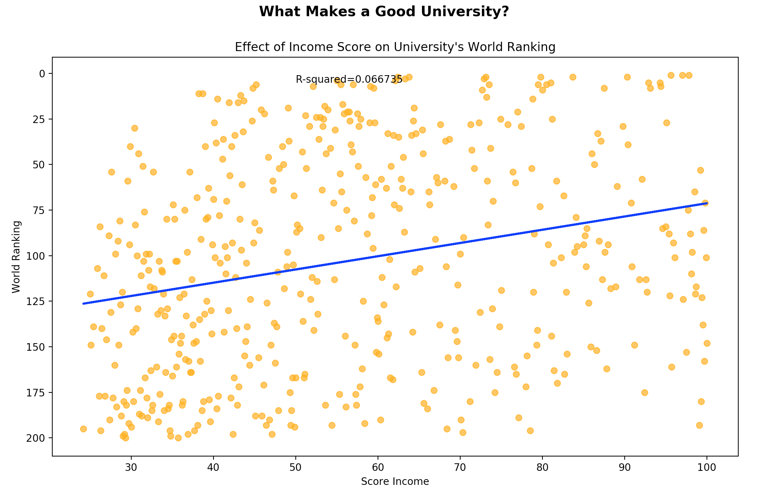
Income (Times)

Slide 17
Conclusions
RESEARCH MATTERS!
Ultimately, universities are research institutions – not bootcamps.
Especially research that is published in reputable journals and highly cited
Education is not the primary determinant of rank!

