Slide 1
What Makes a University “Good”?
Rohan Raval
Yaser Qazi

Slide 2
World Rankings
Factors Affecting Rank
Research, Quality of Education, Quality of Faculty
How to determine that?
Sources
CWUR, TIMES, SHANGHAI

Slide 3
Research

Slide 4
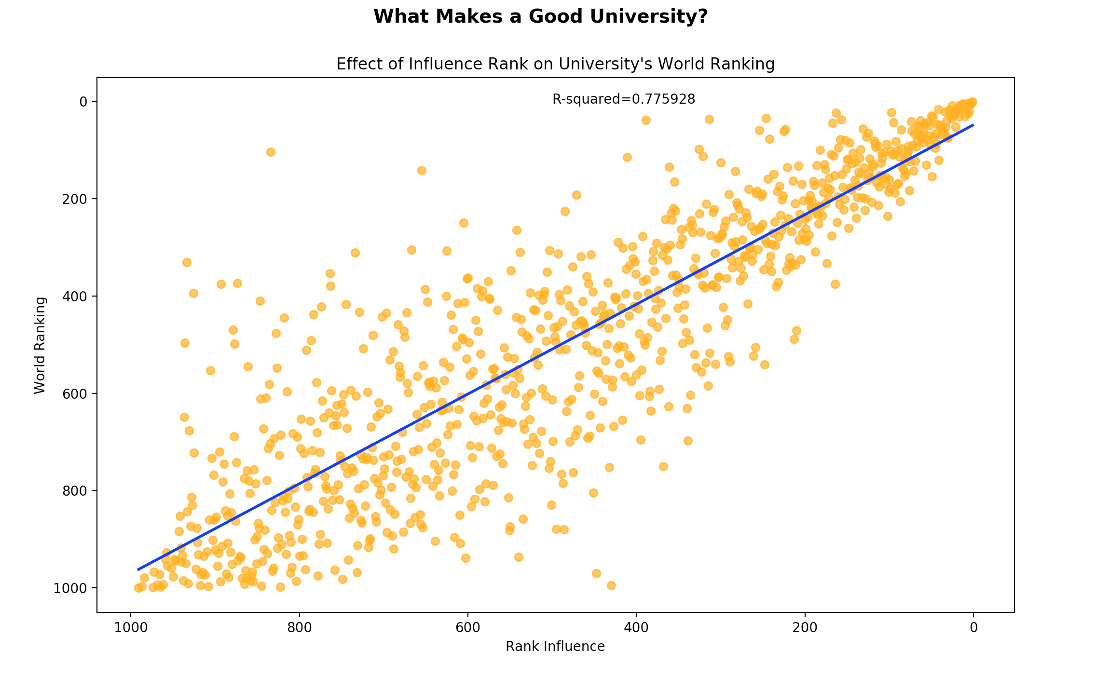
Research – Influence Score (Times)

Slide 5
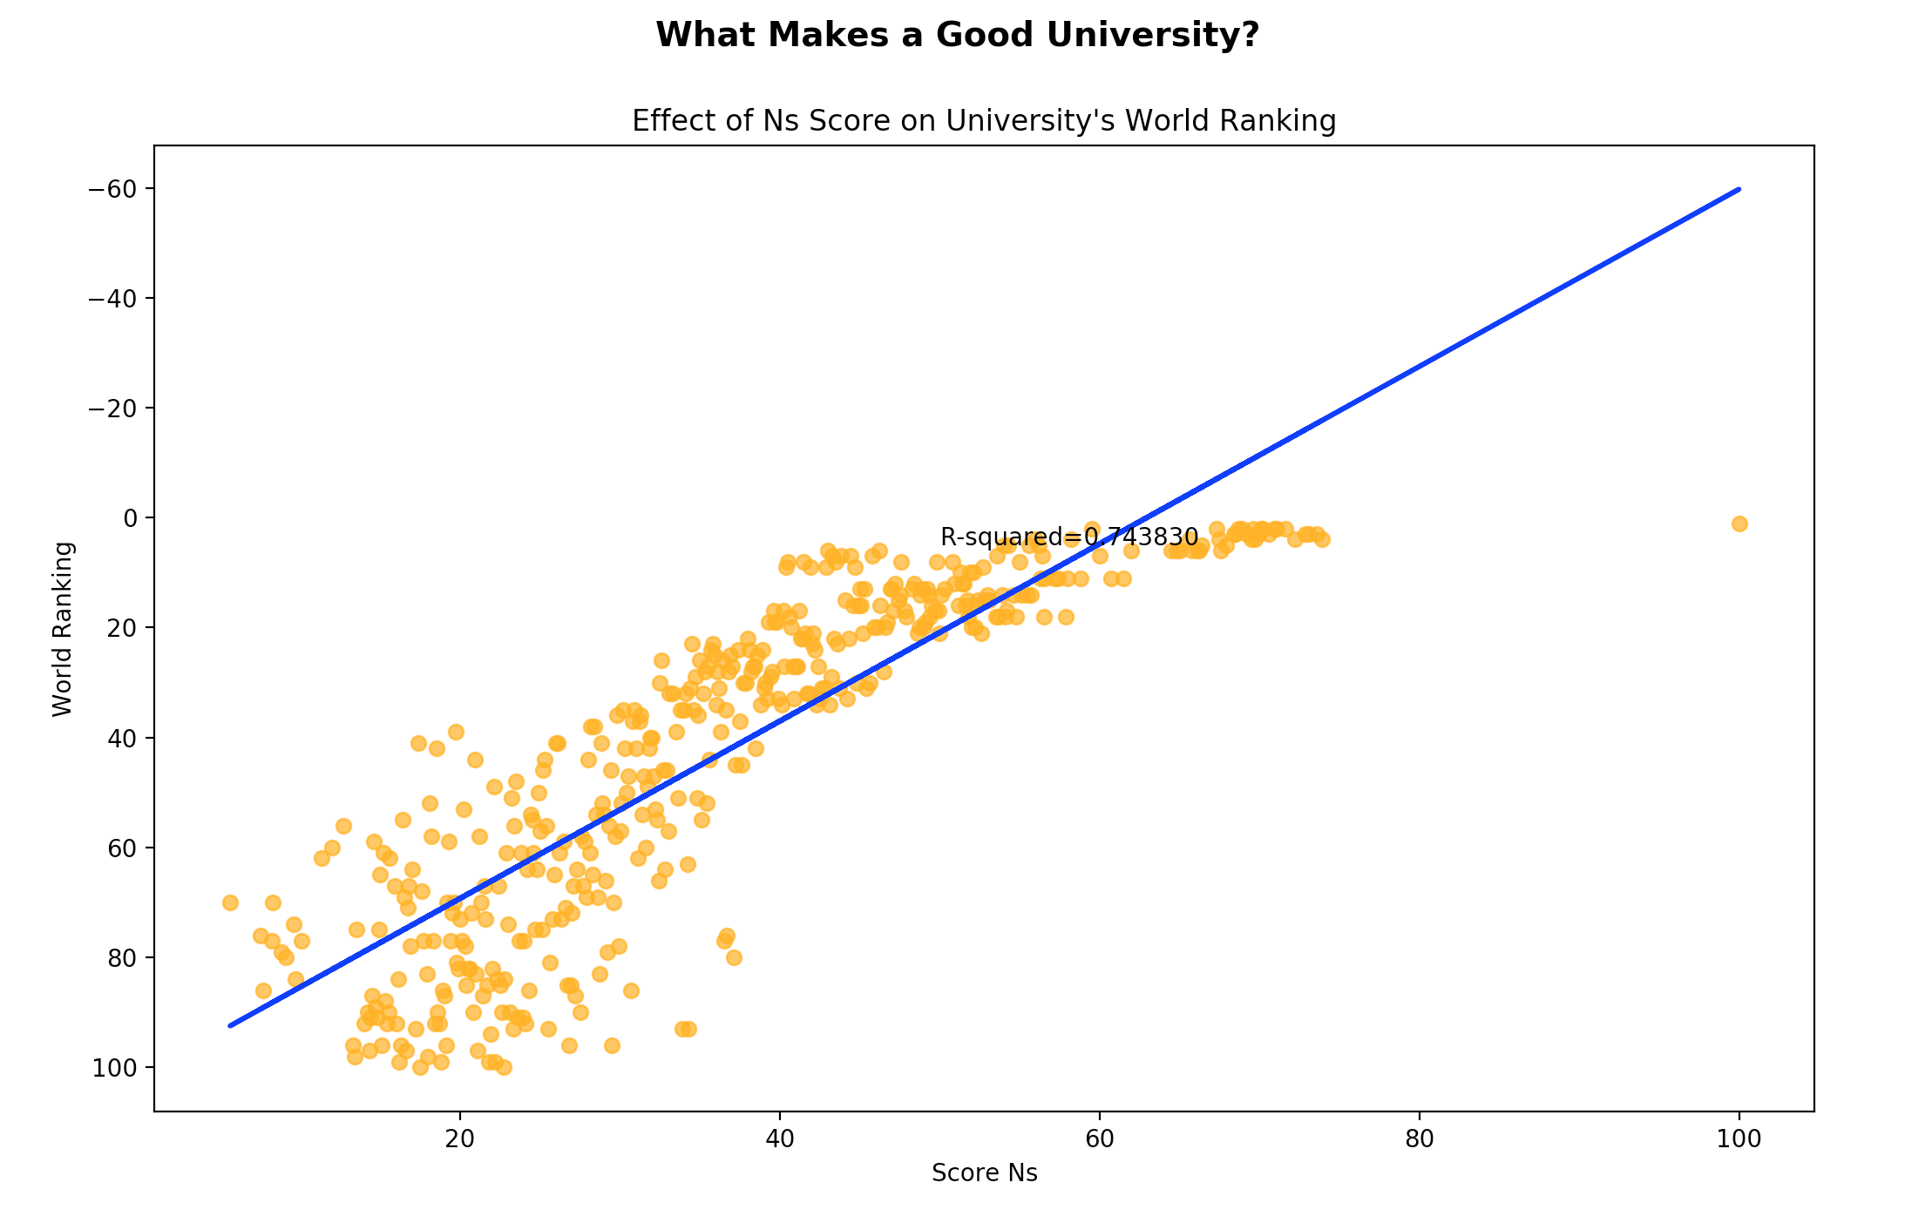
Research – Nature & Science Score (Shanghai)

Slide 6
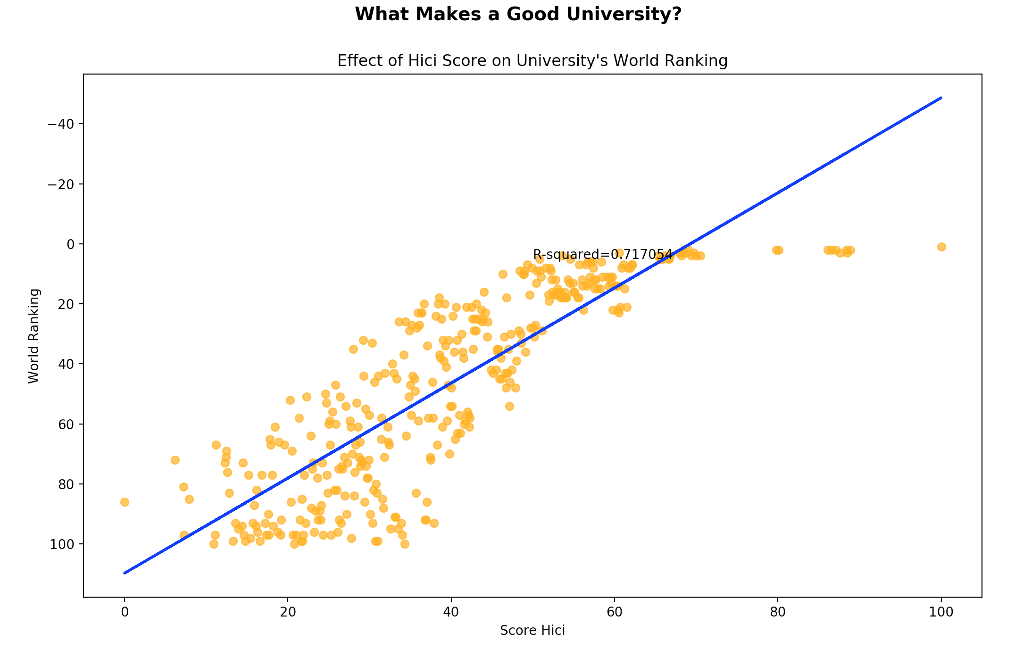
Research – Highly Cited (TS) Score (Shanghai)

Slide 7
Quality of Faculty

Slide 8
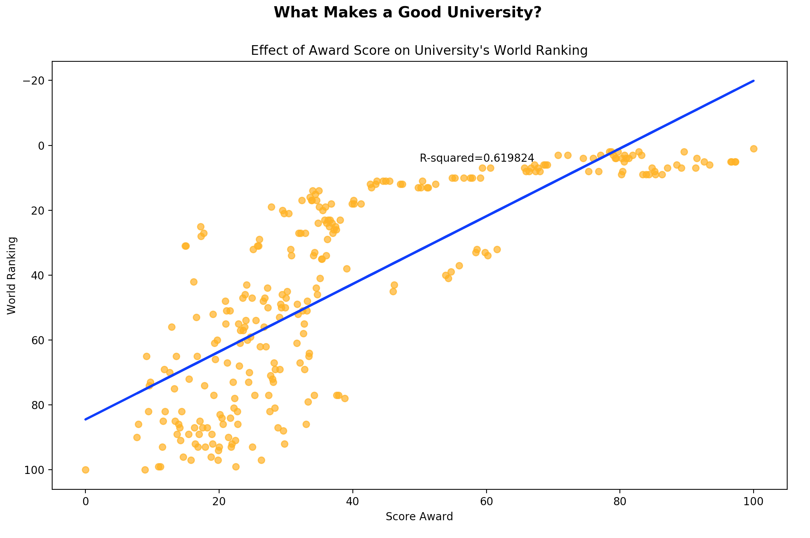
Research – Faculty Award Score (Shanghai)
Notes:
d

Slide 9
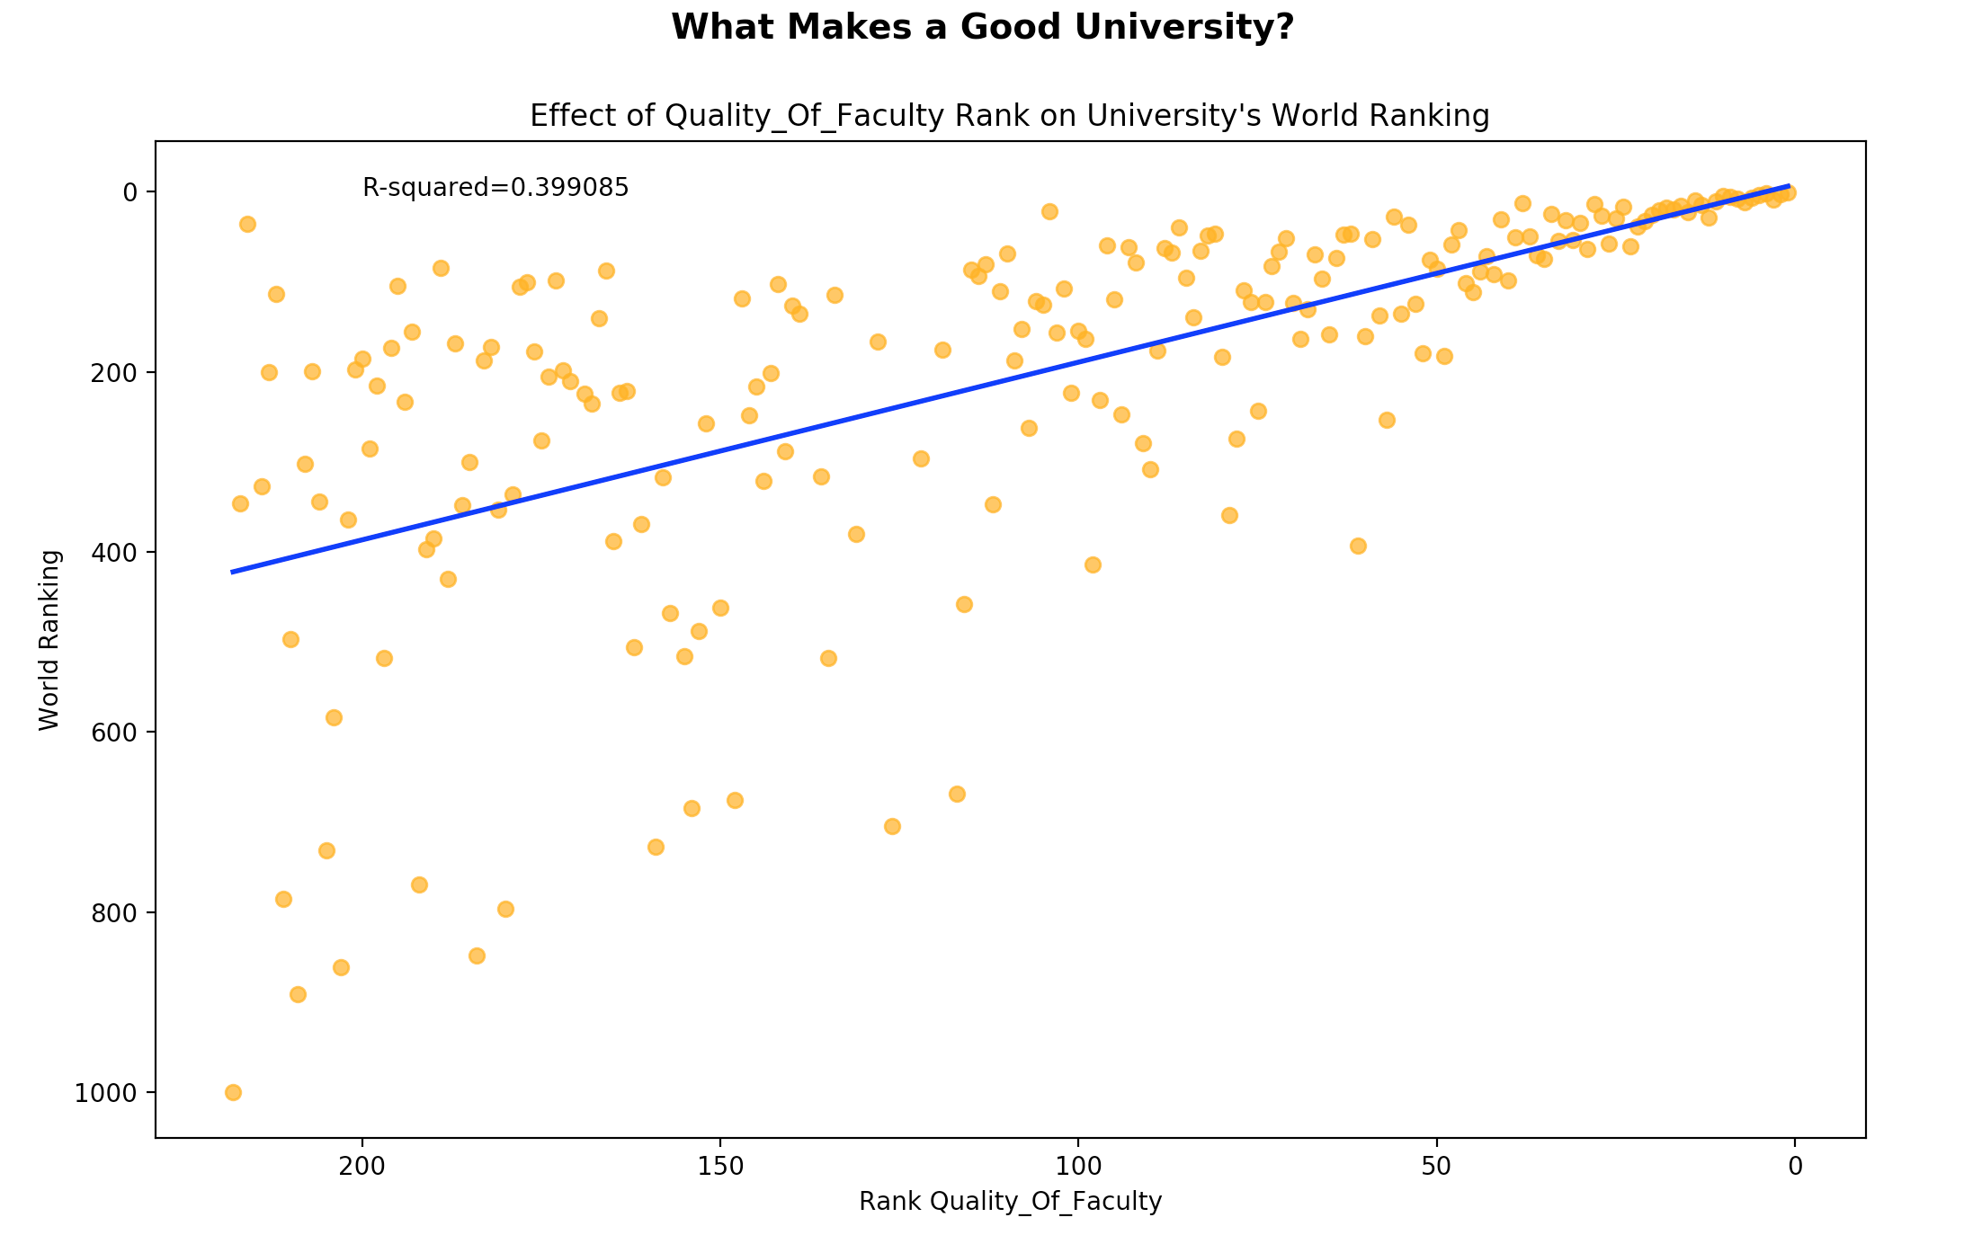
Faculty – Quality of Faculty Rank (CWUR)

Slide 10
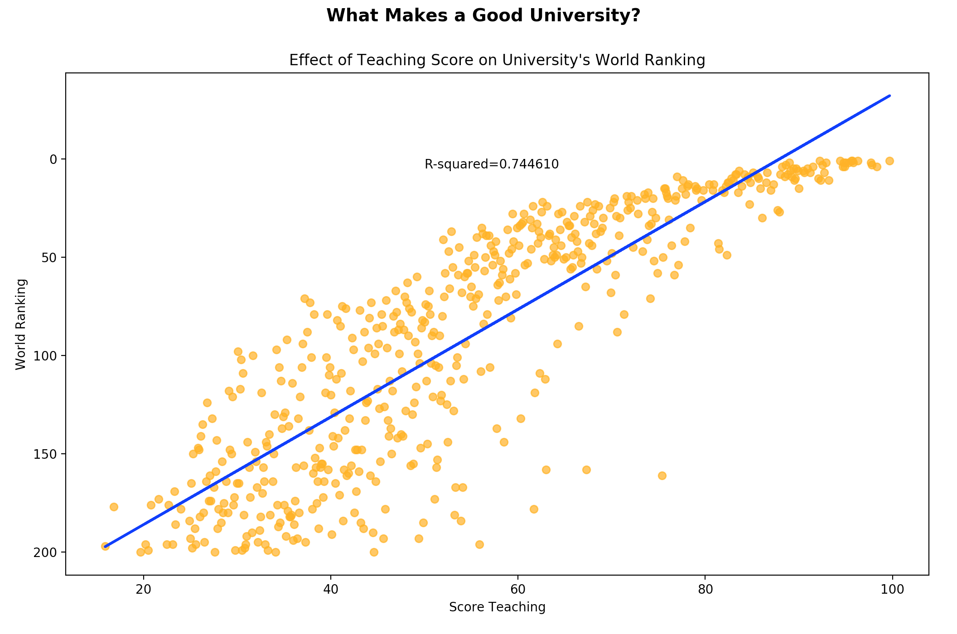
Faculty – Teaching [reputation] (Times)

Slide 11
Quality of Education

Slide 12
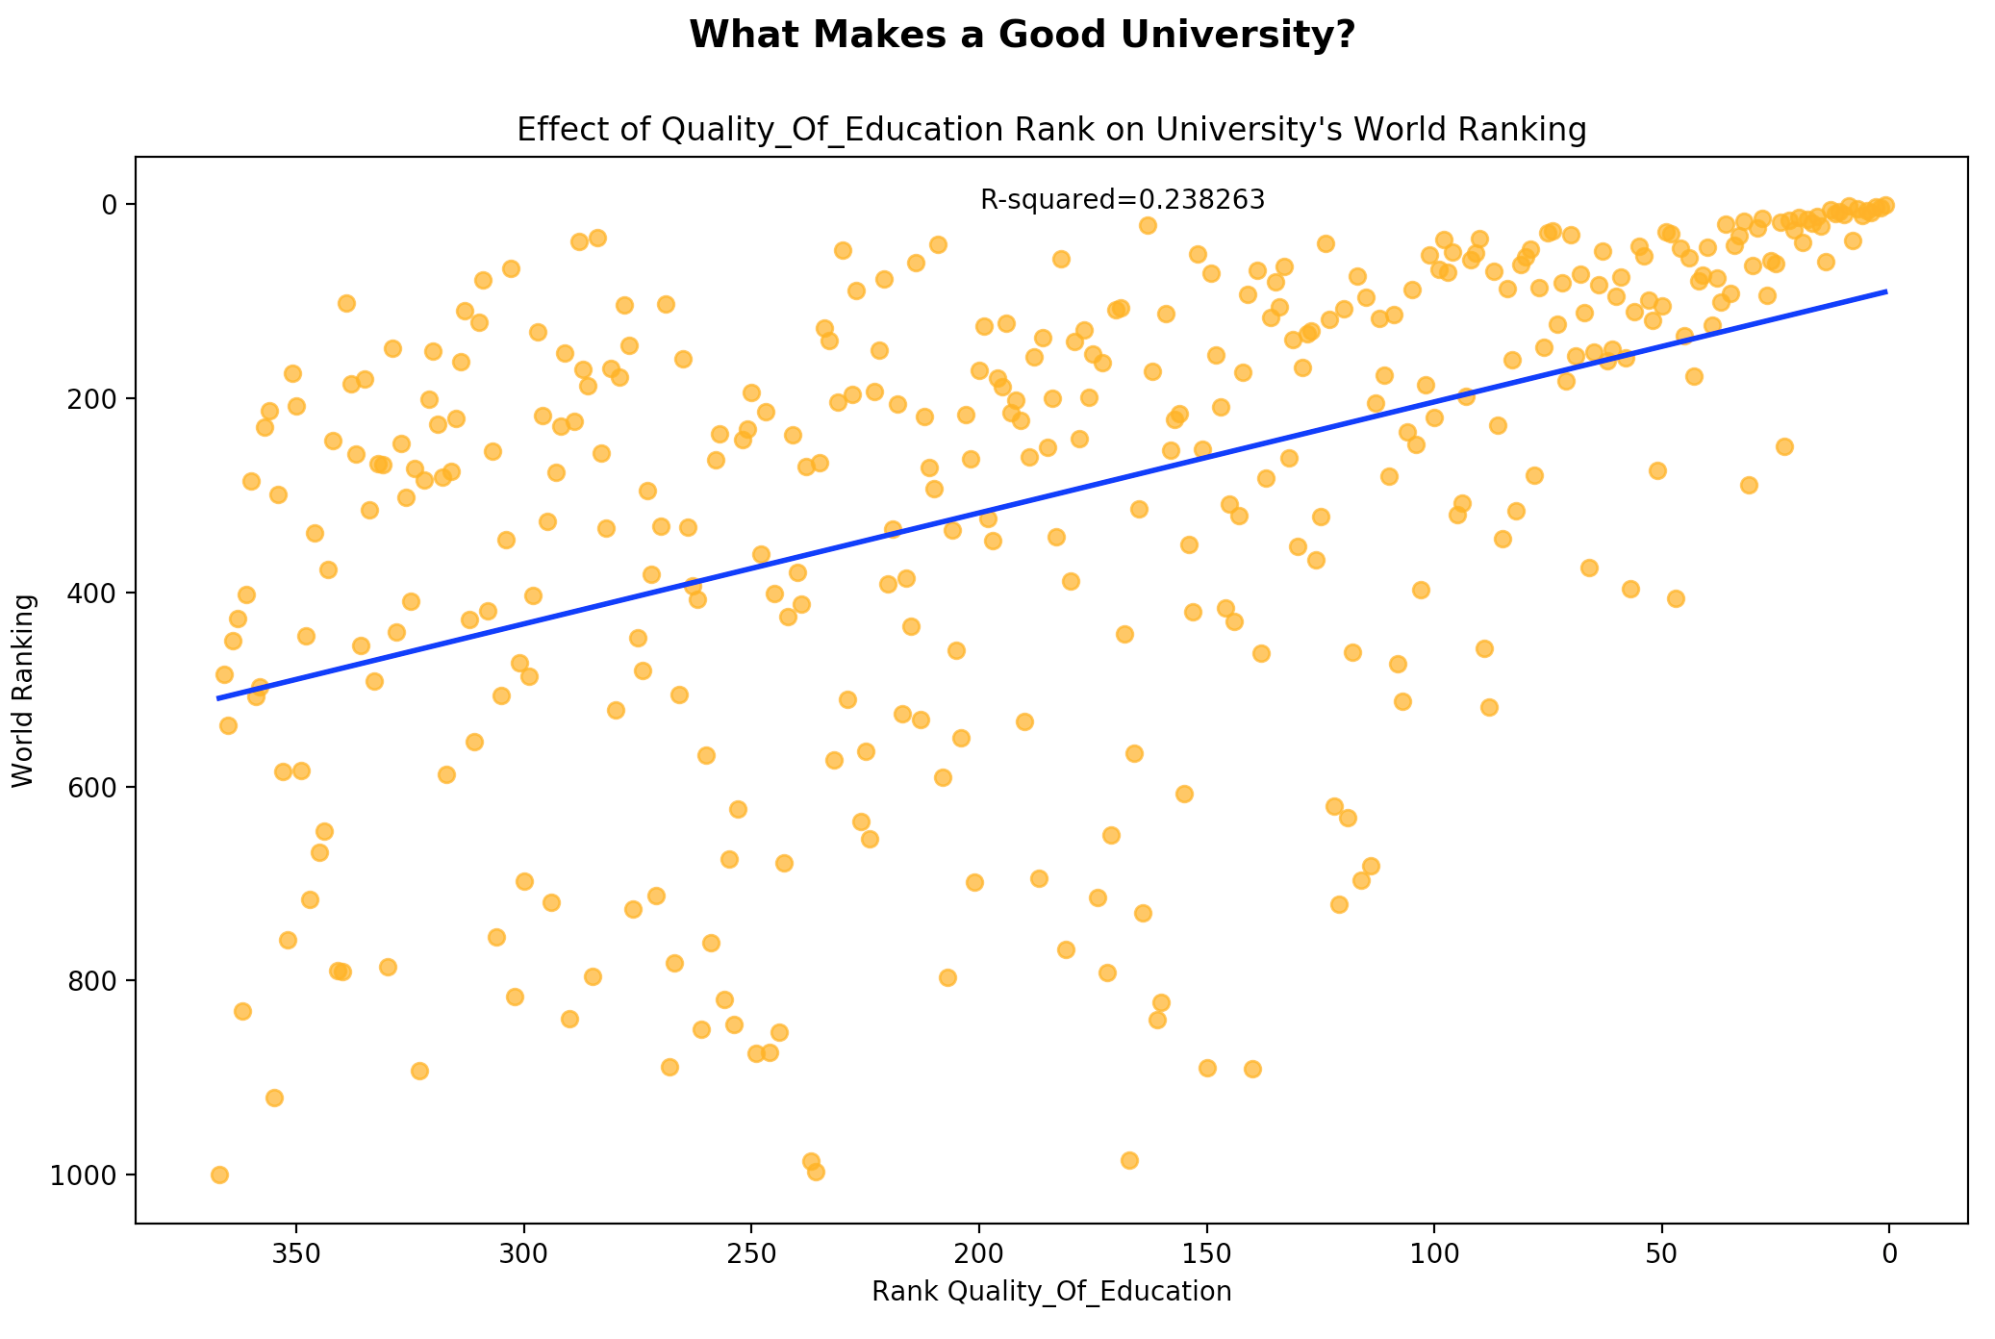
Faculty – Quality of Education Rank (CWUR)

Slide 13
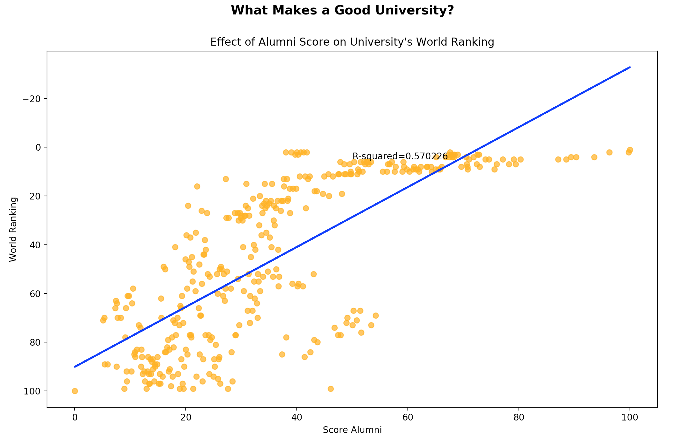
Faculty – Alumni Award Score (Shanghai)

Slide 14
Factors that Don’t Matter

Slide 15
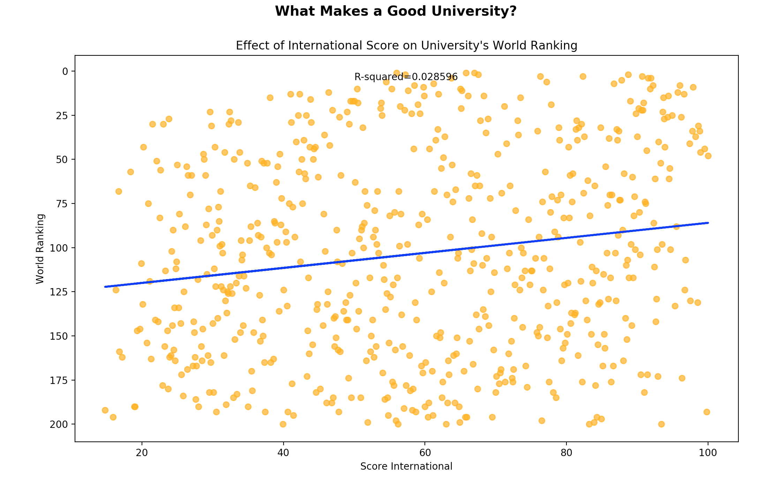
International (Times)

Slide 16
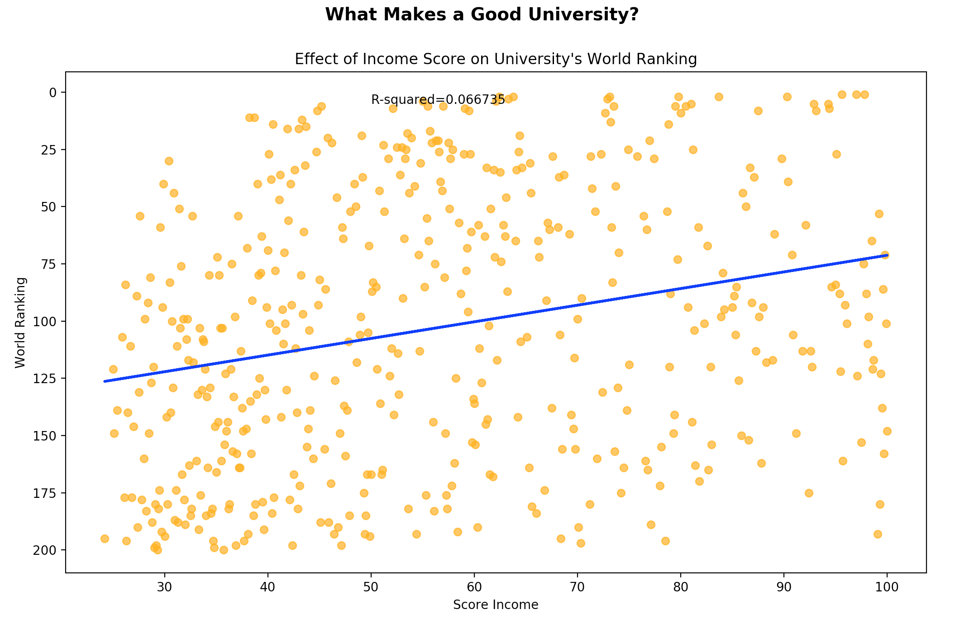
Income (Times)

Slide 17
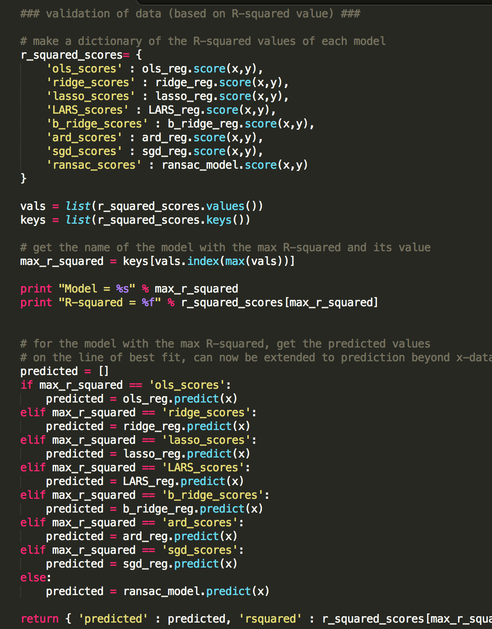
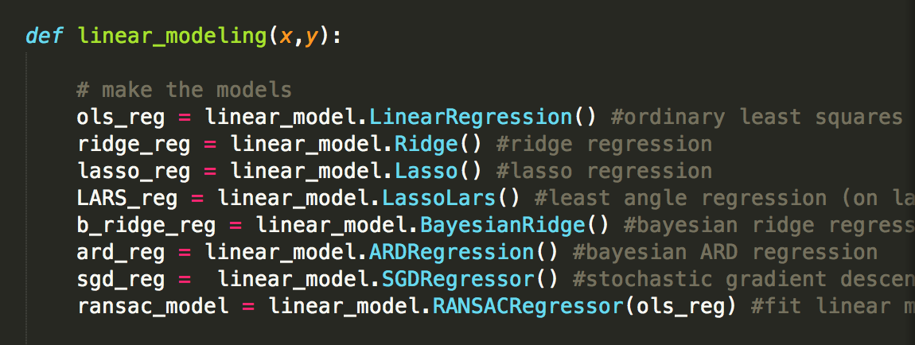
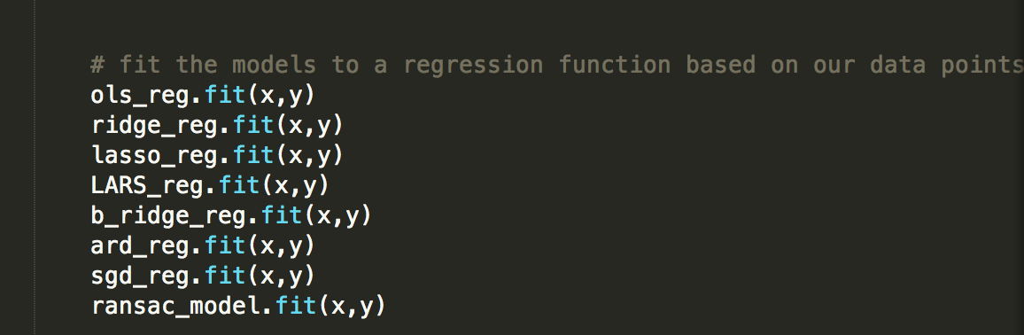
Code (Python ☺)
VALIDATION BASED ON R²
Modeling
Fitting

Slide 18
Conclusions
RESEARCH MATTERS!
Ultimately, universities are research institutions – not bootcamps.
Especially research that is published in reputable journals and highly cited
Education is not the primary determinant of rank!
People also care too much about income, etc. but it all boils down to research prestige!

