Slide 1

SMART INDIA HACKATHON 2026
TITLE PAGE
Problem Statement ID – SIH26105
Problem Statement Title- AI-Powered Continuous Cyber Risk Quantification and Investment Optimization Platform
Theme- Blockchain & Cybersecurity
PS Category- Software
Team ID- [YOUR TEAM ID]
Team Name (Registered on portal) [YOUR TEAM NAME]

Slide 2
CyberQuant AI
Your Team Name
PROPOSED SOLUTION
CONTINUOUS RISK INTELLIGENCE
• Pulls in data non-stop from tools like SIEM, EDR, IAM and vulnerability scanners.
• Links that data to how important each business asset is, so risk stays realistic.
• Updates itself automatically, so the risk picture is never out of date
FINANCIAL RISK QUANTIFICATION
• Turns technical issues into simple rupee/dollar numbers anyone can understand.
• Calculates Expected Annual Loss (EAL) and Value at Risk (VaR) for any asset or the whole company.
• Estimates likely loss ranges, factoring in downtime, breach costs and penalties
AI DECISION SUPPORT
• Uses AI to find out which issues are costing the business the most money.
• Suggests clear next steps — like patching, restricting access or adding monitoring.
• Lets anyone simply ask 'What's our biggest cyber risk today?' and get a straight answer.
BUDGET OPTIMIZATION
• Works out the best mix of security fixes for whatever budget is available
• Calculates ROI (ROSI) so leaders can justify every rupee spent
• Shows a simple spend-vs-risk-reduction chart, so it's easy to see where more spending stops helping.

Slide 3
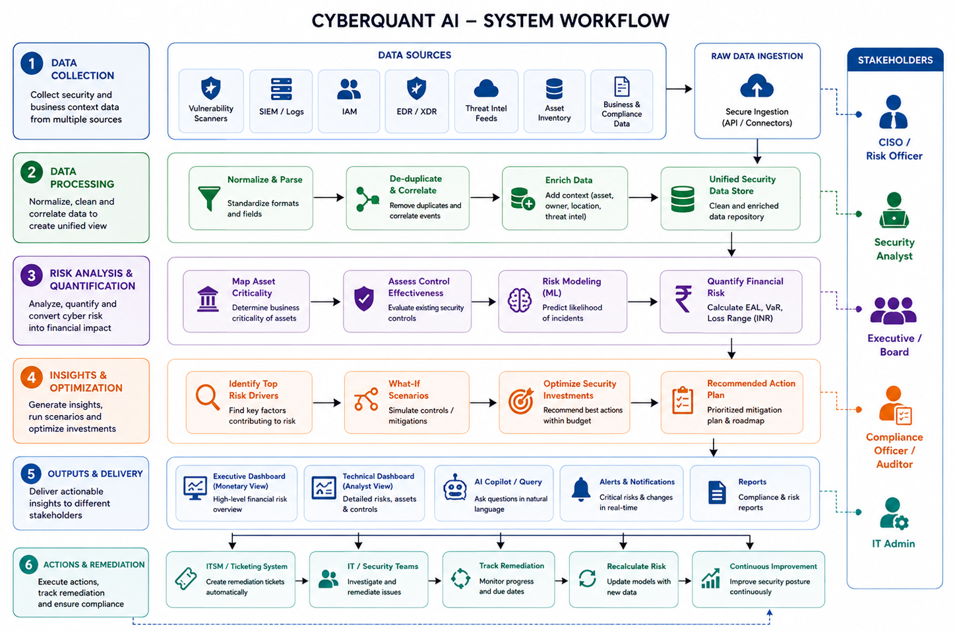
TECHNICAL APPROACH
Your Team Name
TECHNOLOGY STACK
Frontend: Next.js / React, TypeScript, Tailwind CSS
Backend: Python, FastAPI, PostgreSQL, Redis
AI / ML: XGBoost, scikit-learn, SHAP, Grounded LLM interface
Risk Analytics: NumPy, SciPy, Monte Carlo Simulation
Optimization: Google OR-Tools
Deployment: Docker, cloud-ready architecture
Data Sources: NVD/CVE, CISA KEV, SIEM, IAM, EDR, CSPM, Asset Inventory

Slide 4
FEASIBILITY AND VIABILITY
Your Team Name
FEASIBILITY
• Built using proven, ready-to-use tech — AI models, risk math and cloud tools.
• Each part (data links, analytics, dashboards) works on its own, so it's easy to build and upgrade.
• Fits in alongside a company's existing security tools instead of replacing them.
KEY CHALLENGES
• Security data from different tools is often messy or incomplete.
• Most companies don't have much historical data on past incidents and losses.
• Threats keep changing, so models can go stale if not refreshed regularly.
MITIGATION
• We clean and quality-check every piece of data before it's used.
• Our models give a realistic range, not one exact number — and experts review the results.
• We protect data with encryption and access control, and keep watching for any drift.

Slide 5
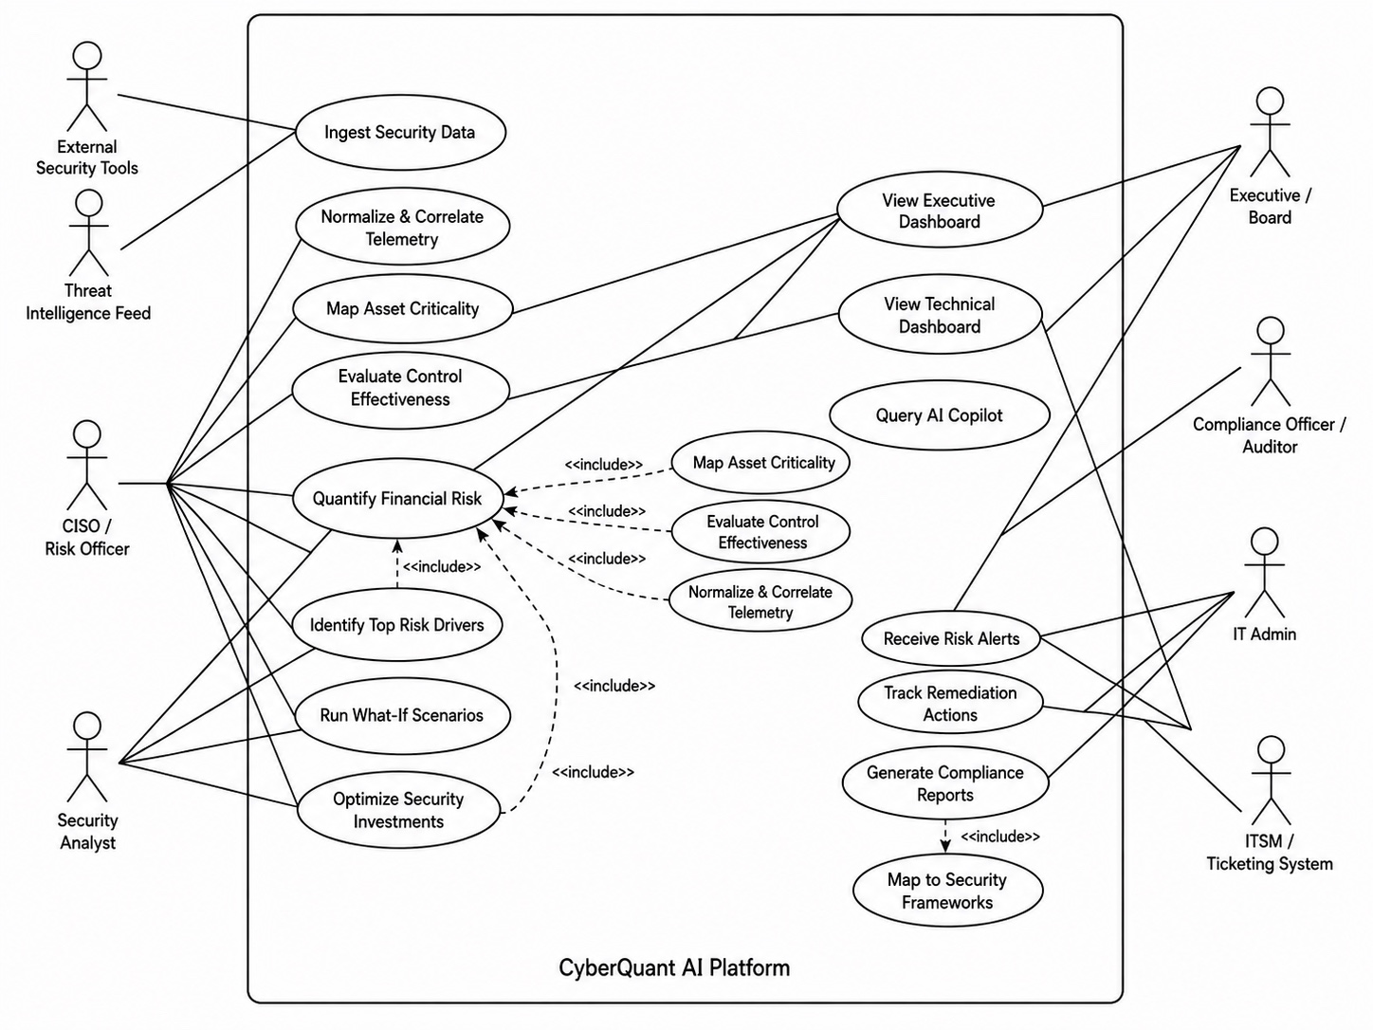
IMPACT AND BENEFITS
Your Team Name
TARGET USERS
USE CASE DIAGRAM
CISOs / Risk Officers
• Get a clear, money-based view of risk and know exactly what to fix first.
Executives / Boards
• See cyber risk in terms of rupees and business impact, not tech jargon.
Security Teams
• Know which issues to fix first, based on real business impact.
Auditors / Regulators
• Get ready-made reports that make audits and compliance easier.
BENEFITS
ECONOMIC
• Puts the security budget where it actually matters most.
• Stops money being wasted on the wrong fixes.
OPERATIONAL
• Shows risk levels updating live, not just once a quarter.
• Lets teams quickly test 'what-if' scenarios during an incident.
GOVERNANCE
• Gives risk decisions that are easy to explain to auditors and the board.
• Keeps the company aligned with frameworks like NIST and ISO.

Slide 6
RESEARCH AND REFERENCES
Your Team Name
OFFICIAL REFERENCES
COMPARISON WITH TRADITIONAL APPROACH
• NIST Cybersecurity Framework 2.0
A trusted, step-by-step framework for managing cyber risk
• NIST National Vulnerability Database
The main database we use to track known security vulnerabilities
• CISA Known Exploited Vulnerabilities Catalog
Helps us fix the vulnerabilities hackers are actually using right now
• ISO/IEC 27001:2022
A global standard for managing information security properly
• CIS Critical Security Controls
A checklist of top security practices we measure ourselves against
• RBI Cyber Security Framework
The cybersecurity rules Indian banks are required to follow
• SEBI Cybersecurity and Cyber Resilience Framework
The cybersecurity rules for India's stock market and securities firms
Feature | Traditional | CyberQuant AI
Risk Representation | Low / Medium / High | Monetary Exposure
Assessment | Periodic | Continuous
Prioritization | Severity-Based | Financial-Impact Based
Investment Planning | Manual | Budget-Optimized
Scenario Analysis | Limited | What-If Simulation
Executive Interpretation | Technical | Business / Financial

