Slide 1
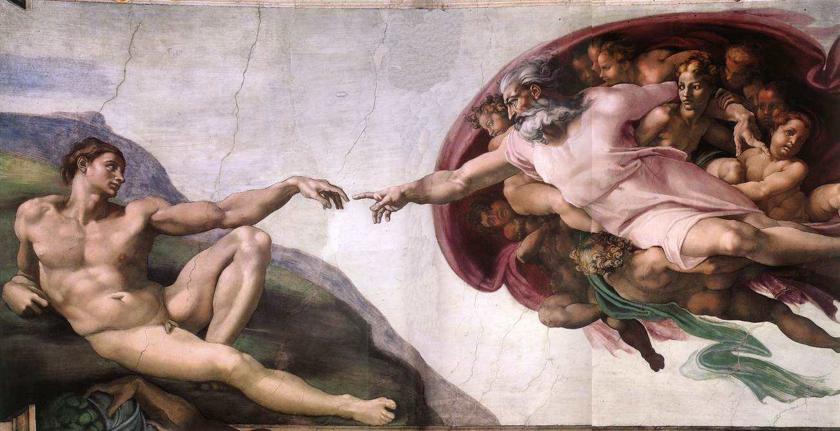
Communication
Notes:
You have other examples like traffic signs,

Slide 2
Language by Symbols and Signs
SEMIOTICS
SIGNS + IMPLIED MEANINGS
Denotation
+
Signifiers
Connotation
+
Signified
The creation of Adam
Syntagms
Notes:
Semiotics is the study of sign and symbols processes as a significant part of meaningful communication, and arose thanks to Ferdinand de Saussure and Charles Sanders Peirce.
In which, explaining very lightly the basics, we have the denotation, which is the form and the physical object, and the connotation associated with this object, therefore, there is a signifier and a signified.
When trying to built a message, the building blocks of communication are called the syntagms, and these syntagms depend on the connotation we have.
The pictures are signifiers and the meaning behind it is the signified. We built some sort of connotation to understand the signified behind the signifier, based on our experiences, ideologies and expectations.

Slide 3
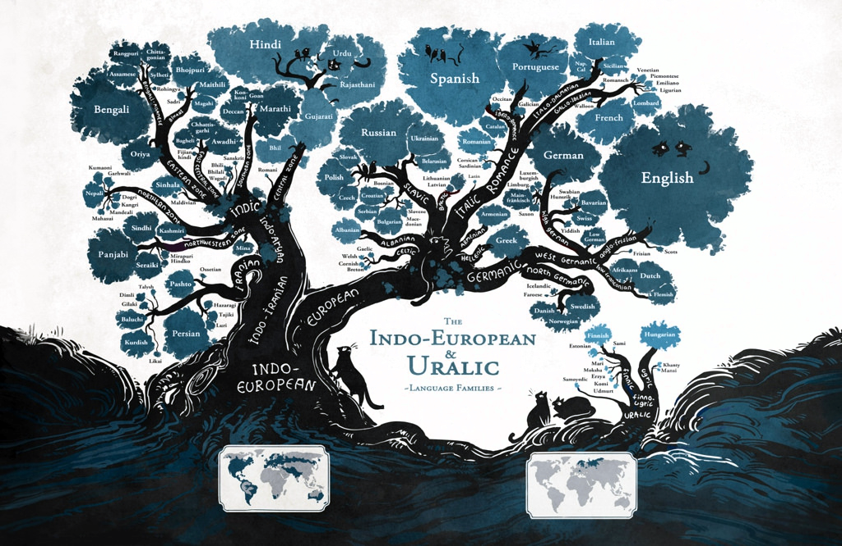
Language Families by Minna Sundberg
Notes:
But this is not the way we write or speak. We have developed languages which is more than a set of prearranged signals.
Looking at this representation of the languages ramification of the Indo-European and Uralic language families. How Indo-European ramificate into European, where more prominently we find the germanic and italic romance that diverged into the main languages of actuality, namely the ibero-romance, ibero-romance and italo-dalmatian, and the anglo-saxonic and high-germanic.
Each have invented their words (signifier) of the signified meaning behind this word, based on their interpretation and experiences.
Japanese called portugal: Barbarians of wine

Slide 4
Levels of Language by David Crystal
Language
Language - foremost a means of communication. The languages messages fall apart into sentences, which are composed of words, which in their turn consist of symbol sequences when written.
Grammar - book of rules and examples which describes and teaches the language.
Syntax - study the way words work in sequences to form a larger linguistics units: phrases, clauses, sentences and beyond.
Morphology - structure of words: how they are built up (walk, walks, walked).
Vocabulary - Study the meaning of words. This is the familiar aspect of the study of meaning, as it provides the content of dictionaries.
Discourse - Study the meaning in sequences of words, therefore in complete sentences.
Grammar
Meaning
Morphology
Syntax
Vocabulary
Discourse
(graph/phon)etics
Pronunciation
(graph/phon)ology
Notes:
Language is foremost a means of communication that is almost unconsciously acquired.
The definition of syntagms applies in here as well since words are the building blocks of the language.
Each developed their own rules to arrange words and each create individual writting systems, wheater if alphabetical, logographic or abjad writing systems, all developed a well established way to communicate speaking and writting.
Besides these spoken languages there are also other languages which do not appear in here, which are the computer languages (python, c++..).

Slide 5
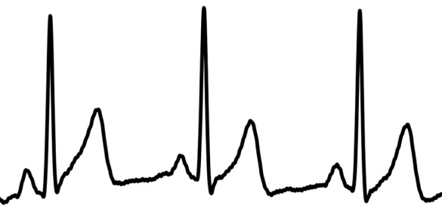
The Meaning behind Time Series
Meaningful information extracted from time series
Associate certain variations over time to specific events with which they are correlated
Associate it with physical events
Denotation
Connotation
Connotation
ECG
Can we translate this information into a grammatical context?
Connotation
PQRS
Notes:
Add a signal for instance...denotation(ECG)→ Connotation (heart)
There is meaningful information associated with a time series, and we, as data scientist read the signals, we try to learn how to speak their language in order to extract the maximum of information.
Can we translate this information into a grammatical context, into textual symbology?
Why would we do that?
Ease the way we work with signals.

Slide 6
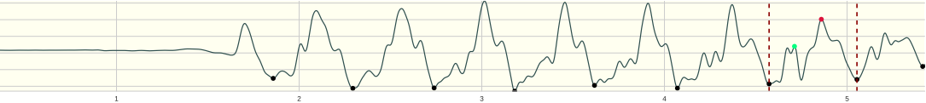
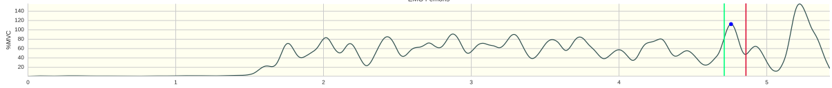
Motivation
→ Find when the athlete started to run
→ Detect the step in which he made an inversion of direction (3 s later)
→ Determinate the pre-activation and maximum peak
→ Find the maximum value in the EMG Signal
(sentence1)
(sentence2)
(sentence3)
(sentence4)
Notes:
Maybe if we could translate the signal grammatically, we could find a way to determinate easily all these step to solve the problem.
These steps would be sequentially connected in the way we think grammaticaly
The motivation of this work focuses on it, namely, how can we find a way to build the grammar of time series.
From the most elementary segments of a language (syntagms) to words and sentences. Therefore, we havê to build the meaningful constituintes of the language and also the rules that specify how these elementos can be organized.

Slide 7
Regular Expressions
Regexes - set of characters that are used as search patterns in text
Regular Grammars
UN: [a-z0-9_]{4,16}
Codification to which specific text matches to
DNA...http://regexr.com/
Two types of characters and Types of Grouping
Metacharacters
Parenthesis
Literal
characters
(...) - build groups of patterns
[...] - everything inside is allowed to be found on the string
[^...] - finds everything less the things inside the brackets.
{a,b} - interval or length of pattern.
{a,} - from a to infinite
\d - find digit in string
\s - matches any whitespace
\Z - matches only at the end of the string
^ - matches the position at the beginning of the string
$ - matches the position at the end of the string
? - is equivalent to {0,1} and matches the preceding subexpression
[a-z]
[A-Z]
[0-9]
...
Notes:
Simple explanation of regex and how it associates with this project
which are metacharacters and literal characters. Metacharaxters are a characters with especial meaning, and the combination of both enables to create a large ser of patterns for text UAL search.

Slide 8
Grammar of Time Series
1
Symbolic Translation of Time Series
Language
a/U b\D a/U d\D...c\D
2
Find Meaning in Sequences and of Syntagms (build the Vocabulary/Dictionary)
Grammar
Meaning
a/U b\D
a/U b\D a/U d\D … c\D
maximum
Morphology
Syntax
Vocabulary
Discourse
3
Find the set of rules (Morph and Syntax) in which the vocabulary will be organized
(graph/phon)etics
Pronunciation
(graph/phon)ology
4
Sync it with the text search engine (Regex/Parsing/…)
Notes:
Agora que expliquei a parte da tradução, falta a parte das regras nas quais nos vamos basear para montar a arquitectura da gramática. Por enquanto, usamos regular expressions...explicar ligeiramente o que são regular expressions.
Mostrar que existem outros tipos de gramáticas, nomeadamente context free grammars (primeiro feito por Chomsky) Backus Nair Foram.
Extended contexto free grammar. Regex são um tipo de contexto free grammar.
First step: find a way to translate the signal into syntagms.
How do we look at time series and represent them as symbols and keep the information that is needed?
There are some works Doné to achieve a symbolic representation of time series, namely SAX.
Bit is it enough to keep the information that is needed? The tine series have more to tell US about, not only amplitude variations, we havê to look até the signal in multiplex levels of analysis:
Level of amplitudes
Level of Events
Level of Orders
Level of multiscale
Level of thresholds
These are questiona that havê to be answered in order to fins a correcta and complete tratranslation of a time serie.
Develop strategies to correlate the grammatical rules of our language in order to correlate with the rules to build our language (signal characterization,

Slide 9
Symbolic Translation
SAX (Symbolic Aggregate Approximation)
Is it rich enough?
c
b
Richness in the analysis
a
Order Level - first, second and third derivative
b
a
a
b
c
c
b
c
Threshold Level - representation of differences in amplitude and time
baabccbc
Signal Length = 128
Word Size = 8
Alphabet Size = 3
Multiscale Level - analysis of the multiscale components
Events Level - analysis of the presence of events
Amplitude Level
MultiSignals Level - possiblity of integrating multiple signals in the analysis

Slide 10
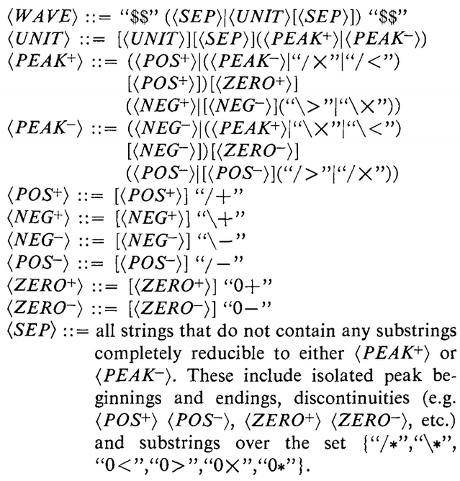
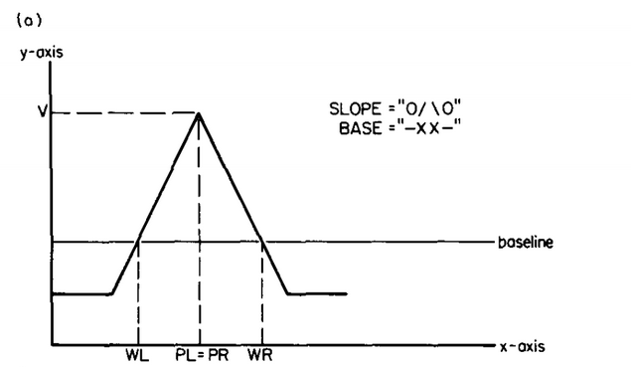
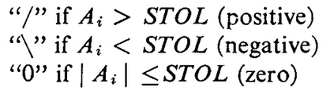
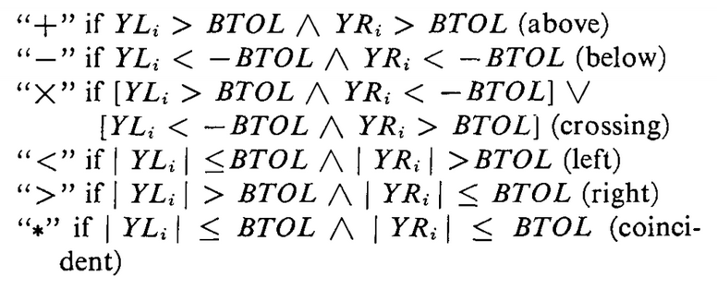
Example 1
“Syntactic Algorithm for peak detection in waveforms with applications to cardiography”
Context Free Grammar
y = Ax + B
Specifying the Terminals
Slope
Base

Slide 11
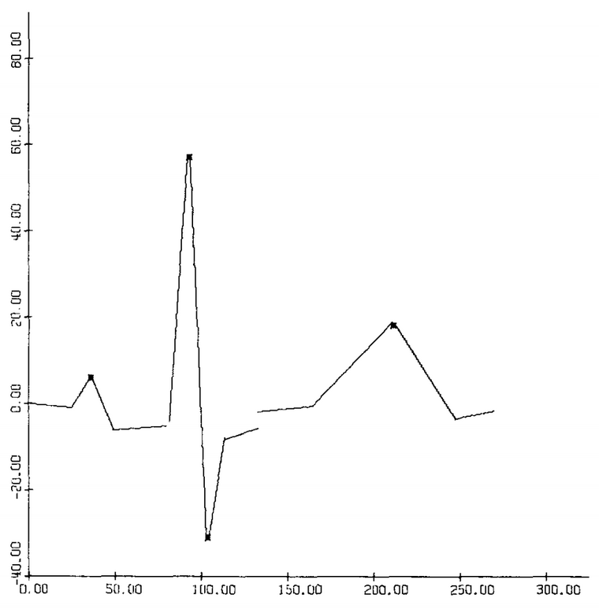
Example 1

Slide 12
Proposed Reasoning
Signal Domain
X_t, W_t, V_t → Time Series
Meaning of Language
Symbolic Connotation
S1 = Quant(X_t, 1, 𝛂), S2 = Quant(D(X_t, 1,’/0\’))
Pattern Search based on Syntactic Analysis
Search Pattern on Regex
[%A %D , re.match(r’?\/1\\’, S2)] → Find Max
Result
Find interval where it fits
Range indexes where the pattern matches the string

Slide 13
Proposed Reasoning - Example 1
Problem: Find peaks higher than a certain 𝛂
𝛂
X_t →
S1
0
0
0
0
0
0
0
1
1
0
0
0
0
0
0
0
0
0
1
1
0
S2
/
\
/
\
\
/
/
/
\
\
\
/
\
/
/
/
\
/
/
\
\
S1 = Quant(X_t, 1, 𝛂)
Quantization of X_t based on 1 level (0,1) for values higher than 𝛂
S2 = Quant(D(X_t, 1,’/0\’))
Quantization of the first derivate of X_t with symbols ‘/0\’

Slide 14
Proposed Reasoning - Example 1
𝛂
X_t →
S1
0
0
0
0
0
0
0
1
1
0
0
0
0
0
0
0
0
0
1
1
0
S2
/
\
/
\
\
/
/
/
\
\
\
/
\
/
/
/
\
/
/
\
\
Complete String
0/0\0/0\0\0/0/1/1\0\0\0/0/0/0\0/1/1\0\0/0\
Regex Pattern
Re = re.match(r’.\/1\\|1\/.\\’)

Slide 15
Proposed Reasoning - Example 2
Problem: Find peaks separated by at least 𝛇
X_t →
S2
/
\
/
\
\
/
/
/
\
\
\
/
\
/
/
/
\
/
/
\
\
S2 = Quant(D(X_t, 1,’/0\’))
Quantization of the first derivate of X_t with symbols ‘/0\’

Slide 16
Proposed Reasoning - Example 2
X_t →
S2
/
\
/
\
\
/
/
/
\
\
\
/
\
/
/
/
\
/
/
\
\
Complete String
/ \ / \ \ / / / \ \ \ / / / \ / / \ \ / \
Regex Pattern
R = re.finditer(r’(\/\\).{𝛇,}(\/\\)’, S2)

Slide 17
Proposed Reasoning - Example 3
Problem: Find when the onset occurs
X_t →
𝛂
S1
0 0 0 0 0 0 1 0 1 1 1 1 1 1 1
S1 = Quant(X_t, 1, 𝛂)
R = re.match(r’1{𝛇,}’, S1)

Slide 18
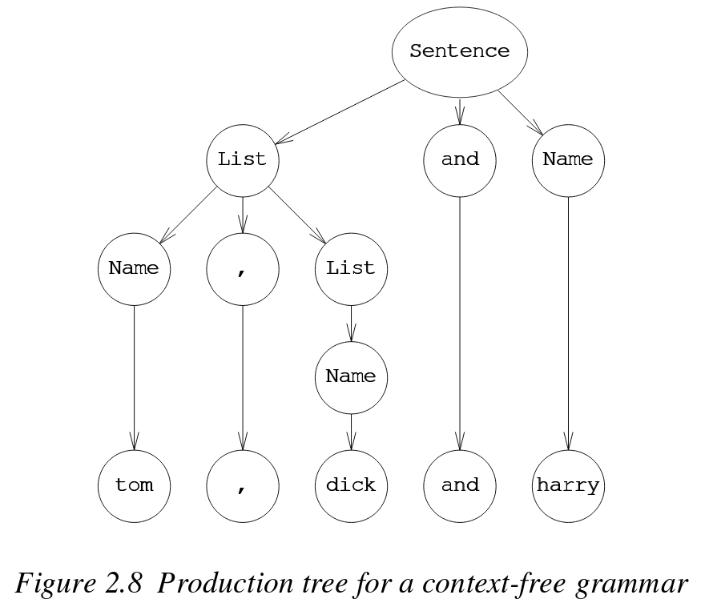
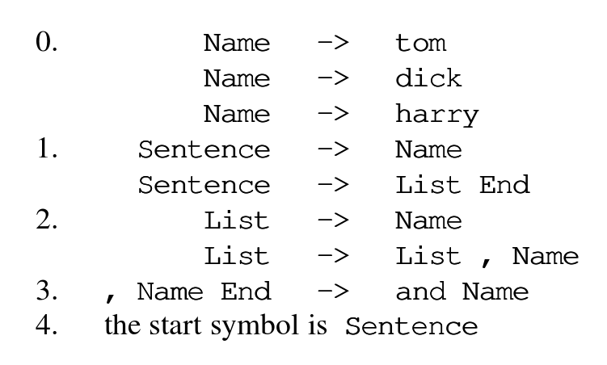
3/4. Patterns, Regexes and PyParsing
Use Python programming language as a tool for extracting information from structured textual data.
Turns to be more powerful than regular expressions but not as general as a full-blown compiler.
To find information within structured text, we must be able to describe that structure.
It is built on the fundamental syntax description embodied in the Backus-Naur Formalism.
Describing a Language through a finite recipe
Terminal symbols
Non-Terminal symbols
And Production Rules
Notes:
Recursive way of describing a language

Slide 19
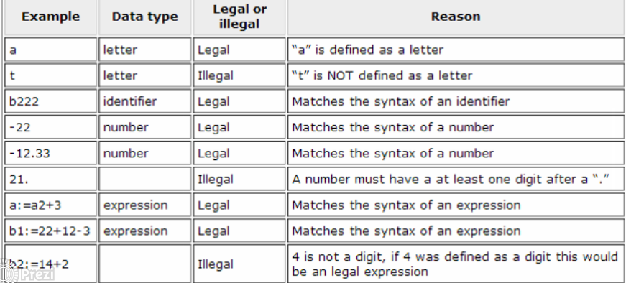
3/4. Patterns, Regexes and PyParsing
The data types of a programming language are defined by EBNF as:
digit = “1”|”2”|”3”|”4”|”5”|”6”|”7”|”8”|”9”
letter = “a” | “b” | “c”
operator = “+” | “-”
identifier= letter {letter|digit}
number= [“-”] digit{digit} [ “.” digit{digit}]
expression = identifier “:=” (identifier | number){ operator (identifier|number)}
Find Meaning in Sequences and Subsequences of Syntagms (build the Vocabulary/Dictionary)
Find the set of rules (Morph and Syntax) that will organize the vocabulary
Notes:
Add the use of parsers based on pattern example
Configure the text search based on these patterns
Explain the exercises that have been made in order to find the correct way to approach the building blocks of the language

